Slide 1



Update on country scale up of differentiated service delivery in the 11 CQUIN countries
Details from the CQUIN Annual Meeting
November 2018

Slide 2

Côte d’Ivoire
National implementation of DSD in Côte d’Ivoire began in April 2017
Recommended implementation – Facility based models (Fast Track ART Refills and Facility Adherence Clubs)
Côte d'Ivoire has 20 regions encompassing 86 districts which have successfully began the nation wide implementation and scale-up of DSD

Slide 3
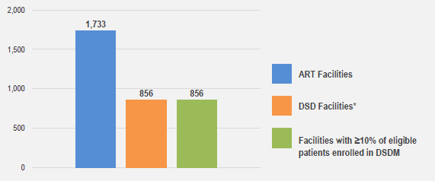
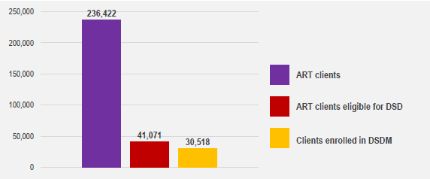
Facility coverage of DSD for ART
As of end of June 2018, 856 out of 1,733 (49%) health facilities in Côte d'Ivoire were implementing DSD services.
Out of 236,422 ART clients, 41,071 (17%) patients were eligible to be enrolled in a DSD model and of these, 30,518 (74%) had been enrolled in either the facility fast track or adherence club DSD models of care.
Patient coverage of DSD of ART
For more details, download the Côte D’Ivoire poster

Slide 4
Next steps for Côte d’Ivoire
  The National AIDS Control Program (PNLS) is leading a review on the implementation of DSD and in the coming months will be considering expansion to other models (community-based)
  National training of trainers
  Development of a DSD implementation strategy and national scale-up plan

Slide 5
Eswatini
Eswatini National AIDS Programme launched DSD in 2014. MoH launched the National Policy Guidelines for Community-Centered Models of ART Service (CommART) Delivery in June 2016
73% of nurses and 83% of expert Clients from ART units have been trained to implement DSD treatment models
HIV in Eswatini - 85% (174,103) PLHIV are on ART and 91% were virally suppressed in 2017
Eswatini offers both facility-based (Fast Track, Teen Clubs, Facility Treatment Clubs for Adults) and community-based (Community-based ART Groups and Outreach Models) DSD treatment models

Slide 6
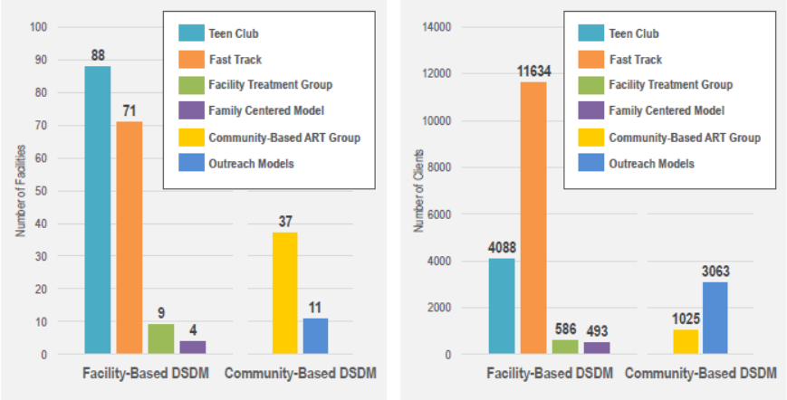
DSD models are currently available in 4 regions. Eswatini has 153 ART facilities eligible to provided DSD and 123 of these (80%) offer DSD. All 123 facilities have enrolled at least 10% of DSD-eligible clients on DSD models.
Some facilities offer more than one DSD model, with more facilities offering facility-based than community-based models
Out of an estimated 134,906 clients eligible for DSD in the country, 20,889 (15.5%) are enrolled in DSD
Facility uptake of DSD
Client uptake of DSD
For more details, download the Eswatini poster

Slide 7
Next steps for Eswatini
  Eswatini will pilot a QI project in 3 high-volume ART clinics to increase the proportion of eligible ART clients
  Conduct an in-country learning exchange to sites with high patient coverage of DSD
  Survey patients and health worker satisfaction with regards to DSD implementation and models offered
  New publication in JIAS - Retention on ART and predictors of disengagement from care in several alternative community‐centred ART refill models in rural Swaziland

Slide 8

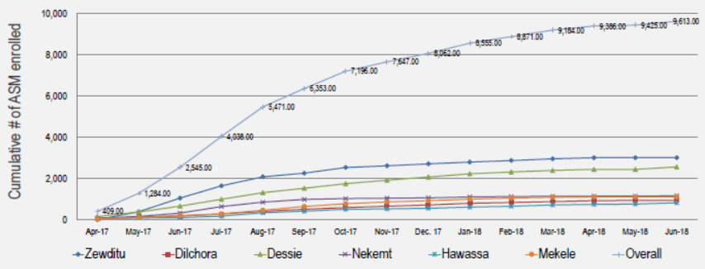
Ethiopia
Ethiopia's Federal Ministry of Health (FMOH) launched national DSD in October 2017 with a focus on a single facility-based DSD model for stable patients
FMOH decided to prioritize one model, Appointment Spacing, piloting in six hospitals, then taking it to scale nationwide
Enrollment in appointment spacing pilot project at 6 hospitals

Slide 9
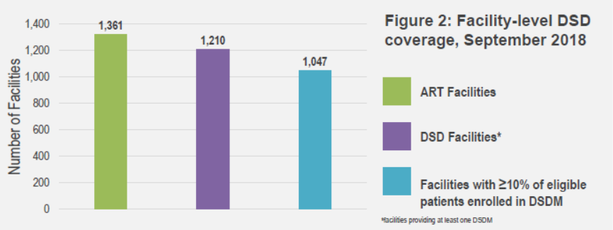
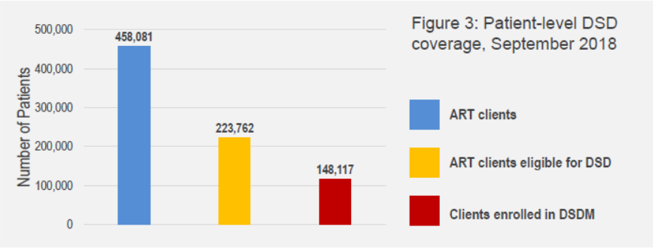
By October 2017, almost 7,200 patients had enrolled in DSD at 6 hospitals
By October 2018, Appointment Spacing was offered at 1,210 health facilities in all 11 provinces
More than 117,000 patients – 26% of all patients on ART in Ethiopia – had transitioned to the appointment spacing model as of October 2018
In September 2018, pilot of a second DSD model was launched (Community ART Groups (CAGs)).
Ethiopia is unique amongst CQUIN network countries in its choice to launch a single DSD model
For more details, download the Ethiopia poster

Slide 10
Next steps for Ethiopia
  Diversification of DSD model, including the launch of UHEW-led CAGs
  Qualitative research study exploring client and provider reaction to Appointment Spacing will be conducted in 2019 with support from CQUIN

Slide 11

Kenya
Kenya Ministry of Health through the NASCOP provided guidance for the national implementation of DSD in July 2016. Prioritized populations: adult patients on ART, stable children and adolescents
NASCOP invested in training HCP on DSD
Community representatives are involved in design, implementation and monitoring of DSD
Kenya recommend a four DSD models including Fast track, six-monthly appointments. Two group models include Facility ART Groups (FAG), Community ART Groups (CAGs)
Kenya health management information system supports both paper and electronic tools to help measure DSD uptake.

Slide 12
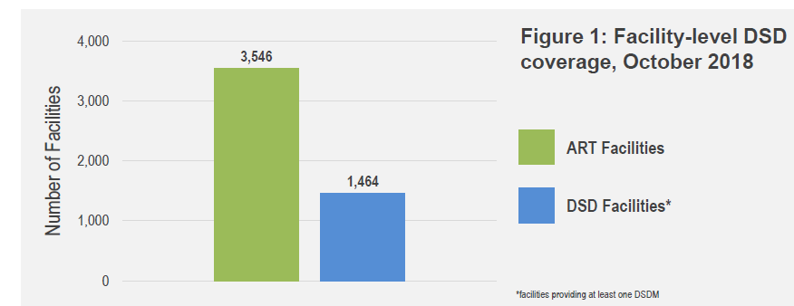
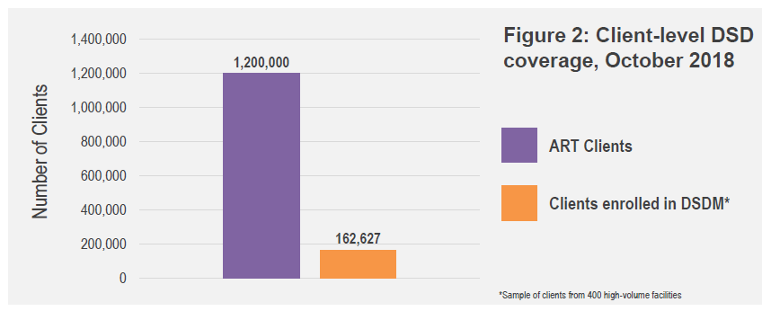
Kenya has 47 semi-autonomous counties, all of which have support for DSD. Two implementing partners (IP) support implementation of DSD at the health facility level.
There are a total of 3,546 health facilities providing ART services, of these 1,464 (41%) offer at least one model of DSD
A survey of 400 high-volume health facilities showed: 162,627 (14%) clients were found to be receiving ART services through a DSD model
For more details, download the Kenya poster

Slide 13
Next steps for Kenya
  DSD scale-up plan, models will be rolled out to all facilities providing ART in June 2019
  Scaling-up client-focused demand creation activities as well as national and facility level data collection and analysis
  Continuous mentorship to health care workers
  DSD costing study and a patient and provider satisfaction survey are planned to launch early 2019

Slide 14

Malawi
Malawi introduced DSD in 2006 as part of the national strategy and has DSD with their national guidelines
Engagement with civil society and PLHIV community has been crucial to the success and scale-up of DSD in Malawi
Malawi offers five DSD models:
  3-Month ART refills
  Teen Club
  Extended-Hour ART refill
  Nurse-Led Community ART Refill (newest to be adapted)
  Drop-In Center (newest to be adapted)
  Fast Track (pilot project ongoing)

Slide 15
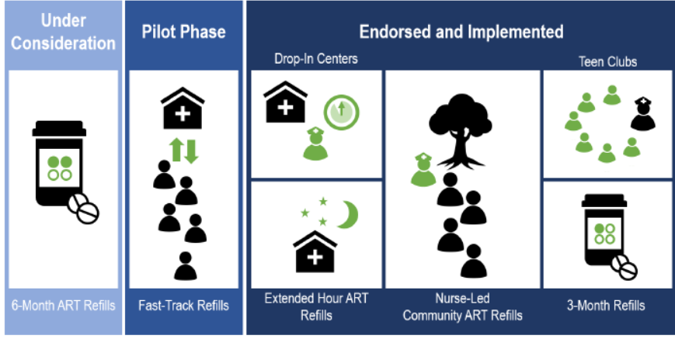
DSD is supported in all 28 districts
6 of the 12 (50%) implementing partners (currently supporting ART services) are also supporting DSD implementation
Total of 740 facilities in country provide ART services, all of which offer at least 1 DSD model
The 3-month ART refill model has been widely implemented
Fast Track Dispensing and CAGs are piloted at 5% and 10% of sites respectively
Models of DSD currently implemented, in pilot phase, and under consideration in Malawi,
Nov 2018
For more details, download the Malawi poster

Slide 16
Next steps in Malawi
Scale up of the Teen Club and Nurse-Led community ART Refill models will continue
Adaption of further extended refill intervals and fast-track model will be informed by the evaluation of pilot findings
Ongoing rapid deployment of electronic records systems to cover >70% of the national ART patient cohort will be used to establish routine reporting on DSD

Slide 17

Mozambique
Mozambique piloted community-based services for PLHIV in 2008
It currently offers both facility-based and community-based DSD models, with the national guidelines recognizing 3 models:
  Three-Month Drug Distribution
  Six-Month Clinical Visit Spacing
  Community Adherence Support Groups
  Services tailored for specific patient populations – the Family Approach and One-Stop models – offer customized opportunities for picking up ART refills
  In 2018, Ministry of Health in Mozambique released guidance on differentiated service delivery on differentiated prevention and testing services and on differentiated ART delivery including community ART groups and family-centered approaches.

Slide 18
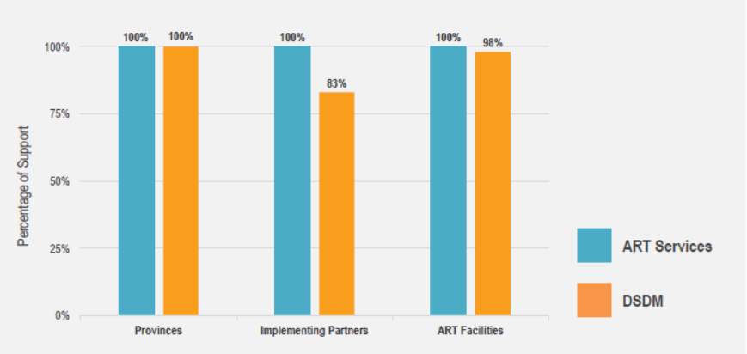
As of October 2018, provision of DSD models is supported in all 11 provinces
10 of 12 (83%) implementing partners supporting ART services also support DSD models and 1,377 of the 1,407 (98%) ART facilities in the country provide at least one DSD model
Support for ART services and DSD models by % among provinces, implementing partners and ART facilities
For more details, download the Mozambique poster

Slide 19
Next steps in Mozambique
  In the next 6-12 months, Mozambique will conduct a phased implementation of outreach with ART initiation
  Ministry will identify data on DSD models on EPTS
  Targets for DSD models will be established
  Investment in mentorship in health facilities
  Launching and dissemination of DSD model guidelines
  Establishment of minimum target for the number of stable patients enrolled in DSD model

Slide 20

South Africa
The South Africa national department of health (NDOH) introduced national adherence guidelines for chronic disease in 2015. It includes standard operating procedures for the set of nationally-implemented DSD models.
The following DSD models are offered:
  Spaced and Fast Lane Appointments (SFLA)
  Adherence Clubs (AC)
  Central Chronic Medicine Dispensing and Distribution (CCMDD)

Slide 21
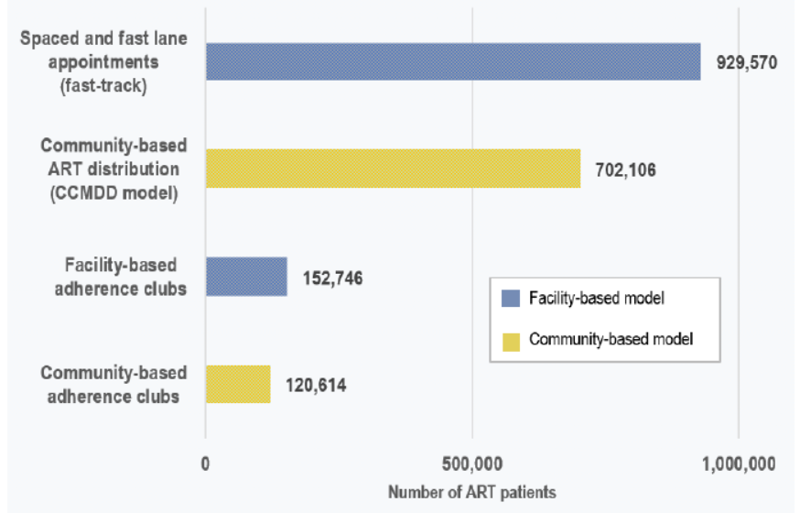
South Africa successfully introduced DSD models for ART across all 9 provinces, with each approximately 4,000 health facilities providing ART enrolling at least 10% of eligible ART patients in DSD model.
Facility-based and community based DSD options are common with 900,000 patients receiving SFLA and over 700,000 receiving ART refills in community settings via CCMDD.
Nearly 275,000 patients are enrolled in ART adherence clubs, a slight majority of whom belong to facility-based clubs.
Number of patients enrolled in DSD models for ART
For more details, download the South Africa poster

Slide 22
Next steps in South Africa
  Design a standardized Advanced Clinical Care with a national training curriculum and plan to convene a national workshop on ACC
  Implement ACC approach in all 9 provinces
  Focus efforts on strengthening M&E for DSD

Slide 23

Tanzania
DSD incorporated into National HIV guidelines include:
  Multi-month prescription extended to 3 months
  Block appointment
  Decentralisation to the low facility level at the community
  Integration of services
  ART Refill: Fast track refill /Family and treatment support refill / Community based individuals ART delivery through mobile outreach by HCW/ Facility based HCW managed groups e.g. Teen clubs, Youth Clubs and adult groups
  DSD Operational Manual and Job Aids
  Revised CTC2 Card with some DSD variables
  Standard training package developed
  Draft National Implementation plan developed
  Tanzanian Ministry of Health, Community Development, Gender, Elderly and Children (MoHCDGEC) and International Training and Education Centre for Health (I-TECH) released HIV Service Delivery Models: Mapping HIV Service Delivery Strategies in Tanzania in 2017

Slide 24
Tanzania
Very low health facility and patient coverage with no data base/ tools to capture information on DSD implementation
  Training coverage: reaching HCWs in all facilities for rapid scale-up of DSD models and tracking of those trained
  Unavailability of all DSD variables in M&E recording and reporting tools
  Lack of targets and routine monitoring of DSD indicators
For more details, download the Tanzania presentation

Slide 25
Next steps in Tanzania
  Finalize revision of M&E tools and Electronic Data Base to capture all information relating to DSD
  Set up the country targets & finalize indicators for DSD
  Finalize National DSD Implementation Plan to include targets, indicators and M&E plan
  Integrate DSD in Continuous Quality Improvement (CQI) initiatives
  Continue rollout and scale up of DSD implementation
  Strengthen tracking of HCWs trained on DSD at all levels using TranSMART Database
  Strengthen use of data for decision making at R/CHMT and Facility levels
  Strengthen demand creation and ART literacy at community level
  Strengthen supportive supervision and mentoring on DSD at facility level

Slide 26

Uganda
DSD was first adopted for national implementation in Uganda in 2016
Under Uganda’s National Guidelines for DSD models, five nationally-endorsed models of DSD have been adopted and all PLHIV in the country are eligible for at least one model
  Facility Based Individual Management model (FBIM) (a.k.a. Comprehensive Clinical Evaluation)
  Facility Based Group (FBG)
  Fast Track Drug Refill (FTDR)
  Community Client Led ART delivery (CCLAD)
  Community Drug Distribution Points (CDDP)

Slide 27
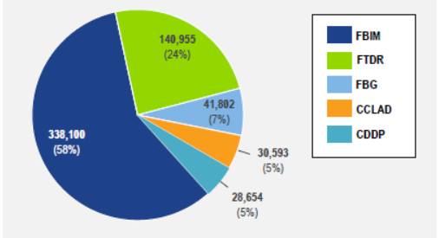
DSD is currently available in 82 (64%) of the 128 districts in Uganda where ART is offered and 19 (95%) of the 20 implementing partners who support ART services, are supporting DSD
Overall facility uptake of DSD currently stands at 40% (734/1,832 facilities)
Of the 1,140,550 PLHIV receiving ART in Uganda, 580,104 (51%) are enrolled in a DSD model
Of all DSD clients, most (338,100; 58%) are enrolled in FBIM
The model with second-highest uptake is FDTR, in which 140,955 (24%) of DSD clients are enrolled
Patient uptake by DSD model
For more details, download the Uganda poster

Slide 28
Next steps in Uganda
  Pilot community-based care and treatment programme
  Develop a national toolkit for DSD for key populations and adolescent girls and young women
  Assessment of the costs and outcomes of DSD models
  Study on the use of quality improvement models to maximize impact and efficiency of DSD implementation

Slide 29

Zambia
The Zambian Ministry of Health (MoH) updated their Consolidated Guidelines for Treatment and Prevention of HIV Infection in 2018 expanding on guidelines for differentiated service delivery for clinically stable clients and for people living with advanced HIV disease.
The nine main DSD models for ART are available in Zambia:
  Facility-based models (Fast Track, Multi-Month Scripting, Urban/Rural Adherence (UAG) group)
    Community-based models (Community Adherence Groups/Clubs (CAG), Chronic Centralized Medicines Dispensing & Distribution (CCMDD), Community (Retail) Pharmacy, Health Post (HP) Model Dispensation)
    Outreach models (Mobile ART Distribution Model, Home ART Delivery)
  Scholars (Adolescent) model – specialty adherence group model for adolescents and young adults

Slide 30
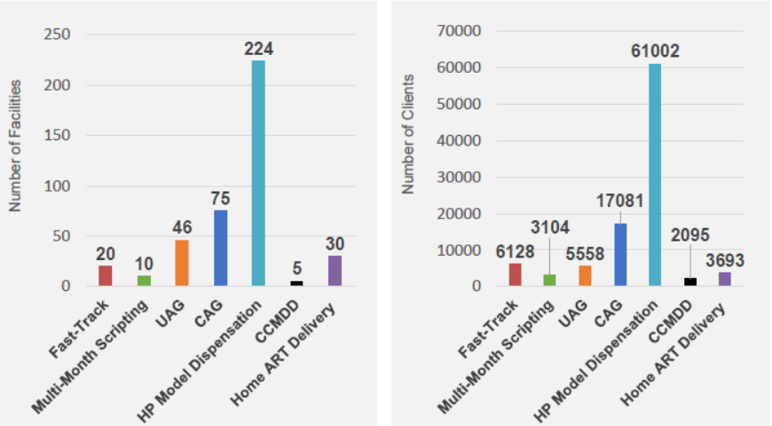
As of October 2018, DSD is supported in all 10 provinces and provided by 7 (88%) of the 8 implementing partners
2,961 facilities provide ART and, of those, 303 (10%) offer at least one DSD model
Most commonly-offered model is the HP Model Dispensation, at 224 facilities, followed distantly by the CAG model at 75 facilities and the UAG model at 46 facilities
Uptake of HP model dispensation far outpaces the uptake of all other models, with 61,002 clients currently enrolled
CAG model comes second with 17,081 clients enrolled, and third most enrolled model is Fast-Track with 6,128 clients
Next steps:
  Rapid and systematic scale-up of the DSD programme nationwide
Facility update of DSD, October 2018
Client update of DSD, October 2018
For more details, download the Zambia poster

Slide 31
Next steps for Zambia
  Rapid and systematic scale-up of the DSD programme nationwide
  Putting to use the lessons learned from many years of IP-implemented standalone models and through the leadership of the DSD Task Force, Zambia is looking forward to a rapid and systematic scale-up on the DSD program
  Check out the CIDRZ CommART Toolkit website

Slide 32

Zimbabwe
DSD was first offered in Zimbabwe in 2009 when Ministry of Health and Child Care (MOHCC) launched the Outreach model nationwide
Zimbabwe Ministry of Health and Child Care (MoHCC) released Operational and Service Delivery Manual for the Prevention, Care and Treatment of HIV in Zimbabwe (OSDM) in February 2017.
Implementing partners began piloting the community ART refill group (CARG) model
Currently, Zimbabwe’s national models of DSD for ART include the Fast Track Refill, Facility Club Refill, CARG and Outreach models. Additionally, Family Refill model and Zvandiri Model.
Currently piloting Out of Facility Community ART Distribution (OFCAD) in one district

Slide 33
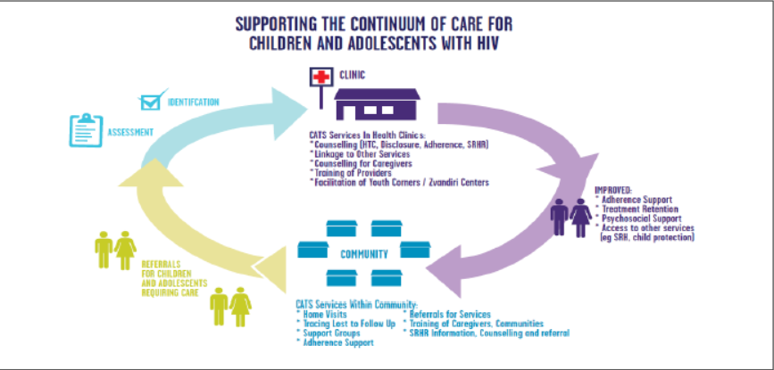
DSD is supported in all 65 districts in Zimbabwe’s 10 provinces
Of 20 implementing partners supporting ART services, 8 are also supporting DSD
1,601 health facilities in the country provide ART and, of those, 901 (56%) have been capacitated to provide at least one DSD model
Zvandiri Approach
For more details, download the Zimbabwe poster

Slide 34
Next steps in Zimbabwe
  Continuing to build on progress already made, with additional focus on aspects of scale-up that have proven challenging (pace of developing M&E tools, acceptability of the Fast Track Refill model among HCW)
  Adoption of an intermittent data review process to allow for the collection of DSD data while national M&E system is still in development
  Best practice sharing meetings and exchange visits to encourage buy-in among HCW
  Ensure consistent implementation of DSD nationwide

Slide 35
For more details:
Check out the dropbox from the CQUIN Annual meeting here
Visit cquin.columbia.edu
Visit www.differentiatedservicedelivery.org and sign up for our quarterly newsletter
Email us at dsd@iasociety.org

