Slide 1
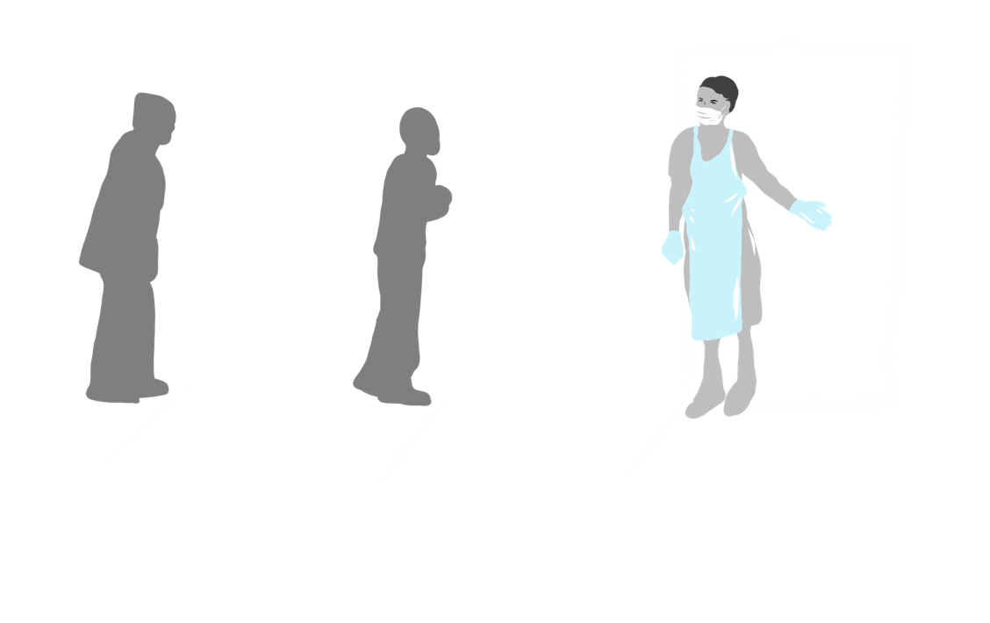
Practical COVID-19 health facility preparedness
LYNNE WILKINSON
dsd@iasociety.org

Slide 2
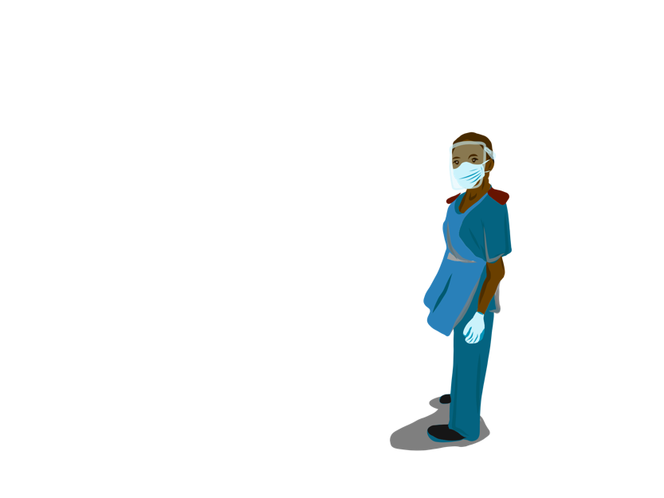
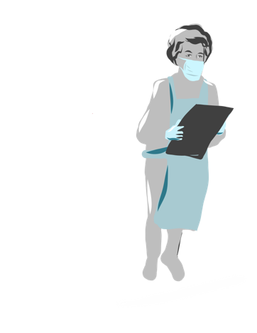
Why prepare facilities?
Protect patients from SARS-CoV-2 infection
Protect healthcare workers from SARS-CoV-2 infection
Allow health facilities to continue to deliver health services
Facilitate COVID-19 testing, referral and management

Slide 3
Seven objectives National South African response
to reduce risk among HIV and TB patients within the context of the COVID-19 pandemic
Reduce the risk of contracting COVID-19 for PLHIV and people with active TB infection
Diagnose and treat COVID-19 in PLHIV and people with active TB infection
Ensure that PLHIV and people with active TB have access to essential services during the COVID-19 lockdown period
Diagnose and treat HIV and TB in people with COVID-19
Reduce the risk of contracting COVID-19 in clients accessing HIV and TB prevention services
Reduce the risk of contracting COVID-19 in key populations
Provide support to the COVID-19 response leveraging existing HIV and TB resources

Slide 4
Top five priorities National South African response
to reduce risk among HIV and TB patients within the context of the COVID-19 pandemic
1. Accelerate decanting to external pick up point
Decanting all eligible clients who are currently not decanted
Transferring clients from in-facility to external pick up points and/or
temporarily from larger group pick up points to external pick up points
2. Implement multi-month dispensing for all chronic patients
3. Rapidly scale up TLD in eligible ART clients
4. Strengthen facility infection control readiness - including infection control practices
Implement infection control practices within the facility and screening/
separation of those with COVID-19 symptoms
Fast track vulnerable patients in facilities
Implement chronic care service delivery points that are separate from
COVID19 screening, testing and care points in open-air environments
5. Expand Community HTS, ART and TB services

Slide 5
Strengthen facility infection control readiness National South African response
to reduce risk among HIV and TB patients within the context of the COVID-19 pandemic
Hands-on training to prepare and set up a primary health care (PHC) facility
Additional components for hospitals
Highlighting application to:
PLHIV attending facilities
Diagnosing TB suspects/TB patients attending facilities
Differentiated service delivery (DSD) for ART patients attending facilities
PPE components not covered in this training, but included in Guide

Slide 6
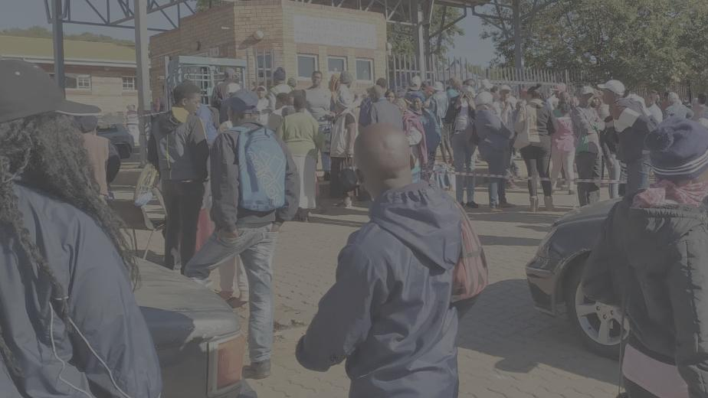
Before facility preparedness intervention
Sanitation
Externalizing chronic management
Reducing non-essential service attendance
Crowded entrance and queuing- No social distancing
Sanitation station at gate entrance clogged
All PHC chronic patients waiting outside while WBOTs triaging and going inside to PHC external tent to fetch file and script and bring treatment outside to patient
All EPI/some acute patients refused entry and sent home
HCW staff very anxious

Slide 7
10 essential components of facility set-up
Single point of entry to facility premises 1 | YELLOW ZONES
Patient and HCW sanitation station 2
First Screening Station 3
Second Screening & Management Station….. (also called Temporary Chest Clinic) 4 | ORANGE ZONES
HIV Testing Stations 5
Specialized clinical service station….. for COVID-19 symptom positive patients 6
COVID-19 and TB testing station 7
HCW sanitation station at entry to routine services 8 | BLUE ZONES
Routine services inside facility….. for COVID-19 symptom negative patients 9
Facility station transfer and exit pathways 10 | TAKE COLOUR FROM PREVIOUS STATION
COVID-19 medium risk
COVID-19 high risk
COVID-19 low risk + protected

Slide 8
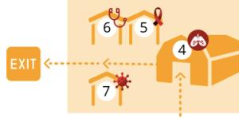
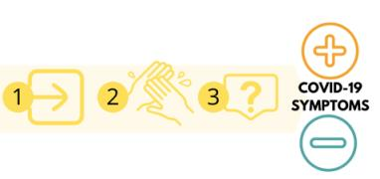
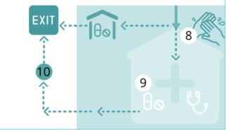
10 essential components of facility set-up

Slide 9
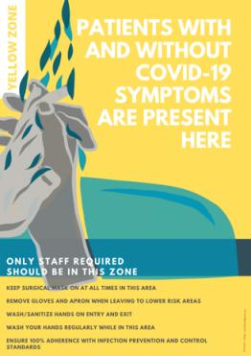
Everyone arriving at the facility passes through the
YELLOW ZONE
Notes:
Yellow Zone:
Moderate COVID-19 risk zone – patients with COVID-19 symptoms have not been identified or separated out yet
Outside the facility is as important as inside the facility. Risk of infection outside brings risk of infection inside
Every patient entering the facility must pass through ALL the yellow zone stations
Rapid patient flow in the yellow section is vitally important to ensure that patients do not become frustrated outside the gate and stop observing social distancing
The aim is pass clinic attendees without COVID-19 symptoms through the yellow zone to the blue zone as quickly as possible not increasing time spent at facilities to receive health services

Slide 10
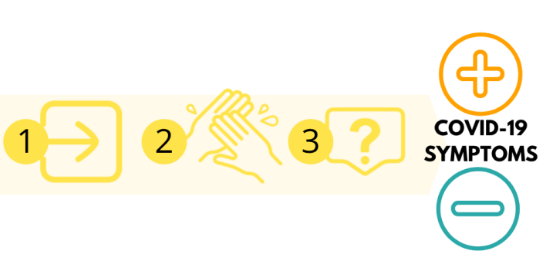
10 essential components of facility set-up
YELLOW ZONE
Notes:
Yellow Zone
Moderate COVID-19 risk zone – patients with COVID-19 symptoms have not been identified or separated out yet
Outside the facility is as important as inside the facility. Risk of infection outside brings risk of infection inside.
Every patient entering the facility must pass through ALL the yellow zone stations.
Rapid patient flow in the yellow section is vitally important to ensure that patients do not become frustrated outside the gate and stop observing social distancing.
The aim is pass clinic attendees without COVID-19 symptoms through the yellow zone to the blue zone as quickly as possible not increasing time spent at facilities to receive health services

Slide 11
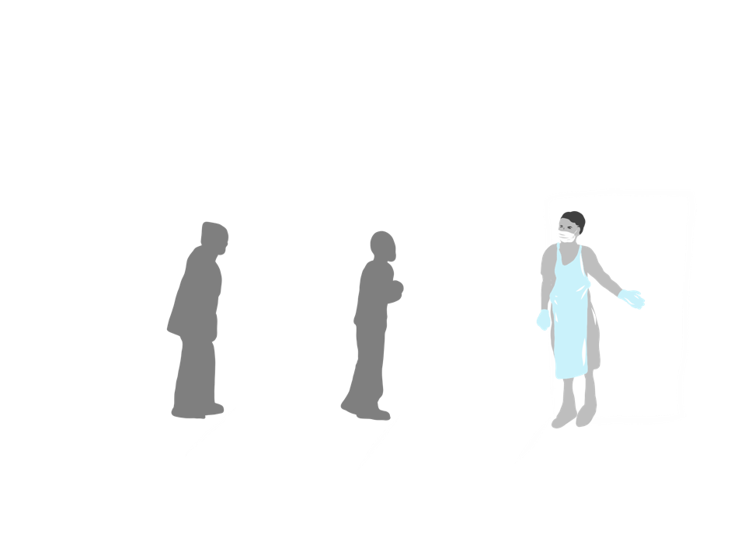
1. Single point of entry into facility premises
YELLOW ZONE
Notes:
Single point of entry into facility premises
Location
This is not into main buildings of the facility but at the gates to the premises. Patients should only be allowed to enter the facility through one gate into the facility. It will be necessary to set up separate exit pathways from the orange and blue zones. The single point of entry should be located in the middle i.e. between orange and blue exits.
Staffing
Gate Designated Official (GDO): To manage single entry point into facility – can be a security guard or lay HCW.
Queue marshals: To manage queue, ensure social distancing and explain process to patients as they wait outside the premises – can be security guard, lay HCW or volunteering community members.
Station set up
Ground to be demarcated outside facility gate by lines 1.5m apart on the ground with yellow paint. These lines should be painted for a long enough distance to ensure entire queue has demarcated places to stand. This can be many urban blocks.
Appropriate IPC and PPE use for staff
GDO and queue marshals to wear surgical mask and disposable apron (one per shift) and can wear non-sterile gloves provided understanding that gloves cannot be sanitized and similarly to hands can transfer the virus. GDO and queue marshals to attempt not to come closer than 1.5 meters from any patient while managing area outside the gate.
GDO and queue marshals to wash/sanitize hands each time he/she removes gloves when leaving Yellow/Orange Zone. Also wash or sanitize hands when re-entering Yellow/Orange zone. Should keep exits and re-entries to a minimum during shift.
Station set up and procedure
Queue marshals to manage patients line up in queue outside gate 1.5m on demarcated lines on the ground.
GDO to work at gate ensuring patients only enter one at a time passing to sanitation station. The GDO must be directed by those at sanitation station and first screening station when to let the next patient through.
The single point of entry should not be used by patients exiting the facility – see detail below.

Slide 12
1. SINGLE POINT OF ENTRY Risk of infection outside brings risk of infection inside
Location
At the gates to the premises, not at doors into the buildings
Staffing
Gate Designated Official (GDO) (security guard or lay HCW)
Queue marshals (WBOTs/community members)
Station set up
Ground to be demarcated with paint outside facility gate with lines 1.5m apart – for long distances
Station set up and procedure
Queue marshals to manage patients in queue outside gate and ensure social distancing
Loudhailers useful for queue marshals
GDO to work at the gate letting one patient at a time to pass to sanitation station
Notes:
Single point of entry into facility premises
Location
This is not into main buildings of the facility but at the gates to the premises. Patients should only be allowed to enter the facility through one gate into the facility. It will be necessary to set up separate exit pathways from the orange and blue zones. The single point of entry should be located in the middle i.e. between orange and blue exits.
Staffing
Gate Designated Official (GDO): To manage single entry point into facility – can be a security guard or lay HCW.
Queue marshals: To manage queue, ensure social distancing and explain process to patients as they wait outside the premises – can be security guard, lay HCW or volunteering community members.
Station set up
Ground to be demarcated outside facility gate by lines 1.5m apart on the ground with yellow paint. These lines should be painted for a long enough distance to ensure entire queue has demarcated places to stand. This can be many urban blocks.
Appropriate IPC and PPE use for staff
GDO and queue marshals to wear surgical mask and disposable apron (one per shift) and can wear non-sterile gloves provided understanding that gloves cannot be sanitized and similarly to hands can transfer the virus. GDO and queue marshals to attempt not to come closer than 1.5 meters from any patient while managing area outside the gate.
GDO and queue marshals to wash/sanitize hands each time he/she removes gloves when leaving Yellow/Orange Zone. Also wash or sanitize hands when re-entering Yellow/Orange zone. Should keep exits and re-entries to a minimum during shift.
Station set up and procedure
Queue marshals to manage patients line up in queue outside gate 1.5m on demarcated lines on the ground.
GDO to work at gate ensuring patients only enter one at a time passing to sanitation station. The GDO must be directed by those at sanitation station and first screening station when to let the next patient through.
The single point of entry should not be used by patients exiting the facility – see detail below.

Slide 13
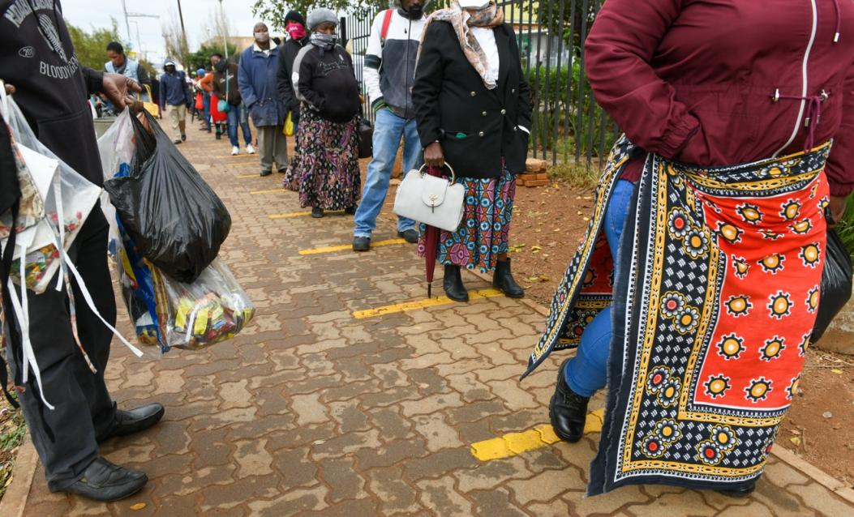
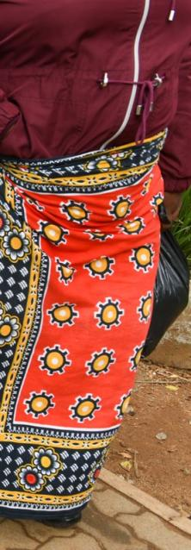
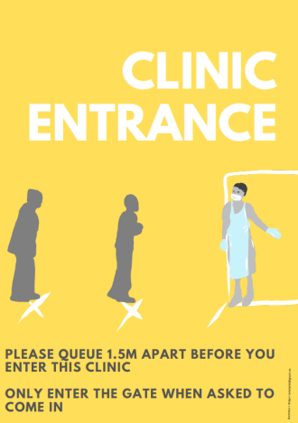

Slide 14
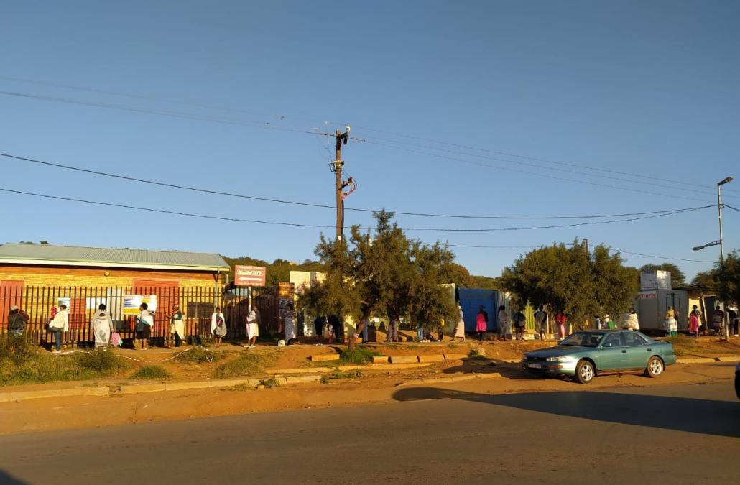
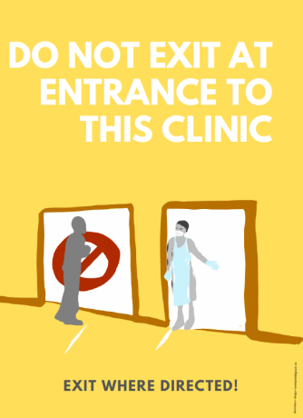
The single point of entry should not be used by patients exiting the facility

Slide 15
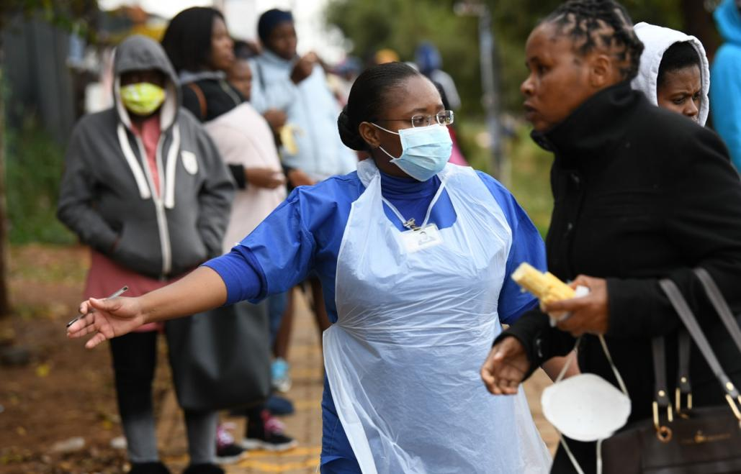

Slide 16
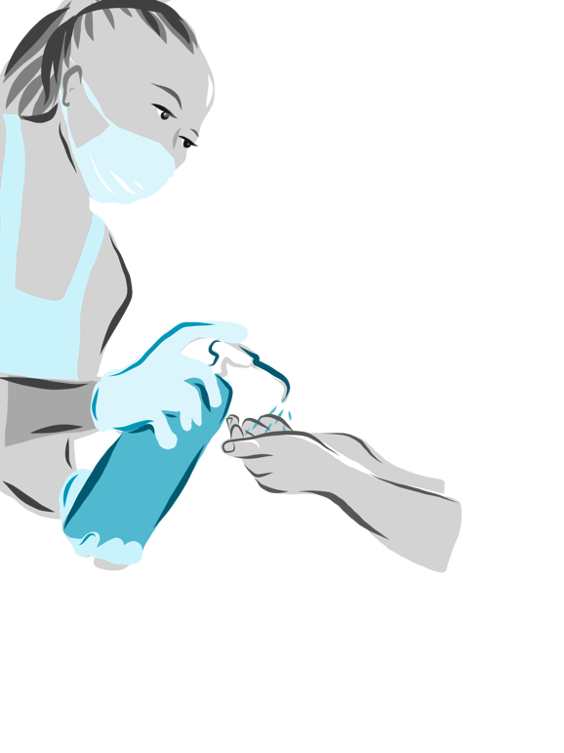
2. Sanitation Station
YELLOW ZONE

Slide 17
2. SANITISATION STATION Hand sanitizing or hand-washing of every person entering
Location
Short distance from single entry point, inside gate
Outside facility buildings
Staffing
Sanitation Designated Official (SDO) (security guard/ lay HCW/ admin staff member)
Station set up and procedure
Sanitizer spray
OR
Bleach/water solution in water container with tap on edge of table with bucket to catch water
SDO only allow one person at a time into sanitation station. Next patient only permitted once sanitation complete
Patient stands in marked block for sanitation
SDO approaches patient. Patient does not approach SDO
Notes:
Sanitation station
Location
Short distance (at least 1.5m) from single entry point, outside facility buildings
Staffing
Sanitation Designated Official (SDO): To sanitize patient’s hands - can be a security guard or lay HCW or admin staff member.
Appropriate IPC and PPE use for staff
SDO to wear surgical mask and disposable apron (one per shift) and can wear non-sterile gloves provided understanding that gloves cannot be sanitized and similarly to hands can transfer the virus. SDO to stay as far away from the patient as possible while sanitizing hands.
SDO to wash/sanitize hands each time he/she removes gloves when leaving Yellow/Orange Zone. Also wash or sanitize hands when re-entering Yellow/Orange zone. Should keep exits and re-entries to a minimum during shift.
Station set up and procedure
SDO only allows one person to pass to the sanitation station from the gate and only once sanitation complete – allows another patient to approach.
Patient stands in marked block for sanitation. SDO approaches patient. Patient does not approach SDO.
Sanitation station set up – there are 3 options set out below in order of best option to worst option (but still adequate)
Sanitizer spray station
No table is required
SDO sprays hand sanitizer on each patient’s hand and ensures patient fully rubs sanitizer over both hands up to wrists.
SDO is not to touch patient or let patient touch sanitizer bottle
Bleach/water solution in water container with tap on edge of table and bucket to catch water after tap turned on
Water container is filled with water/bleach solution and placed on a table/chair (see Annex 3)
SDO operates tap to pour solution over patient’s hand and ensures patient fully rubs bleach/water solution over both hands up to wrists.
SDO is not to touch patient or let patient touch water container or tap

Slide 18
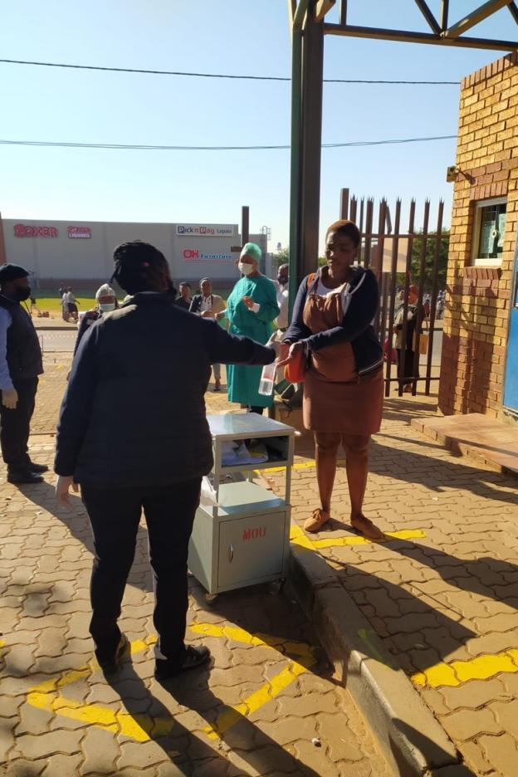
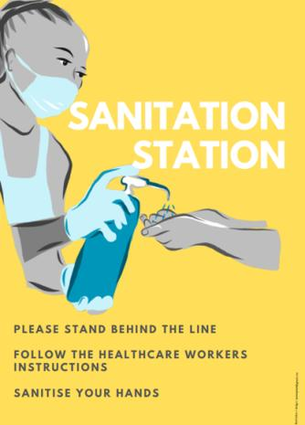

Slide 19
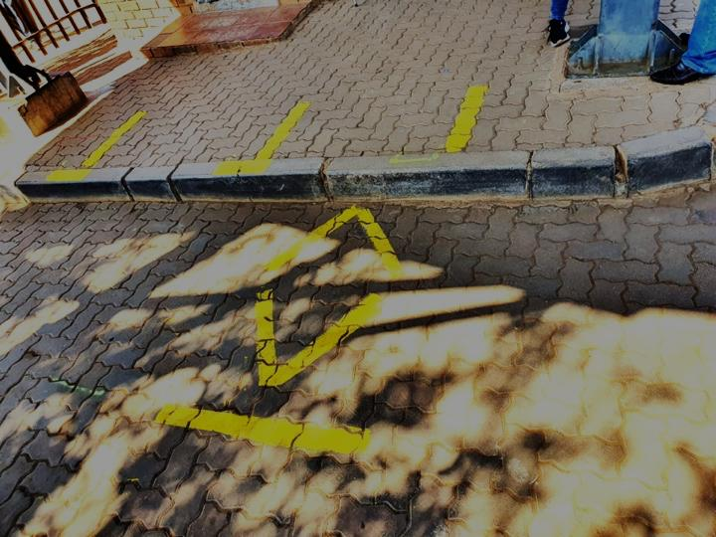
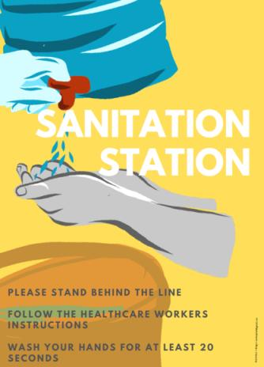

Slide 20
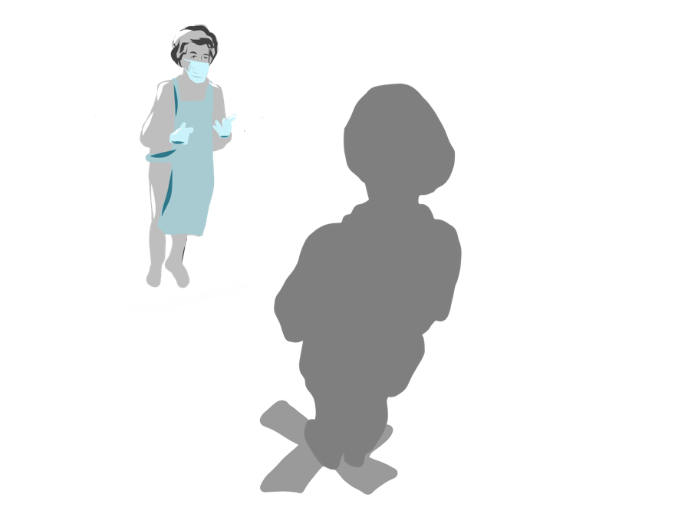
3. First Screening Station
YELLOW ZONE

Slide 21
3. FIRST SCREENING STATION Symptom screening and triage of every patient
Location
Short distance from Sanitation Station, outside facility buildings and just inside the gate
At a position where all patients entering facility must pass
Staffing
First Screening Station Queue Marshal
One staff member to manage the queue
Can be a security guard, lay HCW or administrative staff member
First Screening Screener/s
Staff members to screen the patients
At higher volume facilities may need 3-5 1st Screeners
Can be lay HCW, enrolled nurse, nursing assistant
Notes:
1st screening station (also called COVID-19 symptom screening station)
Location
Within site of the sanitation station, outside facility buildings. Should be sufficient space between sanitation station and 1st screening station to allow for some queuing for screening.
Staffing
1st screening station queue marshal (1st SS Queue Marshal): To manage the queue between sanitation station and 1st screening station. Can be a security guard, lay HCW or administrative staff member.
1st screening station screener/s (1st Screener): To screen the patients for COVID-19 symptoms. At higher volume facilities may need 3-5 1st Screeners. 1st Screener/s can be lay HCW, enrolled nurse, nursing assistant. Where facility has sufficient professional nurses after staffing 2nd screening station and COVID-19 testing station, this triage can also be run/supervised by a professional nurse.
Station set up
Ground to be demarcated leading from sanitation station to 1st screening station with lines 1.5m apart marked on the ground
High volume facilities may need 3-5 1st screening sub-stations within 1st screening station (at least 1.5m apart). 1st Screeners must also be 1.5m from one another. 1st Screeners will each need a chair and either a clipboard or a small single person foldable table. They will require the updated COVID-19 screening questions printed on their tables/clipboards. They will also likely need a stat sheet. There will be a box in front of each 1st Screener with cloth masks for symptomatic patients. Facilities can also consider orange and blue stickers to indicate screening complete and which zone patient screened into.
There can either be one queue line from sanitation station to 1st screening station or there can be multiple lines in front of each 1st screening sub-station.
1st screening station should be under cover (if possible) to protect during periods of rain. An open sided gazebo/tent can be used.
Appropriate IPC and PPE use for staff
1st SS Queue Marshal and 1st Screener to wear surgical mask and disposable apron (one per shift) and can wear non-sterile gloves provided understanding that gloves cannot be sanitized and similarly to hands can transfer the virus.
1st SS Queue Marshal and 1st Screener to wash/sanitize hands each time he/she removes gloves when leaving Yellow/Orange Zone. Also wash or sanitize hands when re-entering Yellow/Orange zone. Should keep exits and re-entries to a minimum during shift.
Station procedure
1st SS Queue Marshal to:
Ensure patient is standing 1.5 meters apart on the demarcated lines.
Indicate to the patient when to move to marked place in front of 1st Screener.
Not to come closer than 1.5 meters from any patient while managing queue.
1st SS screener/s to:
Ask screening questions (see Annex 4) – these questions may change and should be updated:
Cough or fever or shortness of breath or sore throat developed in last 14 days OR
Significant worsening of chronic cough in past 14 days OR
Sudden very obvious loss of smell or taste in last 14 days
If POSITIVE SCREEN (answers any one of the above questions in the affirmative)
Ask the patient to take cloth mask from the box
Explain how to put it on
Ensure patient fits it correctly
Do not touch patient
Explain to the patient that they will receive all their services they have come to the clinic for in the external tented section.
Direct patient to 2nd screening and management station (temporary chest clinic) in the Orange zone along cordoned pathway. Where possible ensure the runner from this station comes forward to receive and direct the patient within the orange zone.
Ensure the patient does not go to the blue zone for any reason.
If NEGATIVE SCREEN (answers ALL of the above questions in the negative)
Ask patient which routine service they are attending in the facility (e.g. OPD, ANC, ART MCH, FP etc) and direct them accordingly especially to any external chronic treatment refill station.
Inform patient of any services that have been closed during the COVID-19 pandemic.
Where patient decides not necessary to attend facility today – direct patient towards blue zone exit (see component 10 below).
Facilities can consider issuing patient with appropriate colour sticker to be placed on the front of their clothing to indicate screening complete and whether screened orange and blue.
Where facility runs 24 hour services, the 1st screening station remains vital. This can moved to the entrance of the emergency department and/or maternal and obstetric unit, with those symptom-positive kept separate from those symptom- negative, in an isolation room within emergency/MOU departments (see more detail in Annexure 5 and 6).

Slide 22
3. FIRST SCREENING STATION Symptom screening and triage of every patient
Station set up
Ground to be demarcated with lines 1.5m apart on the ground between Sanitation Station and First Screening Station
There can either be one queue line from Sanitation Station to First Screening Station or there can be queues in front of each First Screening sub-station.
Station should be under cover (if possible) to protect during periods of rain
Where facility runs 24-hour services
First Screening Station remains vital, but can be moved to the entrance of the Emergency Department after-hours
Symptom-positive patients kept separate from those symptom-negative (Emergency Department patients)
Symptom-positive patients to be attended to in isolation room within Emergency Department

Slide 23
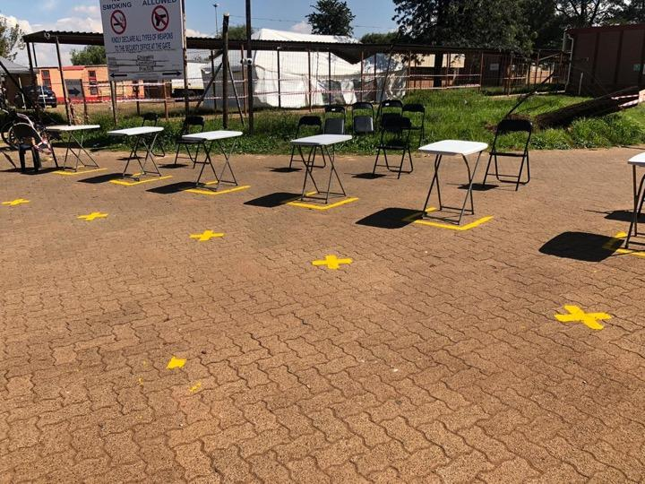
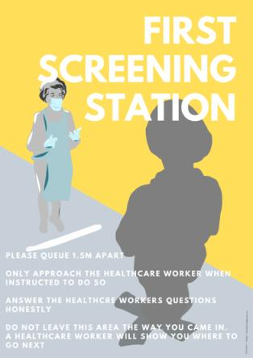

Slide 24
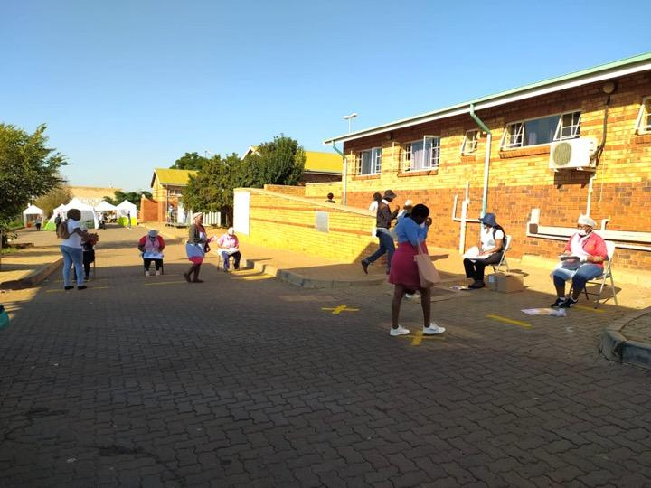
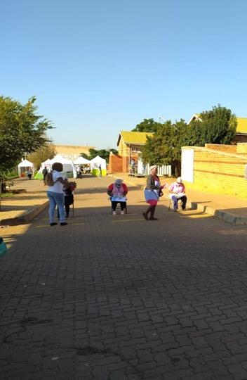

Slide 25
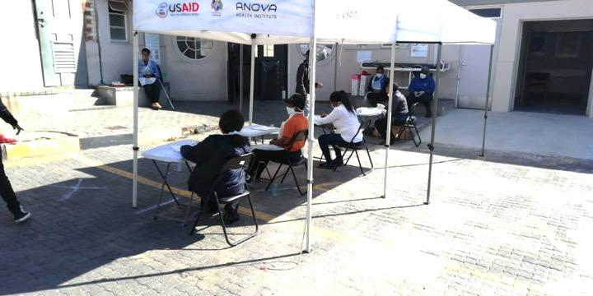

Slide 26
3. FIRST SCREENING STATION First Symptom Screen
IN THE LAST 14 DAYS (2 WEEKS) HAVE YOU DEVELOPED:
1. Any one of the following:
Cough
OR
Fever
OR
Shortness of breath
OR
Sore throat
OR
2. Significant worsening of chronic cough
OR
3. Sudden very obvious loss of smell or taste
YES to any ONE screening question
POSITIVE SCREEN
DIRECT TO ORANGE ZONE
NO to ALL screening
questions
NEGATIVE SCREEN
DIRECT TO BLUE ZONE
(ROUTINE SERVICES)

Slide 27
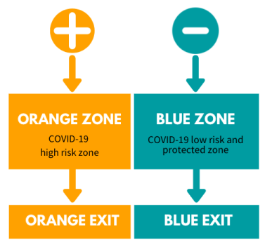
3. FIRST SCREENING STATION First Symptom Screen

Slide 28
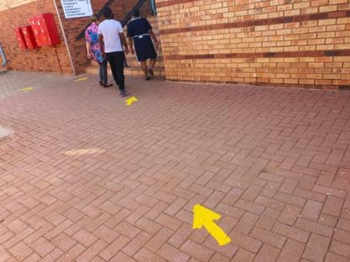
10. PATHWAYS
Yellow pathways need to be set up from:
single point of entry to Sanitation Station
Sanitation Station to 1st Screening Station

Slide 29
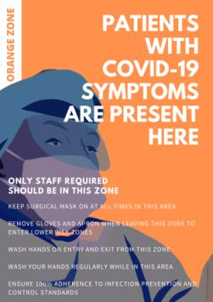
Patients with a POSITIVE SCREEN directed to the
ORANGE ZONE
Notes:
High COVID-19 risk zone – patients with COVID-19 symptoms screened, assessment, managed and tested in this zone.
All stations within Orange Zone within a cordoned off part of the clinic premises.
Patients with COVID-19 symptoms triaged into the Orange Zone do not enter any other part of the facility. Healthcare workers see them in the Orange zone and collect treatment for them. Patients in the Orange Zone either go home directly from Orange Zone or are transferred to the Emergency department or referral hospital from the Orange Zone.
Patients require good communication and support while in the Orange Zone to understand why serviced in this part of the facility and that there is no need for them to go anywhere else in the facility.
All health facilities to provide COVID-19 testing in their Orange Zone to avoid need for transfer to testing site.

Slide 30
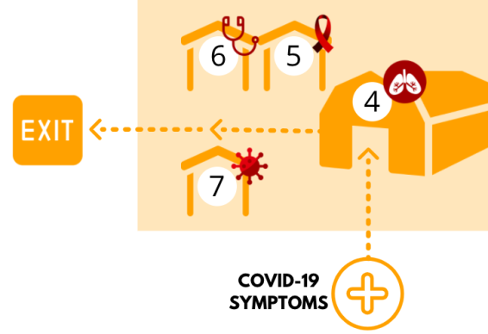
10 essential components of facility set-up
ORANGE ZONE

Slide 31
4. Second Screening & Management Station (Temporary Chest Clinic)
ORANGE ZONE

Slide 32
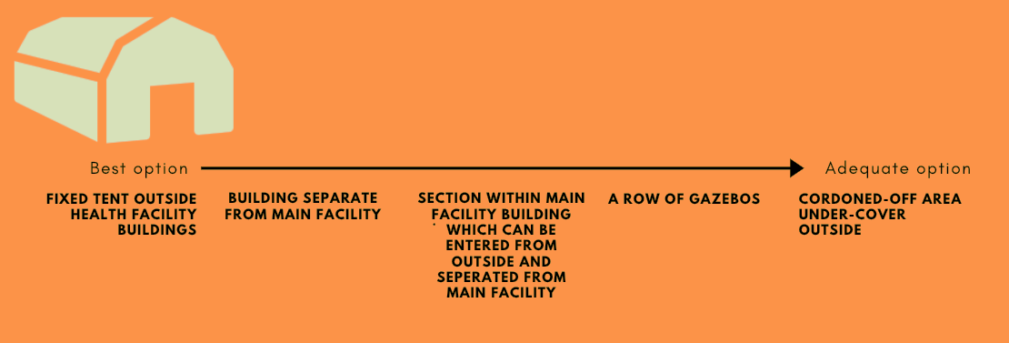
4. SECOND SCREENING & MANAGEMENT STATION (Temporary Chest Clinic)
Location
Notes:
2nd screening and management station (also called temporary chest clinic)
Location
Main station within Orange zone.
The best option is an external fixed tent where tent is available and facility external space makes this feasible. The tent should be located with a direct cordoned pathway from 1st screening station.
Other options in the following order from best to worst options listed below (all are adequate)
Row of gazebos
Cordoned off area outside under cover (e.g. under parking roof)
Separate building from main facility services if this exists
Separate section of the facility which can be entered from outside and closed off from the remainder of the facility

Slide 33
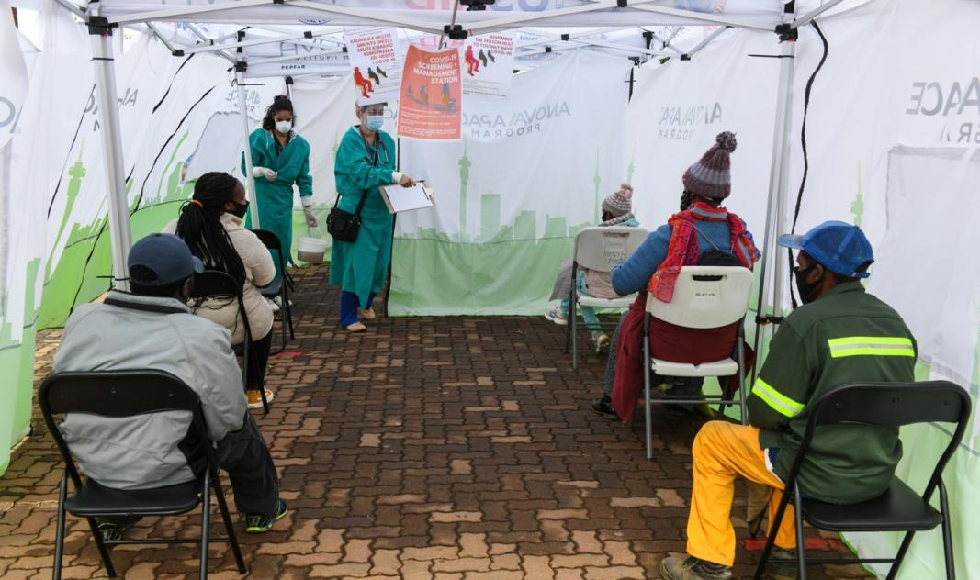

Slide 34
4. SECOND SCREENING & MANAGEMENT STATION (Temporary Chest Clinic)
Staffing
Orange Zone Clinician (professional nurse or doctor):
Screen, assess and manage patients with COVID-19 symptoms
At higher volume facilities may need 2 clinicians
Runner (WBOT or CHW):
Ensures patient does not need to go anywhere else in the facility. Collects patient folders, treatment/chronic refills or blood results and brings them to the Orange Zone Clinician
Makes sure patients stay in their allocated seats.
Disinfects seats between patients
Escorts patients to testing and out of the facility
2-5 staff depending on volume
Useful additional staff:
Counsellor: need for and procedures for home isolation (can be HIV testing counsellor)
Orange Zone cleaner: Can be shared with COVID-19 Testing Station
Administrative clerk: Where facility requires head count/opening of files
Notes:
Staffing
Critical staff are:
2nd screening and management station clinician (Orange Zone Clinician): To further screen, assess and manage patients with COVID-19 symptoms. Should be a professional nurse or doctor. At higher volume facilities may need 2 clinicians.
Patient navigator/runner: To support Orange Zone clinician and all patients in this station. He/she will welcome patients, communicate how the patient will be supported and doesn’t need to go anywhere else in the facility, collect patient folders, treatment/chronic refills or blood results and bring them to the consulting clinician. Will also fetch any required specialized clinician to the patient (as requested by consulting clinician), make sure patients stay in their allocated seats and do not leave Orange Zone, disinfect seats between patients and escort patient to testing and out of the facility using Orange exit pathway.
Depending on staff compliment, the following staff members would also be of assistance
Counsellor: To counsel all Orange Zone patients on need for and procedures for home isolation. This can be HIV testing counsellor allocated to Orange Zone.
Orange Zone cleaner: See cleaning procedures below (can be shared with COVID-19 testing station)
Administrative clerk: Where facility requires opening of files and headcount of patients seen in Orange Zone.

Slide 35
4. SECOND SCREENING & MANAGEMENT STATION (Temporary Chest Clinic)
Station set up
Waiting area
Chairs in waiting area must be placed 1.5m apart with paint/tape on the floor demarcating spacing
Chairs should not be moved
Patients must not move between chairs in waiting area but stay on one allocated to them on arrival
Private Orange Zone Clinician consulting area
Stationed in a gazebo off main tent/ cordoned off cubicle within tent/ room off the waiting area/ screened off desk at least 2m from waiting area
Should have all necessary equipment at hand
Equipment listed in Annex 1 of Guide (mobile oximeter and thermometer strips/infrared)
Notes:
Station set up
Chairs must be placed 1.5m apart with paint demarcating on the floor where to be placed. Patients must not move between chairs in waiting room but stay on one allocated to them on arrival. Facilities can consider chair moving with patient throughout Orange Zone and disinfection once patient leaves for re-use.
The Orange Zone Clinician/s should be placed in a room off the waiting area/gazebo off main tent/cordoned off cubicle within tent/room. Where none of the above possible, at desk screened off at least 2m from the seated queue system.
Orange Zone Clinician/s should have pulse oximeter, thermometer, manual BP cuff and glucometer at hand (see Annex 1). They can either prescribe treatment which is fetched by runner from pharmacy or have a box of commonly used drugs with them. They should have temp file or form to complete management plan.
Appropriate IPC and PPE use for staff
All staff in 2nd screening and management station to wear surgical mask (one per shift), non-sterile gloves and disposable apron (to discard when leaving Yellow/Orange zone in facility or one per shift).
All staff members to wash/sanitize hands each time he/she removes gloves when leaving Yellow/Orange Zone. Also wash or sanitize hands when re-entering Yellow/Orange zone. Should keep exits and re-entries to a minimum during shift.
Where Orange Zone Clinician required to come into close contact with patient, should wear goggles or visor. The clinician needs to clean all surfaces touched by the patient, including seat, stethoscope, cuffs if used. Should discard non-sterile gloves and aprons between each patient interaction, sanitize hands, disinfect googles/visor.
Cleaners also to wear goggles/visor and disinfect per shift.
Station procedure
COVID-19 symptom positive further screening and management procedures
Five step approach to screening, assessment and management set out in algorithm below with following summary of steps:
Severity – refer to emergency dept/hospital
Determine who should be tested for COVID-19
Counsel on home isolation + patient info leaflet
Determine HIV status and TB sputum collection
Determine reason for clinic attendance and where essential MANAGE patient incl.
Provide treatment (can be collected from pharmacy)
Collection of treatment from chronic/ART
Call necessary specialized clinician to manage at specialized clinical service station (e.g. ante-natal nurse).
The Orange Zone clinician could consider use of the assessment form set out in Annex 13 to support their management.
Counselling and educating on isolation options
All patients with COVID-19 symptoms should be counselled and educated on importance and procedures for home isolation until they either receive a negative COVID-19 test or 14 days if not tested.
Patients should be provided with patient information leaflet in their home language on home isolation procedures. See Annex 7.
Once SA Government is able to provide isolation facilities for those patients who are unable to isolate at home, this option should also be explained, discussed and supported.

Slide 36
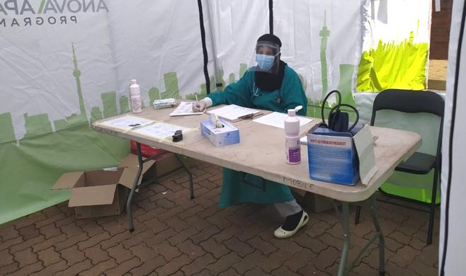

Slide 37
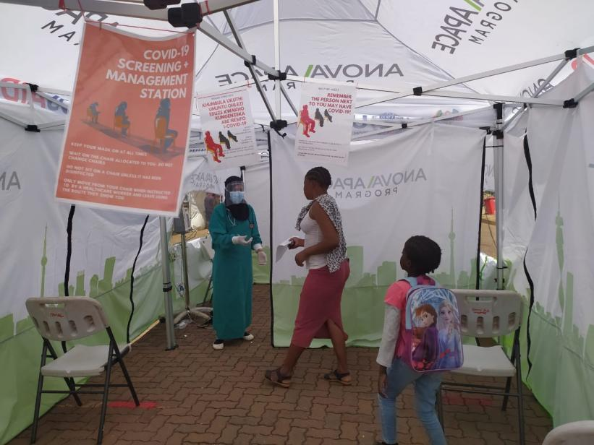
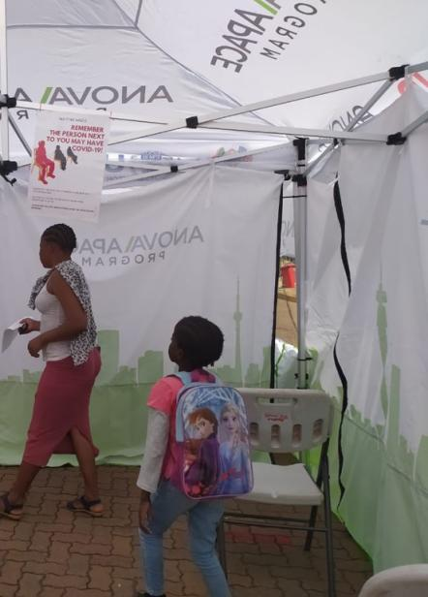
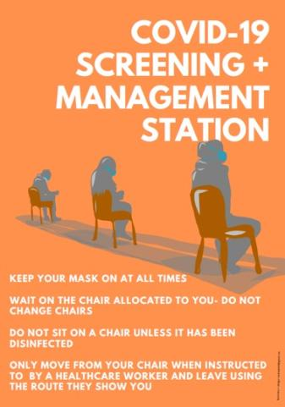

Slide 38
4. SECOND SCREENING & MANAGEMENT STATION Five step screening, assessment and management approach
Assess severity of symptoms and need for Emergency Department /hospital referral
2. Determine need for COVID-19 testing using updated PUI criteria
3. Provide counselling on home isolation and patient information leaflet
4. Ascertain HIV status to determine TB risk (HIV test and collect TB sputum)
5. Determine reason for clinic attendance and manage OR call for specialized clinical services

Slide 39
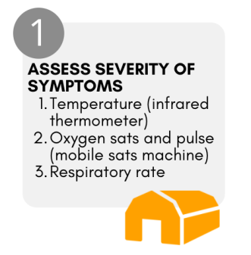
4. SECOND SCREENING & MANAGEMENT STATION Five step screening, assessment & management approach Assess severity of symptoms
1

Slide 40
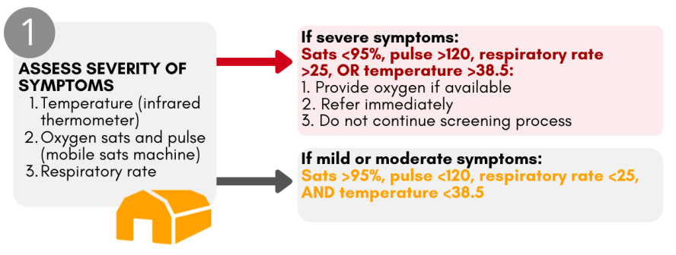
4. SECOND SCREENING & MANAGEMENT STATION Five step screening, assessment & management approach Assess severity of symptoms
1

Slide 41
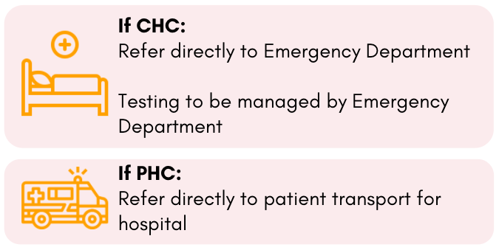
4. SECOND SCREENING & MANAGEMENT STATION Five step screening, assessment & management approach Assess severity of symptoms
1
SEVERE:

Slide 42
4. SECOND SCREENING & MANAGEMENT STATION Five step screening, assessment & management approach Determine need for COVID-19 testing
2

Slide 43
4. SECOND SCREENING & MANAGEMENT STATION Five step screening, assessment & management approach Provide counselling on home isolation
2

Slide 44
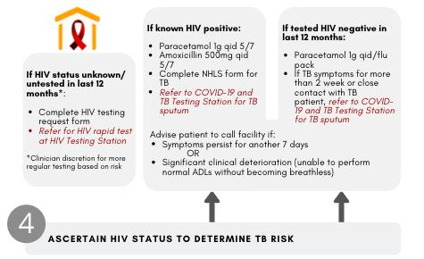
4. SECOND SCREENING & MANAGEMENT STATION Five step screening, assessment & management approach Ascertain HIV status to determine TB risk
4
Notes:
Ascertain HIV status to determine TB risk:
If known positive:
Paracetamol 1g qid 5/7
Amoxicillin 500mg qid 5/7
Sputum jar and form for Ultra - either cough now in safe space or relative to return sputum specimen to facility
If unknown/untested in last 12 months
HIV rapid at 2nd screening station or linked HIV testing gazebo (if not possible assume HIV positive)
Tested HIV negative in last 12 months
Paracetamol 1g qid/flu pack
If known close contact of TB patients send sputum for Ultra
Advise patient to call facility if:
Symptoms persist for another 5 days
Significant clinical deterioration (unable to perform normal ADLs without becoming breathless)

Slide 45
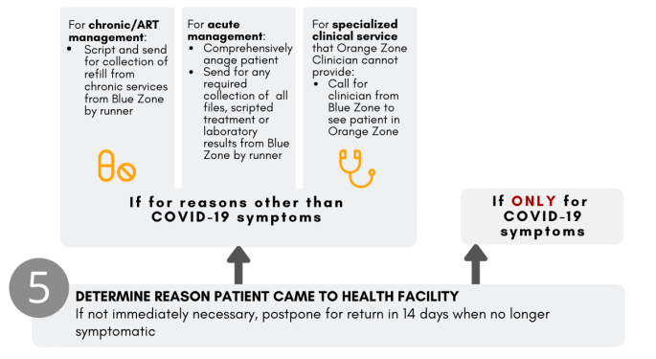
4. SECOND SCREENING & MANAGEMENT STATION Five step screening, assessment & management approach Determine reason patient came to health facility and manage
5
Notes:
If need another health service:
Assess and manage
Runner to collect files, blood results, treatment from pharmacy
Where necessary send runner to collect specialized clinician

Slide 46
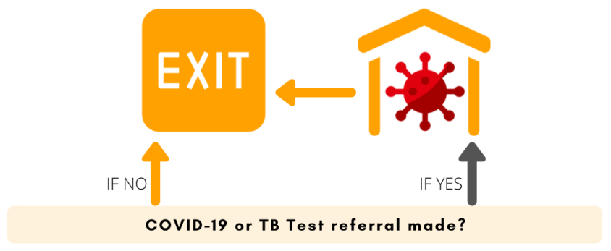
4. SECOND SCREENING & MANAGEMENT STATION Five step screening, assessment & management approach Determine reason patient came to health facility and manage
5
Notes:
If need another health service:
Assess and manage
Runner to collect files, blood results, treatment from pharmacy
Where necessary send runner to collect specialized clinician

Slide 47
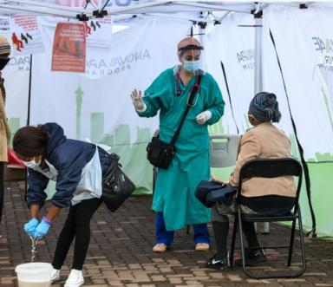
4. SECOND SCREENING & MANAGEMENT STATION (Temporary Chest Clinic)
Cleaning procedures
Cleaned a minimum of three hourly
All chairs must be disinfected between use by patients i.e. no patient should sit on chair that has not been disinfected
The cleaner should disinfect all hard surfaces, including chairs and surrounding floor area with disinfectant
Use bleach/water solution – see Annex 3
Notes:
2nd screening and management station specific cleaning procedures
The 2nd screening and management station should be cleaned a minimum of three hourly.
All chairs must be disinfected between use by patients i.e. no patient should sit on chair that has not been disinfected.
The cleaner should disinfect all hard surfaces, including chairs and surrounding floor area with disinfectant (can use bleach/water solution – see Annex 3)

Slide 48
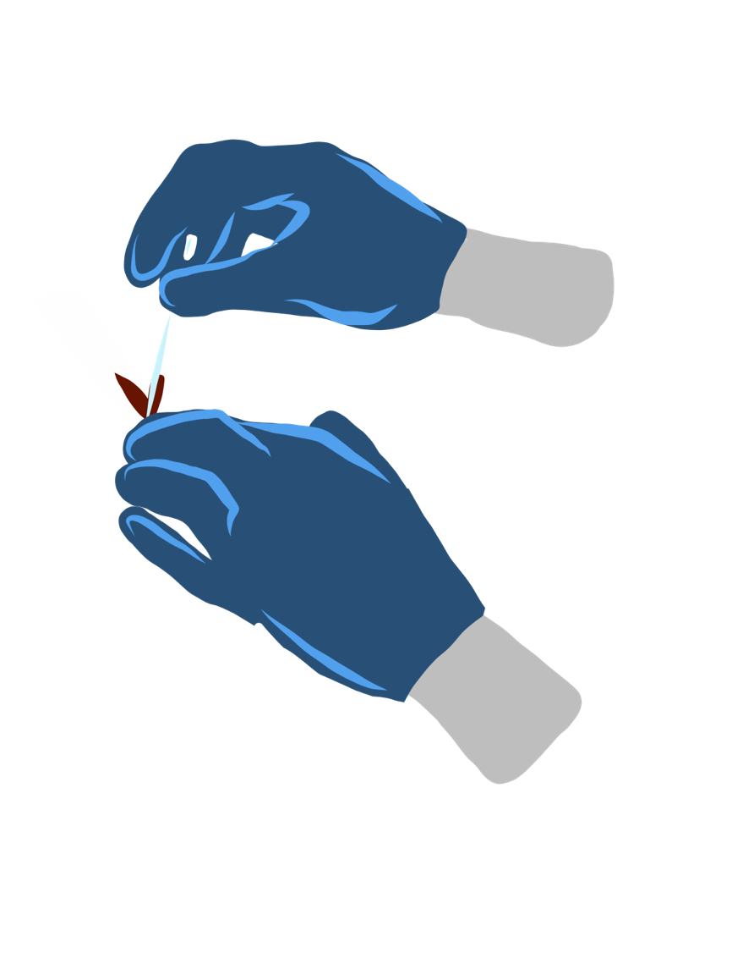
5. HIV Testing Station
ORANGE ZONE
Notes:
HIV testing station

Slide 49
5. HIV Testing Station
Location
Easily accessible from Orange Zone
Staffing
HIV test provider (trained lay healthcare worker)
Station set-up
Separate gazebo with privacy, a small table and 2 chairs
Requires all HIV testing equipment
Station procedure
Disinfect station between every patient
Carry out HIV test for all patients referred from Orange Zone
Note HIV test result on request for test from Orange Zone Clinician. Send back with runner to Orange Zone Clinician for decision on whether TB testing required
Where TB testing required, Orange Zone Clinician to complete NHLS specimen form
Notes:
Location
Easily accessible from 2nd screening and management station.
Staffing
HIV test provider: Trained lay healthcare worker.
Station set-up
Requires separate gazebo with privacy, a small table and 2 chairs and all HIV testing equipment.
Appropriate IPC and PPE use for staff
HIV test provider to wear surgical mask (one per shift), disposable apron (to discard when leaving Yellow/Orange zone in facility or one per shift) and non-sterile gloves to be changed between every patient tested.
Disinfect station between every patient.
Station procedure
Carry out HIV test for all patients referred from 2nd screening and management station.
Note HIV test result on request for test from Orange Zone Clinician and send back with runner to Clinician for decision on whether TB sputum specimen required for testing. Where it is required, Orange Zone Clinician to complete NHLS specimen form for TB test.

Slide 50
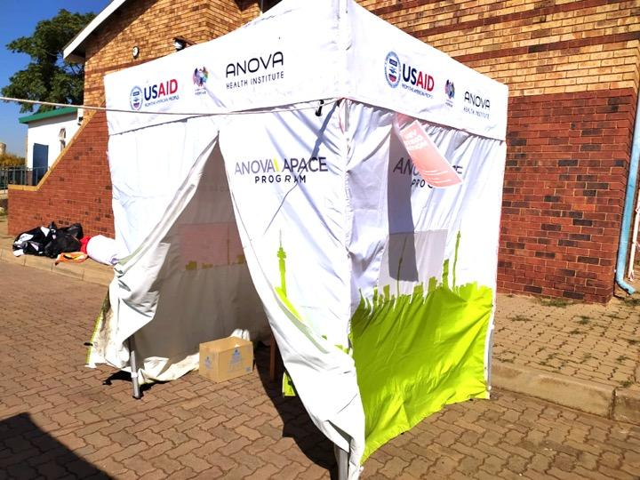
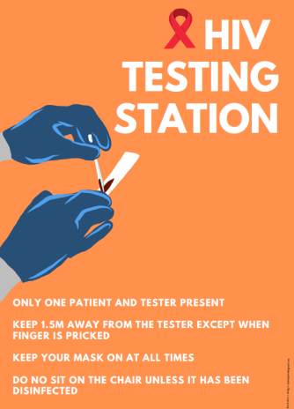
Pic

Slide 51
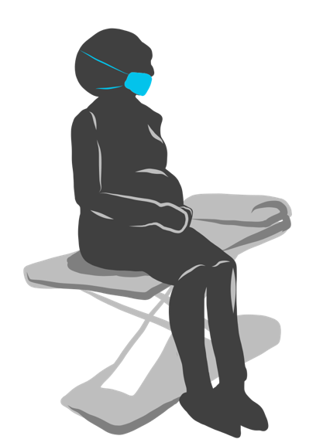
6. Specialized Clinical Service Station
ORANGE ZONE
Notes:
Specialized clinical service station
Location
Easily accessible from 2nd screening and management station. Ideally immediately next to this tent.
Staffing
No permanent staffing. Used by specialized clinician from Blue Zone to see patient for any clinical service that cannot be provided by Orange Zone Clinician e.g. Dentist or complex ante-natal/ART consult.
Station set-up
Requires separate gazebo with privacy, an examination bed and 2 chairs.
Appropriate IPC and PPE use for staff
Specialized clinician to wear surgical mask (one per shift), disposable apron (to discard when leaving Yellow/Orange zone in facility or one per shift) and non-sterile gloves to be changed between every patient examined.
Disinfect station between every patient.
Station procedure
Specific to service provided.

Slide 52
6. SPECIALIZED CLINICAL SERVICES STATION
Location
Easily accessible from Orange Zone
Ideally immediately next to Orange Zone tent
Staffing
No permanent staffing
Used by specialized clinician called from Blue Zone to see patient for any clinical service that cannot be provided by an Orange Zone Clinician
Station set-up
Requires separate gazebo with privacy, an examination bed and 2 chairs
Station procedure
Disinfect station between every patient
Specific to service provided

Slide 53
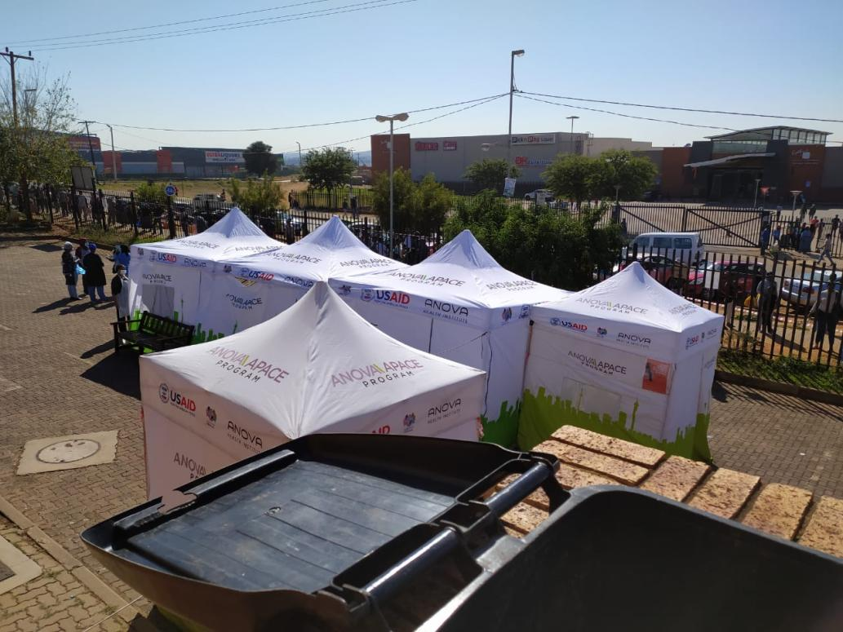
Notes:
COVID-19 and TB testing station
Location
Easily accessible from 2nd screening and management station. Last station before exiting the facility.
Staffing
Testing Clinician: Professional nurse or doctor. This can be the same person as the Orange Zone Clinician in very low volume facility.
Testing station form completers: To complete all the forms (see below). 1-4 lay HCWs or admin clerks depending on volume.
Station set-up
Requires well ventilated space for carrying out COVID-19 test. In order of preference from best to worst option (all adequate)
Separate well ventilated tent/gazebo outside facility building (more than 5m away from any other station). Should have at least 2 sides open for ventillation.
Open air cordoned off external space
Requires space for donning and doffing PPE and table/s for PPE supply and to collate specimen with forms and put in box for lab collection. Can be outside gazebo or in an attached gazebo.
Requires separate space for specimen form completion. Set of chairs and single tables for those staff completing forms. Ideally this would be under cover. Boxes next to tables with blank forms that require completion.
Appropriate IPC and PPE use for staff
Testing Clinician to wear N95 mask, goggles or eye visor, gloves and disposable gown.
Change N95 mask and disposable gown after every shift. Disinfect visor frequently. Change gloves between each patient.
Wash/sanitize hands between every patient
Disinfect station between every patient.
Station procedure
Form Completers to complete the following forms:
PUI form
NHLS lab form
COVID-19 specimen form
Testing Clinician to fetch completed forms when ready to test next patient. Forms should not be given to patient but transferred from Form Completers to Testing Clinician.
Where Orange Zone Clinician has indicated at TB sputum needs to be taken, this can either be taken in Testing Station or appropriate open space away from all staff and other patients.
The Testing Clinician will then take a specimen for COVID testing (see detailed testing procedure in Annex 10) in the following order of preference based on best sensitivity:
Sputum (if patient has a productive cough)
Nasopharyngeal swab
Oropharyngeal swab
TB sputum sample sent by runner to TB section in facility for registration and submission to lab.
COVID-19 specimen to be packed with all forms in box (can be cooler box). If a dry swab i.e. no transport medium does not need to be on ice.
COVID-19 specimens to be collected by courier and sent to lab preferably on the same day but if not possible, can be sent the next day.

Slide 54
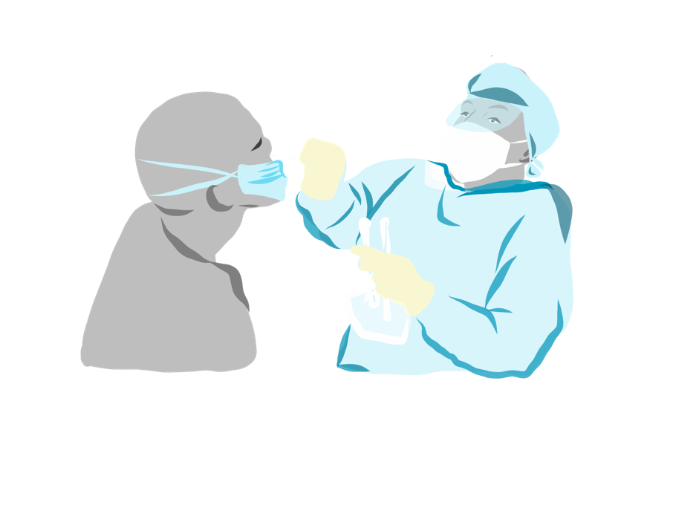
7. COVID-19 & TB Testing Station
ORANGE ZONE

Slide 55
7. COVID-19 & TB Testing Station
Location
Easily accessible from Orange Zone
Last station before exiting the facility
Staffing
Testing Clinician:
Professional nurse or doctor
Can be the same person as the Orange Zone Clinician in very low volume facility
Testing Station Form Completers
Can be lay HCWs or administration clerks
1-4 depending on volume

Slide 56
7. COVID-19 & TB testing station
Station set-up
Space for donning and doffing PPE
Table/s for PPE supply and to collate specimens and forms in box for lab collection
Can be outside gazebo or in an attached gazebo
Separate space for specimen form completion
Set of chairs and single tables for Form Completers
Ideally this should be under cover
Boxes next to tables with blank forms
Well-ventilated space for conducting testing at least 5m away from any other station
and 2 sides open for ventilation

Slide 58
COVID-19 & TB testing station
Notes:
Appropriate IPC and PPE use for staff
Testing Clinician to wear N95 mask, goggles or eye visor, gloves and disposable gown.
Change N95 mask and disposable gown after every shift. Disinfect visor frequently. Change gloves between each patient.
Wash/sanitize hands between every patient
Disinfect station between every patient.

Slide 59
7. COVID-19 & TB Testing Station
Station procedure
Form Completers to complete forms
Testing Clinician to fetch completed forms when ready to test next patient
Forms transferred from Form Completers to Testing Clinician
COVID-19 detailed testing procedure at link or in Annex 9 of Guidelines
Sputum (if patient has a productive cough)
Nasopharyngeal swab
Oropharyngeal swab
TB sputum take in Testing Station or in safe open space away from others
TB sputum sample to TB section in facility for registration and submission to lab by runner
COVID-19 specimen to be packed with all forms in box (can be cooler box). If a dry swab does not need to be on ice
COVID-19 specimens to be collected by courier for lab on same or next day
Notes:
Form Completers to complete the following forms
Testing Clinician to fetch completed forms when ready to test next patient. Forms should not be given to patient but transferred from Form Completers to Testing Clinician.
Where Orange Zone Clinician has indicated at TB sputum needs to be taken, this can either be taken in Testing Station or appropriate open space away from all staff and other patients.
The Testing Clinician will then take a specimen for COVID testing (see detailed testing procedure in Annex 9) in the following order of preference based on best sensitivity:
Sputum (if patient has a productive cough)
Nasopharyngeal swab
Oropharyngeal swab
TB sputum sample sent by runner to TB section in facility for registration and submission to lab.
COVID-19 specimen to be packed with all forms in box (can be cooler box). If a dry swab i.e. no transport medium does not need to be on ice.
COVID-19 specimens to be collected by courier and sent to lab preferably on the same day but if not possible, can be sent the next day.

Slide 62
10. Exit Pathways and Orange Exit
Orange pathways need to be set up from:
2nd Screening and Management Station to:
COVID-19 and TB Testing Station
Patient transport
Emergency Department (Orange Isolation Room)
Orange Exit
COVID-19 and TB Testing Station to Orange Exit
Marked on the ground by orange arrows
Cordoning tape to block off areas that should not be entered
Cordoning tape to create corridors of one-directional movement

Slide 63
10. Exit Pathways and Orange Exit

Slide 64
Patients with a NEGATIVE SCREEN directed to the
BLUE ZONE
Notes:
Low COVID-19 risk zone – patients without COVID-19 symptoms (but may be asymptomatic) managed in this zone.
All routine services in facility building are Blue Zone. This includes registry, vitals station, outpatients department, ante-natal services, family planning services, mother and child services, chronic care services including ART services, HIV testing services, TB services, emergency department (other than isolation room), maternal and obstetric unit (other than isolation room), dentistry, ophthalmology and other routine health services.
Patients without COVID-19 symptoms are triaged into the Blue Zone and do not enter the Orange Zone under any circumstances.
Strict social distancing (patients queuing and seated 1.5m apart) essential.

Slide 65
10 essential components of facility set-up
BLUE ZONE

Slide 66
8. Healthcare Worker Sanitation Station
BLUE ZONE
Notes:
Low COVID-19 risk zone – patients without COVID-19 symptoms (but may be asymptomatic) managed in this zone.
All routine services in facility building are Blue Zone. This includes registry, vitals station, outpatients department, ante-natal services, family planning services, mother and child services, chronic care services including ART services, HIV testing services, TB services, emergency department (other than isolation room), maternal and obstetric unit (other than isolation room), dentistry, ophthalmology and other routine health services.
Patients without COVID-19 symptoms are triaged into the Blue Zone and do not enter the Orange Zone under any circumstances.
Strict social distancing (patients queuing and seated 1.5m apart) essential.

Slide 67
9. Routine Services
BLUE ZONE

Slide 68
All routine services in facility building fall inside the Blue Zone, including:
Registry
Vitals station
Outpatients Department
Ante-natal services
Family planning services
Mother and child services
Chronic care services including ART services
HIV testing services
TB services
Emergency Department
Maternal and Obstetric Unit
Dentistry
Ophthalmology
other routine health services

Slide 69
Routine services
Wherever possible, reduce the number of service points that patients need to visit
Wherever possible reduce amount of time spent at the facility
At all places where patients are required to queue, patient seating to be marked to ensure 1.5m social distancing while sitting
Every seat in the entire facility should be marked
This should be managed by queue marshals and all staff working in area to ensure patient compliance
Notes:
Appropriate IPC and PPE use for staff
Current guidelines – see Annex 12: Healthcare worker staff coming into contact with patients WITH NO COVID-19 symptoms: Cloth mask (washed daily) and hand sanitize/wash regularly.
Where facility has sufficient PPE stock: Apply the following also for patients WITH NO COVID-19 symptoms:
Healthcare staff coming into contact with patients, wear surgical mask (one per shift).
For healthcare workers examining patients, disposable apron and non-sterile gloves. Discard non-sterile gloves and apron after each examination and hand sanitize.

Slide 73
Chronic treatment/ART refill
Implement fast-track system
Stop all group interaction with patients, manage one at a time
Consider setting up treatment refill station outside main facility building but still in the Blue Zone
(see NDOH “Response to reduce risk among HIV and TB patients within the context of the COVID-19 South African response)

Slide 74
10. Exit Pathways and Blue Exit
Staffing
Not essential but helpful to manage correct usage
Set-up
Marked on the ground by orange arrows
Cordoning tape to block off areas that should not be entered
Cordoning tape to create corridors of one-directional movement
Blue pathways need to be set up from:
All routine clinical services to Blue Exit
Also use Blue Pathways to create corridors of one-directional movement through the health facility building in the Blue Zone

Slide 75
10. Exit Pathways and Blue Exit
Notes:
Add slide with diagram

Slide 76
Impact of facility preparedness for PLHIV attending health facilities
Triaging and separating PLHIV based on COVID-19 symptoms
Protects PLHIV from infection while at the facility
Ensures HIV testing for those not tested
Prioritizes TB screening and diagnosis
Ensures appropriate assessment, management and access to treatment for PLHIV with COVID-19 symptoms and/or TB symptoms in a safer clinic environment
Ensures routine service delivery to PLHIV without symptoms in a safer clinic environment

Slide 77
ART patients attending health facilities screening POSITIVE for COVID-19 symptoms
Assessed and managed within separate designated area
ART clinical/rescript: Clinician see patient with patient with folder
Severity of symptoms/need for COVID-19 testing
If coughing Investigate for TB
ART refill only: Lay HCW working in this area collects ART refill and brings it to ART patient
Patient counselled to isolate, contact facility by telephone/come back to facility if condition deteriorates.
Patient contacted to return if TB diagnosed for TB management
PLHIV 1.5m apart + surgical mask

Slide 78
PLHIV attending health facilities screening NEGATIVE for COVID-19 symptoms
Shortest possible time at facility Fewest service points possible
ART clinical/rescript/VL:
No need to attend registry/vitals
Folder already within clinician
If stable: enrol in out-of-facility DSD model
6m script + longest ART refill possible
PLHIV queue 1.5m apart preferably outside – managed individually (NO group interactions)
ART refill only:
Can set up external refill collection point operated by lay HCW OR Fast lane pick up in facility building
For all PLHIV not only stable
Longest ART refill possible

Slide 79
What did it take to achieve change? 3 days of technical support
Identify model CHC
2-3 hour on-site training session with walk around facility to identify changes needed – at CHC invited all PHCs
Ensuring required equipment on-site at CHC especially tents, tables and chairs, PPE and test kits
1 day set up:
station set up with facility staff
station duty allocation with facility manager/clinical lead/OTLs
1.5 days running patient flow with facility team
Review end of each day to continue consensus building, solutions to challenges, implement changes
Ongoing technical support monitoring

Slide 80
How to prepare hospitals 10 Components + 4

Slide 81
Hospital set-up Emergency Department with dedicated COVID-19 area

Slide 82
Hospital set-up COVID-19 PUI Ward and Non COVID-19 Ward

Slide 83
Hospital set-up COVID-19 PUI Ward

Slide 84
Hospital set-up Confirmed COVID-19 Ward

Slide 85
Hospital set-up Non COVID-19 Ward

Slide 86
VIDEO: COVID-19 hospital preparedness
https://youtu.be/iH3CM9Wf1Sw

Slide 87
Acknowledgements
Dr Tom Boyles
Prof Shabir Moosa
Dr Madeleine Muller
Prof Richard Cooke
Teams at 6 model CHC sites in Johannesburg district
Dr Jean Elphick (illustration and design)
Dr Anna Grimsrud (slide & webinar support)
Chris Collingridge, Barry Christianson (photography)

Slide 88
Thank you & stay safe

