Slide 1

Differentiated Care across the Cascade: Experiences from Zimbabwe
Dr. Tsitsi Apollo
Zimbabwe Ministry of Health and Child Care
IAC, July, 2016
Durban

Slide 2
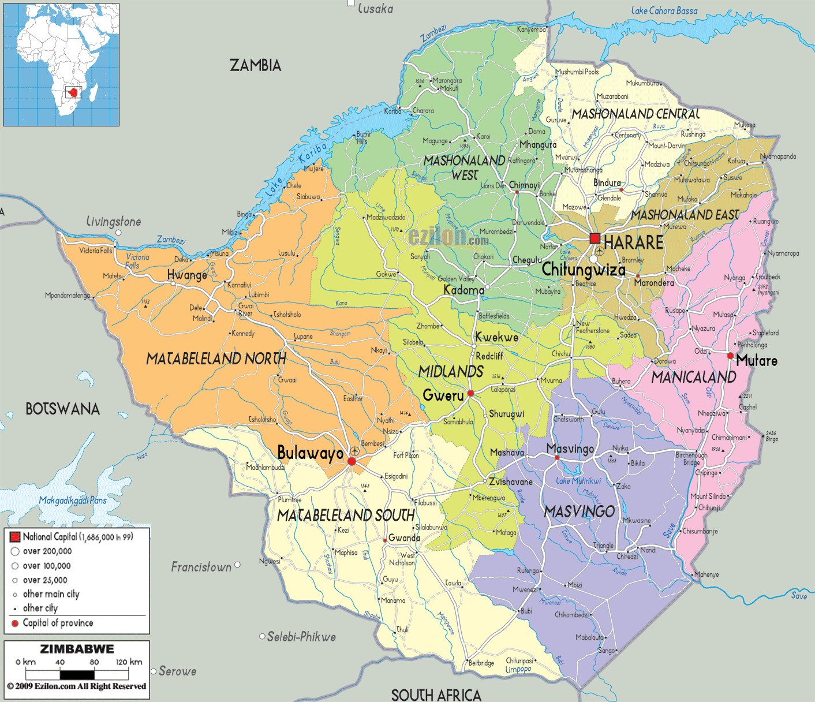
Presentation Outline
Background
Differentiated care model in Zimbabwe
Conclusion
Rationale
Critical Enablers

Slide 3
Background:
Zimbabwe population: 13 million
Generalized HIV epidemic with prevalence: 14.7%
HIV incidence: 0.88%
# of PLHIV: 1,4 m including 77,000 children
High TB/HIV co-infection rate: 69%

Slide 4
Background:
Number of PLHIV on ART: 891,621 (March, 2016)
  Adults coverage (61%)
  Children coverage (80%)
Retention on ART at 12 months
  Males 87%
  Females 88%
Viral Suppression: 89,5%at 12 months (HIV DR Resistance Survey, 2012)

Slide 5
Rationale for Differentiated Care:
PLHIV present with different needs
Health facilities over-stretched due to large volumes of relatively asymptomatic PLHIV who need care
Limited human resources, space and supplies

Slide 6
Process:
Stake-holder Consultation & Developed Operational & Service delivery Manual in 2014
Piloted the OSDM in five sites for 6 months
Review progress at pilot sites
Sensitization of provincial teams
Rollout to district and health facilities
Oct, 2014 –March, 2015
June, 2015
August, 2015
April, 2015
July, 2014

Slide 7
-Developed to support the implementation of the WHO 2013 HIV Guidelines
-User-friendly and clearly articulates the ‘how to’ deliver services
-Defines the minimum package across the prevention, treatment and care cascade
-Defines roles and responsibilities of the different cadres including community
-Identifies operational strategies that aim to address leakages in the cascade
-Highlights special considerations for children, adolescents, pregnant and lactating women

Slide 8
Differentiated ART Delivery:
Service Intensity
Service Frequency
Service Location
Health worker
Four levels to adapt care to people’s needs
Source: C. Duncombe Frame-work to delivering HIV care and treatment (TMIH, April 2015)

Slide 9
1. Service Intensity:
Refills:
  Individual refill from pharmacy
  Family ‘ART’ Group’ refill
  Group ‘club’ refill
  Community ART Group refills
Involvement of networks of PLHIV in the determination of appropriate models and development of standard tools for implementing differentiated care
Provision of different service package according to the health status of the patient
  Patients with low CD4 cell count <100 cells/mm3
  ART Initiation
  Lab test
    Haemoglobin for AZT
    Creatinine clearance for TDF
Constraints: Integration of HIV management with co-morbidities such as HTN, DM and limited M and E tools for tracking ‘differentiated care’

Slide 10
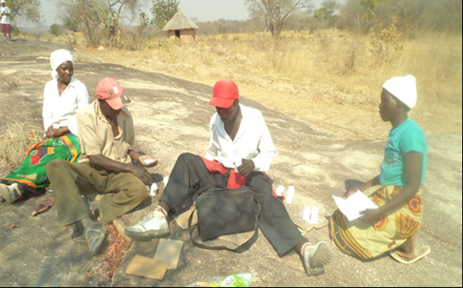
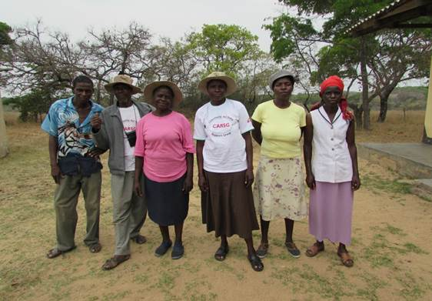
Community ART refill groups
Model
self-selecting patient groups (6-12)
one representative picks up ARVs for the group on quarterly basis
group contribute money for transport/ lunch/in kind support (eg work their fields)
Results: 9 months pilot evaluation (n=207)
100% retention, 99% virally suppressed
Time saving: normally 45mins waiting, 50 mins with staff (nurse, counsellor, pharmacist); ART refill groups: 30 mins to serve 8 patients
Secondary benefits in increased resilience, reduced stigma, more participation in health governance.
Source: MSF, 2014

Slide 11
2. Service Frequency:
Stable adult clients on ART being monitored clinically +/- immunologically are seen 6 monthly for clinical visits
A stable client is defined as one with
  no concurrent illness
  has a VL < 1,000 copies/ml
  at least 6 months on ART
Clinics schedule 3-monthly refill visits
Appointment diaries +/- electronic patient management system- generated appointment lists in use to support tracking of clients and defaulters
Infants are followed up monthly until 18 months, thereafter 3-monthly
Children are seen 3-monthly until transitioned to adult ARV doses with 6-monthly visits
BF & PW have their clinic visit schedule synchronized and integrated into MNCH services
Constraints/Gaps: Effective tools & HR for triaging clients, paediatric ART not fully decentralized hence limiting service access; need for secured ARV pipeline

Slide 12
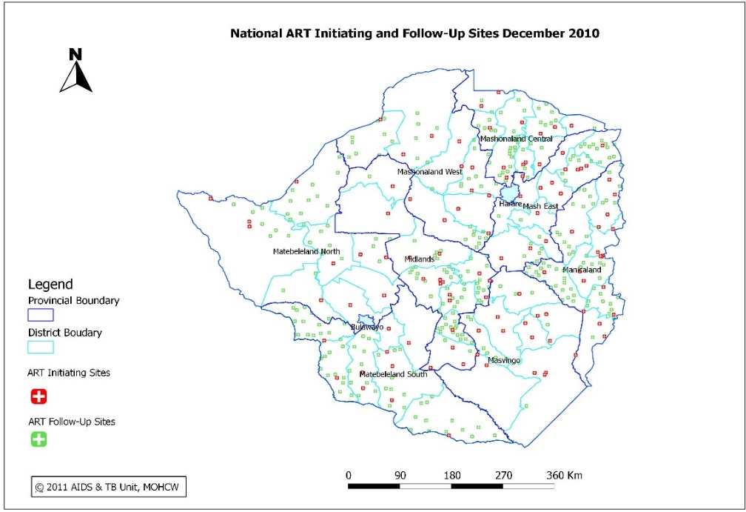
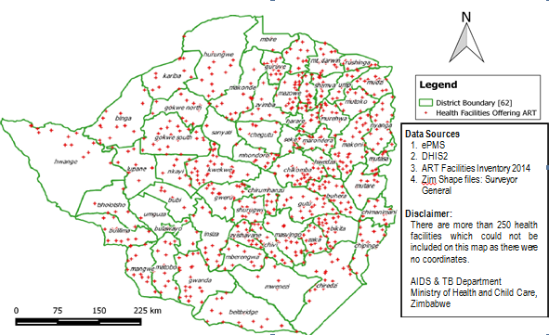
3. Service location:
Decentralization of ART services
Integration of ART/TB services
  Easier at lower level facilities
  Strong referral systems required at higher levels
Offering PMTCT services in MNCH platform
Community-level services
  CSS Framework for health sector being developed
  Community worker’s role in adherence and psychosocial support and defaulter tracking
National Health Strategy has provision of establishment of ‘Health Posts’
Constraints: TB Infection control, space

Slide 13
4. Type of Health Worker:
Primary Care Nurses: lower level cadres (18 month training post O-Level education); manning primary care clinic
Primary Counsellors: Lay counsellors (9 month training); conduct HTS services including RDT for HIV
Community health workers:
  Village Health Workers
  Over 87,000 community healthy workers
  77 different types of community cadres
Capacity building of HR: HIV Integrated training package (supports provision of integrated services eg TB/HIV, HIV/SRH), psychosocial support for children & adolescents LHIV
Constraints: Inadequate numbers of HRH; freezing of government posts, lack of harmonized incentives for community workers

Slide 14
Patient:
Children
Adolescents
Pregnant and Breast-Feeding Women
Men
Key Pops: SW, Prisoners, Migrant Workers
Stable on ART
Unstable on ART
Well patients
Late Presenters

Slide 15
Critical enablers:
Explicit national guidelines/SOPs on ‘Differentiated Care’
Engage with key stakeholders especially networks of PLHIV for demand creation
Secure adequate resources for
  sensitization & training
  buffer stock of medicines
Develop an M & E plan
  Monitoring tools
  Consider integration with quality improvement initiatives

Slide 16
Conclusions:
Differentiated care is anticipated to :
  Provide targeted interventions to specific type of patients who would otherwise not have their needs fully met
  Foster ‘patient-centric’ or ‘patient-oriented’ care delivery models
  Alleviate the burden on the already overstretched health system
Need to identify strategies to address retention among ‘well patients’

Slide 17
I Thank You

