Slide 1


Slide 2


ART Adherence Clubs
South Africa
August 2014

Slide 3
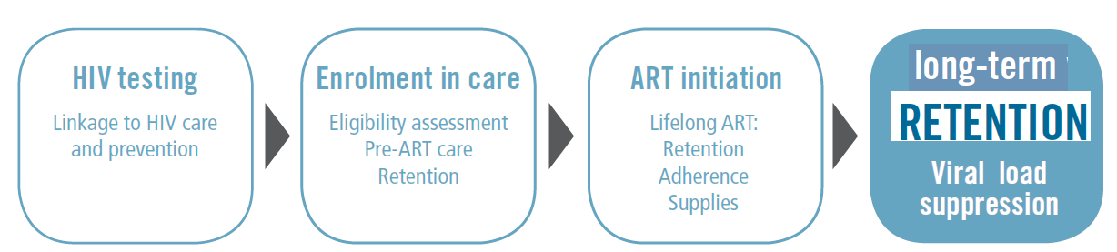
Which gap in the cascade?
WHO (2013). Global update on HIV treatment 2013: Results, impact and opportunities

Slide 4
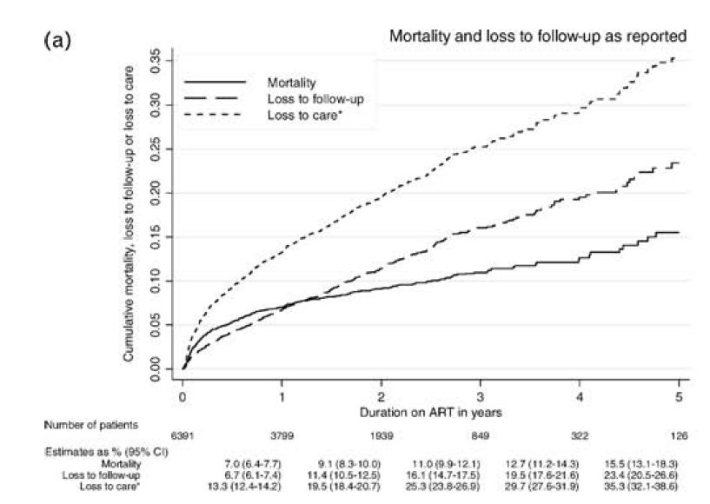
Growing losses to ART care
Boulle et al (2010)
Notes:
Boulle A, Van Cutsem G, Hilderbrand K, Cragg C, Abrahams M, Mathee S et al. (2010). Seven-year experience of a primary care antiretroviral treatment programme in Khayelitsha, South Africa. AIDS, 24, 563-572.

Slide 5
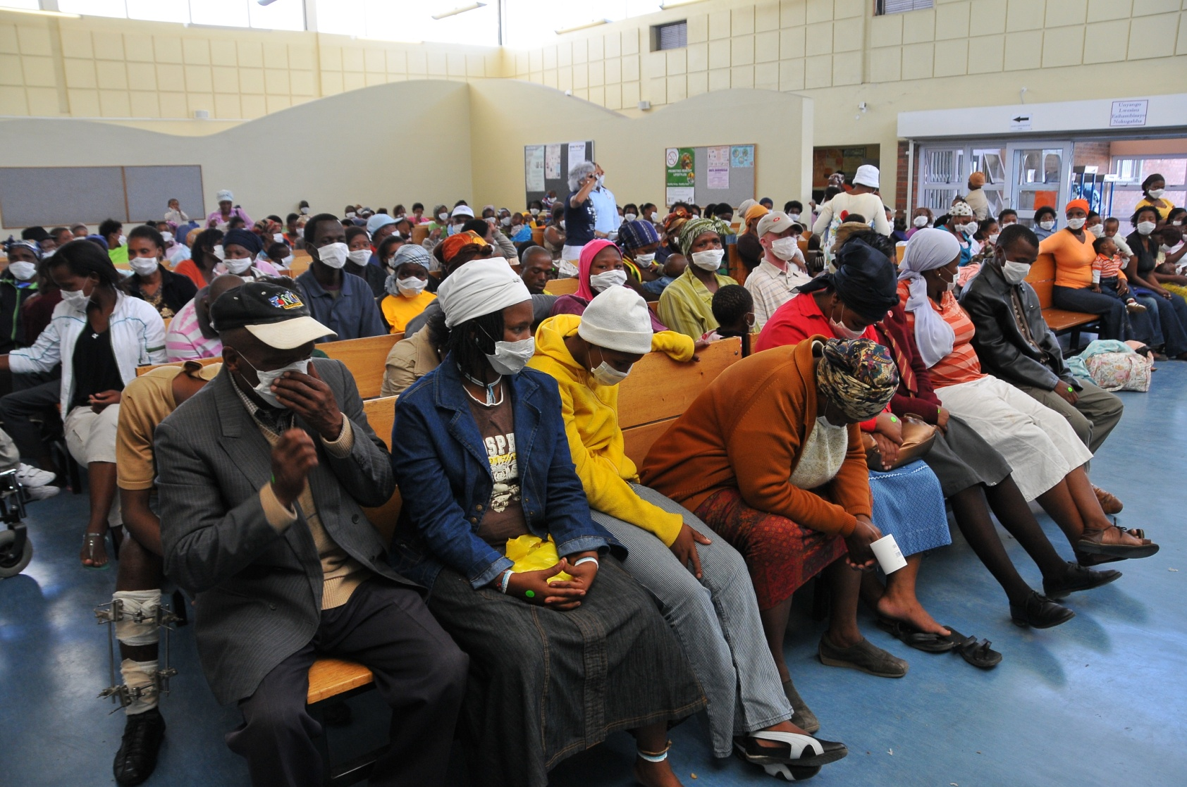
Congestion…
Queue for folder
Queue for triage
Queue for clinician
Queue for bloods / other?
Queue for pharmacy
Notes:
And looking at the congestion, most of the time the person is in the clinic is queuing for something.

Slide 6


Slide 7
What are ART clubs in a nutshell?
Quick service option for groups of 30 stable ART patients
Run by lay HCW = “club facilitator”
Nurse supported from clinic
Held at clinic/in community venues

Slide 8
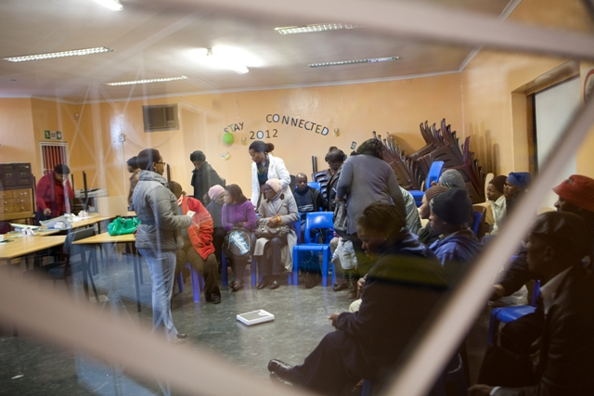
How do ART clubs work?
  Every 2 months:
  Quick clinical assessment
  (referral if required)
  Collection of 2 month ART supply
  Quick optimized group support
  Every 2 months:
  Sees referrals
  Once a year:
  Blood taken for CD4 and VL
  Clinical consultation
Nurse supported
Lay HCW run

Slide 9
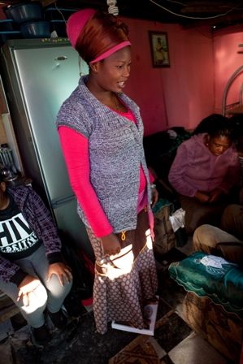
Who qualifies?
Adult (also child/youth versions)
On the same ART regimen for at least 12 months (regimen 1 or 2).
2 most recent consecutive viral loads = LDL
No medical condition requiring regular clinical consultations.

Slide 10
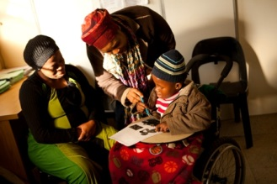
How allocated?
Clinician confirms qualification for club
Lay HCW allocates – considering whether any specific group patient wants to join/where patient resides/family members in any club
Can switch clubs

Slide 11
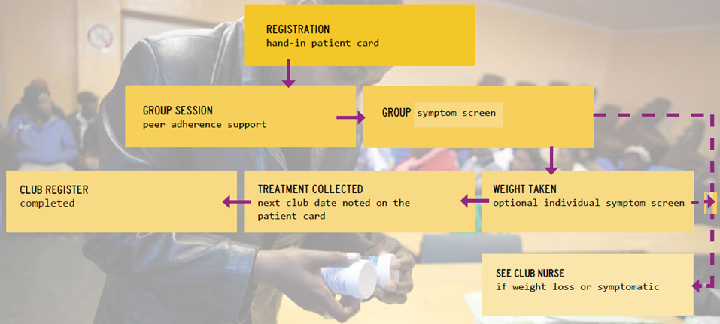
Club session

Slide 12

Buddy support/
Club exit
  Patient can send buddy if cant attend
  Patient exit club returning to clinic care if:
    misses club visit (5 day grace period)
    Becomes clinically unstable including high viral load
  Requalify for club if VL LDL/clinically stable again

Slide 13

Club
M&E
Lay HCW completes paper register at club visit: records ART dispensed, weight, symptomatic, club exit
Paper register data captured into clinic electronic register

Slide 14

Early challenges & lessons learnt
Club size: Max 30 patients
Dispensing regulatory issues: Lay HCWs distribute already dispensed ART
Club paper registers: Limit fields, support completion and monitor
Club patient responsibility: Buy-in from all clinic staff – these remain their patients
Facility club organogram: Identified roles and responsibilities beyond running the club
Limited benefit perceived by pharmacy staff: engage actively

Slide 15

Pilot outcomes
97% (club) vs 85% (clinic) RIC of patients who qualified for clubs over 40 months
67% less virological rebound
        Luque-Fernandez, M.A.et al. 2013. Effectiveness of patient adherence groups as a model of care for stable patients on antiretroviral therapy in Khayelitsha, Cape Town, South Africa. PLoS One, 8, e56088

Slide 16
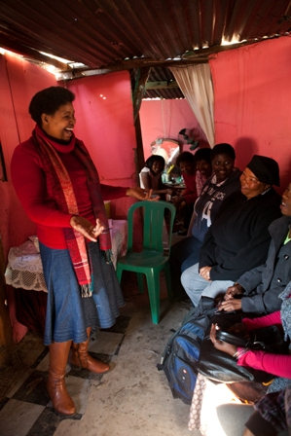
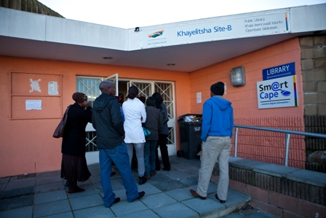

Phased approach
Patient preference remains…
Facility based clubs
Community venue based clubs (close to clinic)
Community venue/home clubs

Slide 17

Child and adolescent versions
Both facility based
Child model additions:
  Family membership
  Disclosure integration: age specific
Adolescent:
  Combined pre-ART, early ART and stable ART patients in group
  Integrated family planning
  Increased focus on support components

Slide 18
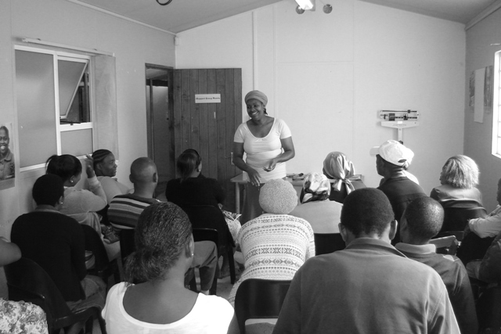
From pilot to Western Cape DOH scale out

Slide 19
27 800 patients
retained in club care

Slide 22
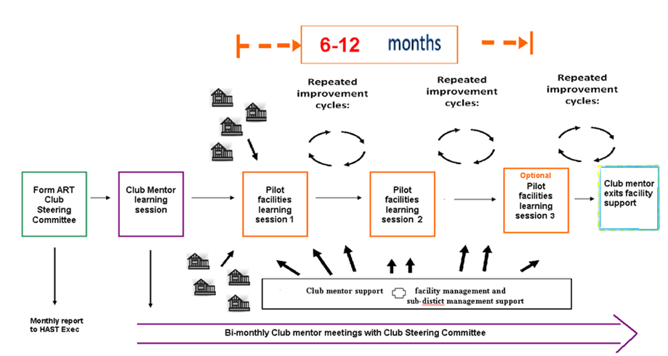
Scale out approach
Wilkinson, L.S. 2013. ART adherence clubs: A long-term retention strategy for clinically stable patients receiving antiretroviral therapy. Southern African Journal of HIV Medicine, 14, 48-50.
Notes:
22

Slide 23
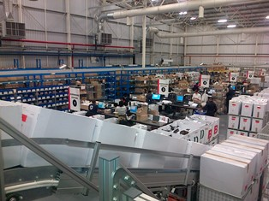
Club model developments
Inclusion of club component into clinic electronic databases (eKapa/tier.net)
Use of centralised chronic dispensing unit for packing ART scripts for clubs
FDCs for clubs
Activism/watchdog role strengthened by club membership
4 month supply to clubs over year end to support annual circular migration + travel planning in clubs

Slide 24

Scale out enablers
Partnership recognition: received national social innovation award
Learning session approach to gain buy-in of entire facility team
Supported by toolkit development and availability
Ongoing mentorship support beneficial
Regular feedback of results/outcomes to club teams motivating
Facility/sub-district ownership increased by early reporting responsibilities on club outcomes
Value of DOH setting and monitoring facility based targets for club enrolment quarterly

Slide 25
Scale out challenges
3 month club cycle desirable from outset
>40 clubs per facility + new patient intake pressure
require more HR (lay HCW and management of club system)
6m scripting requirements = regulatory obstacles
Reliable drug supply critical for clubs
Ongoing monitoring support for capturing of club data into facility electronic M&E system necessary

Slide 26

Resource material

Slide 27



