Slide 1
Differentiated models of ART delivery -
The Decision Framework and online knowledge repository
Anna Grimsrud, PhD
International AIDS Society
It’s time to deliver differently:
Country experiences of differentiated ART delivery
18 July 2016
Notes:
how differentiated models of care can help make test & start a reality so that we reach more people earlier in their disease progression and fit treatment into people’s lives, rather than the other way around. So this would be a ‘roundup’ of the operational strategies for decentralization of testing and linkage and treatment as well as a short summary of evidence to support them.

Slide 2
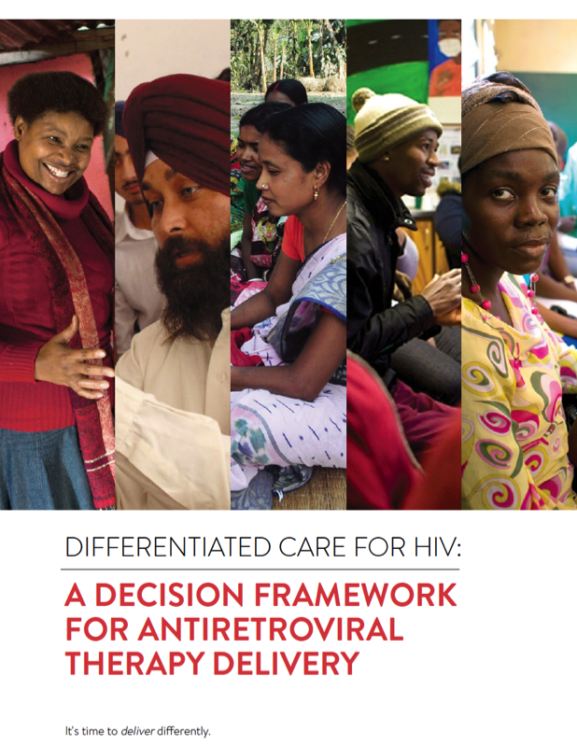

Slide 3

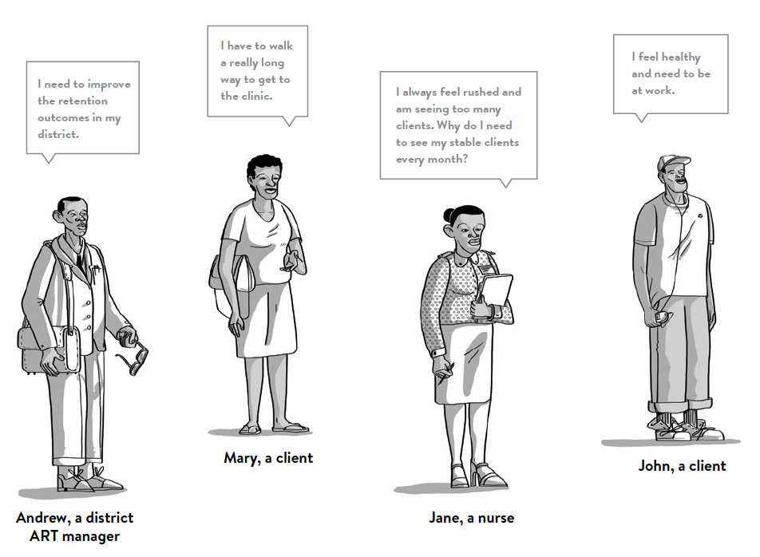

Slide 4

Differentiated care
is a client-centred approach that simplifies and adapts HIV services across the cascade to reflect the preferences and expectations of various groups of people living with HIV (PLHIV) while reducing unnecessary burdens on the health system.

Slide 5
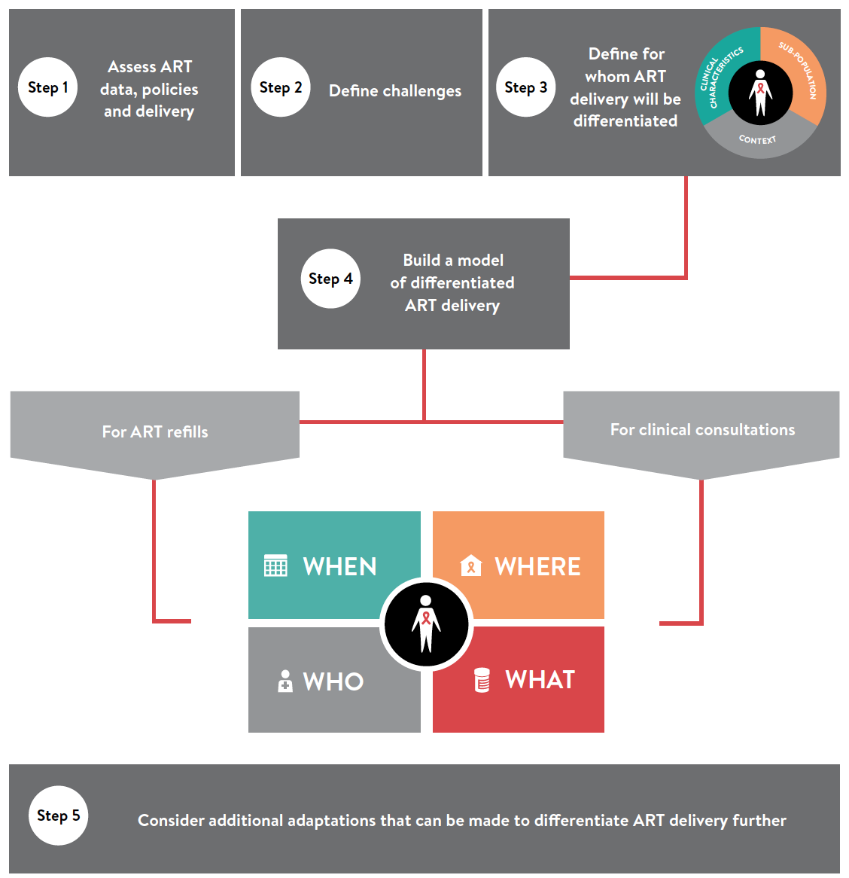

Slide 6
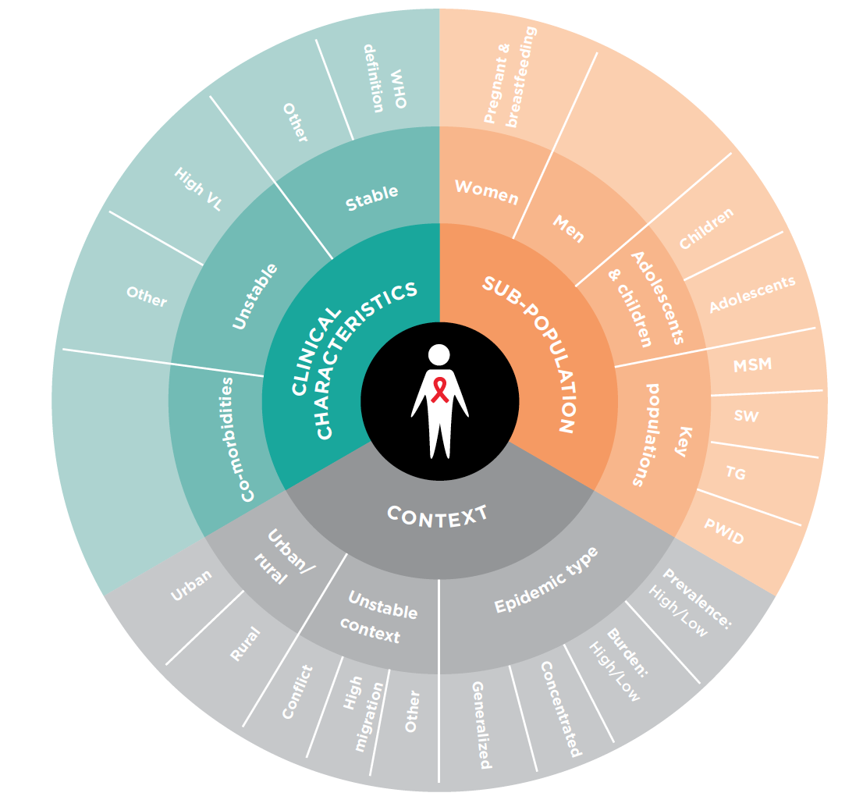
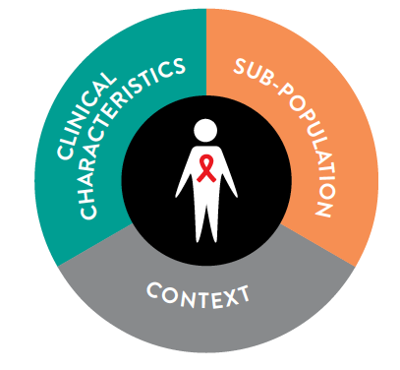
The three elements

Slide 7

The building blocks

Slide 8
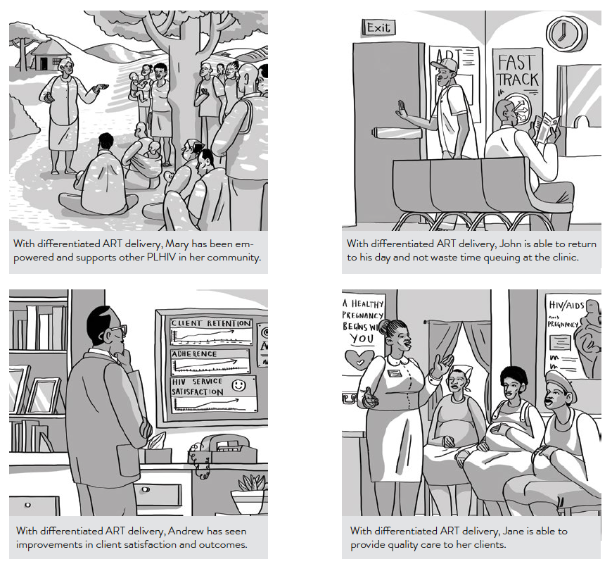

Slide 9

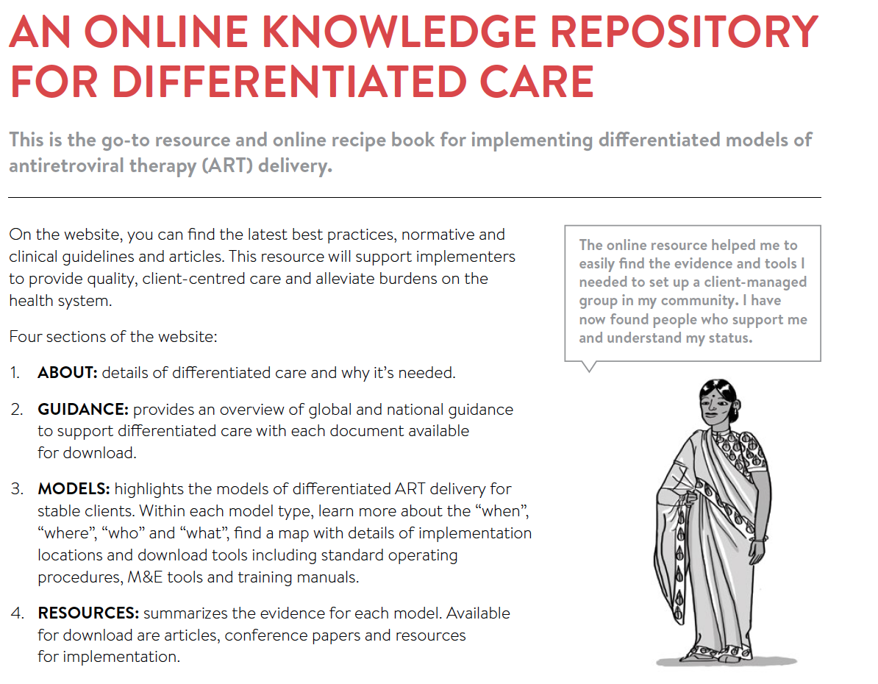


Slide 10
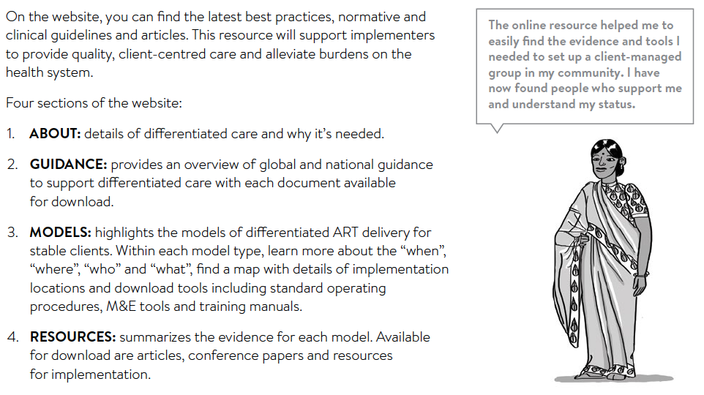

Slide 11

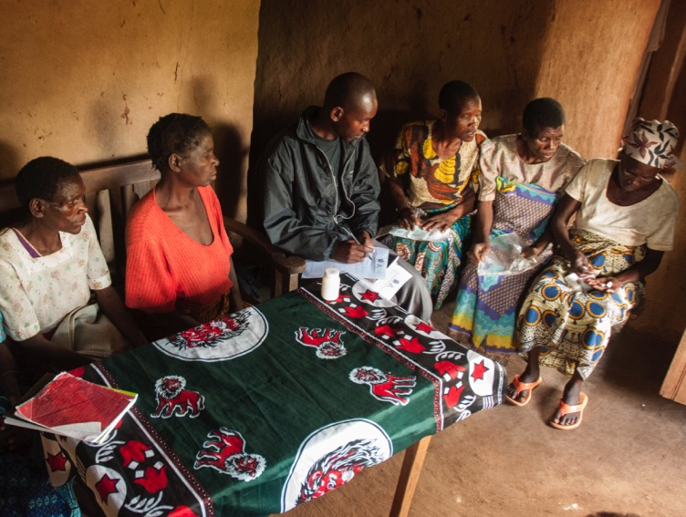


Health care worker-managed group
Client-managed group
Facility-based individual
Out-of-facility individual

