Slide 1
Reaching Treatment for All: Developing a Package of Differentiated Care
Anna Grimsrud, PhD
International AIDS Society
Reaching Treatment for All:
Developing a package of differentiated care
18 July 2016
Notes:
8 minutes
-A brief review of the rationale and concept behind differentiated care
-How can differentiated models of care be flexible to meet different context and program needs?
-How do differentiated models of care provide improved quality care to both patients who are doing well on treatment and those who are not?

Slide 2
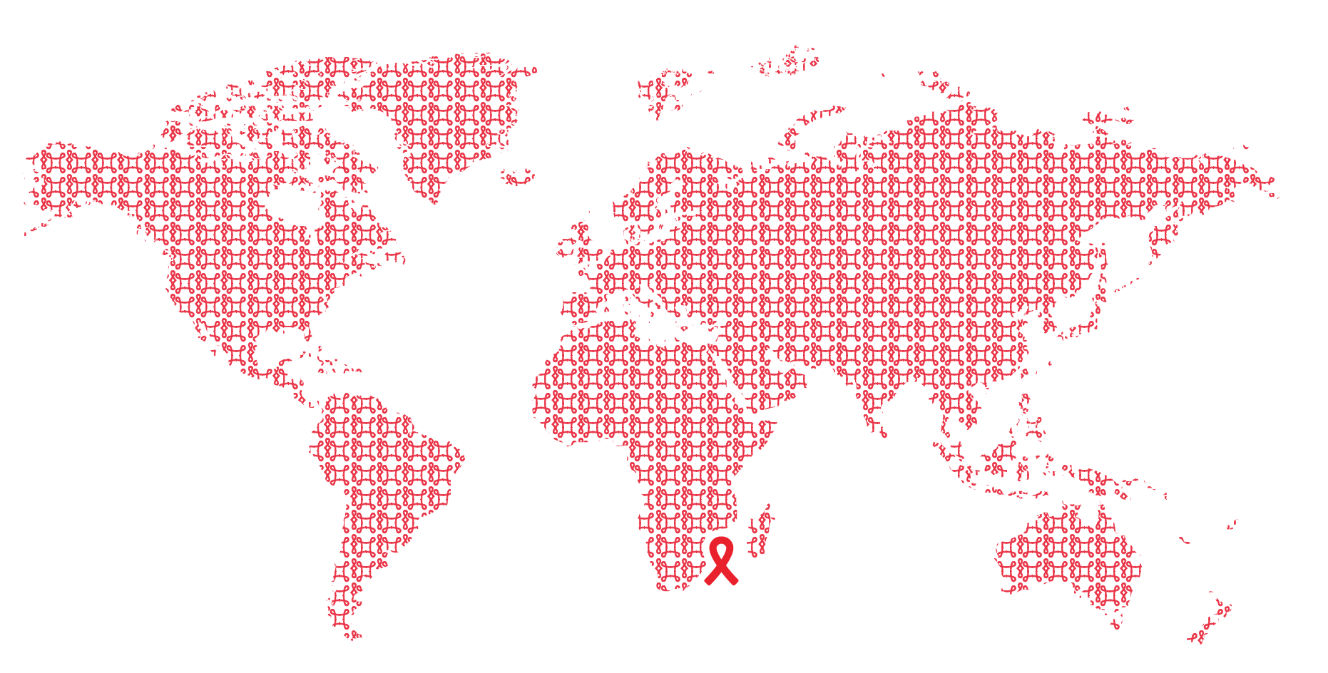
What is differentiated care?

Slide 3

Differentiated care
is a client-centred approach that simplifies and adapts HIV services across the cascade to reflect the preferences and expectations of various groups of people living with HIV (PLHIV) while reducing unnecessary burdens on the health system.

Slide 4


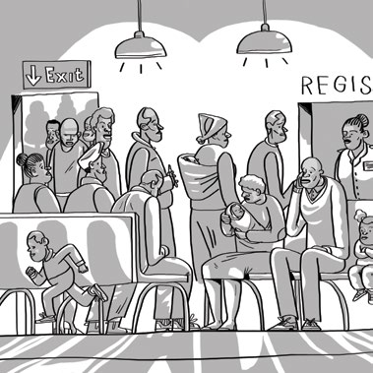
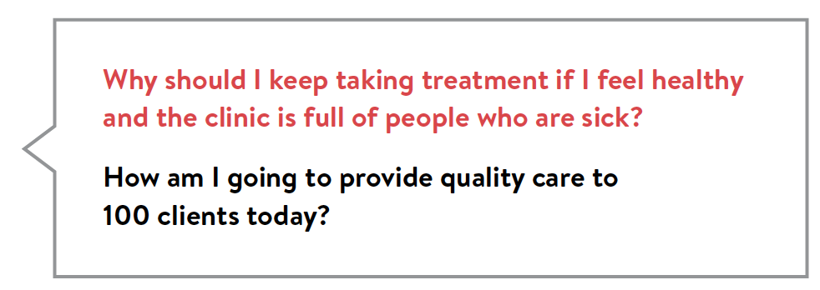
Why it’s time to deliver differently

Slide 5
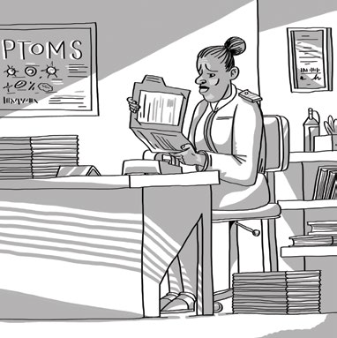
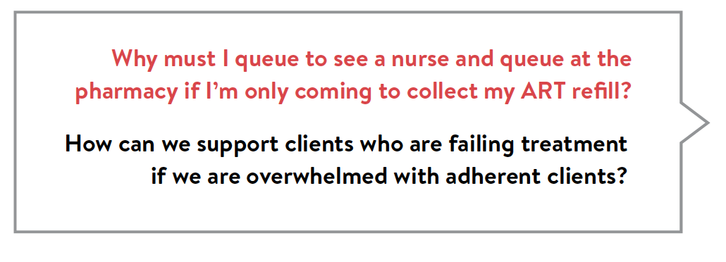
Why it’s time to deliver differently

Slide 6
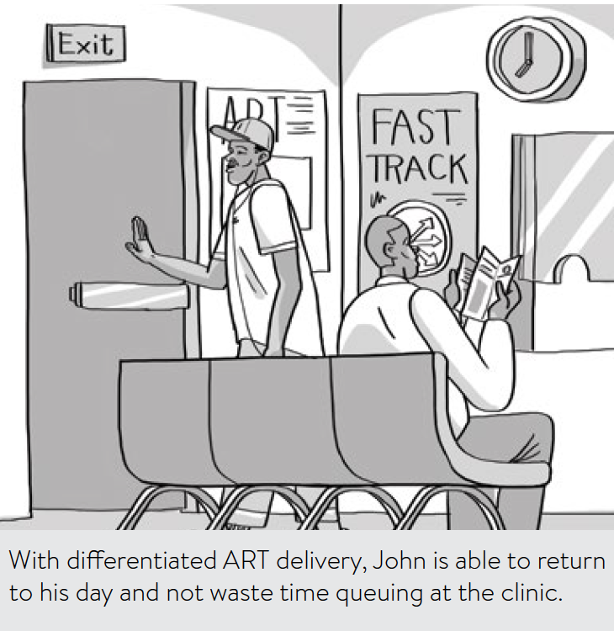
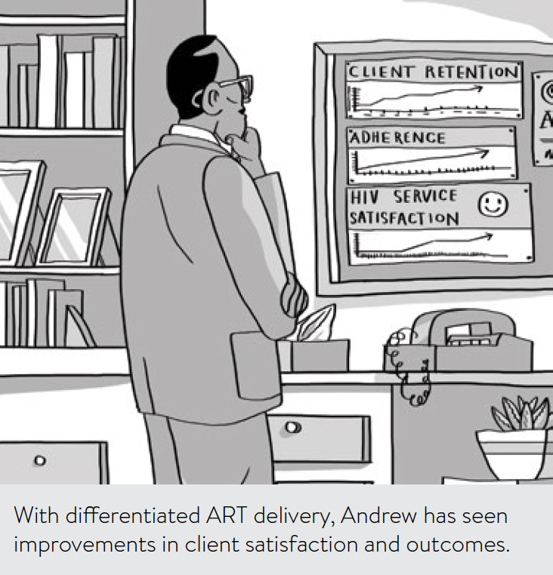
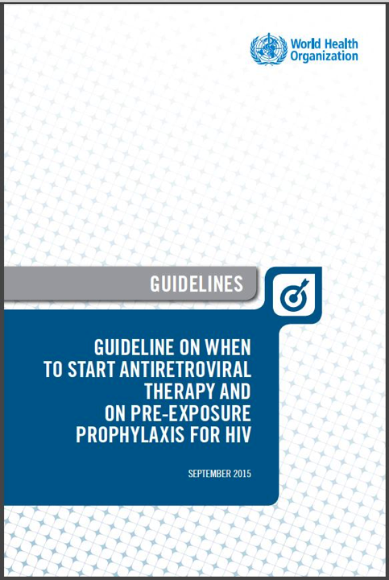
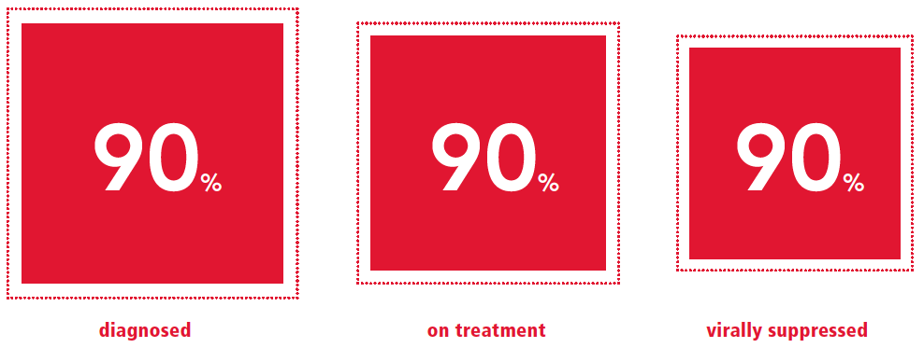
Why do we need differentiated care?
“Treat all”
Notes:
To improve clients’ lives
To improve health system efficiencies and outcomes
To support “treat all”
To reach 90-90-90

Slide 7
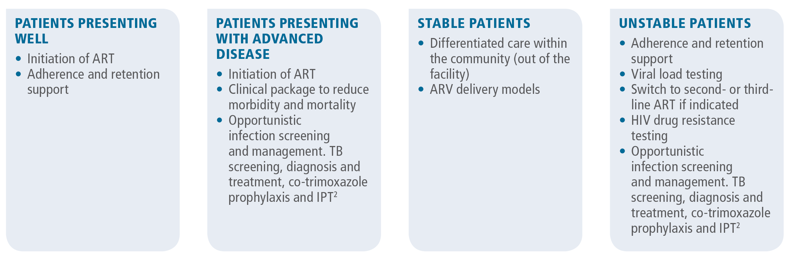
Diversity of care needs for PLHIV

Slide 8
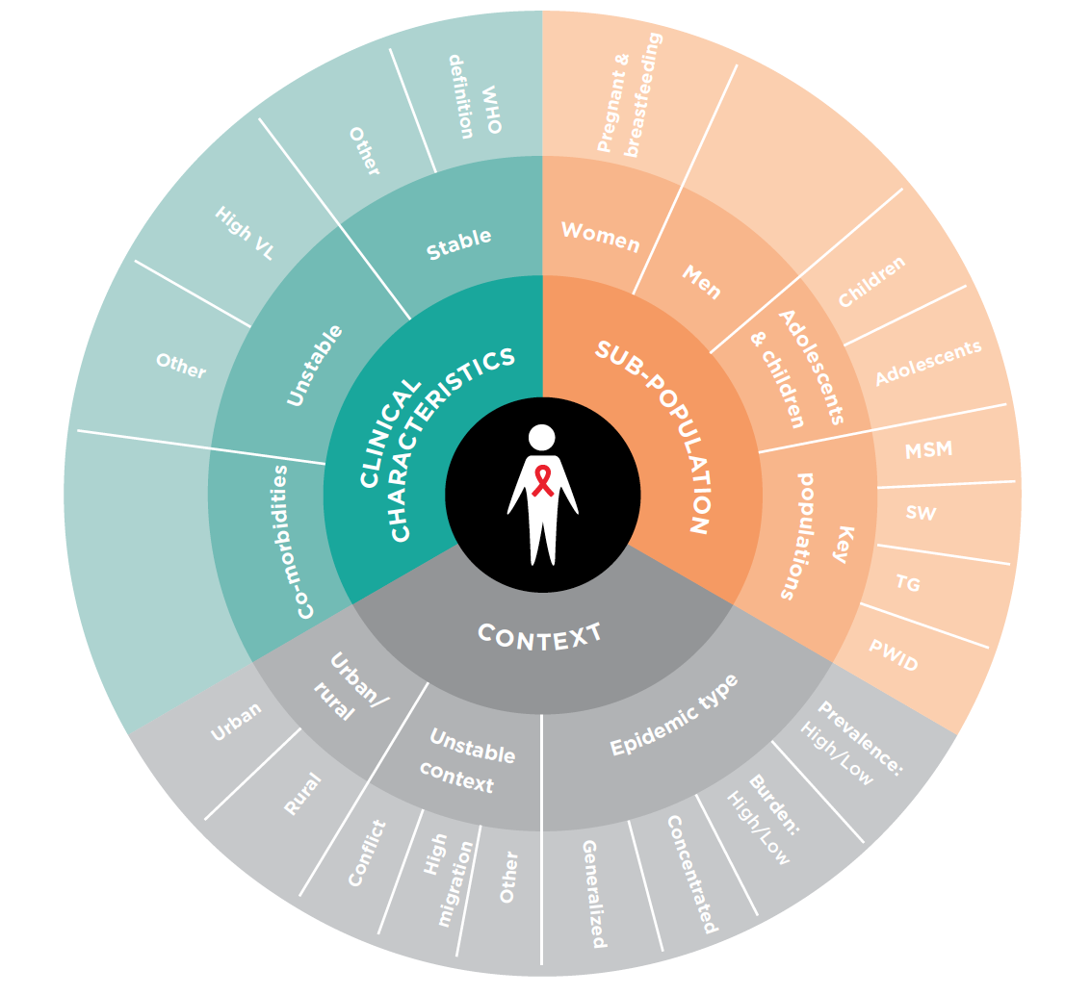
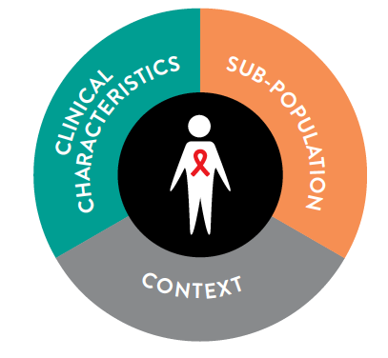
The three elements

Slide 9
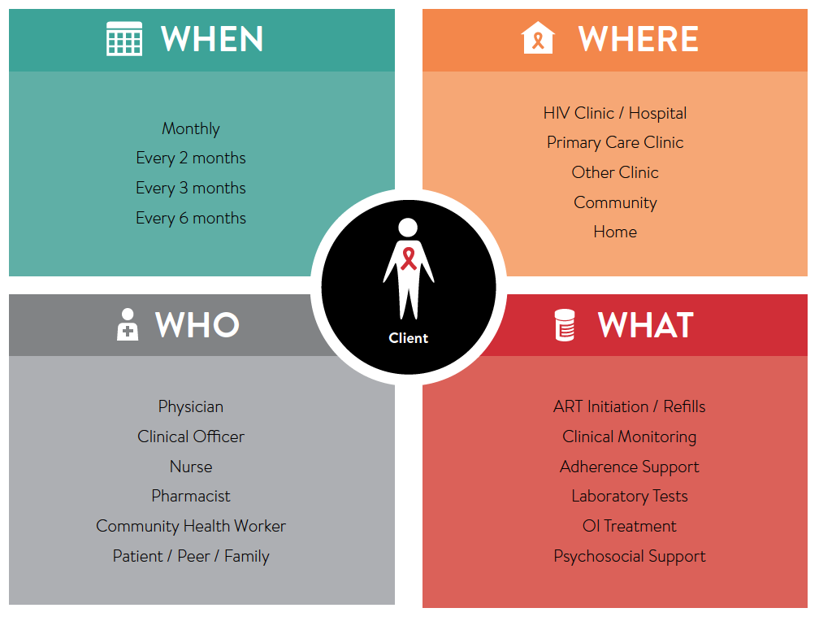
The building blocks

Slide 10
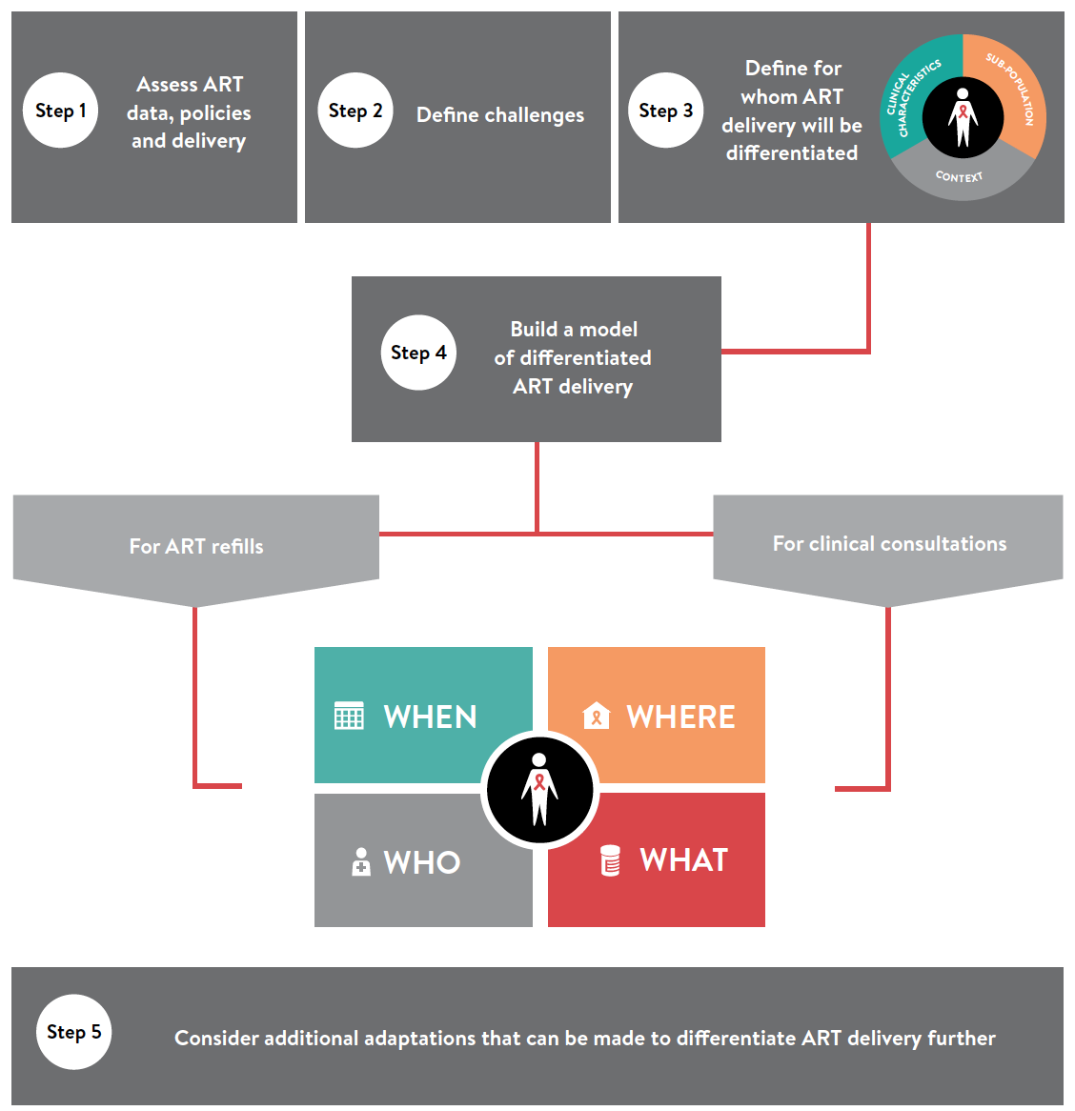

Slide 11
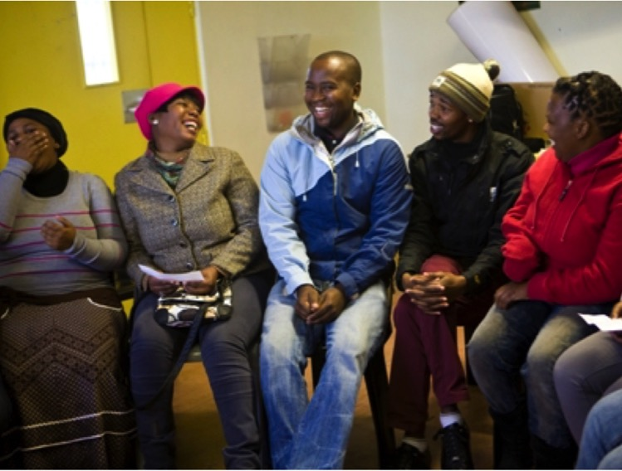
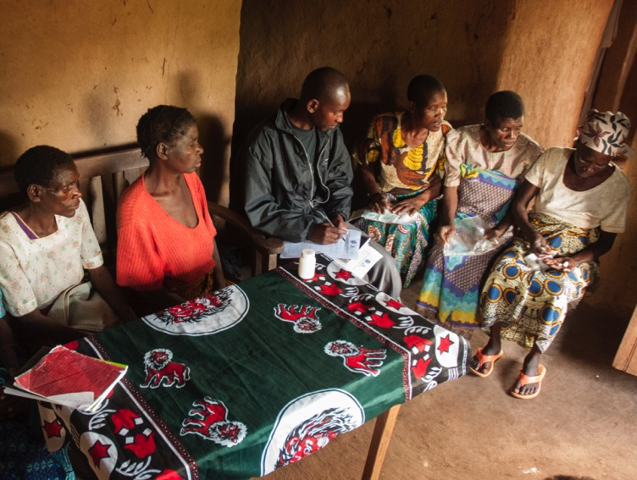
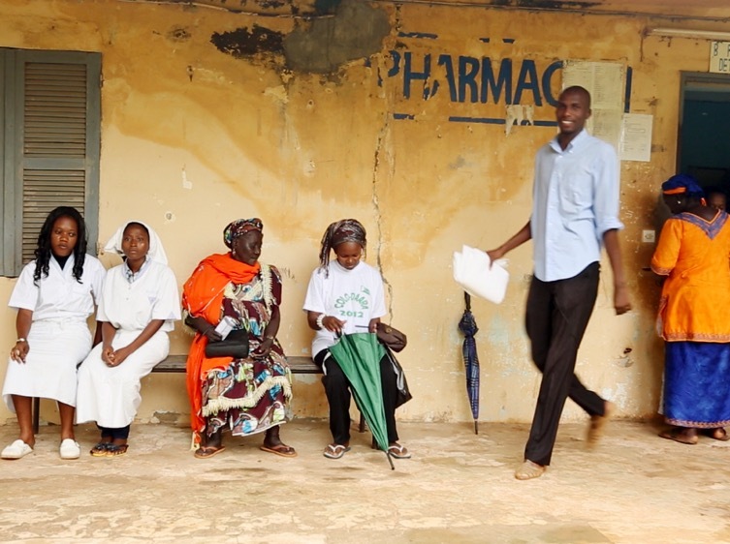

Health care worker-managed group
Client-managed group
Facility-based individual
Out-of-facility individual

Slide 12
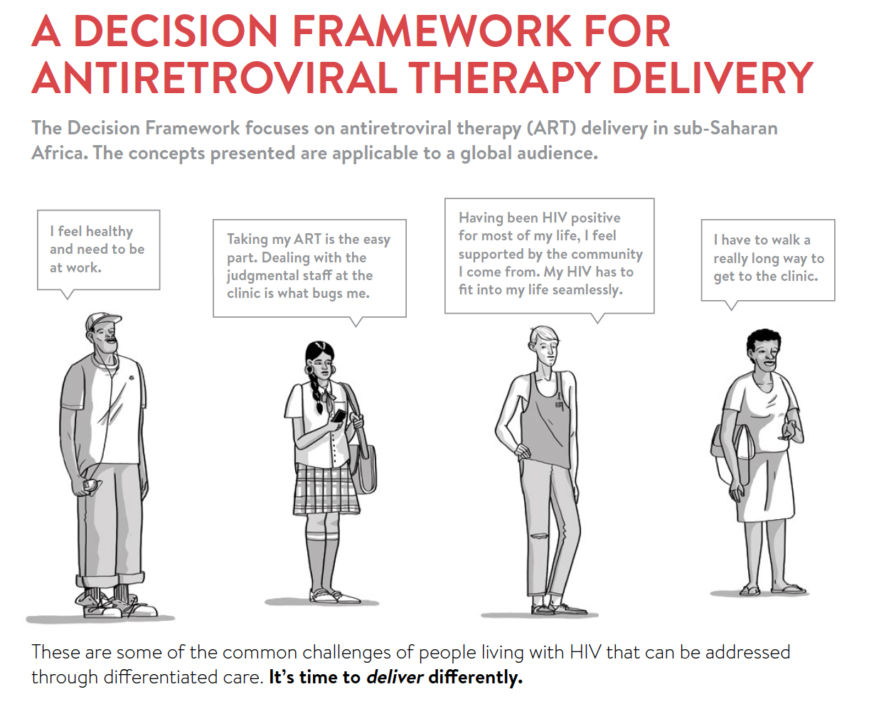


Slide 13
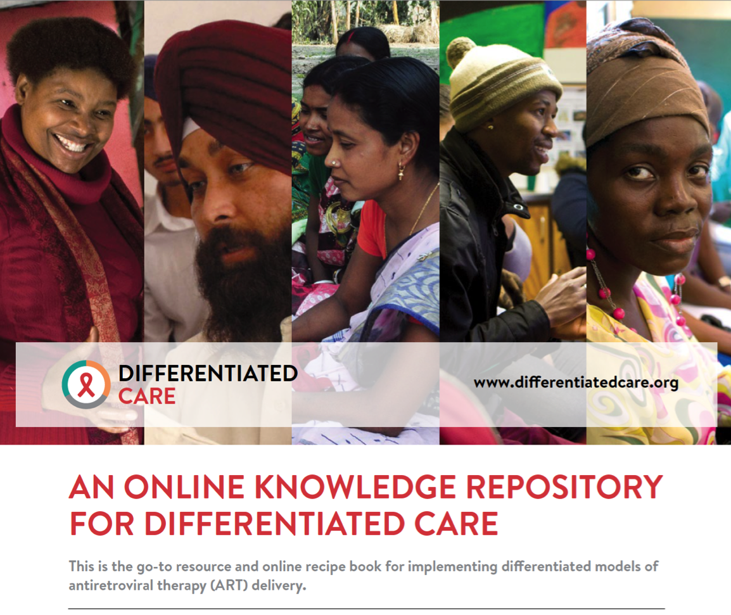

Slide 14

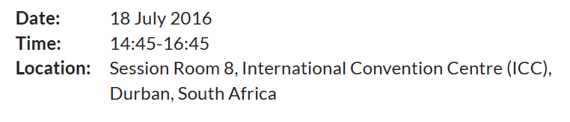
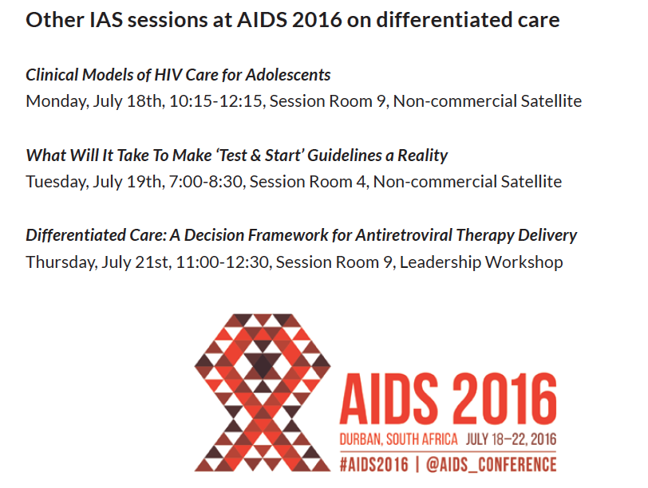
anna.grimsrud@iasociety.org

