Slide 1

Part 9
Running the training
Citation: Chisholm B. DIY WhatsApp-based microtraining. 2026. Available from: https://www.differentiatedservicedelivery.org/resources/diy-whatsapp-based-microlearning/
Need help? Contact Briony on briony.c@icloud.com

Slide 2
In this section
  Step 1: Setting up your desktop
  Step 2: Before the sessions
  Step 3: Delivering the sessions
  Tips and tricks

Slide 3
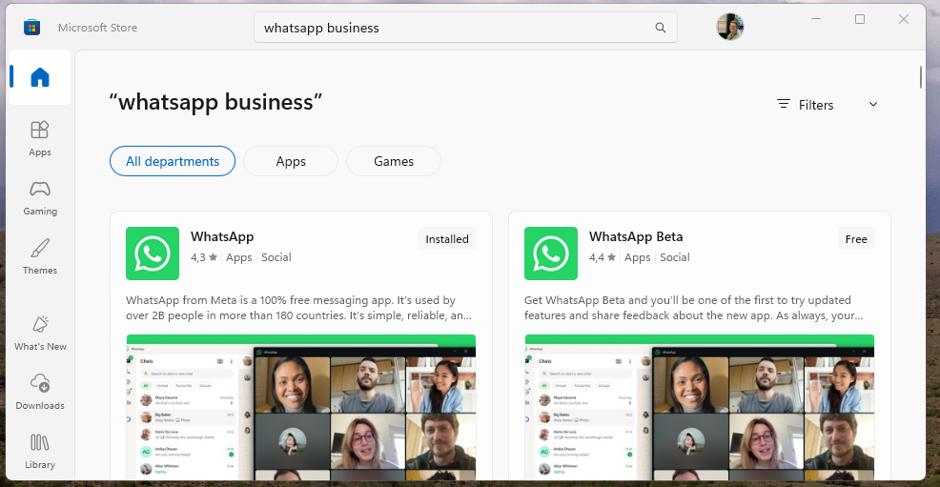



3
Step 1: Setting up
Downloading WhatsApp Desktop
1.1 Click on the ‘Start’ button on your computer and search for the
‘App store’. Click on it to open
1.2 In the App store, search for ‘WhatsApp’ and download it

Slide 4
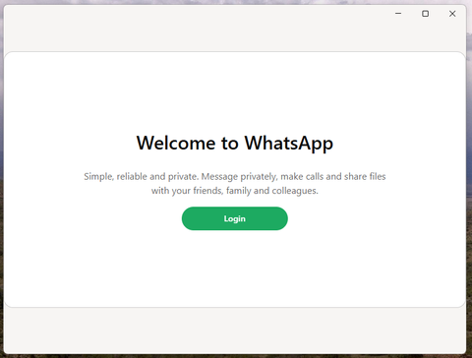
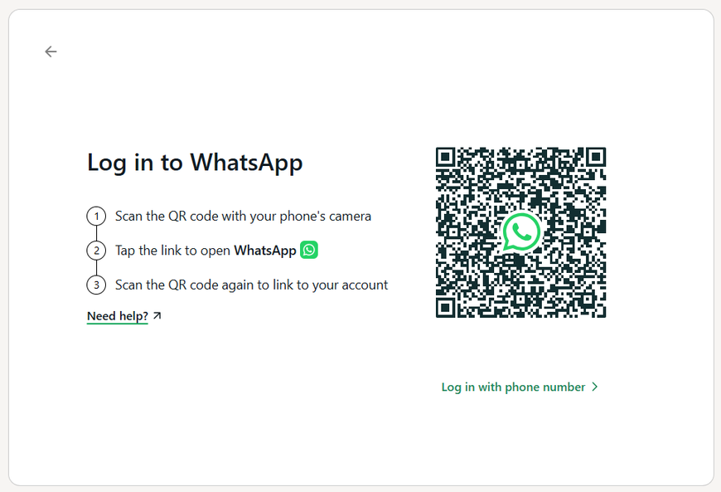
Step 1: Setting up
Downloading WhatsApp Desktop
1.3 Open WhatsApp and click on ‘Login’
1.4 Login in one of two ways:
  Open WhatsApp Business on your phone, go to ‘Settings’ IPhone)/Three dots top right (Android), then ‘Linked devices’, then ‘Link a device’ and hold your phone camera up to read the QR code and say ‘OK’. Keep WA Business open on your phone until desktop loaded
  Click on ‘Login with phone number’ and follow instructions
4

Slide 5




5
Step 1: Setting up
Facilitator set-up
  The training will need to be facilitated from a desktop computer or laptop, ideally two screens, one for the training guide, one for WhatsApp
  If there are not two screens available, the two files can be minimised to show side-by-side (see next slides)

Slide 6
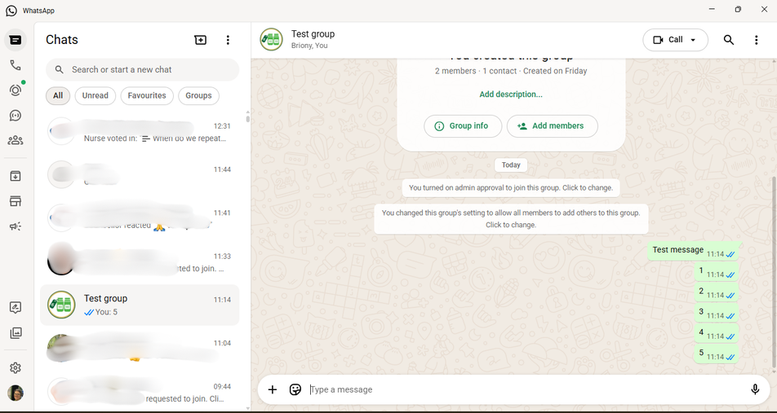
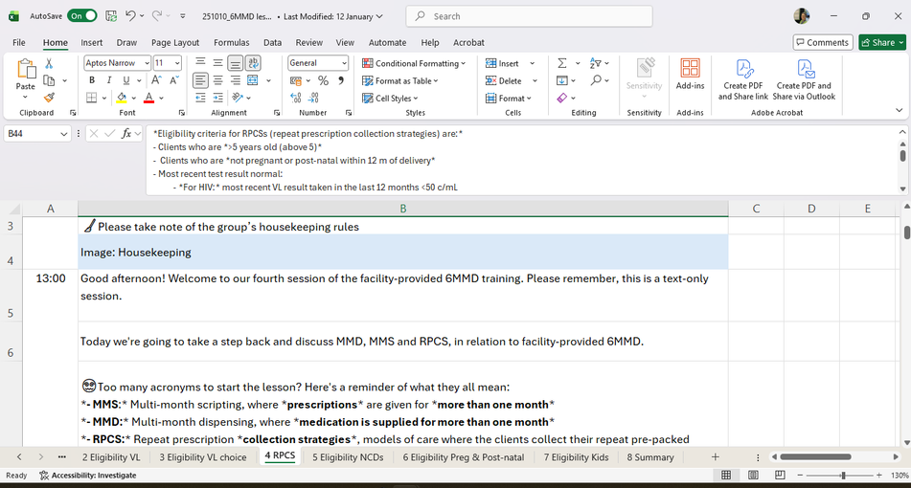
6
Step 1: Setting up
Facilitator set-up with two screens
Screen 1: WhatsApp desktop opened to the training group
Screen 2: Open on the Excel spreadsheet with the day’s lesson

Slide 7
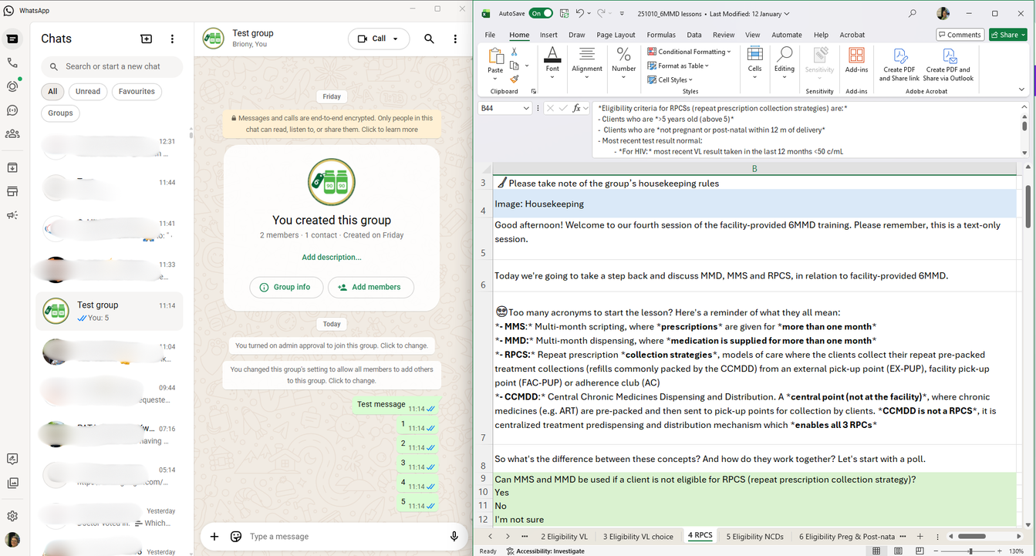
7
Step 1: Setting up
Facilitator set-up with one screen
Minimise both pages and drag them to be split across one screen

Slide 8

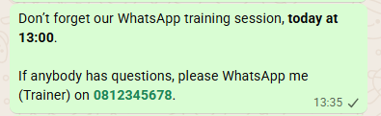

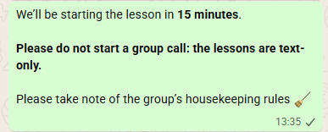
8
Step 2: Before the sessions
First thing on the morning of the sessions, send a reminder
Fifteen minutes before the session, send a second reminder, with the housekeeping rules attached (Part 5)

Slide 9
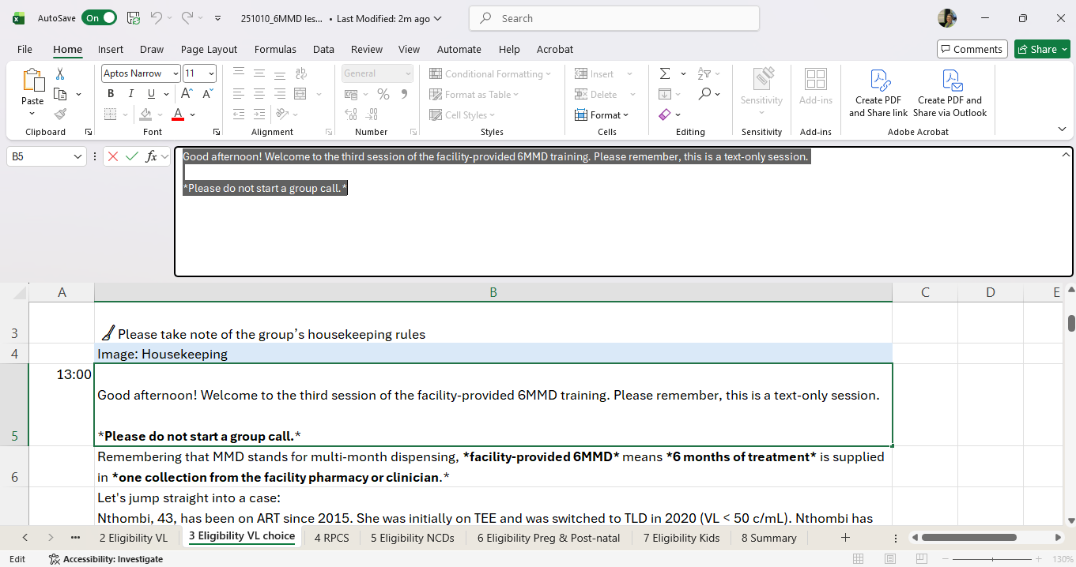
9
Step 3 Delivering the sessions: Open
When the lesson starts:
on the Excel spreadsheet, select the cell with the welcome note. Copy the text from the formula bar and paste it into WhatsApp group. Then click ‘Enter’

Slide 10

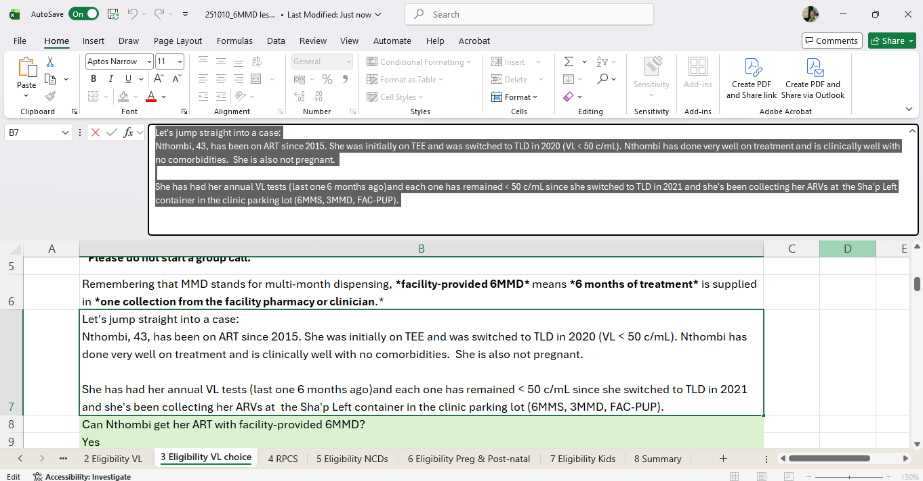
10
Step 3 Delivering the sessions: Content
Each cell is a new message. Work your way down - slowly. Remember, participants are reading much more slowly than you can paste it into WhatsApp

Slide 11
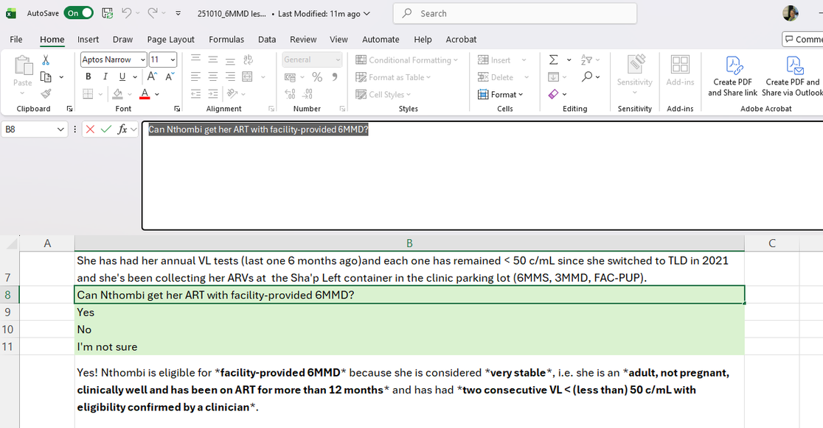
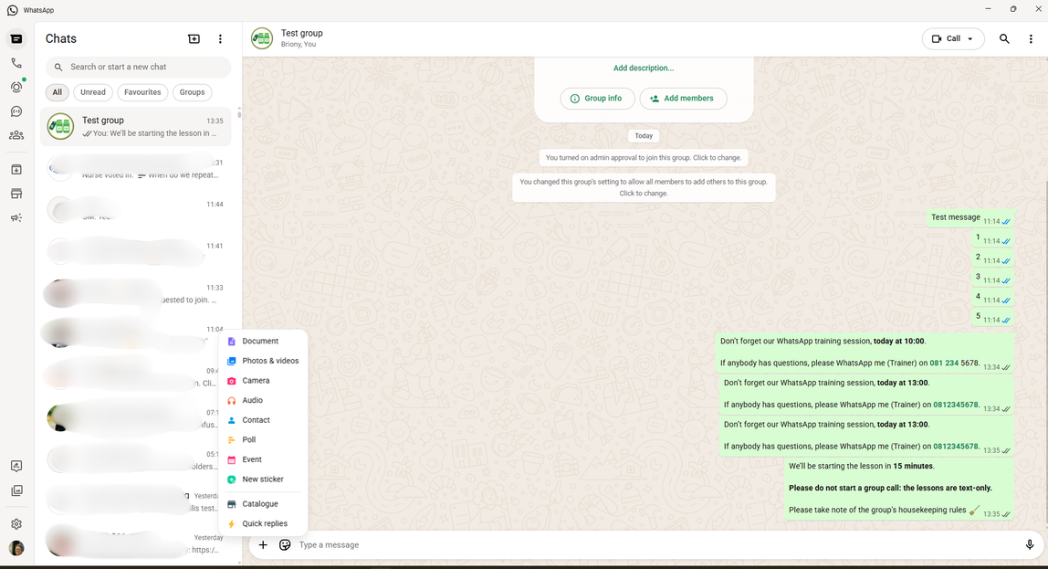
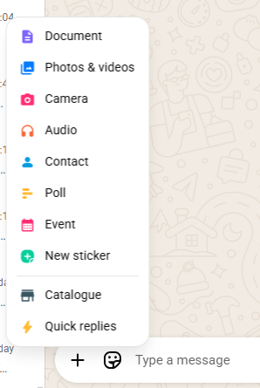
11
Step 3 Delivering the sessions: Polls
Green cells are polls. Again, copy from the formula box and paste.
In WhatsApp, click on ‘+’ then ‘Poll’

Slide 12
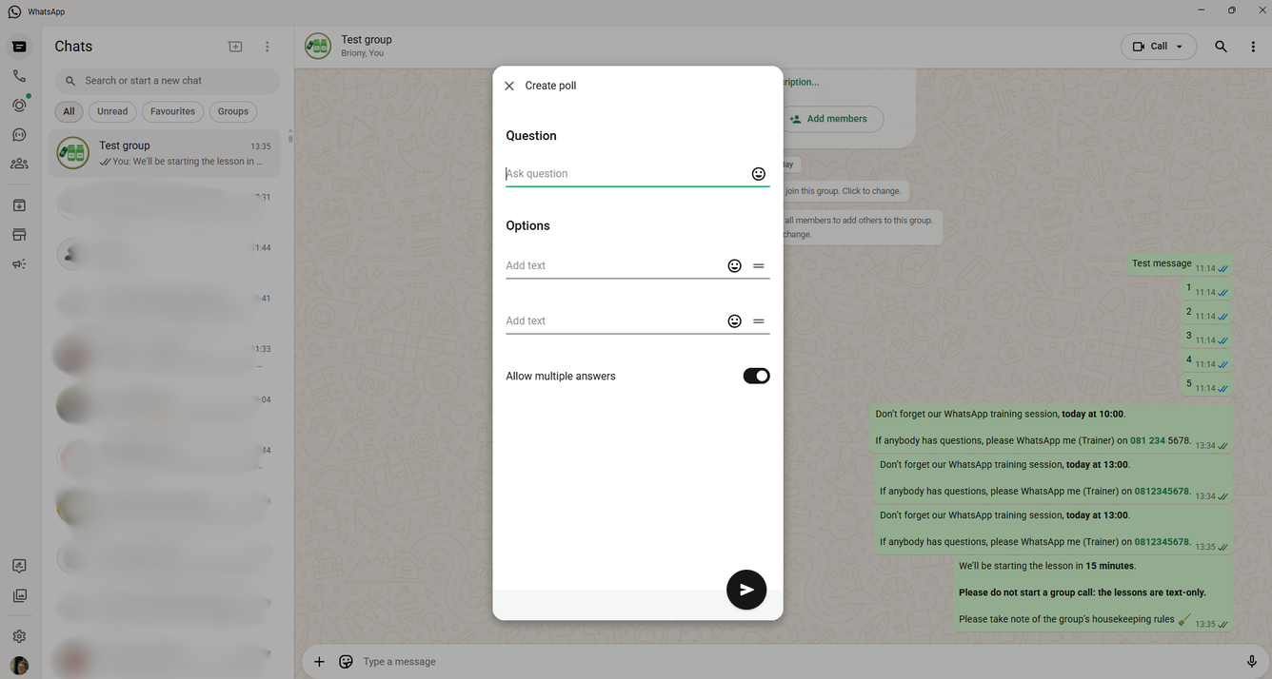
12
Step 3 Delivering the sessions: Polls
Copy/paste the question and answers into the poll.
If the question has ‘Pick all that apply’, leave ‘Allow multiple answers on’. If not, switch it off

Slide 13

13
Step 3: Delivering the sessions
Just a reminder to slow down. If you can see people are still voting on polls,
wait before sending the next message (answer)

Slide 14
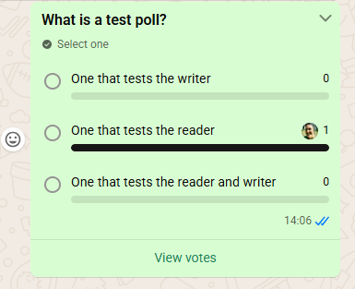
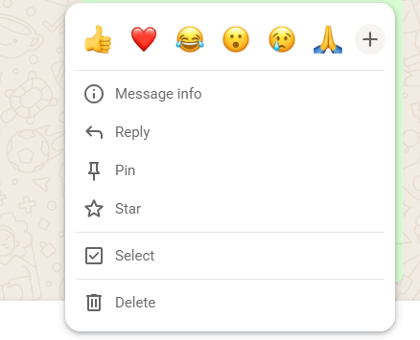
14
Step 3 Delivering the sessions: Polls
Once voting has slowed, click on the down arrow of the poll (top right), click on ‘Reply’ and copy/paste answer into text box

Slide 15
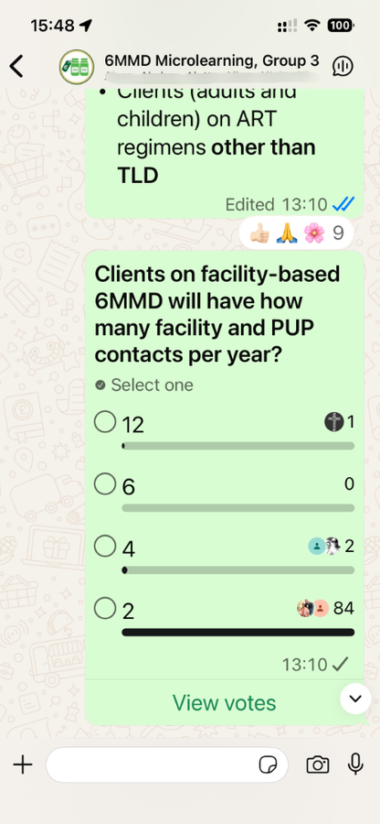
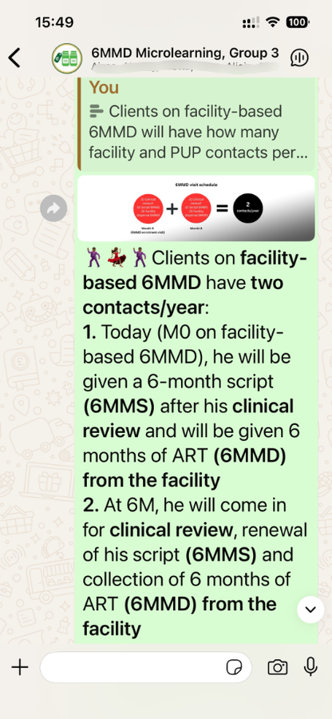

Step 3 Delivering the sessions: Polls
Participants can vote at any time, even when settings are put on admin-only commenting
15

Slide 16
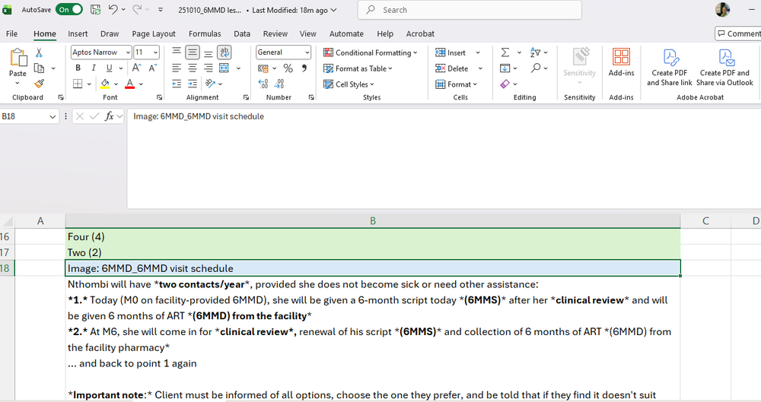

16
Step 3 Delivering the sessions: Images
Blue blocks are where images should be sent
In WhatsApp, click on ‘+’ then ‘Image’, then ‘Photos & videos’. Your Windows folder will show with images numbered as in the spreadsheet. Add the image
Make sure you know where the images are stored!

Slide 17
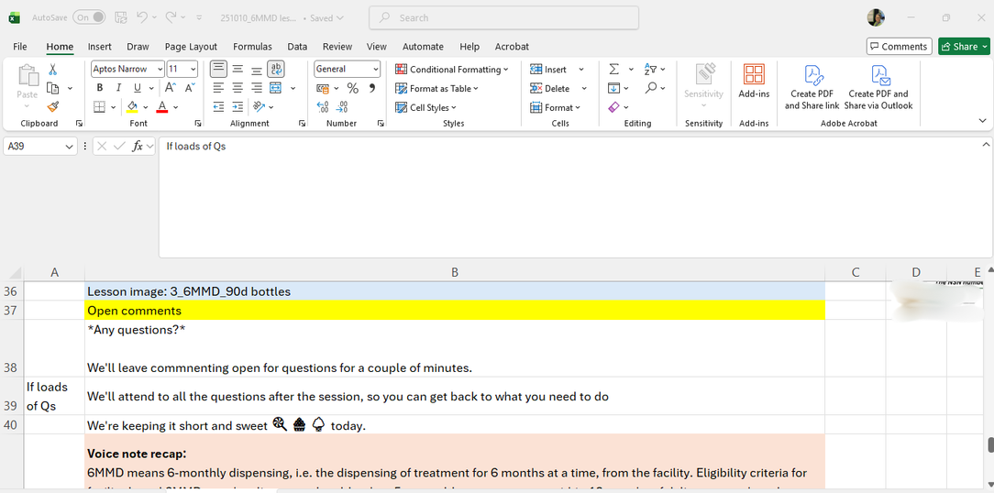
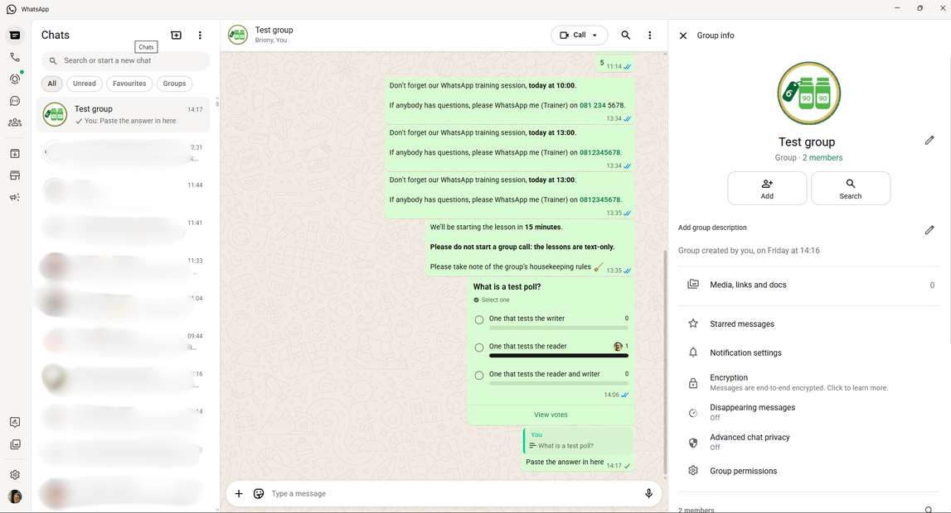
17
Step 3 Delivering the sessions: Q&A
When you get toward the end of the session, a yellow cell will say ‘Open comments’
In WhatsApp, click on ‘Group name’ at the top. Settings will open to the right. Click on ‘Group permissions’

Slide 18
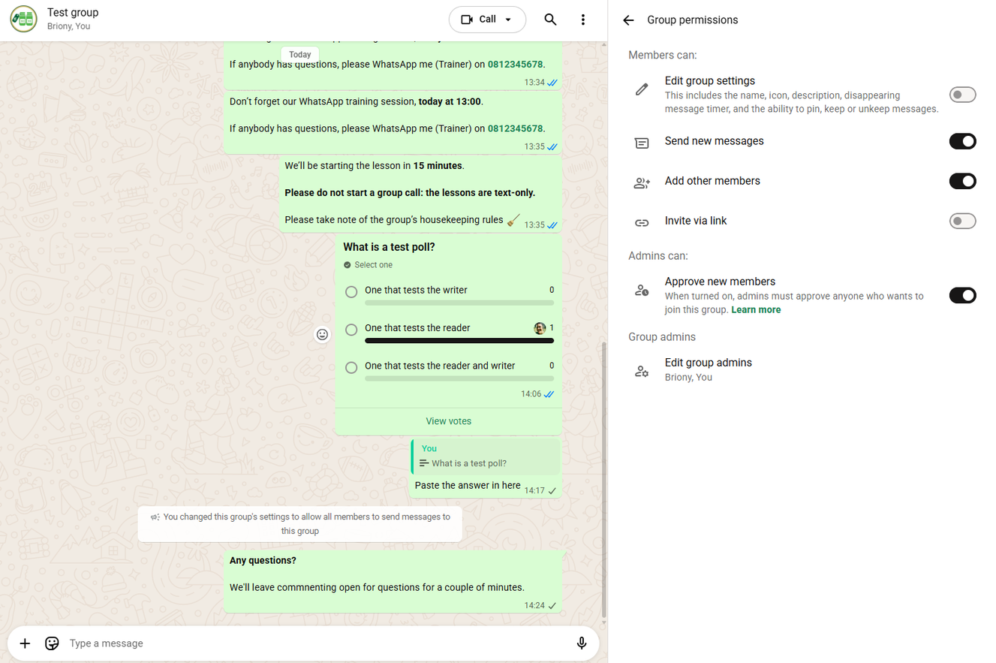
18
Step 3 Delivering the sessions: Q&A
Turn ‘Send new messages’ on. A notification will show in the group.
Send the message asking if there are any questions.
Allow time for people to respond (at least 2 minutes)
Turn off ‘Send new messages’ and send relevant message about answers
Both facilitators then send relevant message about answers

Slide 19
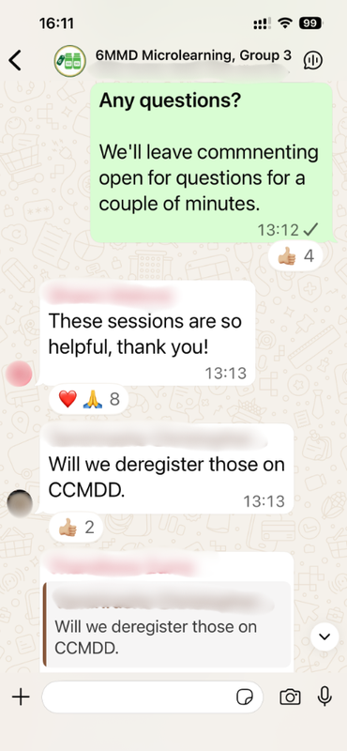
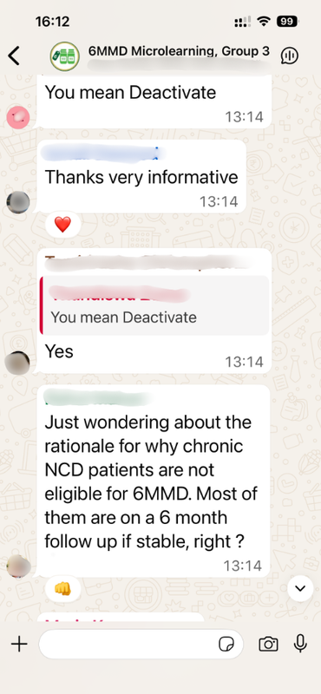
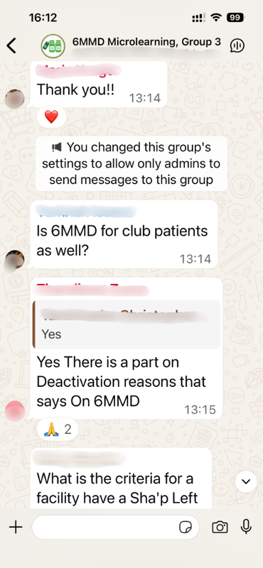
Step 3 Delivering the sessions: Q&A
Remember: questions do not need to be answered immediately.
If you’re unsure, seek advice and answer later
19

Slide 20
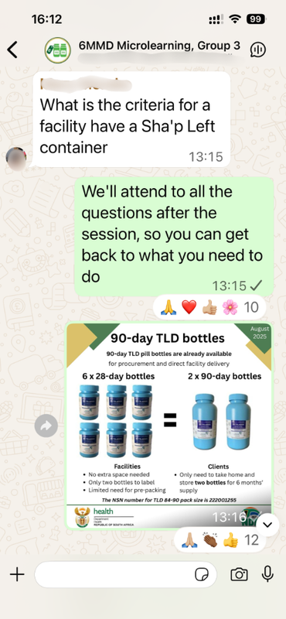
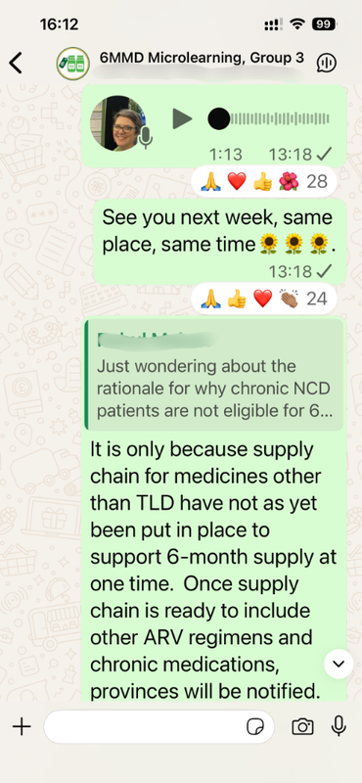
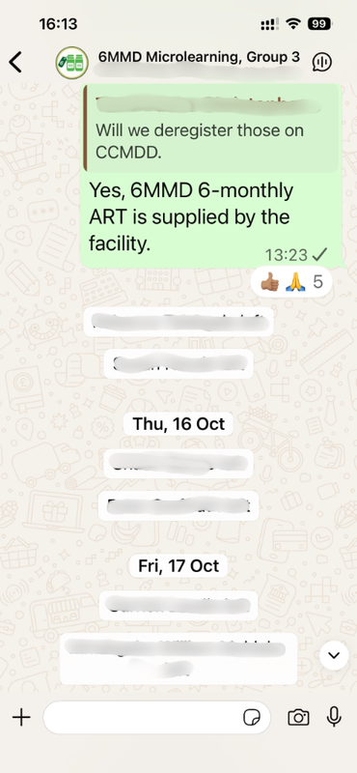

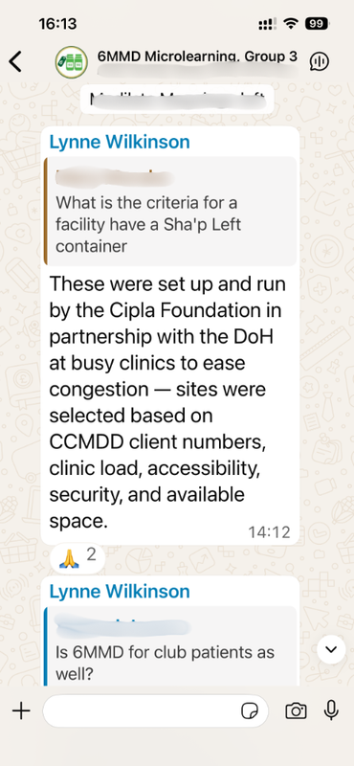

Step 3 Delivering the sessions: Q&A
Facilitator 1 answering Q straight after session
Facilitator 2 answering Q the next day, after discussion with experts
20

Slide 21
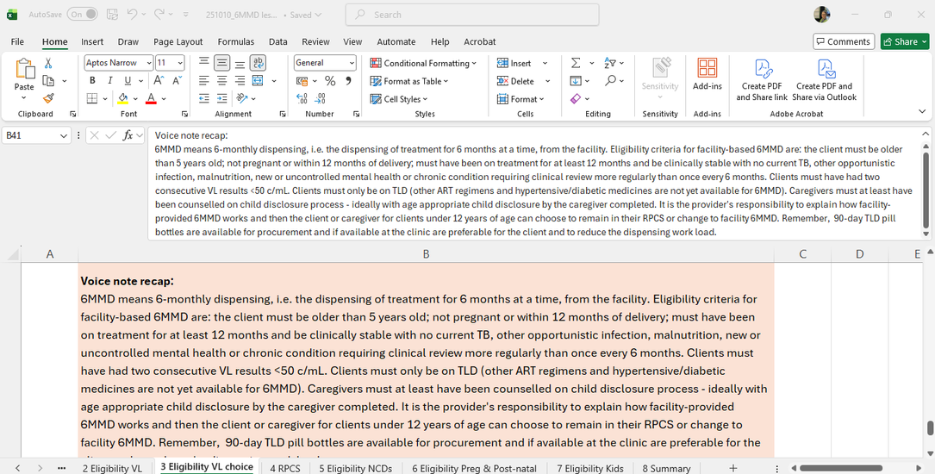


Step 3 Delivering the sessions: VNs
The pink cells are voice notes
Click on the little microphone, record the message, and send. Remember to talk slowly and clearly. These can be pre-recorded and saved. If you wish to use the pre-recorded VN, see next slide
21

Slide 22
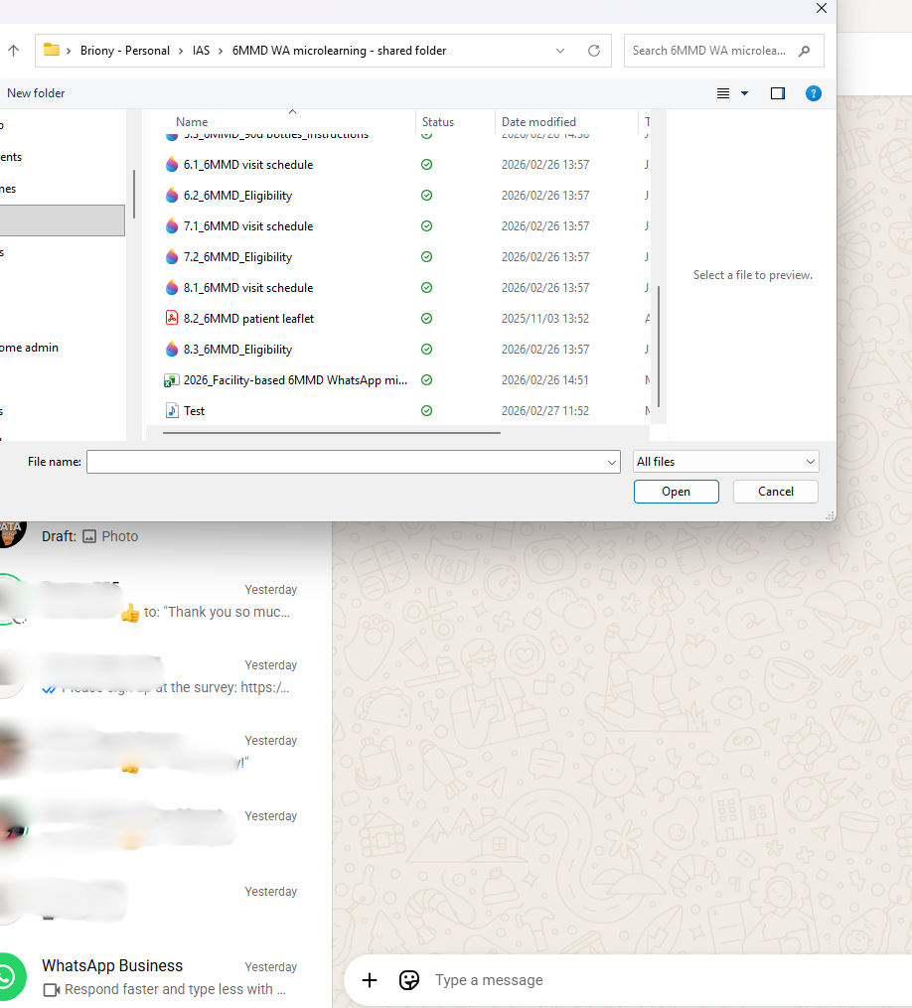
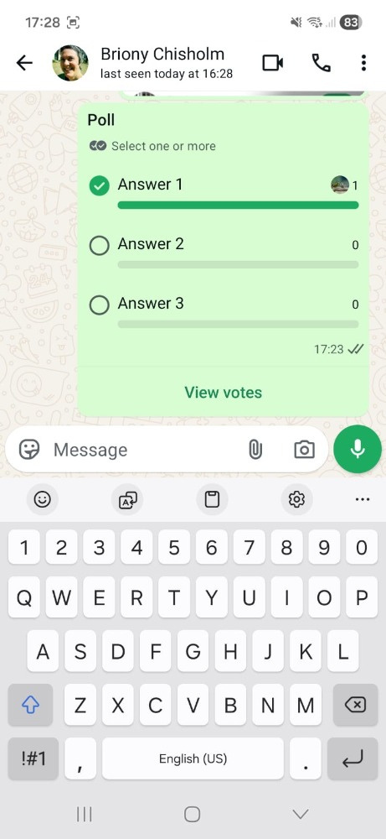
Step 3 Delivering the sessions: VNs
If you’d prefer to use the pre-recorded voice notes
In WhatsApp, click on ‘+’ (iPhone) or
‘Paperclip’ (Android). Click on ‘Audio’
Ensure that ‘All files’ is chosen. Click on relevant
voice note, e.g. ‘Session 1'
Click on ‘Open’
22

Slide 23

23
Tips and tricks
  Set up your computer to make the process easy for you
  Get used to copy/pasting across from Excel to WhatsApp before you start the training
  Make sure you know what folder your images are in
  Ask a colleague to practice with you so that you can work out timing, and make sure you don’t go too fast
  Use emojis! Encourage participants with clapping hands or party poppers when they get things right!
Practice before you start delivering sessions

