Slide 1

Part 8
Marketing and admin
Citation: Chisholm B. DIY WhatsApp-based microtraining. 2026. Available from: https://www.differentiatedservicedelivery.org/resources/diy-whatsapp-based-microlearning/
Need help? Contact Briony on briony.c@icloud.com

Slide 2

Recruitment and training group creation
Marketing and admin
WhatsApp group creation
  Ongoing advertising of the training through relevant channels
  Group management plan
WhatsApp group is populated as sign-ups happen
Recruitment and WhatsApp group creation
Microlearning
familiarisation
Planning
Finalisation of WhatsApp group
  Human resource allocation
  Establish key dates
  Establish recruitment plan
  Create sign-up survey
Introduction to microlearning for all leads involved in recruitment and/or participants
  WhatsApp group is populated as sign-ups happen
  Group management: monitoring participation

Slide 3
In this section
  Step 1: Marketing the training
  Step 2: Preparing a group management plan
  Step 3: Finalising groups
  Step 4: Final checks

Slide 4
Step 1: Marketing the training
Remember
If you’re running a training group, you ideally want everybody who will benefit from the training to join:
cast the invitation net wide and make it easy to join
In previous parts, these questions were answered:
  Who are the target participants?
  How can you contact those people?
  Do you need to create an invitation or message to send?
In this part, we’ll share tips on making sure you reach everybody that will benefit and illustrate how to make a simple invitation
4

Slide 5
Step 1: Marketing the training
Tips on reaching your audience
  Start recruitment early. The earlier, the better!
  Don’t ‘reinvent the wheel’: use recruitment channels that already exist, such as district and facility WhatsApp groups
  Use all the options available to you: WhatsApp groups, e-mail, local/district meetings, implementing partners
  Advertise a number of times, to catch potential participants who missed first (or second ...) notices
Most importantly, make it easy for people to join the group
5

Slide 6
Step 1: Marketing the training
Make it easy for participants to join
  If you don’t need to have tight control over who joins the groups, don’t have it:
    If you don’t need participant details, don’t add a sign-up survey
    If you do need participant details, use a sign-up survey but ask only what you absolutely need to know
  Let people join groups themselves, using the WhatsApp group link or QR code (see Part 6/7)
  Encourage people to share the link or invitation with others that may be interested
6

Slide 7
Step 1: Marketing the training
Making an invitation (JPEG or text)
Important information to include in the invitation:
  What the training is about
  A short explanation of the WhatsApp-based training format
  When the training will happen
  How to sign up
  A contact person, for questions on joining/signing up
  When registration closes, if applicable
7

Slide 8
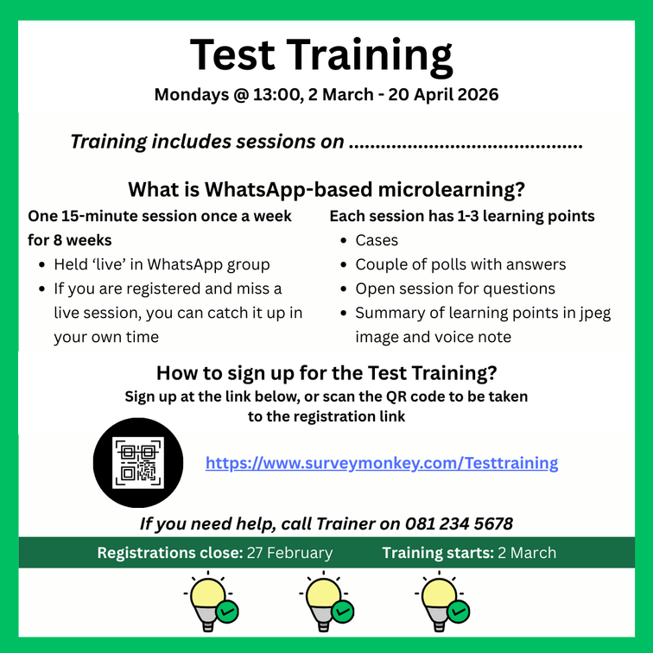
Step 1: Marketing the training
Making an invitation (JPEG or text)
Exciting news!
You’re invited to join us for Test Training on Mondays @ 13:00 from
2 March to 20 April. The training will be for 10-15 minutes in a WhatsApp group, text only. To join, go to https://www.surveymonkey.com/Test or click on the QR code below
The link and QR code used here will be either to the sign-up survey (if you have one), or to join the WhatsApp group directly (if you don’t need people to sign up)
8

Slide 9
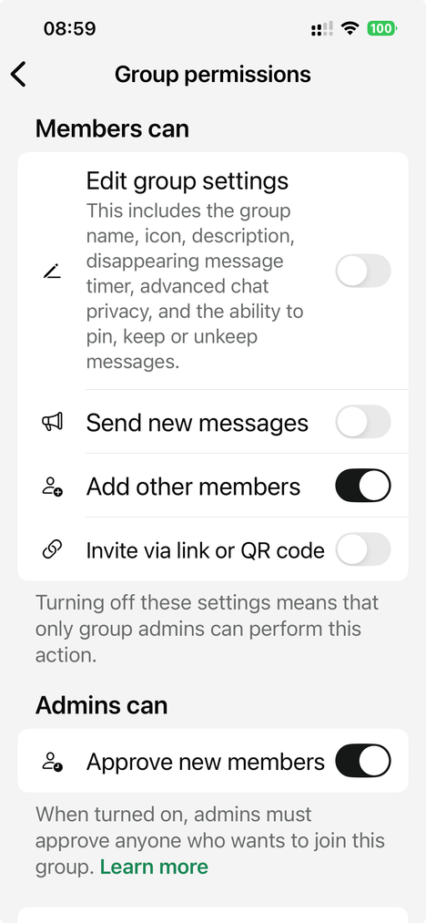
Step 2: Preparing a group management plan
Setting up secure WhatsApp groups: set your settings
Edit group settings: if left on, ALL group members can alter settings. It is preferable to turn this off
Send new messages: if left on, ALL group members can send messages at any time. We advise you to turn this off. This can be switched on after each session to allow questions and discussion for a short period
Add other members: this can be left on if you’re happy to allow all members to add others; or off, if not
Approve new members: if left on, this will only allow members in after admin approval
These two settings should be left off
Only turn on controls that are necessary: we want to be welcoming and make it easy for people to join
9

Slide 10
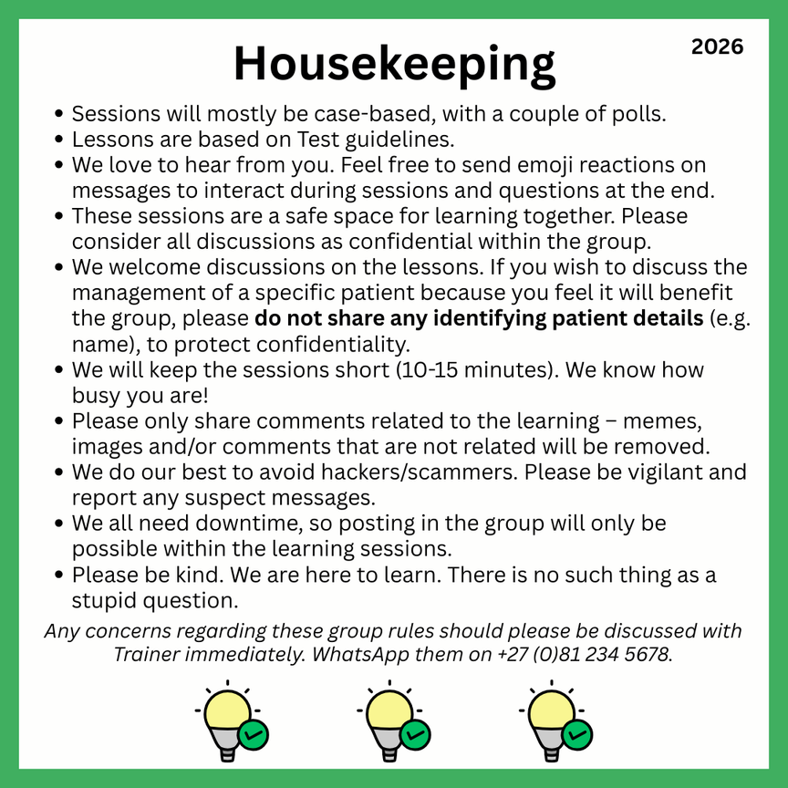

Step 2: Preparing a group management plan
Setting up secure WhatsApp groups: housekeeping rules
Housekeeping rules (either in JPEG or text) must be shared before each session. This is also a good way to remind people of the sessions: send the housekeeping rules 15 minutes before the training
Important
WhatsApp Business must be used for the training as it allows admins to remove comments for everyone. This is vital, in case of the sharing of any confidential information
10

Slide 11
Step 2: Preparing a group management plan
Setting up secure WhatsApp groups: moderating sessions
Commenting should be kept off during the session and
opened at the end for a couple of minutes, to allow for questions.
Depending on the size of the group, you may need a moderator/second facilitator in addition to the facilitator. This is recommended especially for groups with over 100 participants
Answering questions after the session
  If the facilitator is a subject expert and knows answers to questions, they can be answered ‘live’
  If there is ANY question around how to answer a question: send a message to say questions will be answered later, discuss the correct answer with a subject expert, and answer later. Remember, you’re giving information to a large group of people who may also forward the information to others
Thanks for these great questions. We will close now so that you can get back to what you need
to do. Questions will be answered after the session.
It is imperative that correct information is shared within groups
11

Slide 12
Step 3: Finalising groups
  Participants should be added to groups as they sign up (Part 7)
  While a ‘closing date’ should be advertised to encourage early sign-up, participants should be allowed to join until the sessions start
  A few days before the sessions start, send a reminder
Don’t forget! Our Test Training sessions start on Monday at 13:00. We’ll send another reminder on Monday morning. We’re looking forward to learning with you!
12

Slide 13
Step 4: Final checks
  Group settings: are they set so that you have control in the group for the lesson (Part 6 and 7)
  A minimum of two people set as admins: if anything happens to one admin’s access, the other is still there (Part 6)
  Facilitators/moderators: does everyone know what they need to do, and when to do it (Part 6)
Reliable internet access: the facilitator needs to be in a place with reliable internet access, to send messages
13

