Slide 1

Part 7
Creating a training group on
WhatsApp Business
Citation: Chisholm B. DIY WhatsApp-based microtraining. 2026. Available from: https://www.differentiatedservicedelivery.org/resources/diy-whatsapp-based-microlearning/
Need help? Contact Briony on briony.c@icloud.com

Slide 2

Recruitment and training group creation
Marketing and admin
WhatsApp group creation
  Ongoing advertising of the training through relevant channels
  Group management plan
WhatsApp group is populated as sign-ups happen
Recruitment and WhatsApp group creation
Microlearning
familiarisation
Planning
Finalisation of WhatsApp group
  Human resource allocation
  Establish key dates
  Establish recruitment plan
  Create sign-up survey
Introduction to microlearning for all leads involved in recruitment and/or participants
  WhatsApp group is populated as sign-ups happen
  Group management: facilitation and moderating

Slide 3
In this section
  Step 1: Downloading WhatsApp Business
  Step 2: Registering on WhatsApp Business
  Step 3: Creating a group in WhatsApp Business
  Step 4: Adding participants
  Step 5: Making admins
  Tips and tricks

Slide 4

Why WhatsApp Business?
WA Business allows tighter control in groups
  Admins can control who joins groups, who can send messages, and when
  Admins can delete messages - for everyone - sent from any participant, e.g. messages that don’t protect patient confidentiality or irrelevant messages
Let’s start from the beginning
4

Slide 5
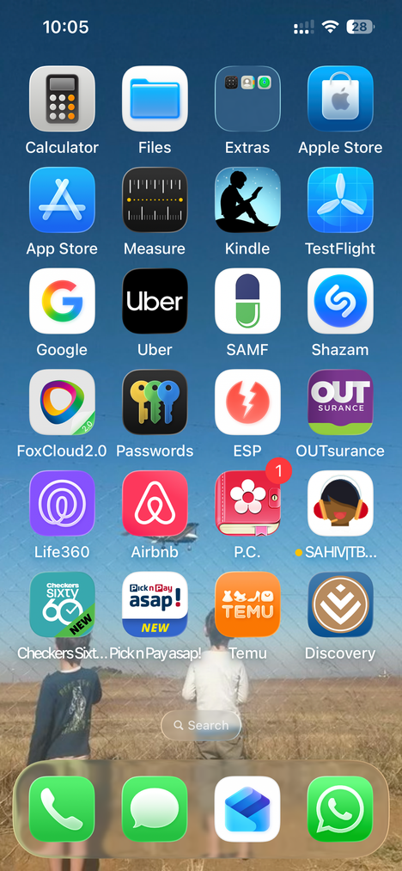
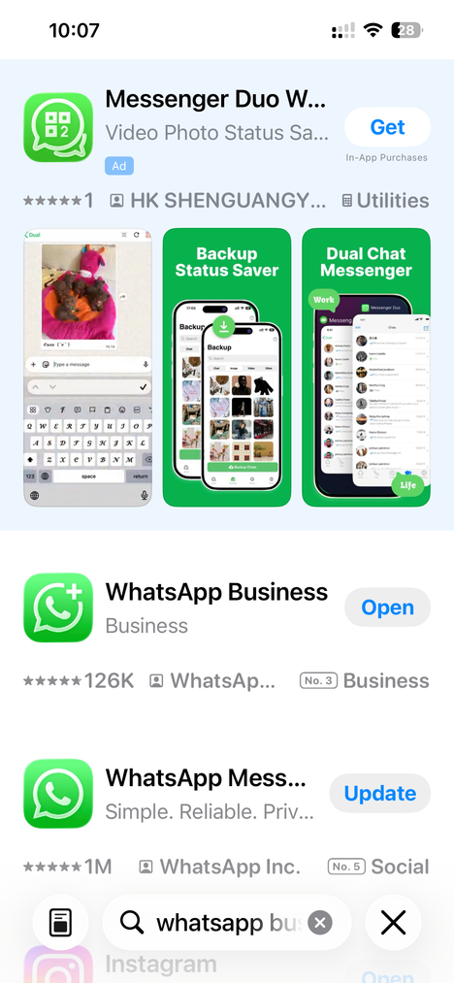
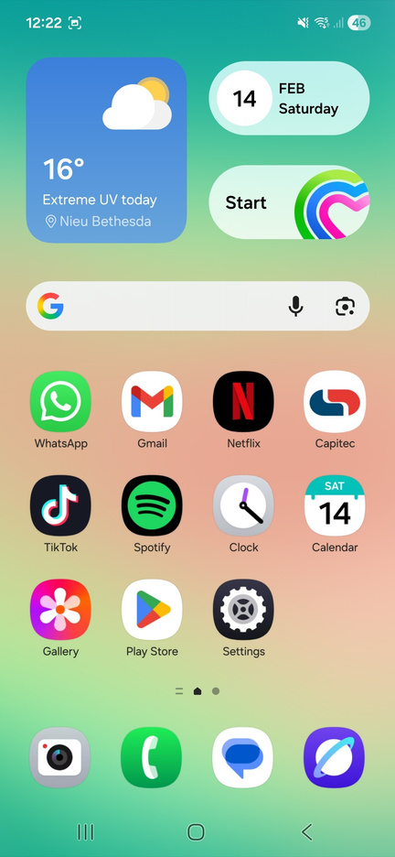
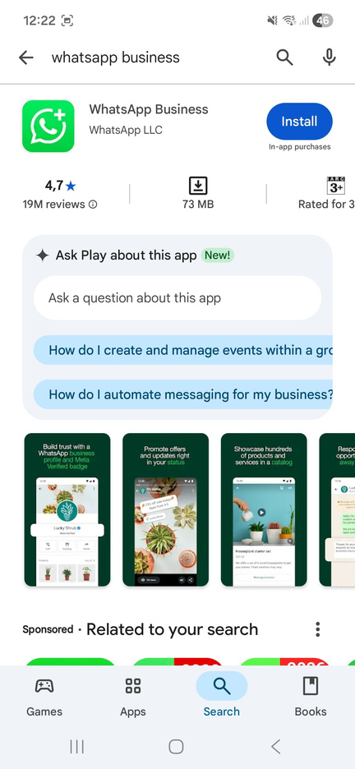

Step 1: Download WhatsApp Business
iPhone (App Store)
On your home screen, click on
‘App Store’. Search for WhatsApp Business and click on ‘Download’ symbol
Android (Google Play)
On your home screen, click on ‘Play Store’. Search for WhatsApp Business and click on ‘Install’
5

Slide 6

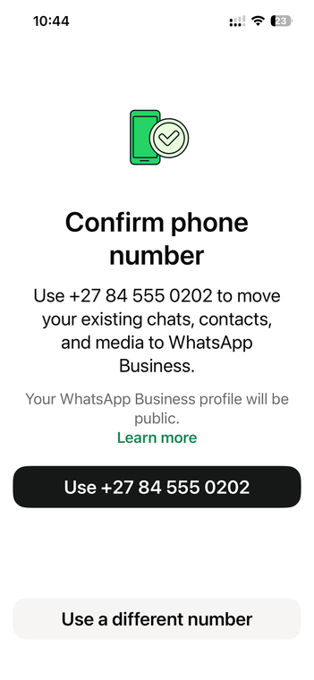
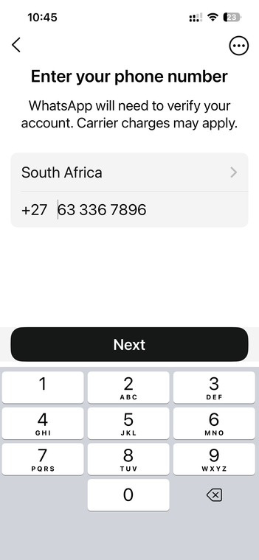

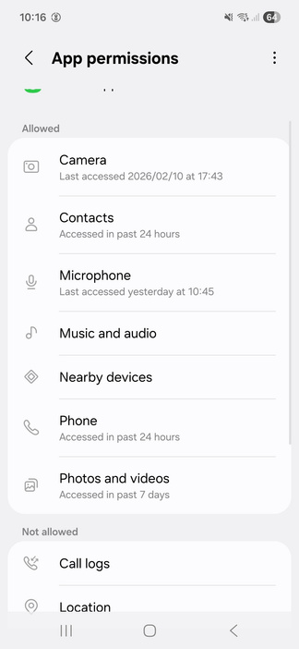
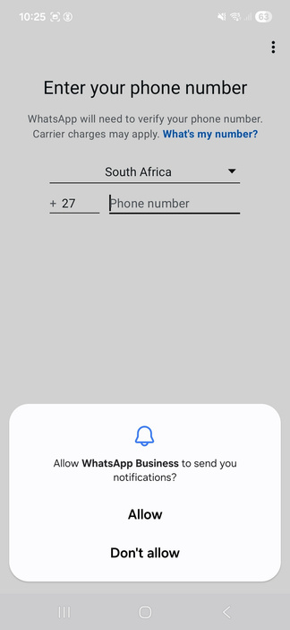
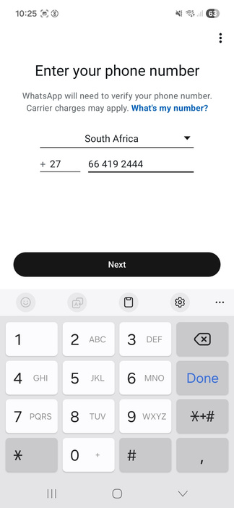
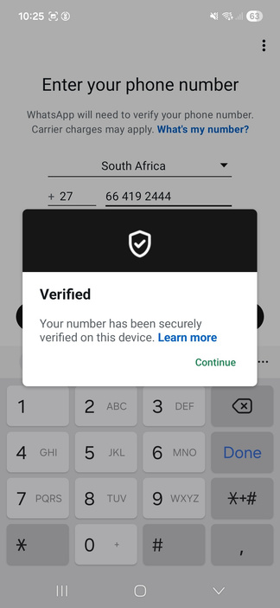
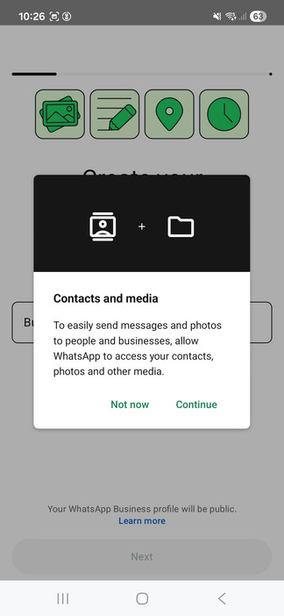
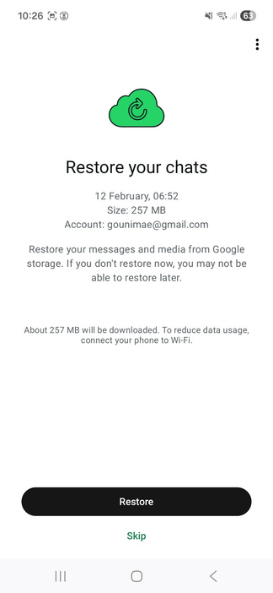

6
Step 2: Open WhatsApp Business and follow prompts to register
1
2
3
Note: you can’t use the same number for WhatsApp Business and WhatsApp. Two options:
  Get a second number (SIM) and use that for WhatsApp Business (most phones can have two numbers) iPhone example
  Change your own number to WhatsApp Business (it works the same) Android example
+27 81 234 5678
Use +27 81 234 5678
1
2
3
4
5
6
7
081 234 5678
081 234 5678

Slide 7
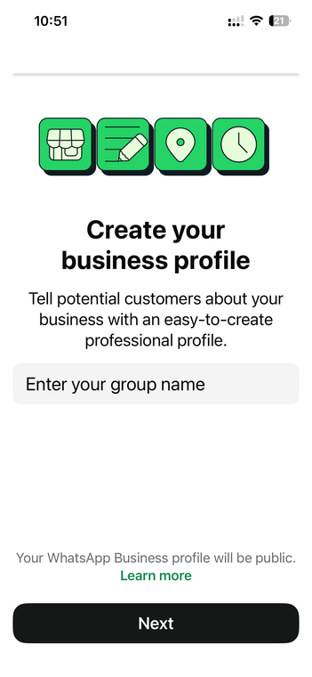
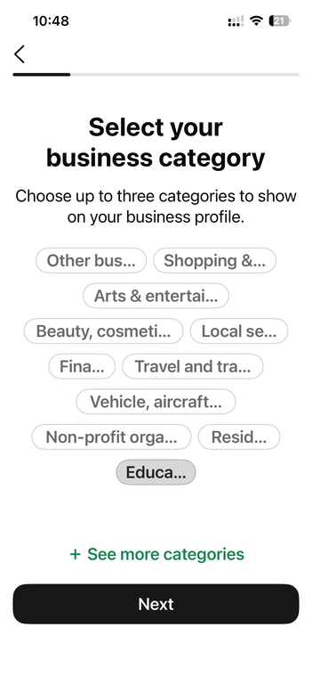
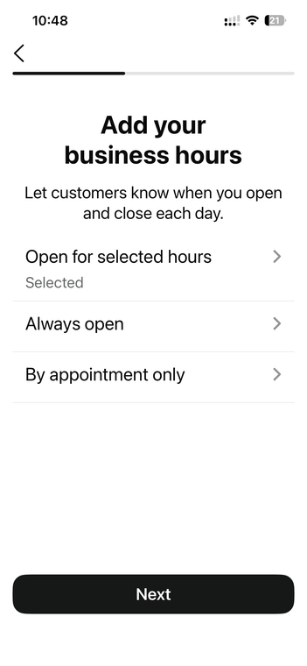
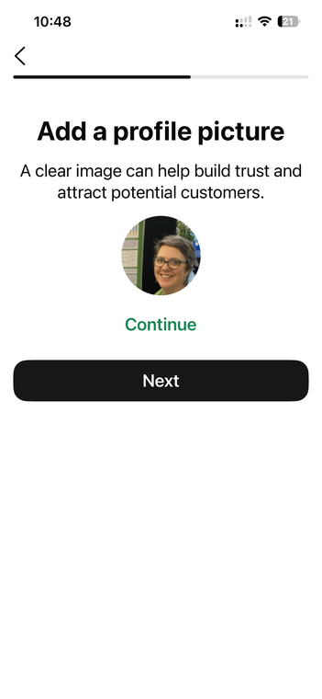
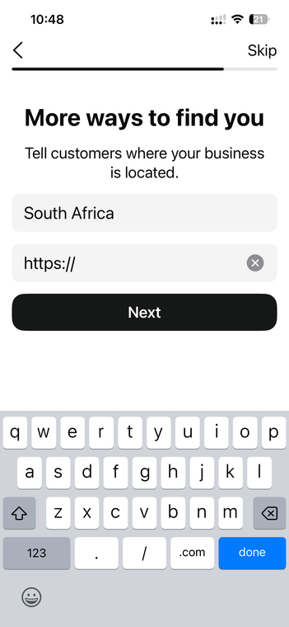
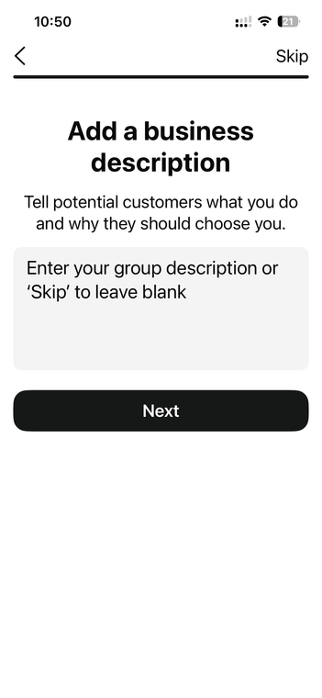
Step 2: Open WhatsApp Business and follow prompts to register
Create business profile
Enter your name and click ‘Next’
Select business category
Pick ‘Education’
Click ‘Next’
Add business hours
Select an option
Click ‘Next’
Add profile picture
Select a picture, if you want to, otherwise leave blank
Click ‘Next’
Add website
Click ‘Skip’
Add business description
Add, if you want to, and click ‘Next’ otherwise leave blank, and click ‘Skip’
You are now registered and can move on to creating a group for training
7

Slide 8
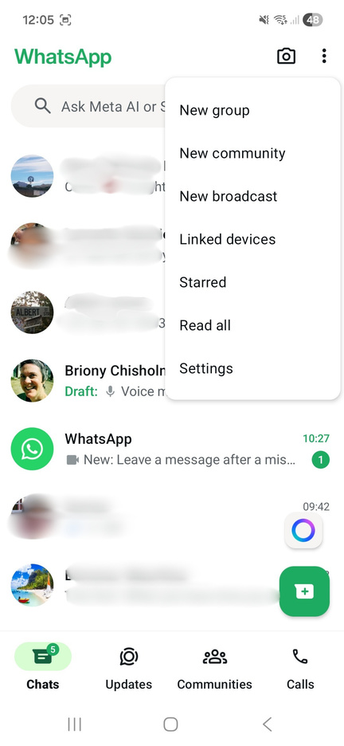
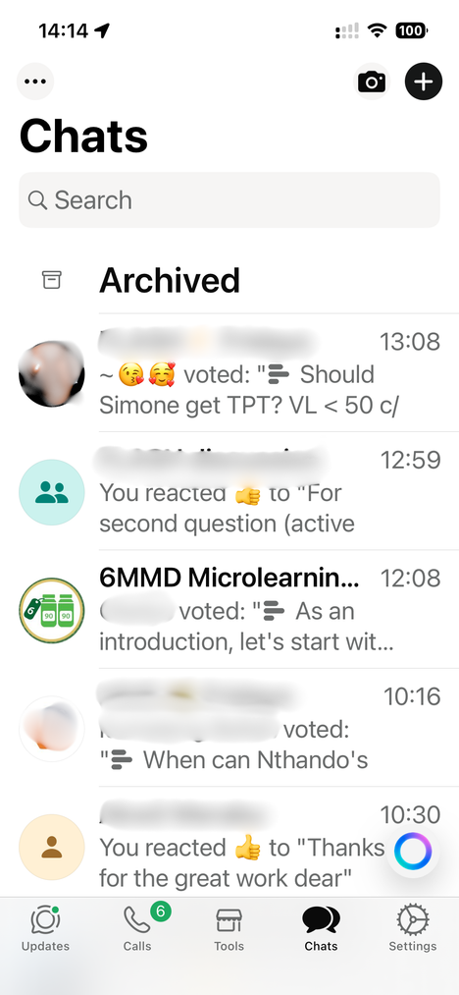
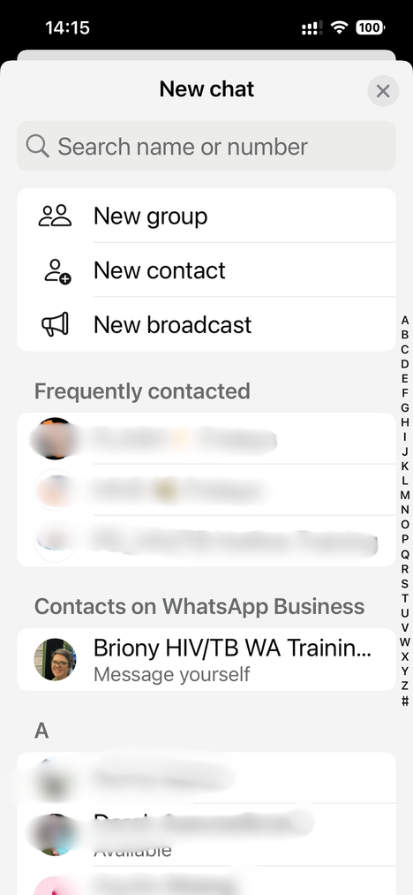
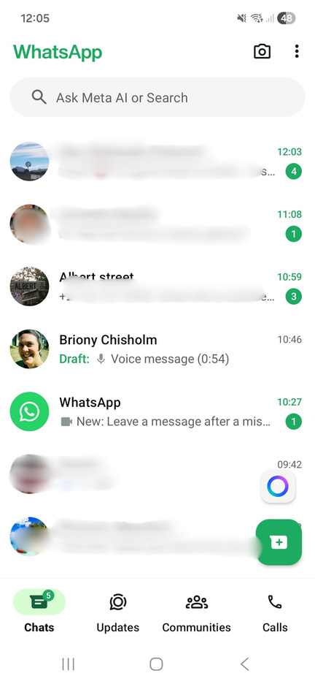
Step 3: Creating a group in WhatsApp Business
1
2
1
2
3.1 Add new group (iPhone):
Click on ‘+’ (top right) then click on
‘New group’
3.2 Add new group (Android):
Click on three dots (top right) then click on
‘New group’
8

Slide 9
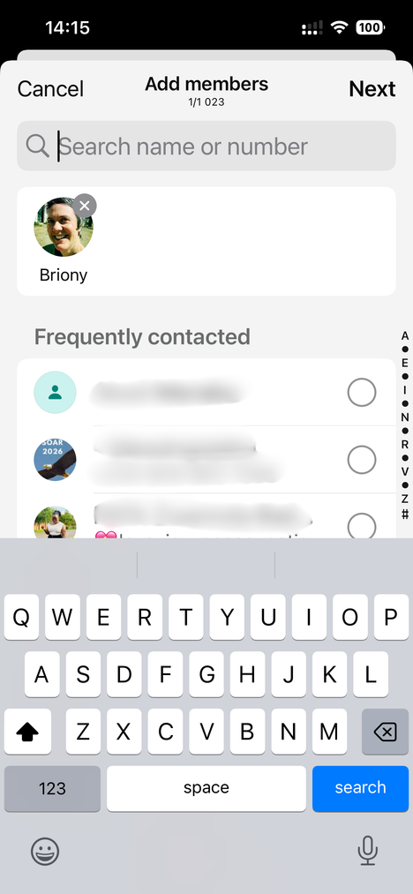
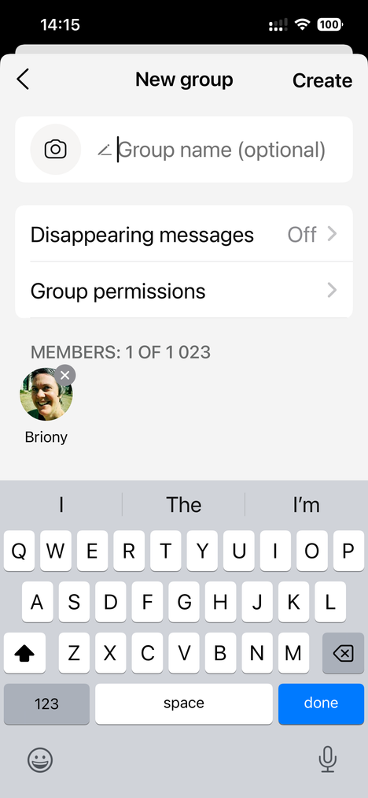
Step 3: Creating a group in WhatsApp Business
3
4
5
3.3 Add members
Add people who will be in the training group, then, click ‘Next’.
If nobody has joined yet, just click ‘Next’
3.4 Name the group
Name the group something recognisable,
e.g. Test Training Group
3.5 Group permissions
Click on ‘Group permissions’
9

Slide 10
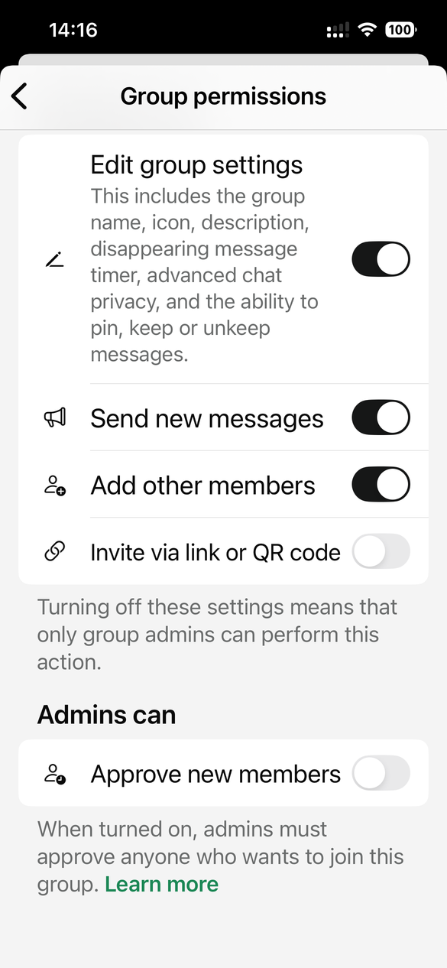
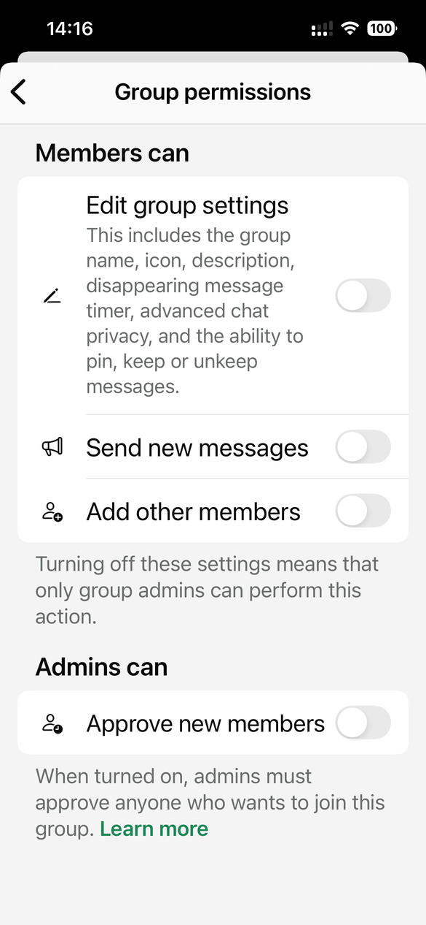
Step 3: Creating a group in WhatsApp Business
A
3.5 Group permissions
Choose the permission settings you
want for your group
Edit group settings: if left on (Image A), ALL group members can alter settings. It is preferable to turn this off (Image B)
Send new messages: if left on (Image A), ALL group members can send messages at any time. We advise you to turn this off (Image B). This can be switched on temporarily after each session to allow questions and discussion
Add other members: this can be left on (Image A) if you’re happy to allow all members to add others; or off (Image B), if not
Approve new members: if left on, this will only allow members in after admin approval. Only turn this on if you feel it’s necessary for your group. We want to be welcoming and make it easy for people to join
B
10

Slide 11

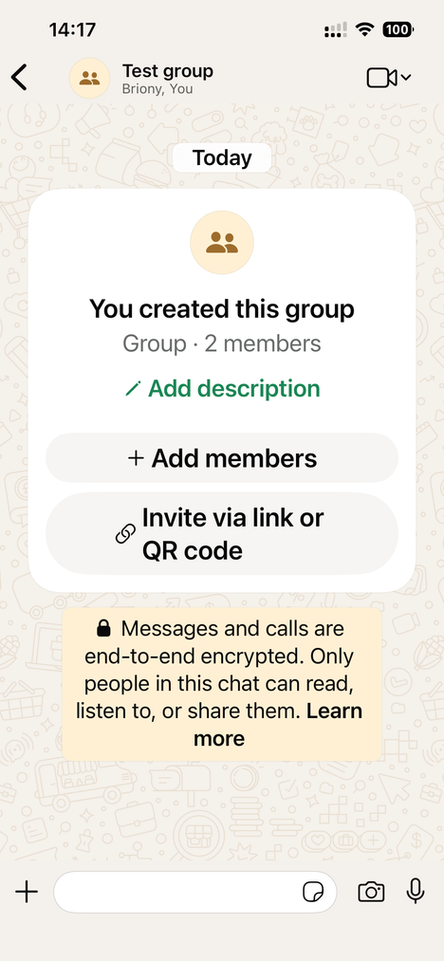
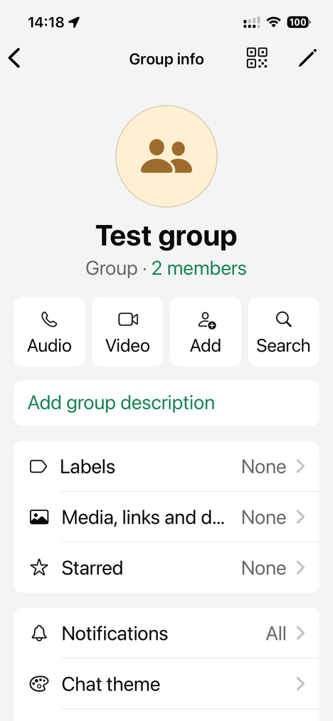
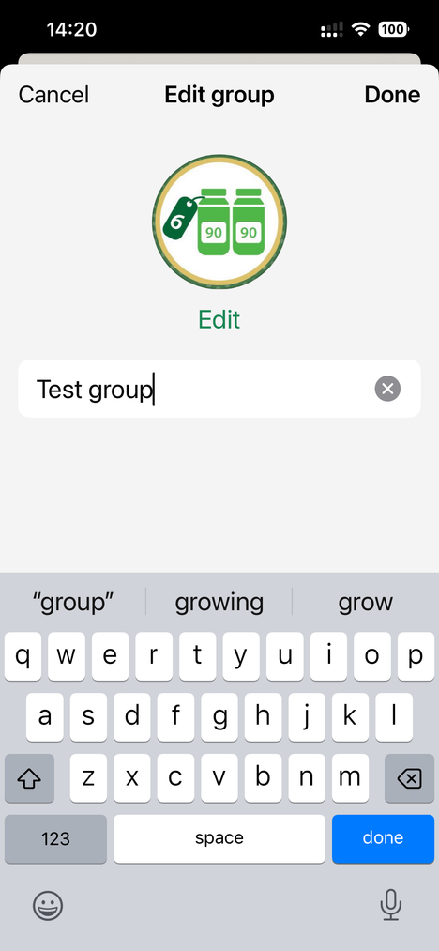
Step 3: Creating a group in WhatsApp Business
3.6 Add group settings
Click on the group name at the top
3.7 Add a group image
Click on the pen (top right, iPhone) or on the image placer (Android). Choose an image that fits the group, e.g. the 6MMD logo from the SOPs
11

Slide 12
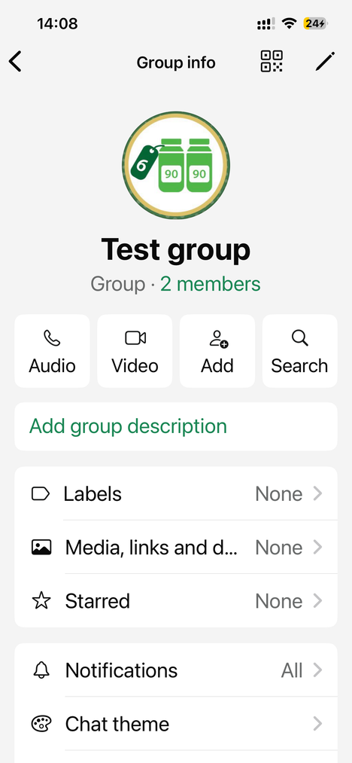
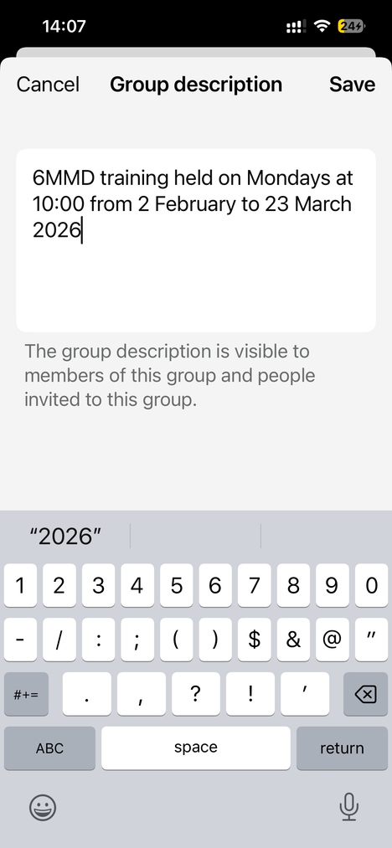
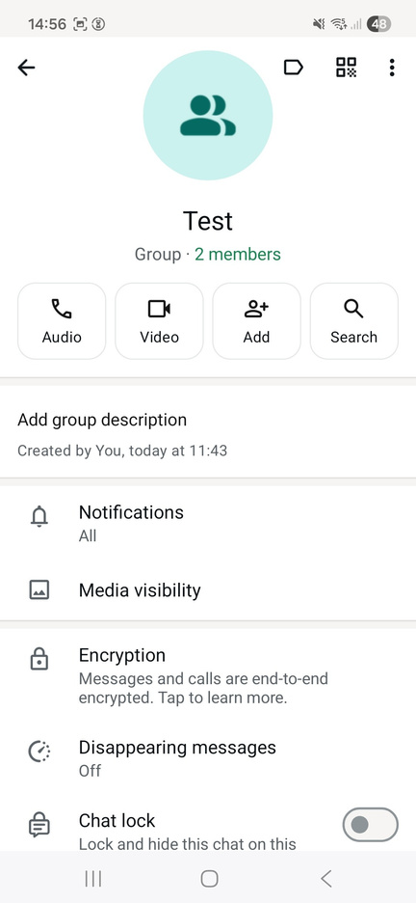
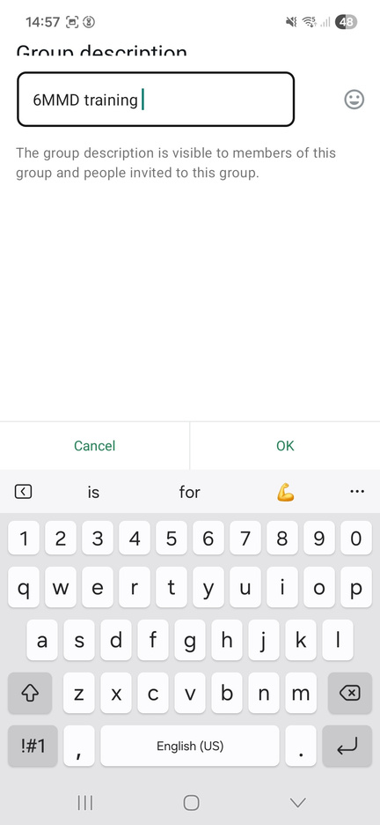
Step 3: Creating a group in WhatsApp Business
3.8 Add group description (iPhone)
Click on ‘Add group description’.
Write details of what the training is and when it will happen. Click ‘Save’
3.8 Add group description (Android)
Click on ‘Add group description’.
Write details of what the training is and when it will happen. Click ‘Save’
12

Slide 13
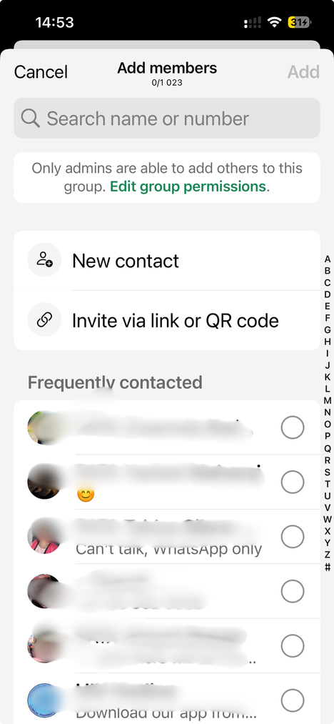
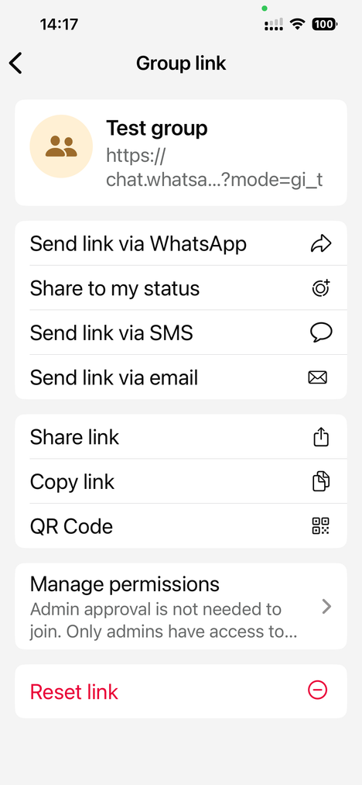
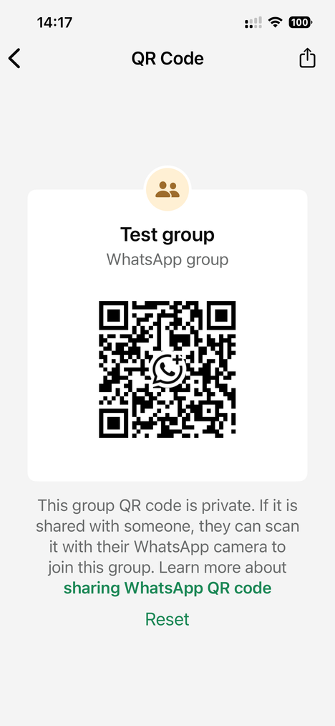
Step 4: Adding people to join the group
4.1 Inviting people to ‘self-join’ (preferred option)
We want to be welcoming and make it easy for people to join
Send invite link and/or QR code
Click on Group name at the top.
Scroll down and click on ‘Invite via link or QR code’.
Share the link and/or QR code in whichever format is easiest
13

Slide 14
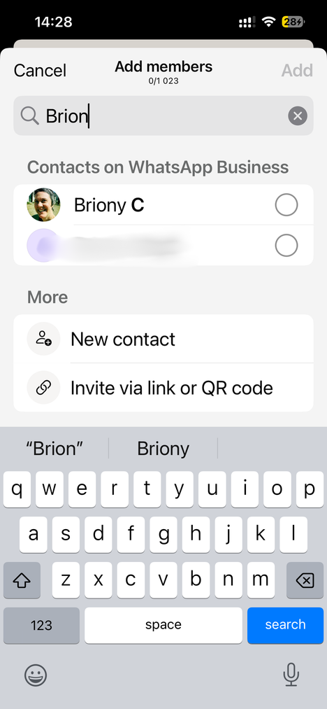
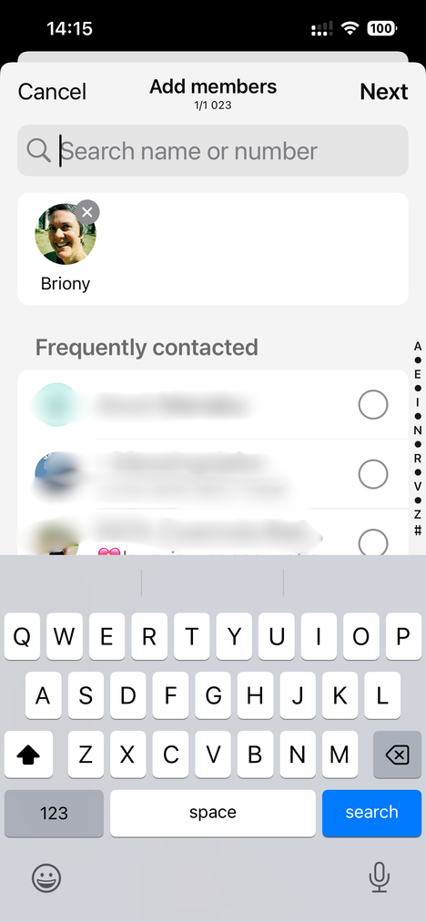
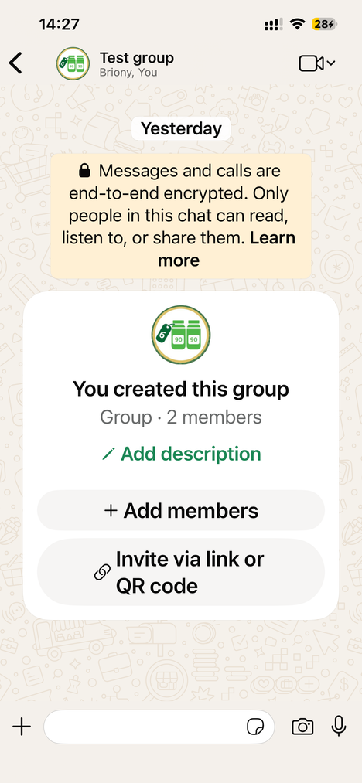
Step 4: Adding people to join the group
4.2 Adding people manually
Add members manually
Click on ‘Add members’
OR
Click on Group name at the top and then click ’Add’
Add members manually
Add members from your contacts by typing their names in the search box, then clicking on their names
14

Slide 15
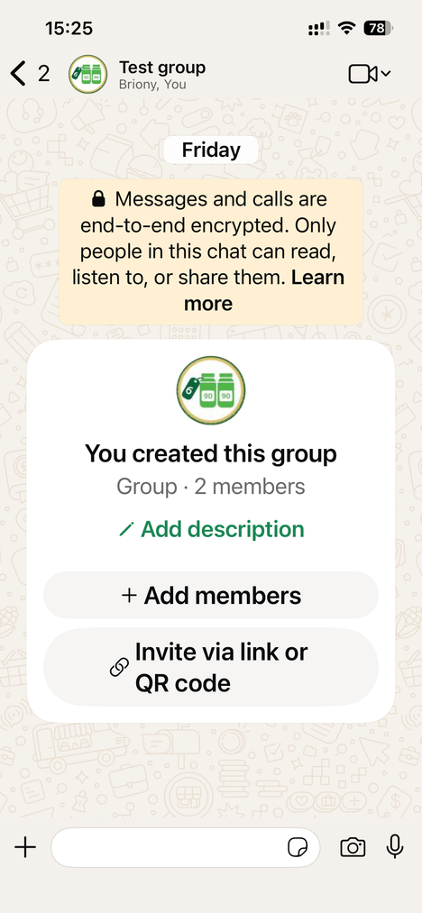
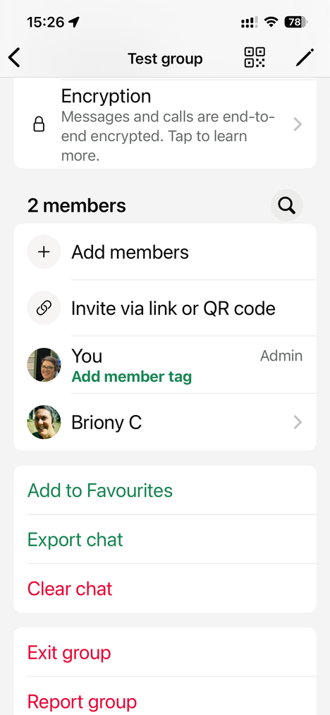
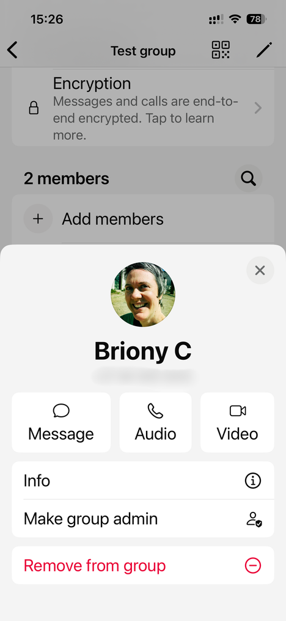
Step 5: Making admins
Always have a number of trusted admins in case of inadvertent bans
These bans are usually temporary and can be appealed
Click on group name
Scroll down to ‘members’ and choose the one you want
to be admin
Click on ‘Make group admin’
15

Slide 16
Tips and tricks when adding participants
WhatsApp is sensitive to any actions that could be considered spam (adding too many people, too quickly; sending the same message to too many people). Sticking to a few rules will minimise the risk of being banned (usually temporary):
  Only add people who have consented to be part of the group: adding people who have not agreed to be part of the group may get you banned from WhatsApp
  When adding participants - even those who have consented - do so slowly: adding too many people at a time may get you banned from WhatsApp
  Ideally, participants should join the group themselves, using the link or QR code. If you want to keep tight control of who is in groups, leave ‘Approve new members’ on in the settings. This will mean you/admin review new participants before they’re allowed in the group
16

