Slide 1

Part 6
Planning to run a training group on
WhatsApp Business
Citation: Chisholm B. DIY WhatsApp-based microtraining. 2026. Available from: https://www.differentiatedservicedelivery.org/resources/diy-whatsapp-based-microlearning/
Need help? Contact Briony on briony.c@icloud.com

Slide 2

Recruitment and training group creation
Marketing and admin
WhatsApp group creation
  Ongoing advertising of the training through relevant channels
  Group management plan
WhatsApp group is populated as sign-ups happen
Recruitment and WhatsApp group creation
Microlearning
familiarisation
Planning
Finalisation of WhatsApp group
  Human resource allocation
  Establish key dates
  Establish recruitment plan
  Create sign-up survey
Introduction to microlearning for all leads involved in recruitment and/or participants
  WhatsApp group is populated as sign-ups happen
  Group management: monitoring participation

Slide 3
In this section
  Step 1: Assemble the crew
  Step 2: Establish key dates
  Step 3: Establish marketing and recruitment plan
  Step 4: Intro to creating a sign-up survey
  Step 5: Creating a survey in SurveyMonkey

Slide 4

Step 1: Assemble the crew
Start planning as early as possible:
preferably a minimum of 8 weeks before the training starts
Key human resources to consider when planning the training:
  Facilitator and moderator
  Administrative assistant(s) for sign-ups
  WhatsApp admin(s) within the group
  Tracking participation
Not all groups will require all of these people: it will depend on group size and individual requirements
4

Slide 5
Step 1: Assemble the crew
1.1 Facilitator and moderator: questions to answer
Who will facilitate the training (deliver the messages)?
Is it necessary to have a moderator/second facilitator?
Who will answer questions in the training?
Will questions be discussed with a subject expert and answered later?
A second person (facilitator) is optimal, and for groups > 100, recommended
5

Slide 6

Step 1: Assemble the crew
1.2 Administrative staff: questions to answer
Is a sign-up survey needed?
This will depend on what info you need from participants (if any) and how controlled you want the group to be
WhatsApp admin(s)
It is advisable to have at least two people as admins in groups
If a sign-up survey is needed:
  Who will design the sign-up survey?
  Who will collect responses?
  Who will add participants?
Important considerations for WhatsApp groups:
  Whose number will be used for the training?
  Who will create the WhatsApp group?
  Who will the admins be?
Training needs to be done in WhatsApp Business to ensure the facilitator has control in sessions (see Part 3). It’s recommended that a separate number (i.e. not a personal number) is used, especially in bigger groups.
6

Slide 7
Step 2: Establish key dates
  When will the training happen?
  When will registration open and close?
  What day(s) will training take place?
  What time will training take place?
Open registration: 5 January
Close registration: 16 February*
Training starts: 2 March
Training
Mondays at 13:00 from
2 March to 20 April
*Always give a closing date but allow people to join to the end -
we want to welcome everyone
Take the participants’ (who will be part of the group) workdays into account and choose a time that will be best for the majority.
Ideally, ask participants themselves.
7

Slide 8
Step 3: Establish marketing
and recruitment plan
If you’re running a training group, you ideally want everybody
who will benefit from the training to join:
cast the invitation net wide and make it easy to join
Key questions to answer:
  Who are the target participants?
  How can you contact those people?
  Do you need to create an invitation or message to send?
Decide on a simple recruitment plan
8

Slide 9


Step 3: Recruitment plan
If you’re running a training group, you need buy-in to ensure that everybody
who will benefit from the training knows about it and can join
NDoH provincial lead
Concept of microlearning discussed and aligned
Teams meeting with district stakeholders
(HAST coordinators, NCD coordinators, clinicians, and pharmacists)
Microlearning platform introduced; guidance provided on signing-up
  Monitor the number of clinicians per facility
  Daily reports to NDoH provincial team
Strengthen coordination by adding provincial, district, and sub-district programme and training leads from DoH on Microlearning WhatsApp groups
Registration invite shared across all NDoH WhatsApp groups
Targeted support provided to
facilities where enrolment is low
9

Slide 10



Step 4: Create a sign-up survey
Only do this if you need participants’ details, to track each one’s participation, and/or have tight control over groups:
each extra step may discourage people from joining
Numerous survey-making tools are available online, including
SurveyMonkey
Each survey tool works slightly differently but they all guide the designer through the process
Google Forms
Surveyplanet
10

Slide 11
Step 4: Create a sign-up survey
Questions that can be included
in the survey
  Consent to participate and/or data to be used for reporting
  First name/surname
  Age
  Gender
  Phone number with WhatsApp
  e-mail address
  Profession/cadre
  Country/province/district/town
  Facility
  Sector (public/private)
  Years of clinical practice
If designing a survey, follow Edward Tufte’s summary of achieving survey design excellence:
Remember
Only ask for data that you really need
“Ask the simplest, clearest questions in the shortest time using the fewest words on the fewest pages and, most importantly, ask
only what you need to know.”¹
Important note: if you collect people’s personal details, be aware of the POPI Act
11
  Tufte E. The visual display of quantitative information. Cheshire, CT, USA: Graphics Press, 1999.

Slide 12
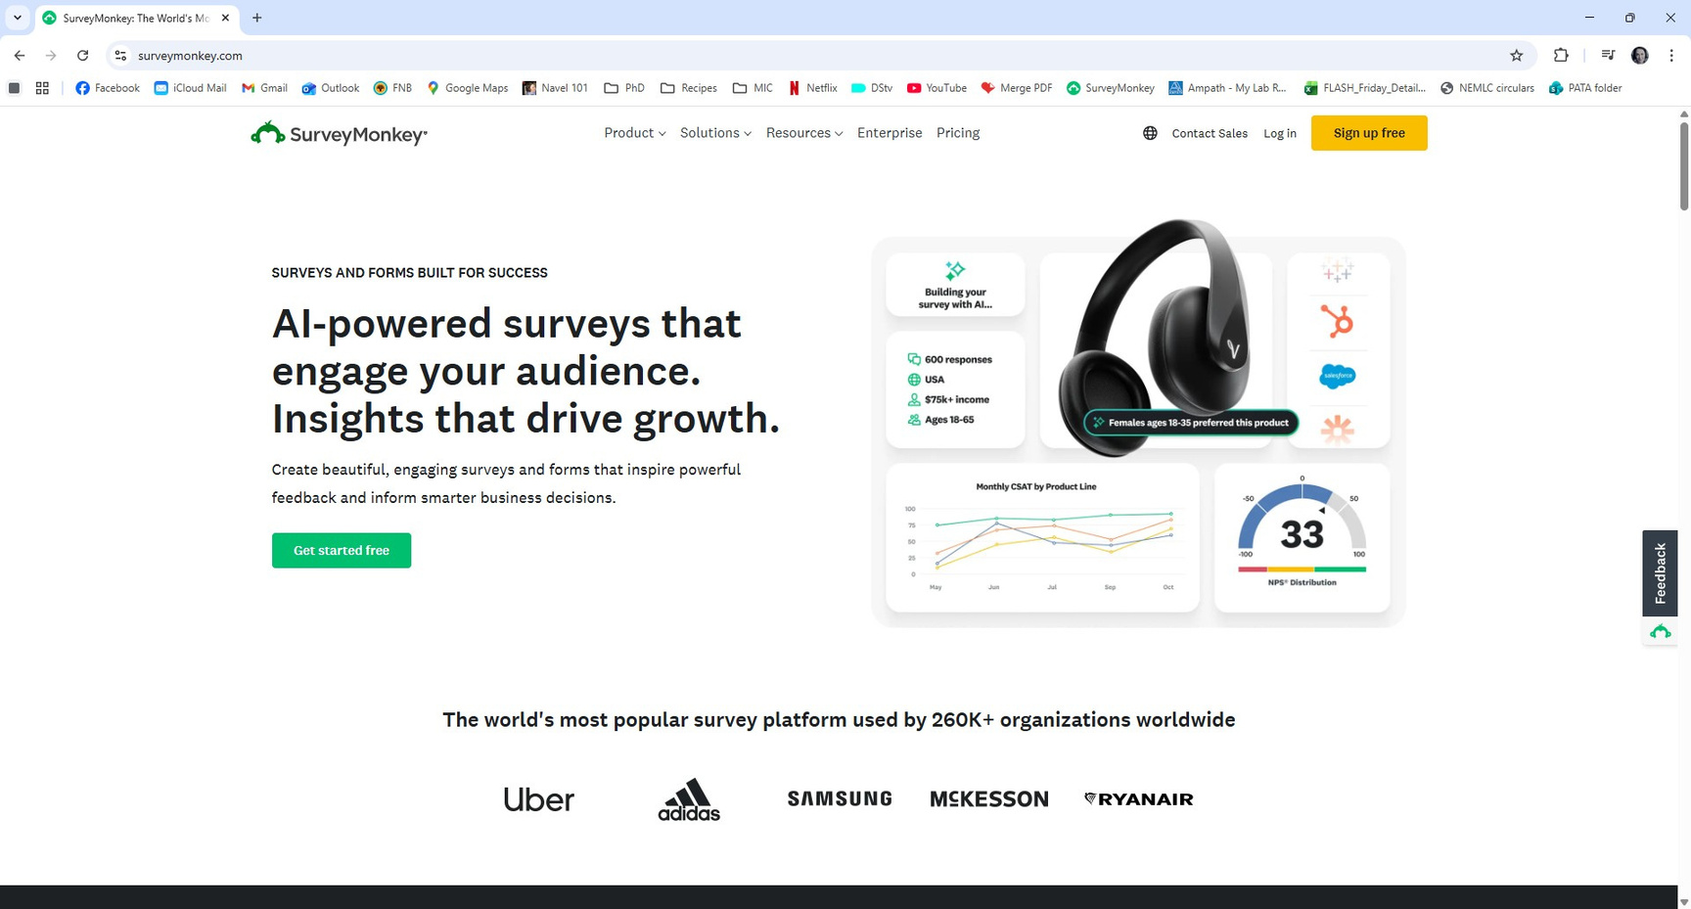
Step 5: Step-by-step guide to making a survey in SurveyMonkey
5.1 Open SurveyMonkey using the link: https://www.surveymonkey.com/
5.2 Click on ‘Sign up free’, create a free account and answer sign-up questions
12

Slide 13
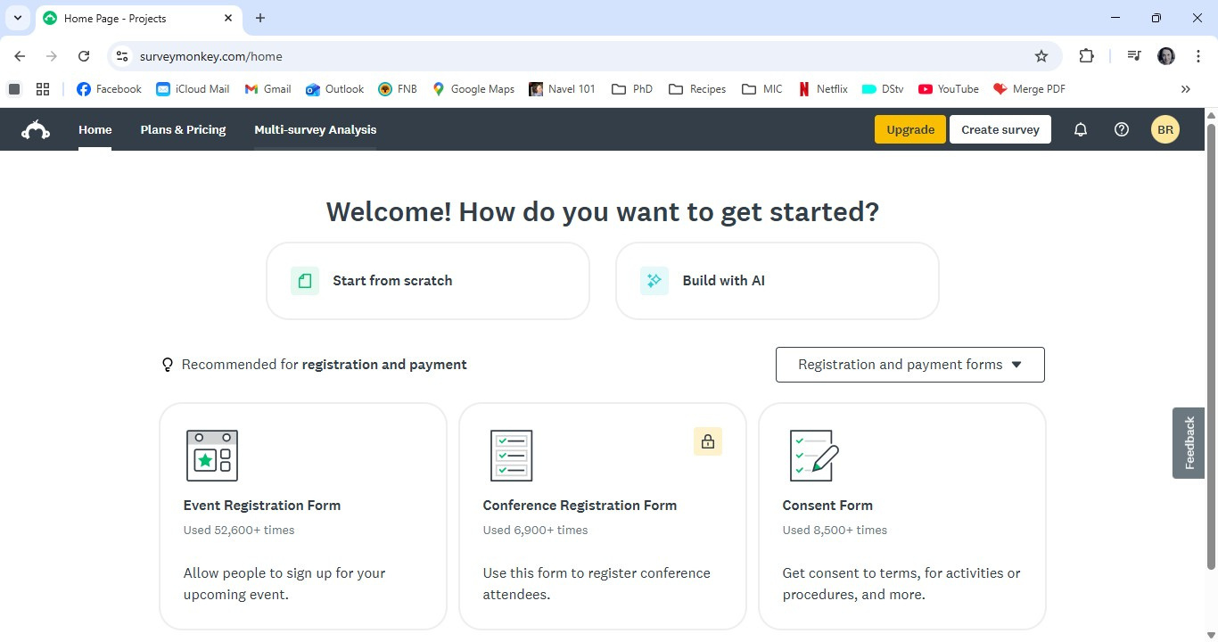
Step 5: Step-by-step guide to making a survey in SurveyMonkey
5.3 Click on ‘Start from scratch’ and a new blank survey will come up
13

Slide 14
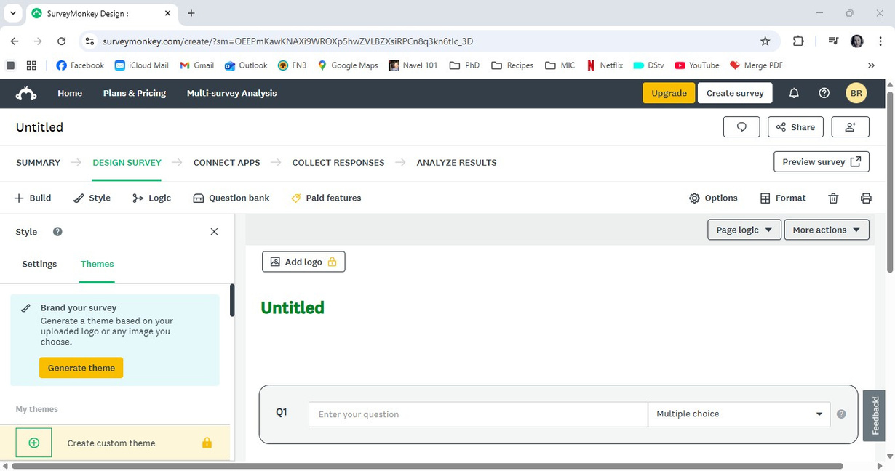
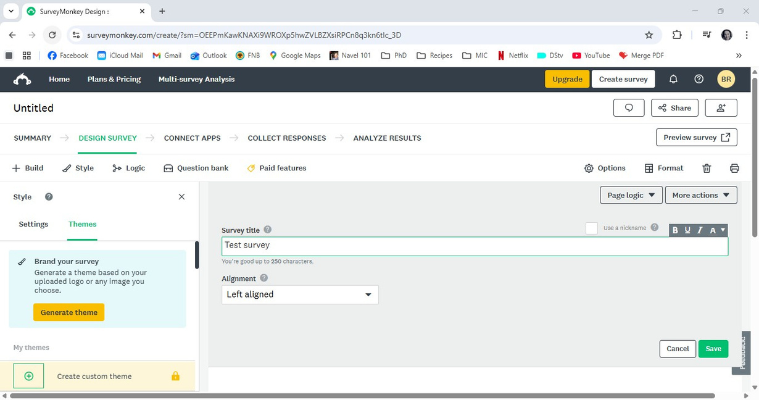
Step 5: Step-by-step guide to making a survey in SurveyMonkey
5.4. Add a logo, if you wish to, by clicking on ‘Add logo’ and choosing one from your own images, then click on ‘Untitled’
5.5 Give the survey a title; click ‘Save’
14

Slide 15
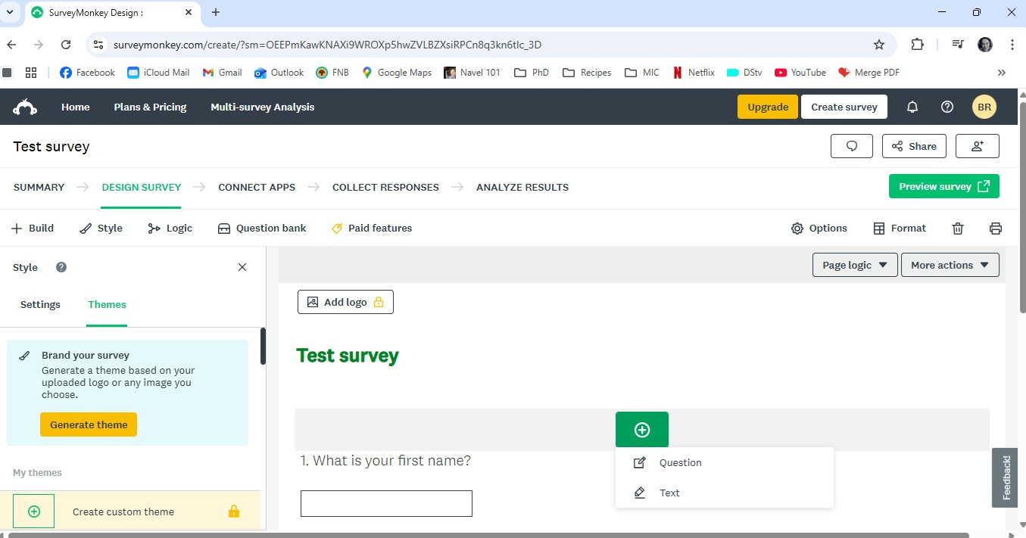
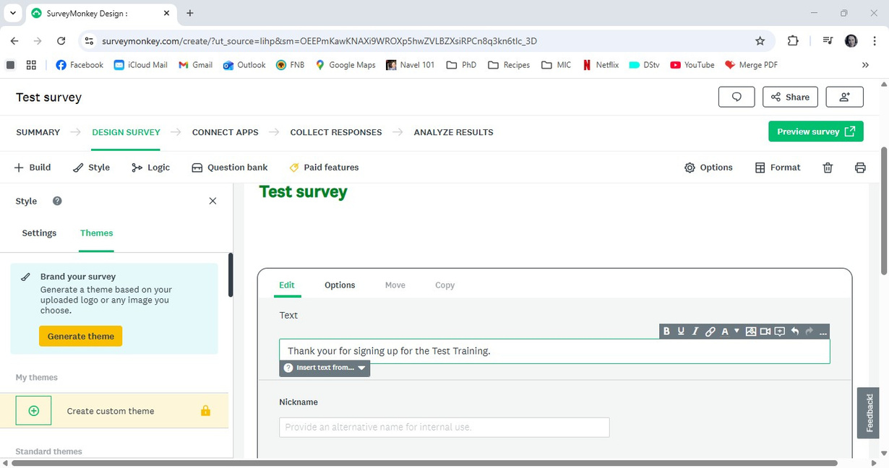
Step 5: Step-by-step guide to making a survey in SurveyMonkey
5.6 Add a welcome note by clicking on ‘+’ and then ‘Text’
5.7 Add a text welcome note with details of when the training will happen. You can use editing tools by clicking on ‘...’
15

Slide 16
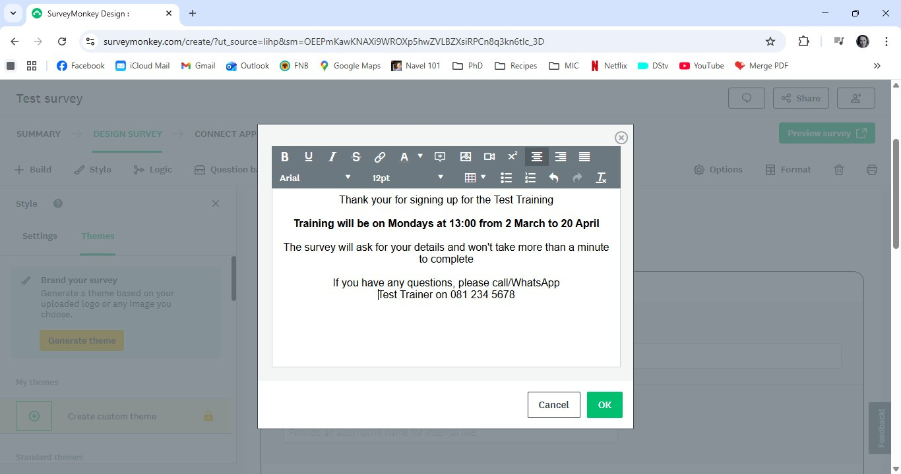
Step 5: Step-by-step guide to making a survey in SurveyMonkey
5.8 Edit the welcome note as you wish and click ’OK’ and then ‘Save’
16

Slide 17
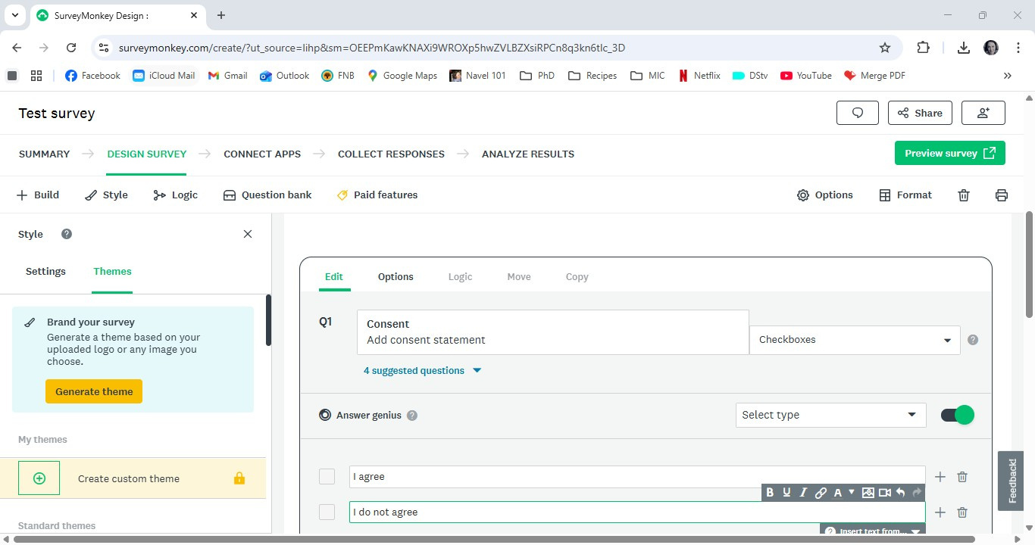
Step 5: Step-by-step guide to making a survey in SurveyMonkey
5.9 Add the first question as consent: click on ‘+’ and then ‘Question’
5.10 Type the consent statement as the question. Choose ‘Checkboxes’ from the dropdown list. Add
‘I agree’ and ‘I do not agree’ as answers. Click on ‘Save’
Consent
By completing this survey, you consent to share your details with the service provider.
These details will be used only for reporting purposes. Any publications resulting from this training will use anonymised data.
17

Slide 18
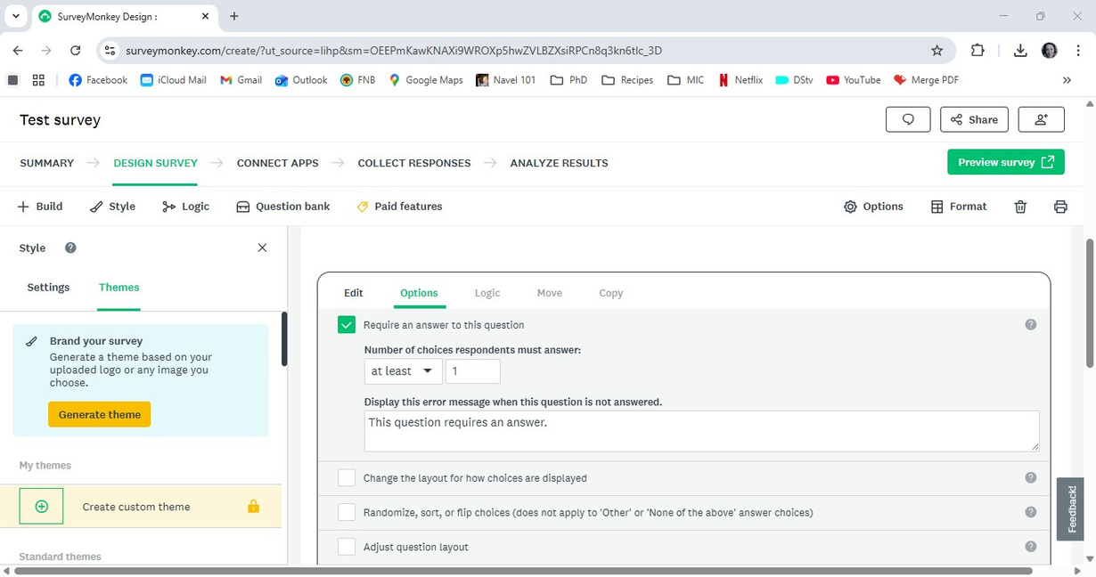
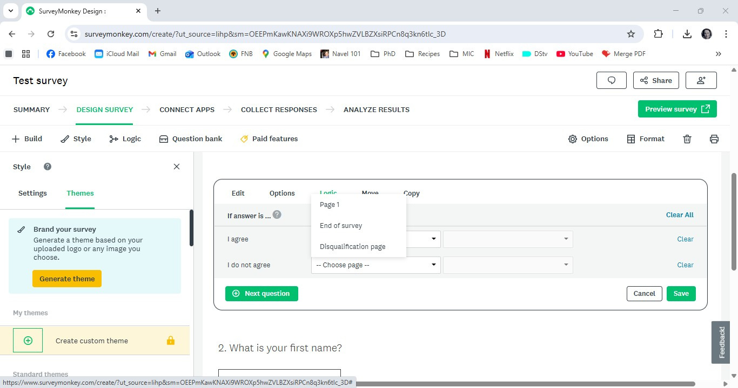
Step 5: Step-by-step guide to making a survey in SurveyMonkey
5.11 Click on ‘Options’ and tick the box that says ‘Requires an answer to this question’. Click on ‘Save’
5.12 Click on ‘Logic’, click on the dropdown list next to ‘I do not agree’, choose ‘Disqualification page’. Click on ‘Save’
18

Slide 19
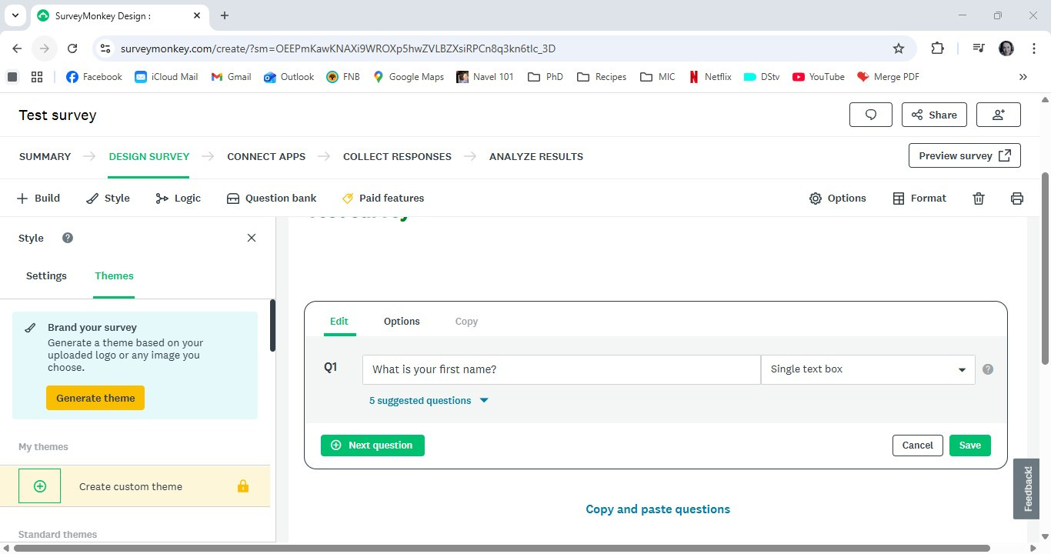
Step 5: Step-by-step guide to making a survey in SurveyMonkey
5.13 Add all the questions you want to have in the survey: click on ‘+’, then ‘Question.
Pick the type of answer you want from the dropdown list and add answers. Click on ‘Save’
5.14 If you want a question to be compulsory, click on ‘Options’, then check the box
‘This question requires an answer’, then click ‘Save’
19

Slide 20
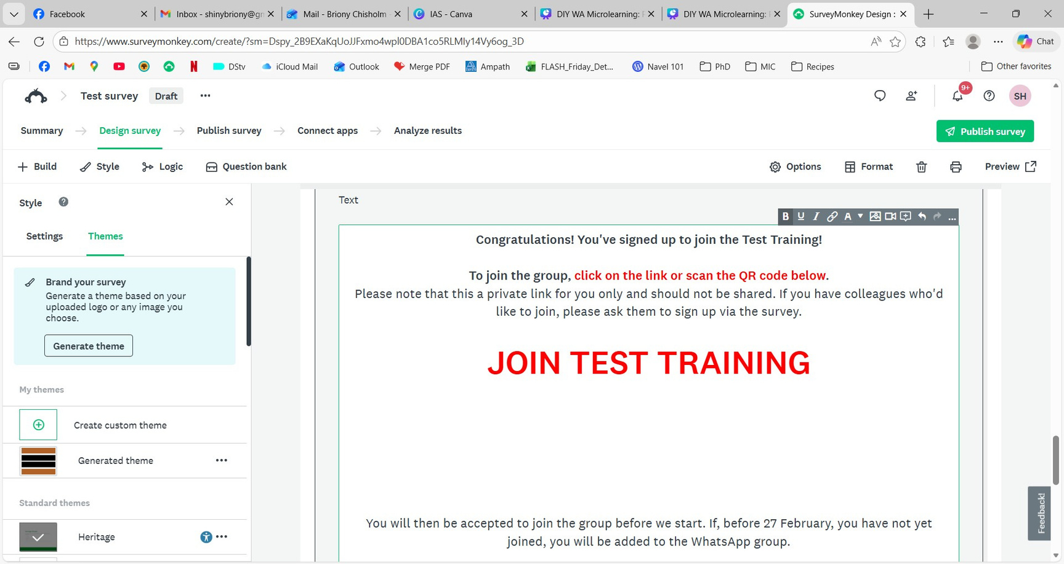
Step 5: Step-by-step guide to making a survey in SurveyMonkey
5.15 Create a final text box which should include the link and QR code to join the WhatsApp group. Click on ‘+’, click on ‘Text’ and do as you did for the welcome note.
To get full editing options, click on ‘...’. Click ‘Save’
20

Slide 21
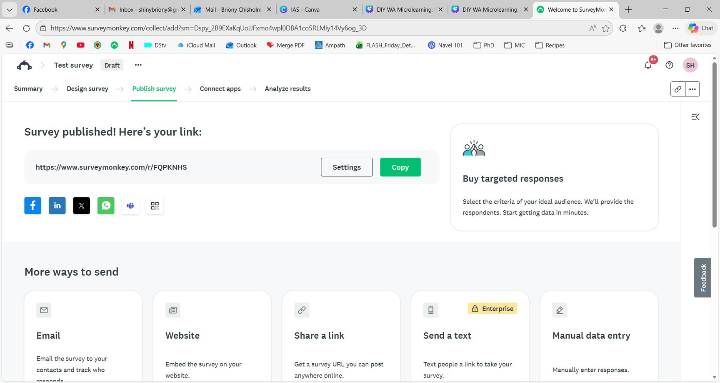
Step 5: Step-by-step guide to making a survey in SurveyMonkey
5.16 Publish the survey, by clicking on ‘Publish survey’. From this page, you can copy the survey link and QR code to add to an invitation/send to potential participants
21

Slide 22
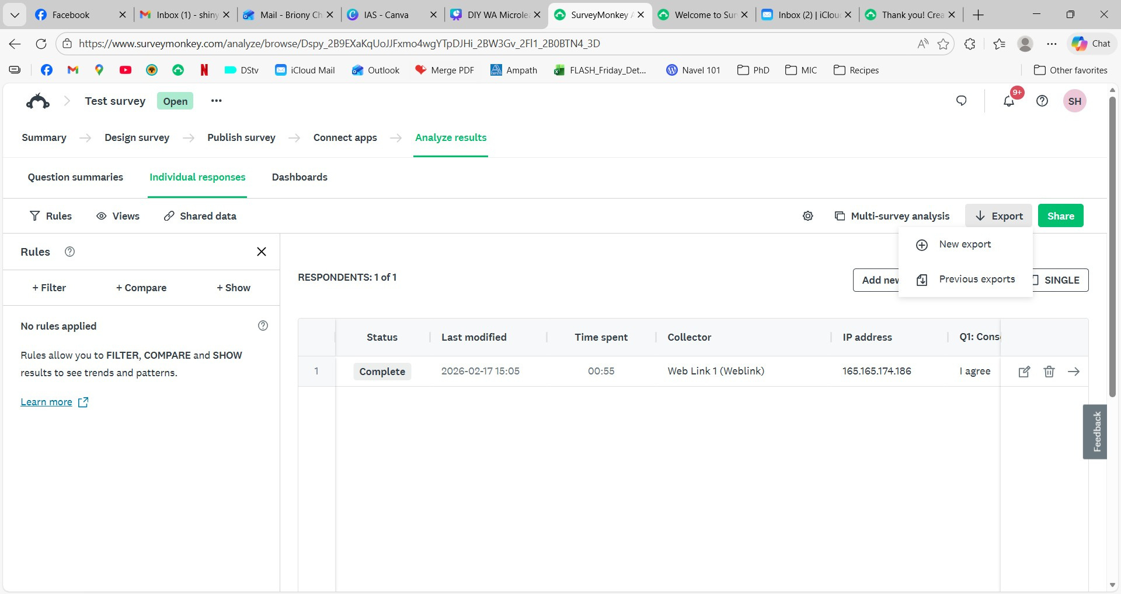
Step 5: Step-by-step guide to making a survey in SurveyMonkey
5.17 To download the sign-ups, click on ‘Analyze results’, then ‘Individual responses’, then ‘Export’, then ‘New export’
22

Slide 23
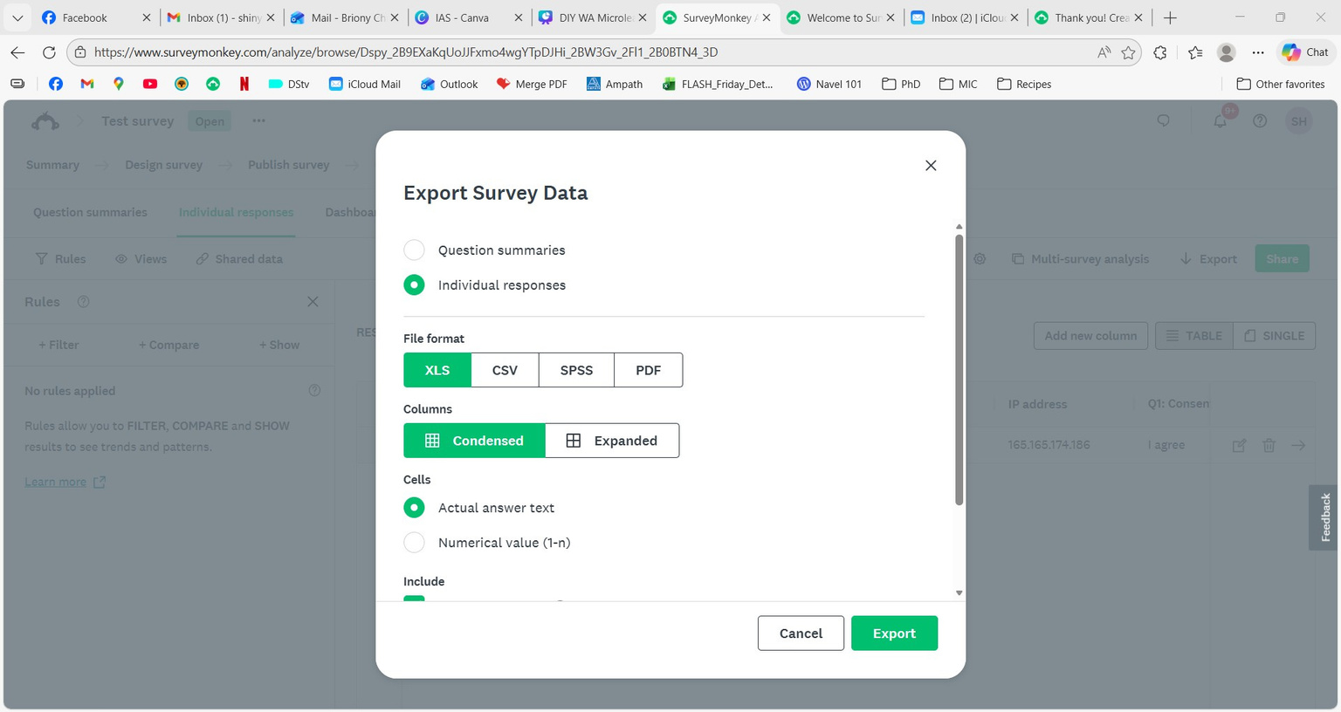
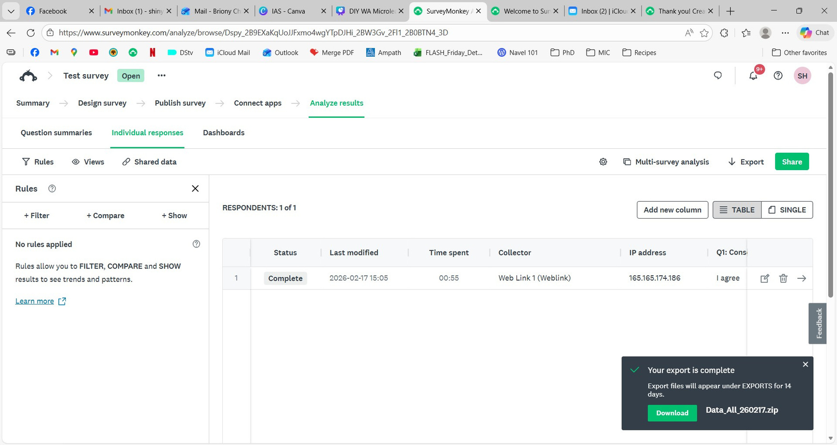
Step 5: Step-by-step guide to making a survey in SurveyMonkey
5.18 Click on ‘Export’. The file will download. Open the file in downloads and you can open the Excel spreadsheet in the folder.
23

