Slide 1

Part 5
Designing the lessons
Citation: Chisholm B. DIY WhatsApp-based microtraining. 2026. Available from: https://www.differentiatedservicedelivery.org/resources/diy-whatsapp-based-microlearning/
Need help? Contact Briony on briony.c@icloud.com

Slide 2

Components of creating microlearning sessions
Lesson design: clear steps for adaptive and iterative development of lessons
Adjustments
Subject expert review
Adjust lessons through a number of drafts and consultation with expert reviewer
Expert review of content
Review cycle
Final content review/finalisation
Planning phase
Design stage
Review guidelines and establish learning points required
Draft lessons designed
Review by organisation requesting training
2

Slide 3
In this section
  Step 1: Time planning
  Step 2: Housekeeping
  Step 3: Introduction (1st lesson)
  Step 4: Lesson structure
    Introduction
    Information messages and case studies
    Polls
    Summary text message; voice note; images
  Step 5: Review and finalisation
  Step 6: Run a pilot session
3

Slide 4
Before we start thinking about designing the lessons, remember that
we’re doing microlearning:
we’re aiming for
short, easily digestible learning points
Think of them as the learning equivalent of a snack, rather than a 3-course meal!
4

Slide 5
While the lessons themselves are the learning time equivalent of a snack, the designing of the lessons
takes time
Make sure that you set aside enough time to design - and check (and check, again) - the lessons before your proposed training time
We generally start at least 6 weeks before the
training sessions are starting
5

Slide 6
Step 1: Time estimates
for an 8-session module
  First draft design: 1-1.5 days/lesson x 8 sessions = 8-12 days
  Technical review: 0.25 days/lesson x 8 sessions = 2 days
  Clinical review: 0.25 days/lesson x 8 sessions = 2 days
  Second draft: 0.5 days/lesson x 8 sessions = 4 days
  Technical review: 0.25 days/lesson x 8 sessions = 2 days
  Clinical review: 0.25 days/lesson x 8 sessions = 2 days
  Final draft: 0.5 days/lesson x 8 sessions = 4 days
  Final review by independent reviewer: 2 days
28 days/6 weeks
Important things to remember
  Some modules may need more review rounds, others fewer: plan for this
  Take everyone’s work/travel commitments into consideration, at the beginning: these reviews may not be able to be done consecutively/immediately
  Share an agreed timeline for each round of reviews
6

Slide 7
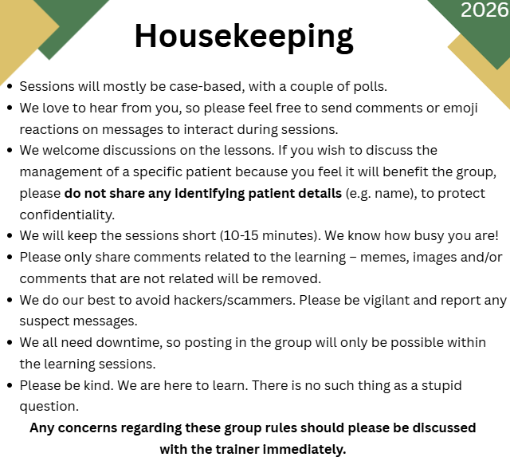
Step 2: Housekeeping
Rules of conduct
  Before each session, housekeeping rules must be sent: they can be sent 15 minutes before the lesson starts, as a reminder of the session
  Text or image
  When writing housekeeping rules, be sure to include patient confidentiality and any other privacy rules applicable in the country
7

Slide 8

Step 3: Introduction/welcome
in the first session
Briefly introduce yourself and any co-facilitator(s)
Introduce the format of the training
Give the dates/times that training will happen
Briefly introduce the subject and how it will be divided over the X sessions
8

Slide 9
Introduction example
Briefly introduce yourself and any co-facilitator(s)
WhatsApp formatting
* * bolds text between asterisks
_ _ italicises text between underscores
Hello, welcome, and thank you for joining us for this short introductory session. 👋
This is a text-only session. *Please do not start a group call.*
A quick introduction. This training was developed by [insert name(s)], a [insert brief bio/affiliation(s)].
In the group are our moderators [insert name(s)].
❓If you have any questions, comments, suggestions or criticisms during the training, you are welcome to ask the training facilitators by messaging them directly or putting them in the chat at the end of the session.
9

Slide 10
Introduction example
Introduce the format of the training and dates/times that training will happen
In this training format, we'll have [insert number of sessions] sessions over [insert number of weeks], held 'live' in this WhatsApp group:
  [Insert frequency] a week on *[insert days and time]*
  10-15 minutes, 'live'
  Sessions will consist of info, case studies, polls and a short open session for questions/interaction
  If you're unable to attend 'live', you will be able to read through the sessions and answer polls when you have time
*Please feel free to interact and ask questions: the more we interact, the more we’ll learn from
each other.*
10

Slide 11
Introduction example
Briefly introduce the subject and how it will be divided
This module will teach *[Insert name of module, e.g. Viral load monitoring during pregnancy and breastfeeding]* from the [Insert main reference used, e.g. the 2021 WHO Consolidated Guidelines].
The module will be divided into [insert number of sessions] as follows:
  Session 1: [Insert topic, e.g. VL monitoring during pregnancy]
  Session 2: [Insert topic, e.g. VL monitoring during breastfeeding], etc.
🙌🏾With the admin done, let's start!
11

Slide 12

Step 4: General lesson structure
Each session contains:
  Introduction/welcome
  1-4 case studies
  4-6 polls with answers
  Information messages
  Summary text message
  Summary voice-note
  Summary image (PNG)
In some instances, one case may be used through multiple sessions, e.g., following an AHD treatment algorithm
12

Slide 13
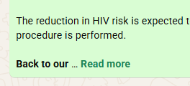
Body of each lesson
  Aim for a maximum of 30 to 40 - short - messages which will be sent over the 10-15 minutes of each session (including intro, closing, images and voice note)
  Test each message on WhatsApp to make sure the whole message shows: avoid the ‘... Read more’
🛑
  Use ‘roadblocks’ to illustrate different scenarios
13

Slide 14
Short introduction to each lesson
  Single message to highlight what was learnt in the last session and introduce what will be taught in this session
In our last session, we discussed family planning and pre-conception care for our women living with HIV.
Today, we’re going to look at the *recommended monitoring during the perinatal period for women living with HIV*.
Let’s jump in with a case.
14

Slide 15

Lesson structure: Body of the lesson
Example: VL testing during the perinatal period (I)
Case: Woman booking pregnancy
Poll: What screening/labs are required at ANC booking?
Learning point (reply to poll): Screening at ANC booking
Information message: TB-NAAT for all at booking
Poll: How often to do VL during pregnancy?
Learning point (reply to poll): VL monitoring during pregnancy
Follow-on to case: Has the baby
Information message: Aligning mother-baby visits
15

Slide 16
Lesson structure: Body of the lesson
Example: VL testing during the perinatal period (II)
Poll: How often to do VL during breastfeeding?
Learning point (reply to poll): VL monitoring during breastfeeding
Information message: Exclusive breastfeeding until 6 months
Roadblock: Her VL is > 50 c/mL
Learning point (reply to poll): Steps to follow if unsuppressed
Poll: When do we repeat her VL?
Learning point (reply to poll): VL monitoring during pregnancy,
if unsuppressed
🛑
16

Slide 17
Lesson structure: Information messages
  Keep it simple and work through each learning point, one-by-one
  Highlight important words by bolding or italicising
  Use emojis to break up text (and make it fun)
WhatsApp formatting
* * bolds text between asterisks
_ _ italicises text between underscores
When a PLHIV has made the decision to come back after disengaging from care, they are *in our facility with their own feet* 😃 and *a commitment to try again*. We don't need to use our scarce resources to trace and encourage re-engagement (expensive and only partially effective).
_We have the perfect opportunity to affirm their decision to return and help prevent future disengagements._
So, who IS considered a re-engaging client?
Lead into a case study
17

Slide 18
Lesson structure: Case studies
  Keep cases short and simple, but include all relevant details
  Make sure they are clinically sound
  Learning points can be included in cases
*Let’s look at a case:*
Sandy, 22, is booking her pregnancy at 12 weeks. She has been on TLD for 4 years and has done very well on it. Her last VL - 6 months ago - was < 50 c/mL.
*Let's look at a case that is a bit more complicated:*
Charmaine, 29, is booking her pregnancy at 13 weeks. She was started on ART in 2016 (TEE) and switched to TLD in 2020. In 2021, she disengaged from care. She has not been on treatment since and is clinically well.
Charmaine is restarted on ART today (TLD).
*Getting expectant mothers on ART and helping them stay on it to keep their VL suppressed is the best way to protect their babies.*
18

Slide 19
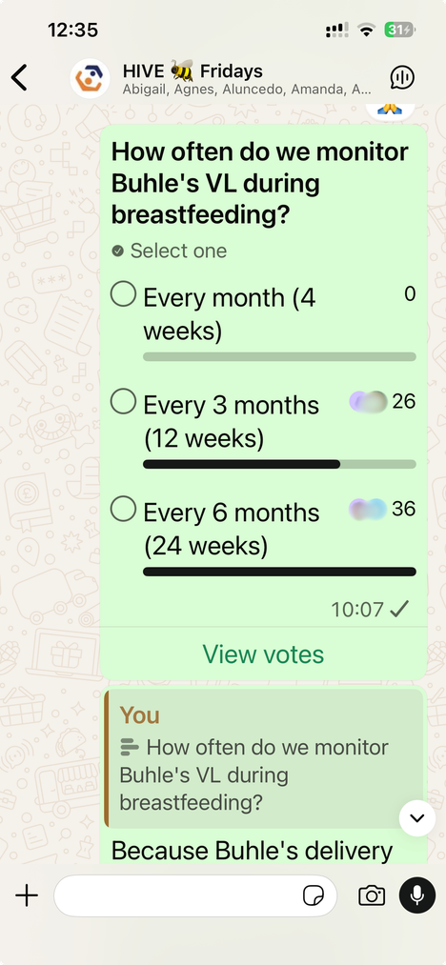
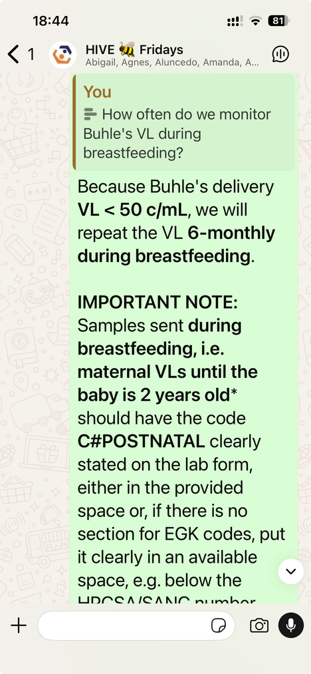
Lesson structure: Polls
  Only use learning points that are black and white, i.e., no grey areas or chance of ambiguity
  Keep questions and answers short and to the point
  Test all polls after writing them
WhatsApp limits
Question: 255 characters
Answers: 100 characters
19

Slide 20

Lesson structure: Summary text message
WhatsApp formatting
* * bolds text between asterisks
_ _ italicises text between underscores
  Summary of learning points from the session
  Use bullet points and bolding
*We’ll end there with a short summary :*
  Women who are currently on ART: VL is done on the *day of booking*
  In pregnant women established on ART whose VL on their *first ANC visit is < 50 c/mL*: VL is *repeated at delivery*
  Pregnant women *restarting ART or newly initiated* on ART: VL is done at *3 months* on ART
  In pregnant women with a *VL > 50 c/mL*: VL should be repeated after *4 weeks*
  A VL is done *at delivery in all women* on ART
Keep it short and sweet!
20

Slide 21
Lesson structure: Voice notes
  Can be pre-recorded (MP3 or M4A file) or read live
  Summary of learning points from the session
  Try to keep the voice note short: 1 to 1 ½ minutes, max
  Practice reading the message aloud - slowly and clearly
A voice-note recap:
In women who are currently on ART and booking their pregnancies, a VL is done on the day of booking. In pregnant women established on ART whose VL on their first ANC visit is < 50 c/mL, the VL is repeated at delivery. In all pregnant women restarting ART or newly initiated on ART, the VL is done at 3 months on ART. A VL is done at delivery in all women on ART. Remember, an elevated VL in a pregnant or breastfeeding mother is a medical emergency and must be managed immediately!
21

Slide 22
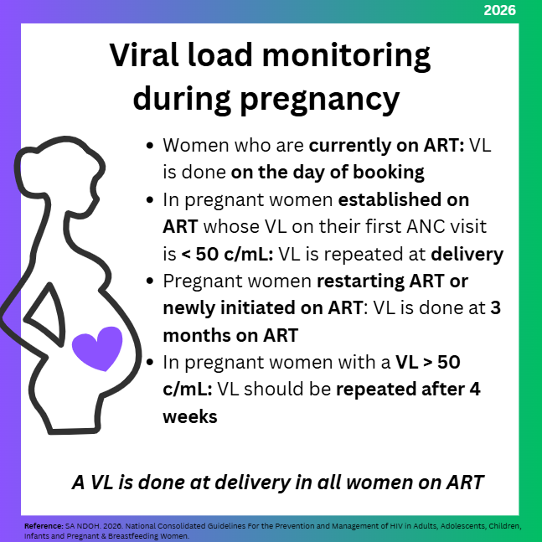
Lesson structure: Images
  Generally, just used for summary at the end, but, if needed, can have images in body of lesson
  Use bullet points and graphics
  Date stamp the image
  Include the reference(s) used
  Check ... and check again
22

Slide 23
Step 5: Review the lessons
Review → adjust → review →
  A couple of rounds of review are often needed
  Try to do first rounds by e-mail
  Often easier to do a final round in a meeting (virtual or live)
Lesson designer
Technical expert
Check that lessons are technically correct
Note
In some cases the technical and clinical check can be done by the same person
Clinical expert
Having a timeline established from the start is vital
Check that cases are clinically correct
23

Slide 24

Final content review/finalisation
Send for review by the organisation requesting training:
there may be a couple of rounds of review
Lesson designer
Organisation
This final review ensures fidelity to guidelines
and national processes
24

Slide 25
Step 6: Run a pilot session
Agree learning points
Develop
lessons
Technical
review
Pilot
Refine
Train facilitators
Training
Recruitment and group creation
  Running a pilot with a small group first irons out any errors and/or points that participants might find confusing
  When running the pilot session, ask for input from participants
25

Slide 26

Tips and tricks
  Set up your computer to make the process easy for you
  Test lessons in WhatsApp so you can work out timing, and make sure you don’t put too much info in each message and poll questions and answers
  Use emojis!
You can never check/proofread too many times!
26

