Slide 1
Five priority actions for differentiated ART delivery in West and Central Africa
ICASA 2019 satellite
Differentiated ART delivery approaches for West and Central Africa: From pilots to plans for scale-up
Anna Grimsrud, International AIDS Society
4 December 2019

Slide 2
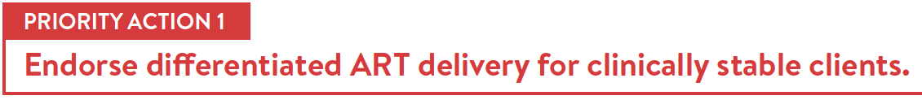

Support 90-90-90 targets where WCA is lagging
Make services more accessible without providing comprehensive services everywhere
Reduce HIV-related stigma
Notes:
The first is the need for differentiated ART delivery for clinically stable clients to be endorsed. It makes sense to start with this population – to highlight that people with HIV can lead normal lives, productive lives. This can support stigma reduction and lead to improvements across the HIV care cascade. There are also health systems gains from DSD – we have seen in east and southern Africa quick scale up alongside both client and health care worker satisfaction.
Differentiated ART delivery for clinically stable clients is endorsed in policy in the Cote d’Ivoire, DRC, Ghana, Guinea, and Sierra Leone and in final discussions in the Central African Republic and Nigeria.

Slide 3
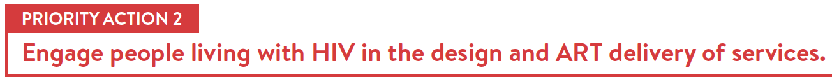
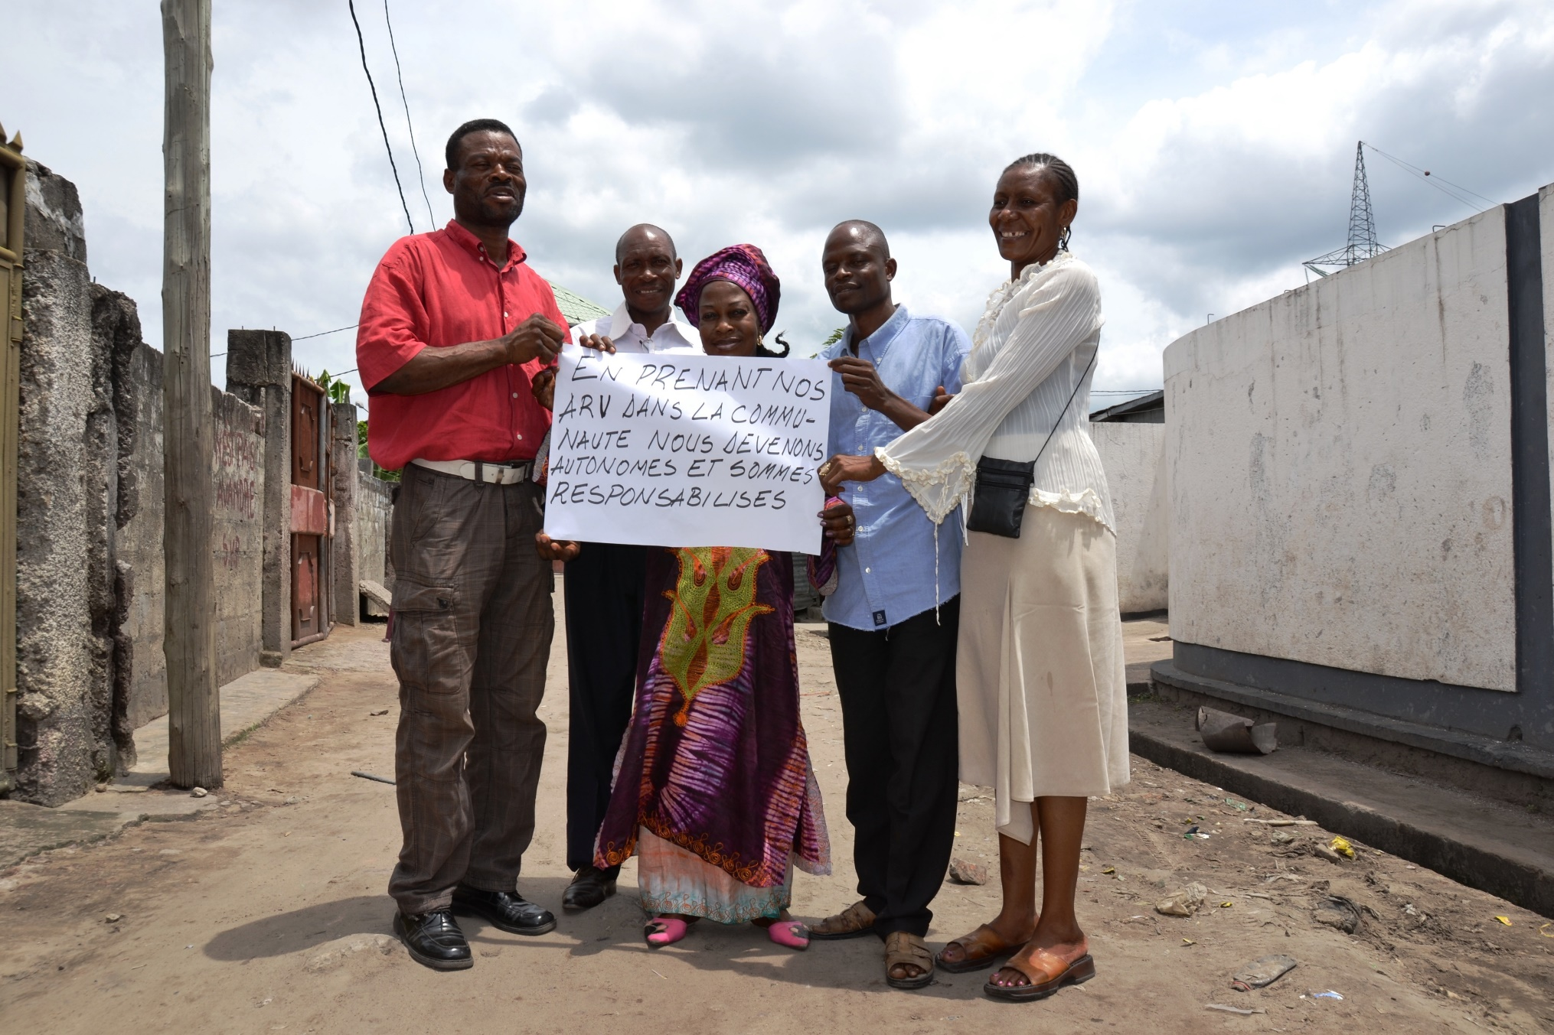
“By taking our ARVs within our community we are responsible for our own care.”
People living with HIV, DRC
Notes:
Secondly, and crucially, is that differentiated service delivery is client centered. Therefore we need to engage people living with HIV – both in the design as well as in the delivery of services.
Here you see a group of people living with in the Democratic Republic of the Congo who receive their ART refills within community distribution points or PODIs as Didier shared, stating that by taking their ART refills within the community, they’re responsible for their own care.
Self-management through quality treatment education is a key component of differentiated ART delivery.

Slide 4
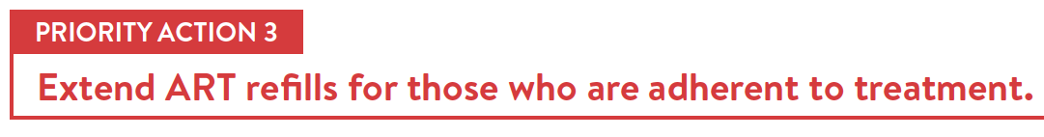
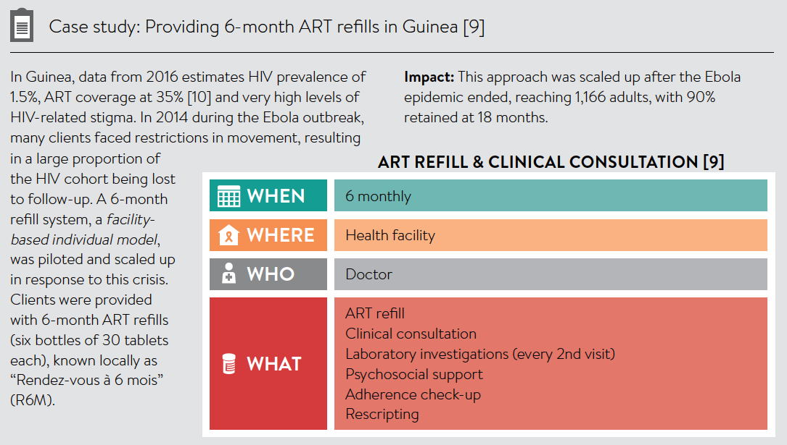
Notes:
The third priority action is to extent ART refills for those who are adherent to treatment. Acknowledging the supply chain challenges, it is critical longer refills be offered to support sustained adherence. The example outlined on this slide is from published data in Guinea where during the Ebola outbreak in 2016, ART refills were extended to up to 6 months and 90% those on longer refills were retained after 18 months.
Extending ART refills for those who are adherent offers benefits to the client and to the health system. Given the generally lower HIV prevalence and high levels of HIV stigma in the region, longer ART refills can enable a reduction in transport costs for clients and minimize the risk of breaches of confidentiality and/or accidental disclosure. It also reduces the necessity of ensuring that frequent ART refills are available at every health facility.

Slide 5
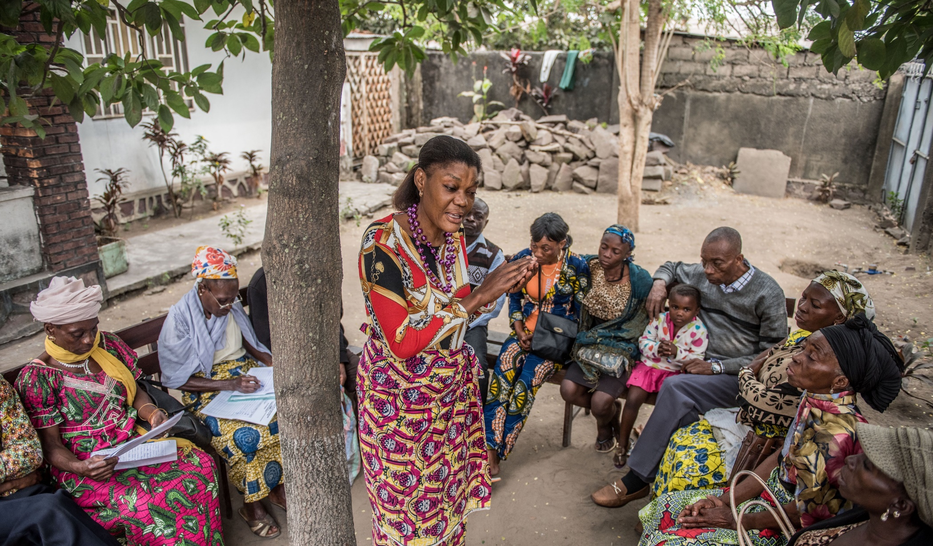
“When I pick up my drugs at a community ART distribution point, I am supported and not stigmatised.
Client, DRC
Notes:
Reducing the frequency of unnecessary visits with a clinician can be beneficial to both clients and the healthcare system. Clients can receive their ART refill quickly and clinicians can focus their attention on ART initiation, managing clients with clinically complex HIV and other diseases.
The building blocks or “who, what, where and when” should be different for clinical consultations compared to for ART refills.

Slide 6
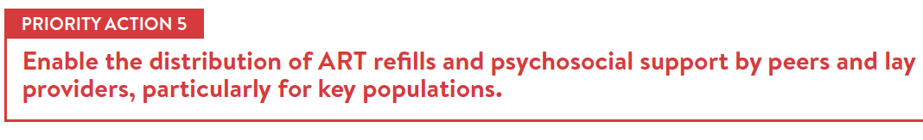



Clients from key populations are supported in Côte d’Ivoire by key population peer navigators and peer educators. Working with clinical teams and community clinics, these peer providers support retention and adherence by providing community ART refills, as well as psychosocial support.
In Sierra Leone, peer female sex workers and men who have sex with men collect ART refills at health facilities for their peers. They then meet their peers at their homes or community venues to distribute the refill.
Programming in Ghana supports men who have sex with men to receive their ART refills at drop-in centers, mobile outreach and couriered ART refills and are also supported through peer providers.
Notes:
Engagement of key population peers and people living with HIV lay providers in the provision of HIV care and
ART delivery treatment is key to increasing peer support, reducing stigma and enabling task sharing. In many WCA settings, high levels of HIV-related stigma continue to exist within communities and among health workers. In addition, the lack of professional healthcare workers is a major barrier to scale up.
Peers and lay providers from key populations and/or people living with HIV can be effectively engaged to distribute ART refills, provide psychosocial support and assist clients with managing HIV.

Slide 7
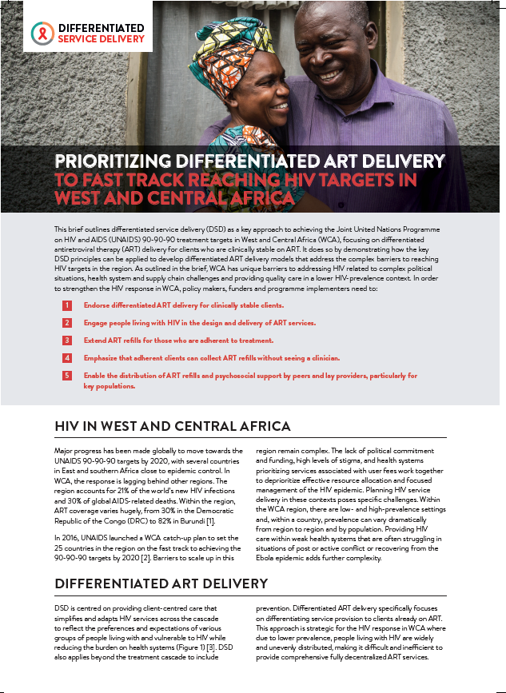
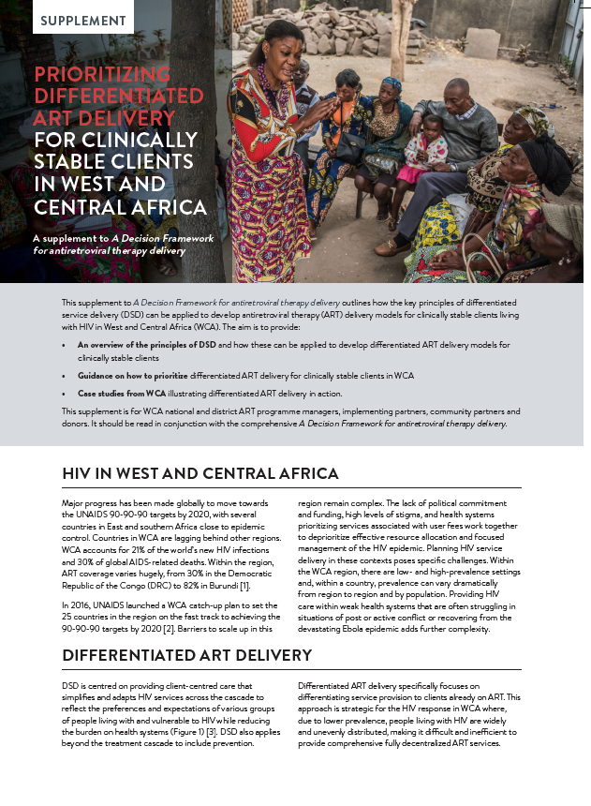
Check out www.differentiatedservicedelivery.org
New documents to advocate for and support uptake of differentiated ART delivery in West and Central Africa – available in English and French
Contact us at dsd@iasociety.org
Notes:
These five key messages are outlined in a new policy document – available both in English and French – developed by the International AIDS Society in collaboration with partners.
The second document shown here is a longer 12-page supplement to the Decision Framework for differentiated ART delivery – which includes guidance on how to prioritize scale up as well as outlining detailed case examples from the region.
For more details, come visit us at the IAS booth here at ICASA or check out www.differentiatedservicedelivery.org
We look forward to speaking with you

