Slide 1

Part 4
Adapting lessons to local context
Citation: Chisholm B. DIY WhatsApp-based microtraining. 2026. Available from: https://www.differentiatedservicedelivery.org/resources/diy-whatsapp-based-microlearning/
Need help? Contact Briony on briony.c@icloud.com

Slide 2
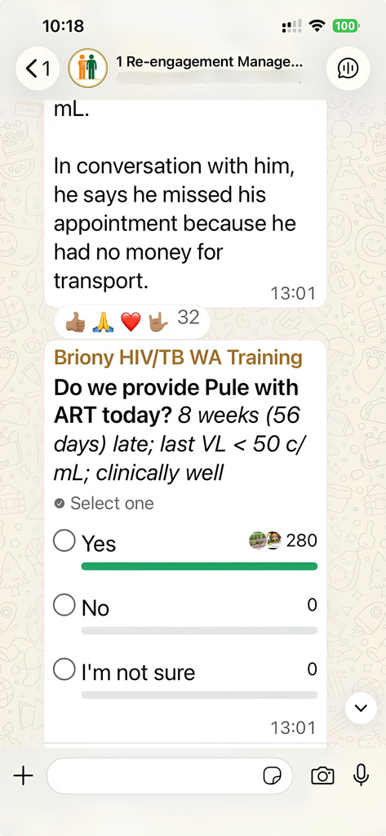

Components of adapting microlearning sessions
Lesson adaptation: adapting lessons to local guidelines
Adjustments
Subject expert review
Adjust lessons through a number of drafts and consultation with expert reviewer
Expert review of content
Presentation of sessions to first group (pilot)
Review cycle
Final content review/finalisation
Planning phase
Design stage
Review guidelines and establish learning points required
Draft lessons designed
Review by organisation requesting training
Adjustments made
Final version online
Review cycle
Adjust lessons through a number of drafts and consultation with expert reviewer
Final content review/finalisation
https://www.differentiatedservicedelivery.org/resources/diy-whatsapp-based-microlearning/
2
Review by organisation requesting training
Local adaptation

Slide 3
In this section
  Step 1: Time planning
  Step 2: Downloading modules
  Step 3: Adapting to local context
  Step 4: Review
3

Slide 4
Developed modules
available for adaptation*
  Facility-based Six-month Multi-Month Dispensing (6MMD)
  Tuberculosis Preventative Therapy (TPT)
  Management of Re-Engagement in Care
  Available at:
  https://www.differentiatedservicedelivery.org/resources/diy-whatsapp-based-microlearning/
  *Based on South African guidelines
4

Slide 5
Step 1: Time planning (estimates)
for an 8-session module
  First adapted draft: 0.5 days/lesson x 8 sessions = 4 days
  Technical/clinical review: 0.25 days/lesson x 8 sessions = 2 days
  Second draft: 2 days
  Final review: 2 days
10 days/2 weeks
Important things to remember
  Some modules may need more adaptions, others fewer: plan for this
  Take everyone’s work/travel commitments into consideration, at the beginning:
these reviews may not be able to be done consecutively/immediately
  Share an agreed timeline at the beginning
5

Slide 6
Step 2: Downloading the module
Download all module materials into a folder
on your own desktop:
  Excel spreadsheet with lesson content
  Images
  Pre-recorded voice notes
https://www.differentiatedservicedelivery.org/resources/diy-whatsapp-based-microlearning/
Module materials can be found at:
https://www.differentiatedservicedelivery.org/resources/diy-whatsapp-based-microlearning/
6

Slide 7


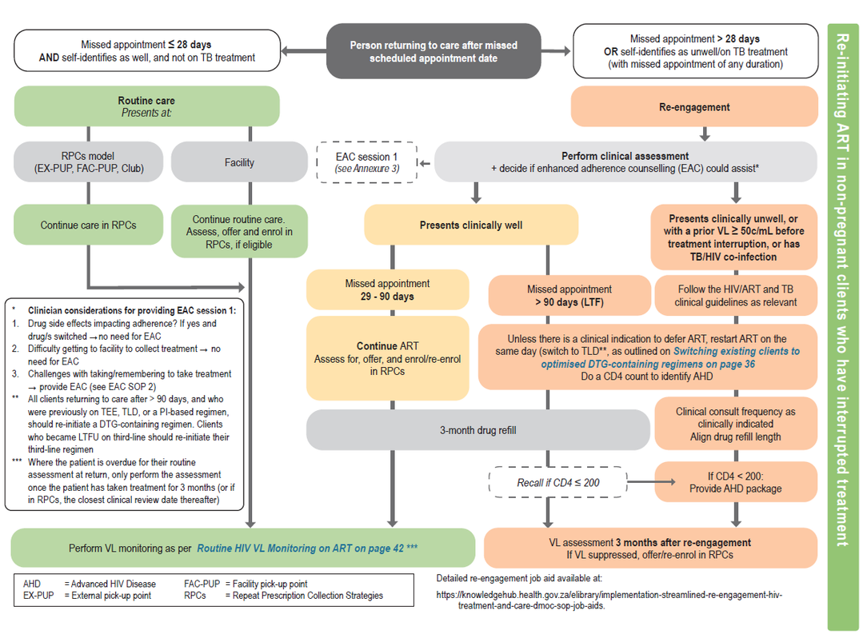
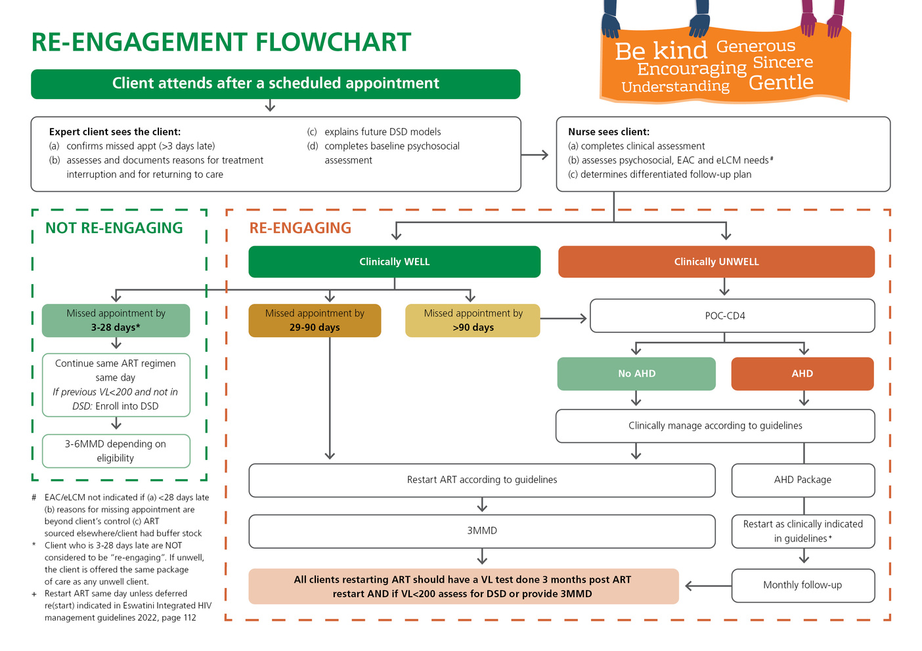
Step 3: Adapting to local content
South Africa → eSwatini
7

Slide 8
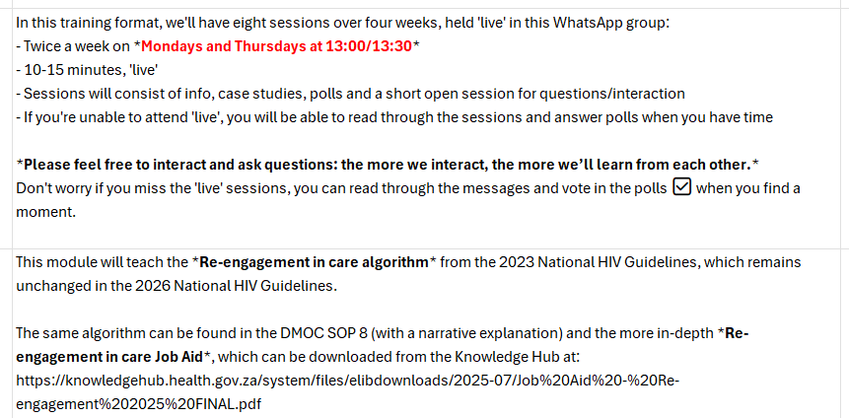
Step 3: Adapting to local content
  Work through each session, line-by-line, comparing local guideline (e.g. eSwatini)
  Remember to change admin aspects:
    Time/days of sessions
    References used
8

Slide 9
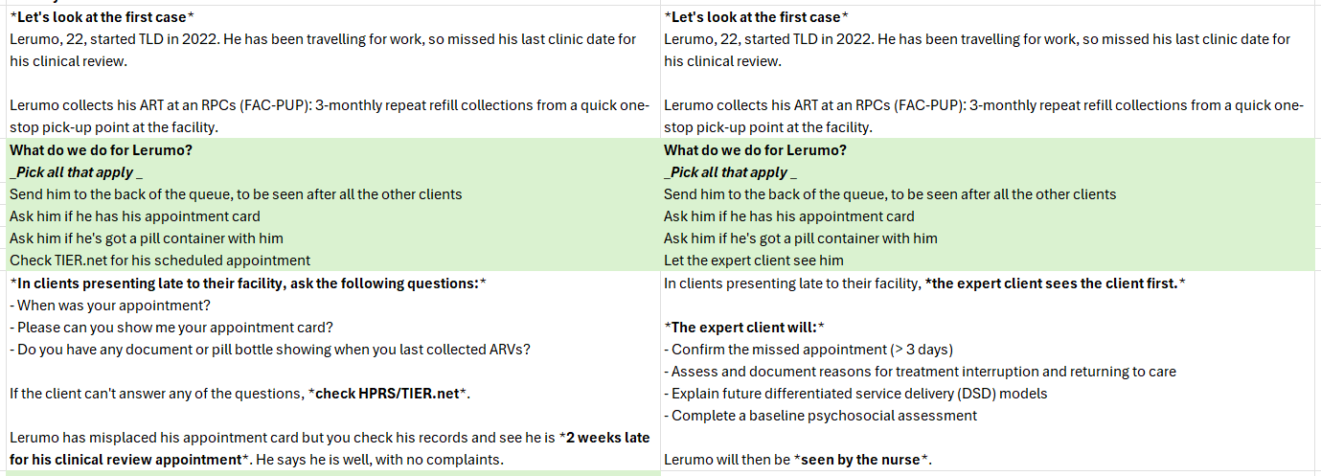
Step 3: Adapting to local content
Work through each session, line-by-line, comparing local guideline (e.g. eSwatini) ) and adjusting content as needed
Remember to adapt your references to your local references throughout the lessons!
9

Slide 10

Step 4: Review adapted content
Technical and clinical review of the adapted content is vital, to ensure fidelity with local guidelines
Review may take a few rounds so be sure to leave enough time for this
10

