Slide 1

Part 3
Planning the lesson design
Citation: Chisholm B. DIY WhatsApp-based microtraining. 2026. Available from: https://www.differentiatedservicedelivery.org/resources/diy-whatsapp-based-microlearning/
Need help? Contact Briony on briony.c@icloud.com

Slide 2

Components of creating microlearning sessions
Lesson design: clear steps for adaptive and iterative development of lessons
Adjustments
Subject expert review
Adjust lessons through a number of drafts and consultation with expert reviewer
Expert review of content
Review cycle
Final content review/finalisation
Planning phase
Design stage
Review guidelines and establish learning points required
Draft lessons designed
Review by organisation requesting training
2

Slide 3
In this section
  Step 1: Establish the audience
  Step 2: Gather reference materials
  Step 3: The toolbox
  Step 4: Put together the team
  Step 5: Establish learning points

Slide 4
Step 1: Establish the audience
Who will be attending the WhatsApp-based training?
Is this training augmenting other training forms (e.g., in-person/virtual)?
What is the audience’s scope of practice?
What is their current knowledge of subject?
What is the audience’s mother tongue?
What you teach
What level to start at
What language you use
4

Slide 5

Step 2: Gather reference materials
What needs to be taught with the WhatsApp-based training?
Gather all relevant references: guidelines, updates,
previous training sessions or notes, job aids,
primary/secondary/tertiary literature, etc.
Watch recordings of previous training and familiarise yourself with all of the relevant references,
including job aids, if available
5

Slide 6

Step 3: The toolbox
  Platform for text messages
  Platform for images
  Platform for voice notes
All relevant references
Dedicated time for lesson design and review
6

Slide 7

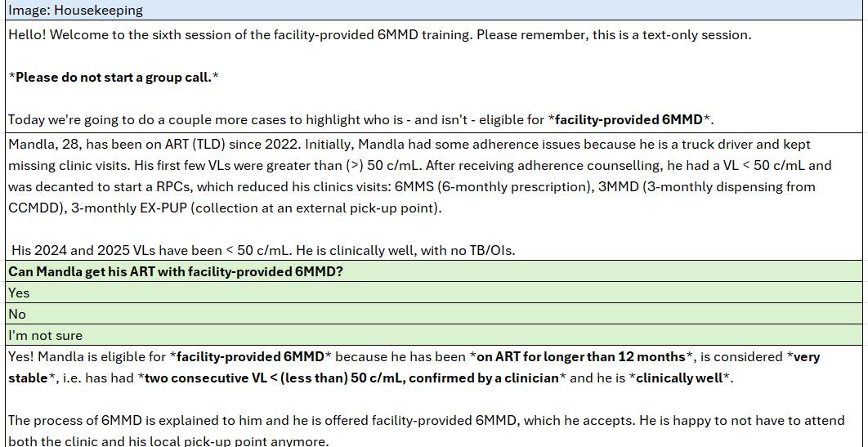



Equipment: Text messages
Lessons can be designed with any tool that allows for division into separate text messages, to make copy/pasting easy e.g. Excel/Google Sheets or a table in Word/Google Docs
7

Slide 8

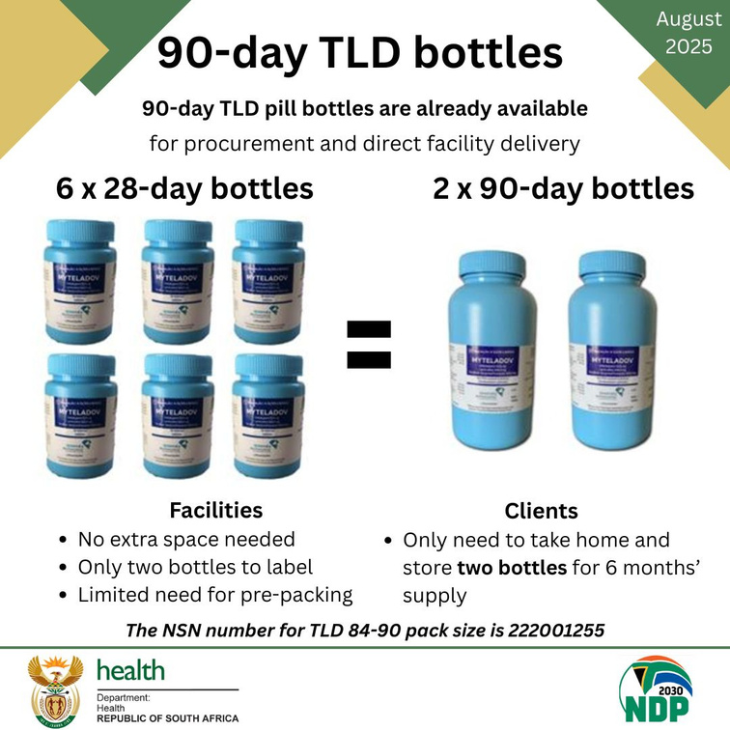

Equipment: Images
Images can be designed on any design tool, e.g. Canva or Paint
Images are best saved as PNG files, for clear sharing on WhatsApp
8

Slide 9



Equipment: Voice-notes
If pre-recording voice-notes, they can be recorded on any voice recording platform
on your phone or computer
Important note: Voice-notes must be saved as an MP3 or M4A file to share on WhatsApp
9

Slide 10
Step 4: Put together the team
Who will be designing the WhatsApp-based training?
If possible, include people who have provided a different form of training on the same topic or put together guidelines/job aids etc., because they will have experience with
what learners may be struggling with, which will help to establish needed learning points
Ideally, you want a team consisting of one or more of each, to ensure fidelity with the guidelines that are being taught:
  Lesson designer: with knowledge of subject being taught
  Clinical expert: to check that cases are clinically correct, e.g., for a module on TPT, an Infectious Diseases specialist
  Technical expert: to check that lessons are technically correct and reflect the programmatic processes, e.g., for the same module, a Differentiated Service Delivery specialist
  Independent final reviewer: this can be the MOH or support partners
10
Next slide

Slide 11
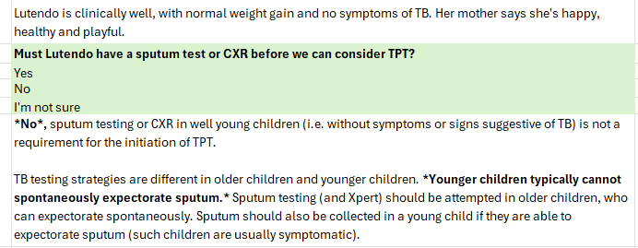
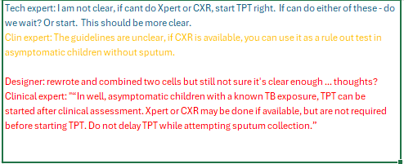
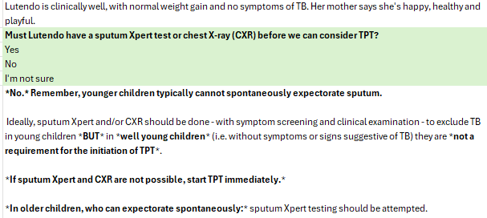

Technical and clinical input
Multiple drafts
11

Slide 12

Step 5: Establish learning points
What needs to be taught with the WhatsApp-based training?
Using all relevant references and experts in the field including, if possible, those who’ve given training on the topic in other forms (in-person, virtual etc.), establish what learning points must be included in the training
Ideally, get input from people working on the ground - the people you’ll be teaching - about what their learning needs, or gaps in knowledge, are
Remember: no more than 2-3 learning points per session,
the aim is to have the session short and sweet!
12

Slide 13
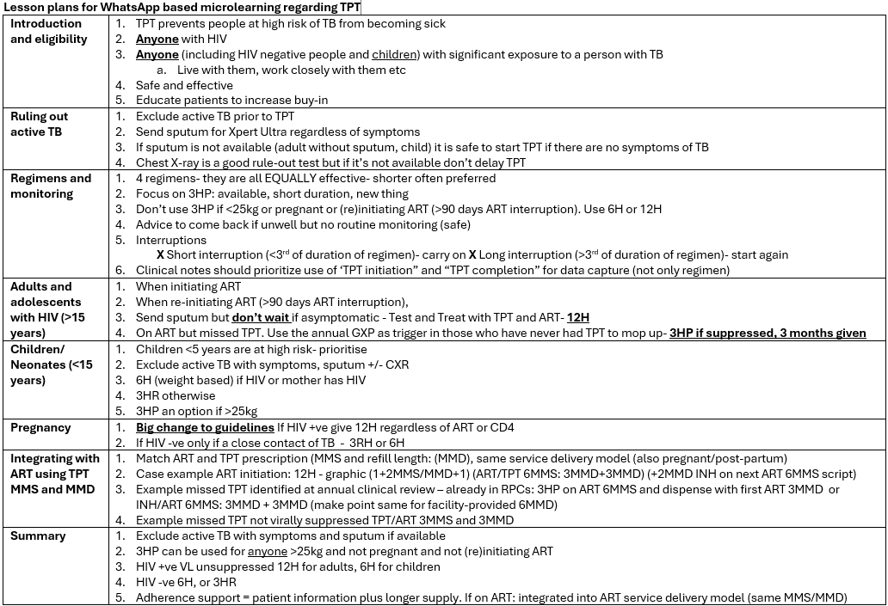
Establishing the learning points is a vital step and often
takes a couple of rounds of discussion
Team review
Spend time on this at the beginning, as it’ll save time later
13

Slide 14

Here, we split
Are you adapting lessons to local context?
Are you designing a module from scratch?
Go to Part 4
Go to Part 5
14

