Slide 1
Overview of the ART delivery framework approach
Consultation on differentiated ART delivery in WCA
Lynne Wilkinson
International AIDS Society
17 May 2019
Notes:
Good morning - Maa-chi, aw di bodi? Commençons (commoso). This morning we are going to briefly go through the differentiated ART delivery framework approach which guides you on the decision making process to plan differentiated ART delivery models in your country/district or facility. I realise that many of you at the table know the approach well and hope not to bore you but always good to ground ourselves at the start.

Slide 2
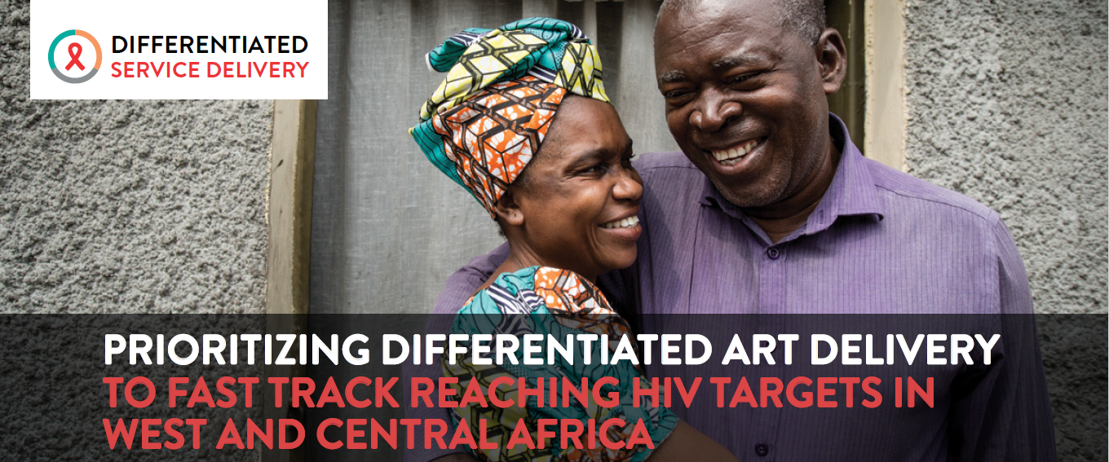

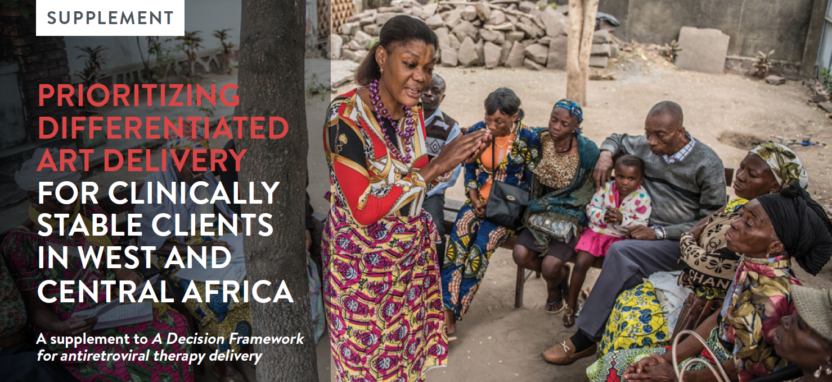
Differentiated ART delivery for
West and Central Africa
Five priority actions for scaling up differentiated ART delivery in WCA
Supplement outlining guidance on ”how” and regional case studies
Notes:
As Anna mentioned, we have put together a supplement to the Decision framework specifically for WCA – it should be read in conjunction but specifically focuses on considerations for this region and case examples from this region.

Slide 3
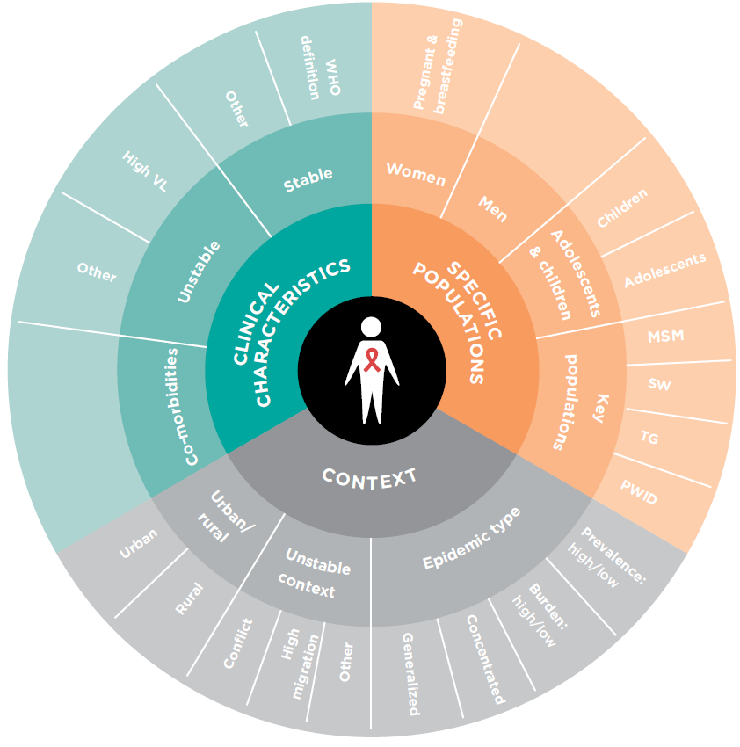
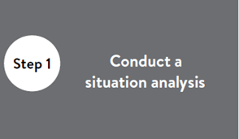
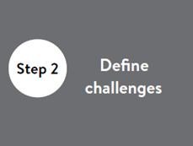
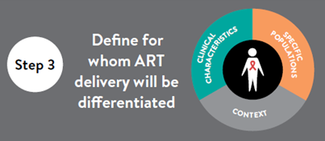
Approach
?
?
Notes:
Step 1 is always completing your situational analysis – 1) assess the data – here very important to look at numbers of clients on ART at facilities and retention rates – most countries phase in implementation starting with high volume sites first 2) assess country policies – do they align with the building blocks of models e.g. can lay cadres distribute ART refills/is the length of a script legislated etc 3) assess the current ART delivery models – mapping of what is being implemented and coverage of these models.
Step 2 – define challenges – from client and HCW perspective – we see increasingly in the literature that clients will accept longer distances to clinics and even longer waiting time to interact with an understanding client friendly HCW. We have also seen in high stigma contexts in West Africa that HCW working with PLHIV can be stigmatised by their colleagues. These considerations may influence your plan.
Step 3 – Define which population you are differentiating services – as Anna spoke about we recommend starting with your stable clients but planning needs to consider your 1) context – stable/unstable, urban/rural and epidemic type – prevalence and concentration AND 2) the specific stable population – adults/children/adolescents?

Slide 4
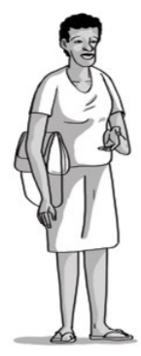
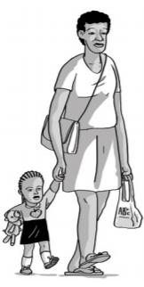
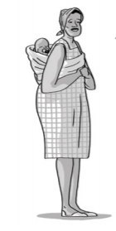
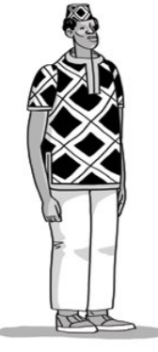

Define stable for population groups
WHO recommends: 12 months on ART, clinically stable and good understanding of adherence, evidence of treatment success (e.g. two undetectable VL, rising CD4, CD4 >200)
  Importantly doesn’t require a VL where not available
Country examples go beyond – 6 months on ART & one undetectable VL
Notes:
It is necessary to define who is categorised as stable – this may be different for adults, children, adolescents and PBFW –key populations should qualify as stable adults but appropriate models may differ.
WHO recommends 12m + 2 UVL NB if no VL – evidence of rising CD4 OR CD4>200
Some countries have gone beyond this – 6m on ART and 1 UD VL – important to write up to provide evidence for WHO guideline revision.

Slide 5
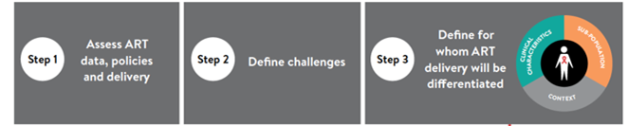
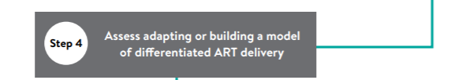
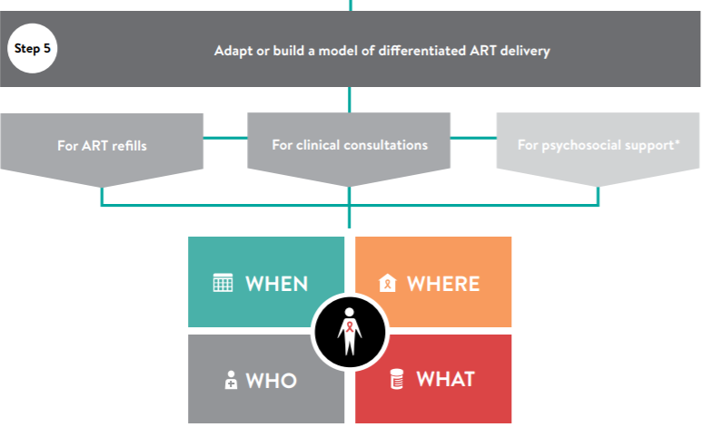
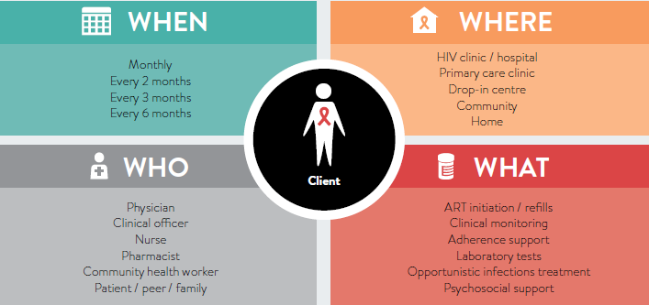
Notes:
Step 4 – is where we start planning models. Firstly it is necessary to assess whether models already exist that merely need an adaption – for instance in Cote d-Ivoire where support groups already existed and ART refills were provided within these groups. Or where an entirely new models needs to be built – for instance PODIs in DRC or community pharmacies in Nigeria – which you will hear about later today.
We will now go through the building blocks quickly – most importantly these building blocks need to be developed separately for ART refills and clinical consultations. For certain special populations, they also need to be separately considered for psychosocial support e.g adolescents and key populations.

Slide 6
WHEN: Service frequency
Frequency of ART refill and clinical consultation visits + time of day services available
WHO recommends: 3-6 monthly for ART refills and clinical consultations
Country examples go beyond: 6 monthly ART refills and annual clinical consultations (South Africa)
Reduces burden on client (direct and indirect costs) and health system (don’t need ART refills available at every facility – can travel further if longer refills given).
In context of high stigma – reduced visits reduce risk of breaches of confidentiality and/or accidental disclosure
Pushing ART refills to six months: National
policy progress in Guinea
Foromo Guilavogui, Ministry of Health, Guinea
Notes:
When building block – refers to frequency of ART refill and clinical consultation visits but also the time of day offered. For instance ART refills may be available for pick up after office hours.

Slide 7
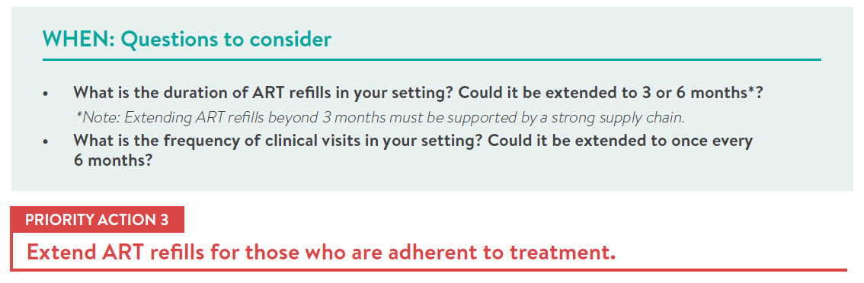
WHEN: Service frequency
Notes:
We need to assess duration of ART refills and clinical consultations in our settings. For WCA, these are the quickest wins – extending refills and separating from clinical consultation visits.

Slide 8
Maximum duration of refills
Notes:
In the survey – we have countries that have moved to 3 or 6 months. You will see in some countries variation in the answers provided – these may be the difference between policy and implementation or implementers. Ideally this should be standardized as much as possible to allow for appropriate supply chain planning but also to develop client trust – where amount of supply changes each time for the client, it creates mistrust and difficulties for clients.

Slide 9
Maximum frequency of clinical consultations
Notes:
Here you see some countries with 6 months and some with annual clinical consultations. Again some variation in answers within countries which may be attributable to difference between policy, implementation or implementer.

Slide 10
WHERE: Service location
Location of services
WHO recommends: ART maintenance at community level = outreach sites, health posts, home based and CBO services
1st step = fast track ART refill pick-up. This means one stop of the patient straight to pharmacy or ART refill pick-up room
3m | 6m | 9m | 12m
Standard visit | Fast track ART pick-up | Standard visit | Fast track ART pick-up
Clinical consult + script + ART refills | Only ART refill pick-up | Clinical consult + script + ART refills | Only ART refill pick-up
Notes:
Where refers to the location of the service – WHO recommends that once stable on ART clients can receive their ART care at health posts, drop in centres and even at home. Again the quickest win/first phase of implementation – is to speed up ART refill visits for clients in the facility where ART services already exist. For ART refill visits where there is no clinical consultation – ideally the client only has one stop and does not have to first have to register/pull folders etc but can go straight to pharmacy or room at facility to collect ART refill. This works best with registers and patient held cards rather than client facility folders.

Slide 11
WHERE: Service location
Decentralization of services: WCA people living with HIV distribution and context stability means focus on decentralization of services needs strategic consideration
Possible strategic options may be:
  Longer ART refills more centrally
  Decentralizing only ART refill
Patient preference: Scaling up PODIs, fast-track and ART refills in peer support groups in the Democratic Republic of the Congo
Didier Kamerhe, PATH, DRC
Notes:
Once fast track ART refills are in place – then possible to re-assess where clients are still struggling to access services and decide on whether further decentralization makes sense in your context. Longer refills up to 6 months may mean you do not need to decentralize extensively. Where shorter refills of 3 months are given, it may be possible just to decentralize refills – not clinical consultations/labs and scripting. Decentralized clinics/health posts could collect their clients ART refills from the main ART site. Alternatively setting up alternative collection points in urban centres. Yesterday we heard about DRC giving clients 3 options – fast track in facility, getting ART refills in their support groups which are run in facilities or in community venues and PODIs – 3 central community based ART refill distribution sites.

Slide 12
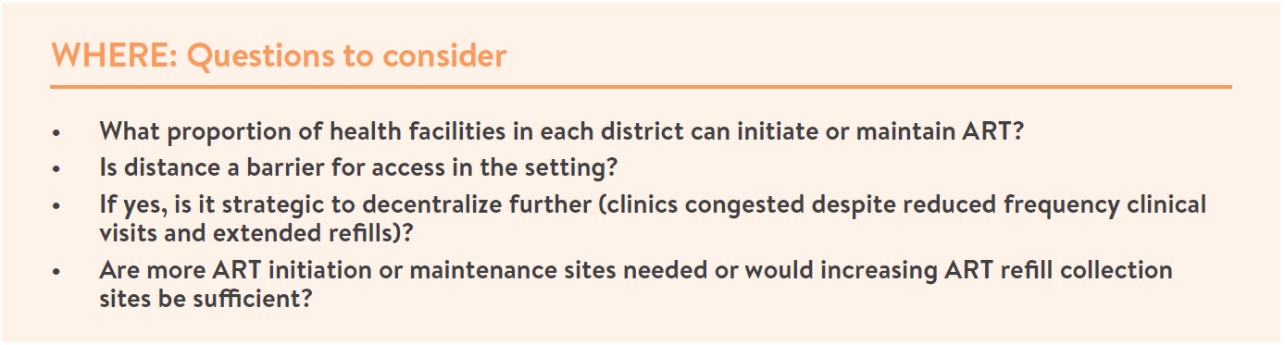
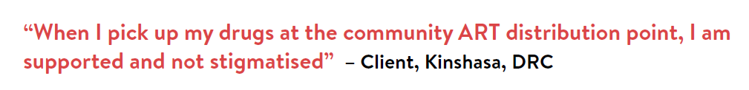
WHERE: Service location
Notes:
Important to the following questions – how many sites can maintain ART? How much of a barrier is distance for clients - will longer refills alleviate or is decentralization required. Can access be improved by getting only ART refills closer to clients?

Slide 13
WHO: Service provider
Service provider for ART refills and clinical consultations
WHO recommends
  ART refills to lay cadres
  Clinical consultations to nurses and clinical officers (saving doctors for sick clients, clients at risk of failing ART or complex co-morbidities)
Shortage of professional HCWs in WCA support task sharing
Lay cadres especially expert patients additional psychosocial support benefit
Providing community ART in a time of conflict:
Pilot projects from Central African Republic
Charles Ssonko, MSF-UK
Notes:
The WHO building block refers to the service provider for ART refills and clinical consults. In contexts with shortage of professional health staff and needing to catch up on 90-90-90 targets, WHO has recommended that these tasks be shifted – ART refills can easily be managed by lay cadres and clinical consults for stable clients by nurses or clinical officers – saving our doctors for those failing or complex.
In context of high stigma – lay cadres can play important psychosocial support role and help reduce internalized stigma. Yesterday you heard about CAR where ART refills have been task shifted to clients in CAGs and pharmacy assistants in fast track ART refills.

Slide 14
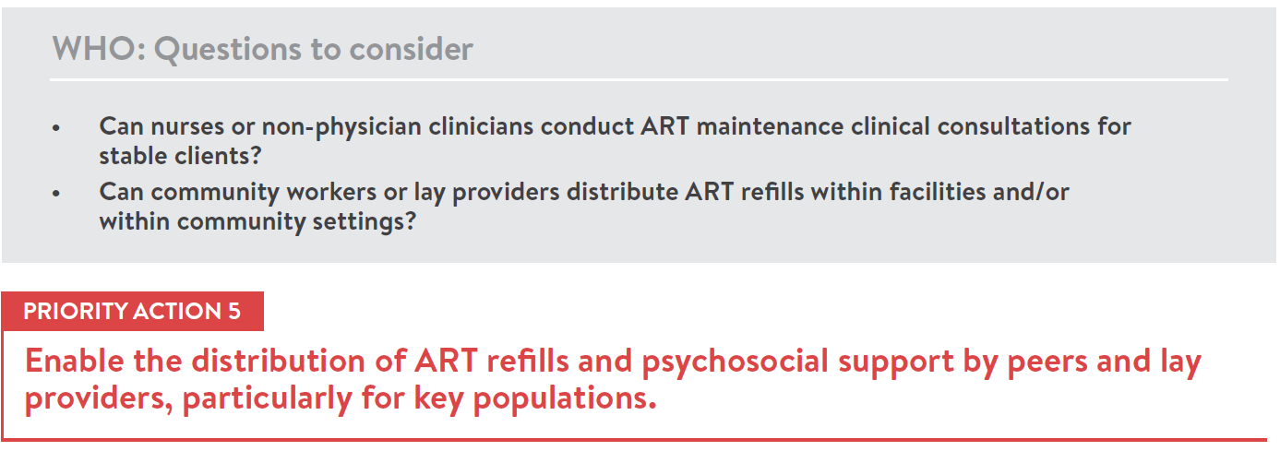
WHO: Service provider
Notes:
Important to assess whether policy enables this task shifting which is an important priority for extending the health systems capacity to provide quality services to clients.

Slide 15
WHAT: Service package
Package of services provided at ART refill and clinical visits
Separately stipulate what services provided at ART refill versus clinical consultation visits
Psychosocial support can either be integrated in these visits or provided more frequently in the community for special populations e.g. adolescents and key populations
ART refill examples = brief symptom screen, CTX refill, FP refills, TPT refill, adherence checks and peer support
Clinical consultation examples = lab investigations, co-morbidity assessment, TPT or FP initiation and assessment, rescripting for ART, CTX, TPT, FP and NCDs
Notes:
The last building block is the what – this refers to the service package at ART refill visits and clinical consultations. As explained earlier – psychosocial support can form part of either of both of these visits or could include additional visits such as community run teen clubs etc. Components of service package to consider for ART refills include other refills e.g. family planning, TB preventative therapy or diabetic/hypertensive refills. Clinical consultations would include labs and scripting but may also include clinical assessment of co-morbities, family planning, start or stop of TPT/CTX.
For key populations – these service package can be further extended to include condoms/lubricants/needles/OST with clinical consultations screening for viral hepatitis B and C, mental health assessment.

Slide 16
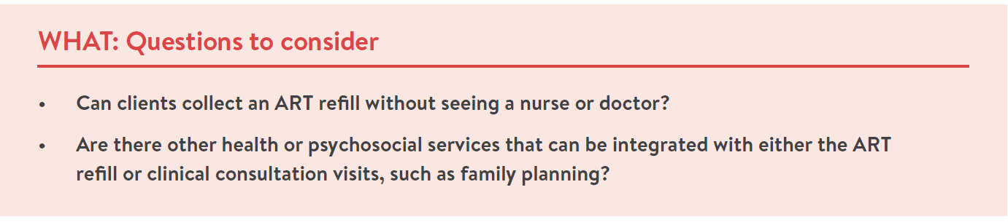
WHAT: Service package
Notes:
Important questions to ask – do you clients have to see a clinician at each visit – what health services can easily be integrated into ART refill or clinical consultations to save your client for having to come separately for services such as family planning.

Slide 17

Thank you from IAS and Ghana
Notes:
And we are done – Na Gode, Merci.

