Slide 1


Multi-month refills of antiretroviral drugs for stable patients in Malawi: Assessing accuracy in the application of eligibility criteria at the health facility level
9th IAS Conference on HIV Science
July 2017
Authors: Margaret L. Prust,* Clement K. Banda, Rose Nyirenda, Frank Chimbwandira, Thokozani Kalua, Andreas Jahn, Michael Eliya, Katie Callahan, Peter Ehrenkranz, Marta Prescott, Elizabeth McCarthy, Elya Tagar, Andrews Gunda
* Presenter; contact: mprust@clintonhealthaccess.org

Slide 2
Background
Many countries are implementing or considering multi-month scripts (MMS) for stable patients in order to reduce burden on lifelong ART on patients and health systems
In Malawi, the national ART guidelines have supported 3-month refills for stable adult patients since 2008
Little is known about how MMS policies are being implemented operationally in Malawi and elsewhere
Objective: To assess the extent to which patients are accurately differentiated as eligible or ineligible for MMS and explore potential causes of inaccuracy in patient differentiation
Notes:
As of Q1 2015, there were 611,031 patients on ART

Slide 3
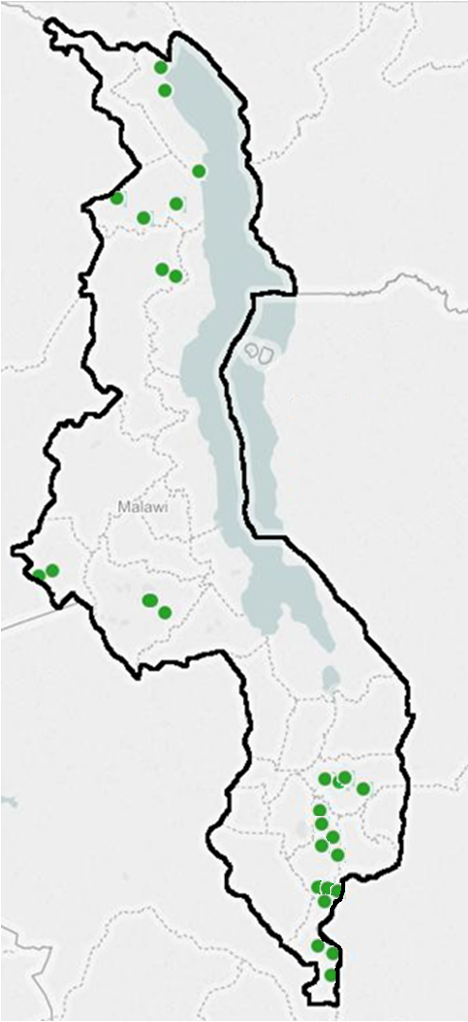
Study methodology
30 public-sector ART clinics were purposefully sampled to achieve diversity in facility type, size, location, and partner support
Data collection:
  75,364 patient record reviews, from electronic data where available or from randomly sampled paper-based records
  136 health worker surveys
  32 interviews with ART clinic in-charges
Analysis
  Quantitative data was cleaned and merged with support of electronic data managers; data was weighted based on different sampling proportions and clustered by facility
  Qualitative data was audio recorded, transcribed, and thematically coded by a team of three researchers
Notes:
17 sites had electronic records, accounting for about 73,000 of the records assessed. In sites with paper based records we sampled ~150 records per facility.

Slide 4
Approximately 86% of patients were eligible for MMS, and 69% of patients were receiving refills of ≥3 months
Percentage of patients eligible for MMS
Percentage of patients receiving MMS
Inclusion criteria | % of patients NOT meeting each criteria
At least 6 months on ART | 7.5%
Suppressed viral load | 6.2%
First-line regimen | 2.5%
No opportunistic infections | 0.8%
No side effects | 0.6%
Age 18 or older | NA*
Good adherence | NA**
4 months or more: 7%
3 month refills: 62%
(55%-69%)***
% of patients
2 month refills: 19%
86.4% (95% CI: 84.0% - 88.6%) meet all criteria to be eligible for MMS in Malawi
1 month or less: 13%
* Our study only collected data about the adult population.
** Due to inconsistencies in adherence data across record types we have not accounted for this criteria. Therefore the true percentage of eligible patients is likely to be somewhat lower than stated.
*** Results are weighted and clustered to adjust for sampling so 95% confidence intervals are shown.

Slide 5
Inaccurate patient differentiation can limit benefits of MMS and present risks
Percentage of eligible and ineligible patients receiving MMS
When eligible patients do not get MMS, the optimal efficiency gains are not being experienced
When ineligible patients access model, patients may not be getting the level of care recommended by guidelines
Eligible
Weighted equiv.
n ≈ 65,000
Ineligible
Weighted equiv.
n ≈ 10,000
Notes:
27% * 65,000 = 17,550 people in the sample who COULD HAVE been on MMS but WERE NOT
42% * 10,000 = 4,200 people in the sample who WERE getting MMS but SHOULD NOT have been

Slide 6
Inaccurate patient differentiation can limit benefits of MMS and present risks
Percentage of eligible and ineligible patients receiving MMS
When eligible patients do not get MMS, the optimal efficiency gains are not being experienced
When ineligible patients access model, patients may not be getting the level of care recommended by guidelines
Eligible
Weighted equiv.
n ≈ 65,000
Ineligible
Weighted equiv.
n ≈ 10,000
According to health worker interviews, causes of incorrect patient differentiation
may include facility- and patient-level factors:
Failure to include eligible patients:
  Lack of knowledge about policy
  Provider concerns about MMS
  Low drug stocks
  Poor adherence not captured in eligibility measure for this study
Inclusion of ineligible patients:
  Lack of understanding of criteria
  Attempt to reduce workload
  Unrecognized transition to becoming ineligible
  Patient requests
Notes:
27% * 65,000 = 17,550 people in the sample who COULD HAVE been on MMS but WERE NOT
42% * 10,000 = 4,200 people in the sample who WERE getting MMS but SHOULD NOT have been

Slide 7
Health worker knowledge of criteria may explain some but not all of the cases of poor patient differentiation
Percentage of ineligible patients receiving MMS that do not meet each criteria
Based on the patient record reviews, ineligible patients receiving MMS most often did not meet the criteria for viral load, time on ART, and ARV regimen
Percentage of health workers listing each criteria
In the health worker survey, most nurses and clinicians mentioned viral load, ARV regimen, or age as criteria for MMS
Notes:
Discuss VL rollout and how eligibility criteria existed before VL – there may be some confusion on how to use the data

Slide 8
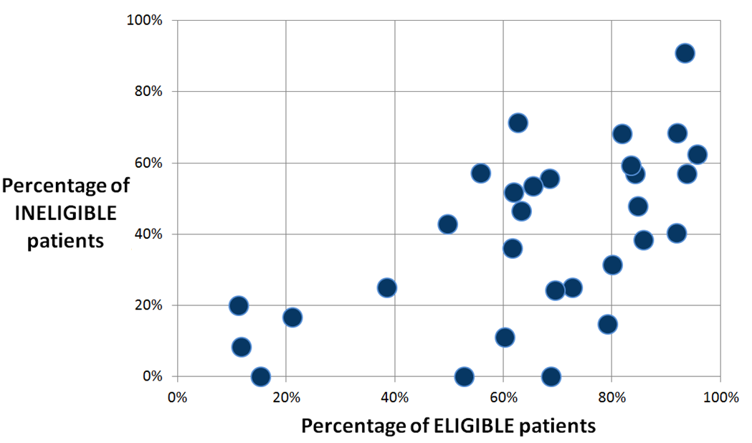
There was variation across facilities in accuracy of patient differentiation
Percentage of eligible and ineligible patients receiving MMS at each facility
Notes:
As of Q1 2015, there were 611,031 patients on ART

Slide 9
There was variation across facilities in accuracy of patient differentiation
Percentage of eligible and ineligible patients receiving MMS at each facility
Inaccurate differentiation: Providing MMS to a similar percentage of eligible and ineligible patients
(False positive rate or
1-Specificity)
Accurate differentiation:
Providing MMS to a high percentage of eligible patients and a low percentage of ineligible patients
(Sensitivity)
The percentage of ELIGIBLE patients getting MMS is a significant predictor of the percentage of INELIGIBLE patients getting MMS (coefficient 0.59, p value < 0.01)
Notes:
As of Q1 2015, there were 611,031 patients on ART

Slide 10
Facility- and individual-level characteristics had some impact on misclassification, but no strong trends emerged
FACILITY-LEVEL PREDICTORS OF
TOTAL MISCLASSIFICATION PERCENTAGE
Facilities in the Southern Region are slightly more likely to misclassify patients compared to the Central Region, but otherwise facility characteristics are not strong predictors of the total percentage of patients that are misclassified *
Independent variable | Coefficient | p value
Region
Central | ref
Northern | 0.05 | 0.61
Southern | 0.20 | 0.03
Facility type
Hospital | ref
Health center | 0.11 | 0.12
Location
Urban | ref
Peri-urban | -0.01 | 0.92
Rural | 0.08 | 0.37
Remote | 0.18 | 0.25
Number of active ART patients (per 1000) | -0.02 | 0.12
Patient to clinician ratio (per 500) | 0.01 | 0.87
Average number of eligibility criteria known by health workers at facility | 0.02 | 0.70
*Facility-level analysis based on bivariate linear regression.
**Individual analysis based on bivariate logistic regression.
Notes:
As of Q1 2015, there were 611,031 patients on ART

Slide 11
Facility- and individual-level characteristics had some impact on misclassification, but no strong trends emerged
FACILITY-LEVEL PREDICTORS OF
TOTAL MISCLASSIFICATION PERCENTAGE
Facilities in the Southern Region are slightly more likely to misclassify patients compared to the Central Region, but otherwise facility characteristics are not strong predictors of the total percentage of patients that are misclassified *
FACILITY-LEVEL PREDICTORS OF
THE ODDS OF MISCLASSIFICATION
Based on individual-level data analysis, age and gender were significant predictors of the odds that a patient would be misclassified, but the influence of these factors was limited in terms of odds ratio change**
Independent variable | Coefficient | p value
Region
Central | ref
Northern | 0.05 | 0.61
Southern | 0.20 | 0.03
Facility type
Hospital | ref
Health center | 0.11 | 0.12
Location
Urban | ref
Peri-urban | -0.01 | 0.92
Rural | 0.08 | 0.37
Remote | 0.18 | 0.25
Number of active ART patients (per 1000) | -0.02 | 0.12
Patient to clinician ratio (per 500) | 0.01 | 0.87
Average number of eligibility criteria known by health workers at facility | 0.02 | 0.70
Independent variable | OR (95% CI) | p value
Male | 0.83 (0.74-0.94) | 0.005
Age (per 10 years) | 0.84 (0.78-0.91) | <0.001
Similar results were observed in sensitivity analyses using other measures of diagnostic accuracy:
Likelihood ratio
Diagnostic odds ratio
False positive rate
*Facility-level analysis based on bivariate linear regression.
**Individual analysis based on bivariate logistic regression.
Notes:
As of Q1 2015, there were 611,031 patients on ART

Slide 12
Conclusions and recommendations
MMS is being widely implemented in Malawi, but the eligibility criteria for this type of care are not being applied consistently
Patient-level, health worker, and facility issues may collectively contribute to misclassification, but data did not show strong trends in predictors of misclassification
As MMS and other models of differentiated care are expanded globally, policy makers, practitioners and researchers should consider the following recommendations:
PROVIDING HEALTH WORKER TRAINING & SUPPORT
Guidance on patient differentiation should be provided through job aides and health worker mentorship
ALIGNING PATIENT RECORD SYSTEMS
Electronic and paper patient records should be aligned with the eligibility criteria so that all necessary information is included; formatting of paper records and prompted in electronic records could improve health worker accuracy in differentiation
CONDUCTING FURTHER RESEARCH
Assessments are needed to examine patient outcomes among people receiving MMS that are eligible and ineligible in order to inform adjustments to eligibility criteria
Notes:
As of Q1 2015, there were 611,031 patients on ART

Slide 13
Acknowledgements and additional information
The authors would like to thank:
  The Malawi MOH for support and collaboration in carrying out the evaluation
  The Bill and Melinda Gates Foundation for funding support
  Study participants for sharing their time and invaluable perspectives
  Baobab Health Trust and Medicines Sans Frontiers (MSF) for providing electronic patient data
  Data collectors and other CHAI Malawi staff that provided coordination and logistical support to this work, in particular: Nurse Nyambi, Alfred Kasito, Ivy Nnakabonge, and Jessica Joseph
Additional results from this study are available in posters at this IAS meeting:
  Service delivery costs for HIV treatment under differentiated models of care for stable patients in Malawi (TUPED1327)
  Patient and health worker perspectives on implementation of models of differentiated care for stable HIV patients in Malawi (TUPED1328)
The authors have no conflicts of interest to declare.
Notes:
As of Q1 2015, there were 611,031 patients on ART

