Slide 1

Part 2
Budget
Citation: Chisholm B. DIY WhatsApp-based microtraining. 2026. Available from: https://www.differentiatedservicedelivery.org/resources/diy-whatsapp-based-microlearning/
Need help? Contact Briony on briony.c@icloud.com

Slide 2
Draw up a budget
Important points to remember when doing the budget
  Include administrative support: creating and administering sign-up surveys and creating groups
  Include time for the facilitator to measure participation: this is done at two/three timepoints after each session
  Equipment/tools: if needed, budget for the use of tools such as SurveyMonkey or Canva Pro
Don’t underestimate the time needed for preparation/administration, lesson design and facilitation

Slide 3
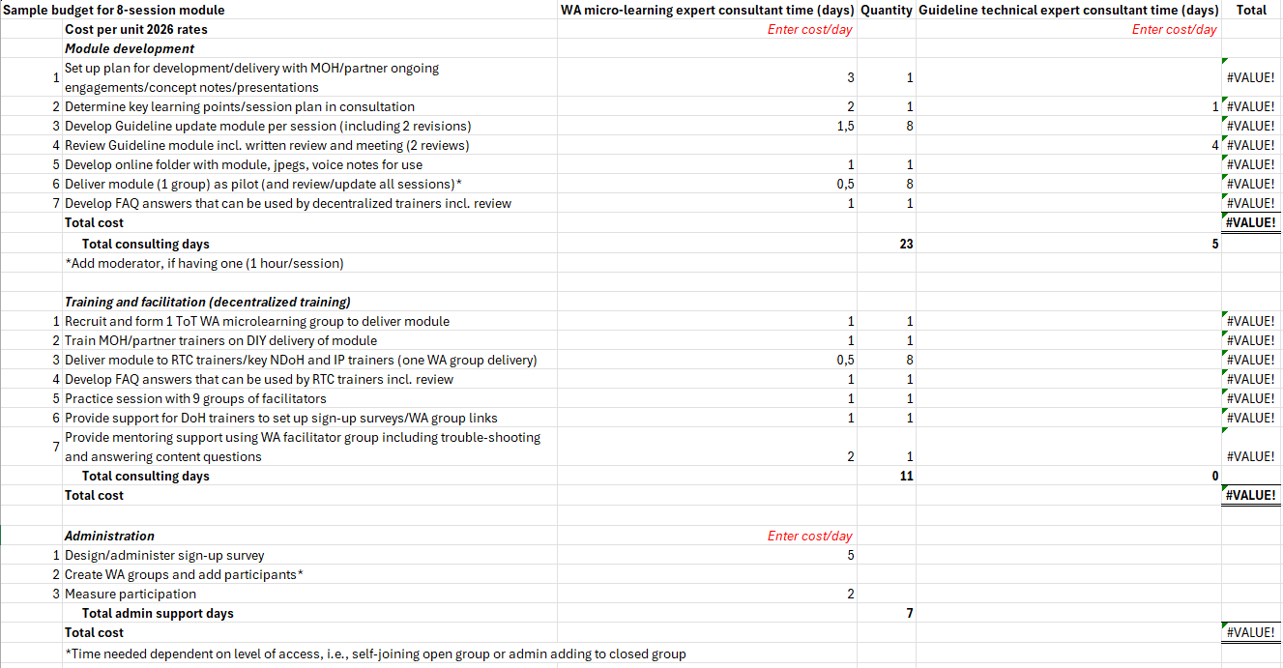
This sample budget is available at https://www.differentiatedservicedelivery.org/resources/diy-whatsapp-based-microlearning/
2

