Slide 1
Overview of key priorities for differentiated ART delivery in West and Central Africa
Consultation on differentiated ART delivery in WCA
Anna Grimsrud
International AIDS Society
17 May 2019
Notes:
Thank you to everyone that has made time, prepared and travelled to be part of this consultation
INTEREST was a great opportunity to meet and discuss specifically work the region
We have been so impressed by all the great work you are doing and are confident that you have important lessons to learn with one another
This afternoon, I’m here to welcome you and give you an overview of why it makes sense to focus on differentiated ART delivery as a starting point in the region, and to restate some of what Linda-Gail Bekker presented yesterday at INTEREST.

Slide 2
Objectives of meeting
Share WCA supplement to Decision Framework for differentiated ART delivery
Promote examples from the region
Advocate and support DSD policies and inclusion in operational plans
Assess level of implementation to date
Foster intra-regional exchange and learning
Notes:
We have 5 objectives this afternoon – which may be ambitious, but also it’s important to be ambitious.
So first we are going to share the supplement on differentiated ART delivery in WCA where much of your work is featured.
Secondly we are going to promote expampes in the region and advocate for support of DSD policies and operational plans. We are also hoping to get a better understanding of implementation to date and through all of this foster intra-regional exchanges.

Slide 3

Differentiated service delivery (DSD), or differentiated care, or is a client-centred approach that simplifies and adapts HIV services across the cascade, in ways that both serve the needs of PLHIV better and reduce unnecessary
burdens on the health system.

Slide 4
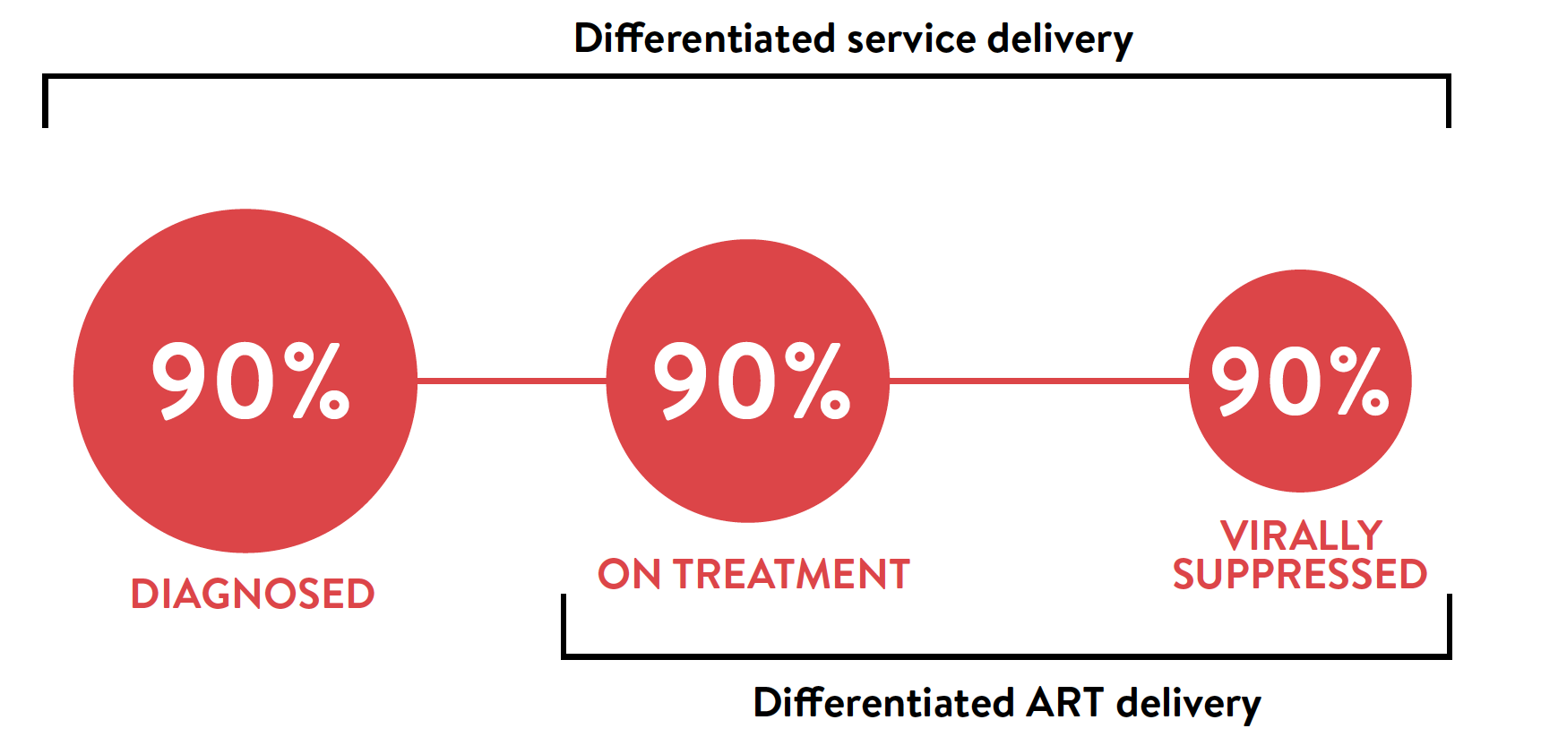
Differentiated ART delivery
Notes:
DSD is across the cascade and can support all three of the 30s but really ART delivery looks as treatment and viral suppression. However, by providing tx that is client centered we are optimistic there will be a knock on effect highlighting client centeredness and support more people to test earlier.

Slide 5
Why differentiated ART delivery focus in WCA?
Lagging behind with 90-90-90 targets
Lower prevalence, people living with HIV more widely and unevenly distributed
  Need to develop models that work for WCA
Opportunity to make services more accessible without providing comprehensive services everywhere
Reduce HIV-related stigma
Notes:
Focussing on ART delivery in WCA makes sense – we want to ensure there is a good treatment programme in place for when new people are diagnosed

Slide 6
Why start with stable ART clients?
Large numbers of clients already stable on ART who need to be retained
Health systems need to leverage capacity to start newly diagnosed clients on ART and focus on clients at risk of failing treatment
Biggest and quickest gains for clients and the health system

Slide 7
ART clients in Cape Metro facilities,
South Africa 2011-2018
Notes:
This is an example from South Africa- the only non-WCA example you’ll see today, but perhaps the area that Lynne and I know the best. Now this is HIV treatment cohort date from the facilities around Cape Town. If you

Slide 8
Clients in clinic and Adherence Clubs,
Cape Metro facilities, South Africa
73,735 clients
(38% of cohort)
Adherence Club clients
All other clients
(including stable clients receiving MMS and increasingly quick pick-ups)
Notes:
The ”standard of care clients” increased, but on top of this, more that a 1/3 of clients are now in the Adherence Club differentiated ART delivery model of care. This DSD model enabled this massive scale up.

Slide 9



Differentiated ART delivery framework series
General population
Children, adolescents and pregnant and breastfeeding women
Key populations
Notes:
Guidance on how to adapt or build differentiated ART delivery models – the second framework focused on special populations including children, adolescents and PBFW and the third on key populations. For this meeting we brought out a supplement which takes into consideration WCA context

Slide 10
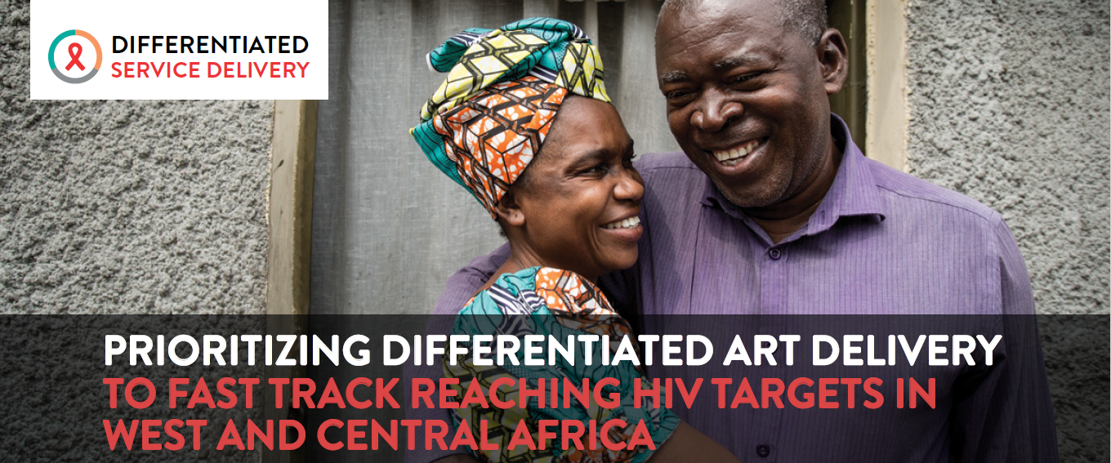
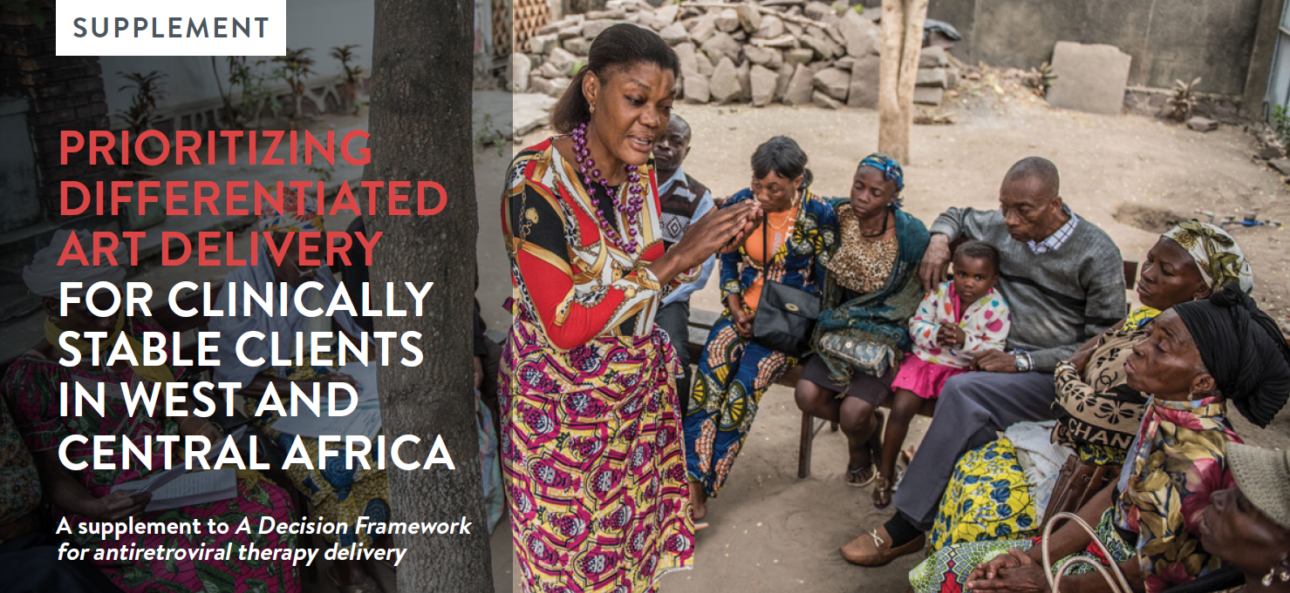
Differentiated ART delivery for
West and Central Africa
Five priority actions for scaling up differentiated ART delivery in WCA
Supplement outlining guidance on ”how” and regional case studies

Slide 11
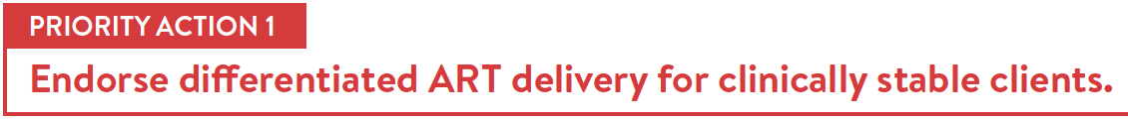

Notes:
The first is the need for differentiated ART delivery for clinically stable clients to be endorsed. It makes sense to start with this population – to highlight that people with HIV can lead normal lives, productive lives. This can support stigma reduction and lead to improvements across the HIV care cascade. There are also health systems gains from DSD – we have seen in east and southern Africa quick scale up alongside both client and health care worker satisfaction.
Differentiated ART delivery for clinically stable clients is endorsed in policy in the Cote d’Ivoire, DRC, Ghana, Guinea, and Sierra Leone and in final discussions in the Central African Republic and Nigeria

Slide 12

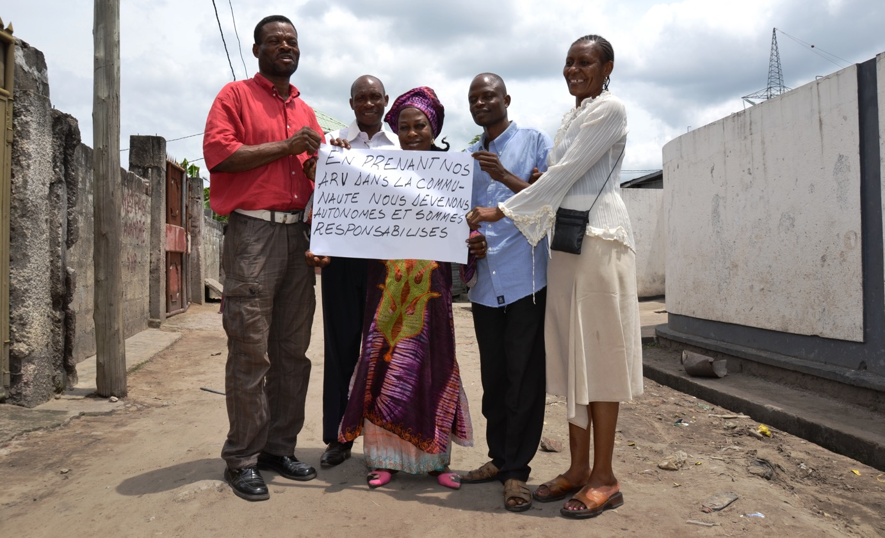
“By taking our ARVs within our community we are responsible for our own care.”
People living with HIV, DRC
Notes:
Secondly, and crucially, is that differentiated service delivery is client centered. Therefore we need to engage people living with HIV – both in the design as well as in the delivery of services.
Here you see a group of people living with in the Democratic Republic of the Congo who receive their ART refills within community distribution points or PODIs as Didier shared, stating that by taking their ART refills within the community, they’re responsible for their own care.
Self-management through quality treatment education is a key component of differentiated ART delivery.

Slide 13

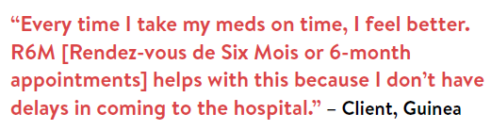
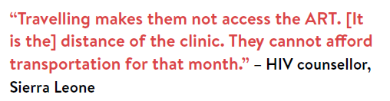
“
“
Notes:
The third priority action is to extent ART refills for those who are adherent to treatment. Acknowledging the supply chain challenges, it is critical longer refills be offered to support sustained adherence.
Extending ART refills for those who are adherent offers benefits to the client and to the health system. Given the generally lower HIV prevalence and high levels of HIV stigma in the region, longer ART refills can enable a reduction in transport costs for clients and minimize the risk of breaches of confidentiality and/or accidental disclosure. It also reduces the necessity of ensuring that frequent ART refills are available at every health facility.

Slide 14
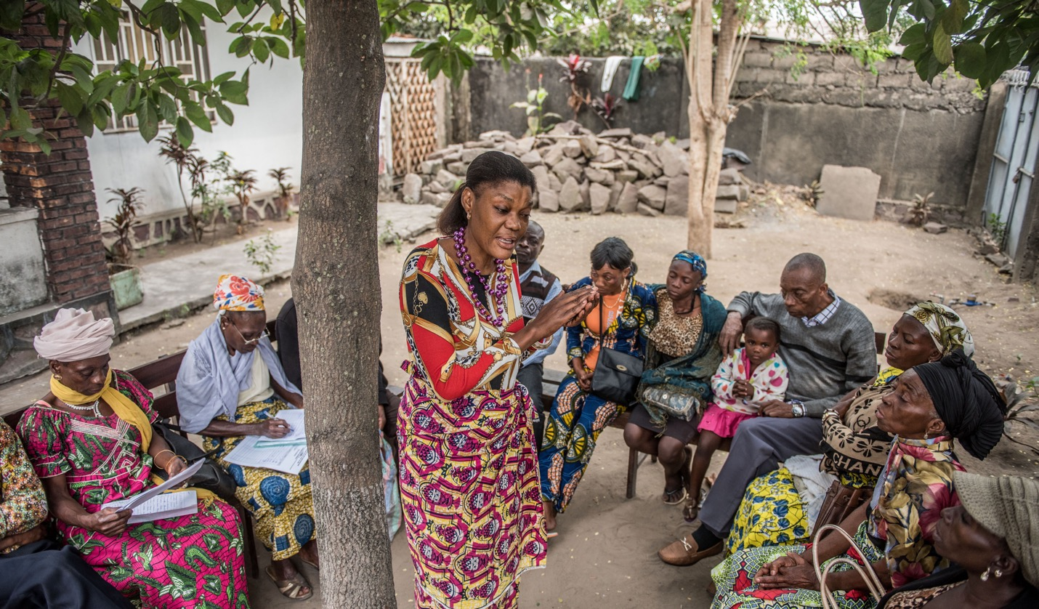
Notes:
Reducing the frequency of unnecessary visits with a clinician can be beneficial to both clients and the healthcare system. Clients can receive their ART refill quickly and clinicians can focus their attention on ART initiation, managing clients with clinically complex HIV and other diseases.
The building blocks or “who, what, where and when” should be different for clinical consultations compared to for ART refills.

Slide 15
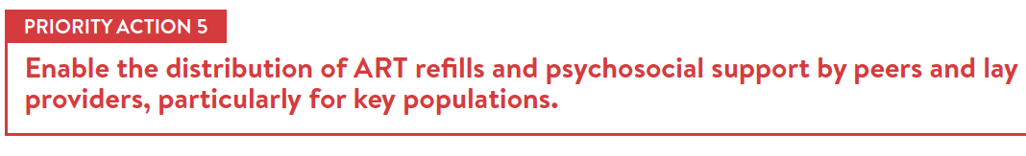



Clients from key populations are supported in Côte d’Ivoire by key population peer navigators and peer educators. Working with clinical teams and community clinics, these peer providers support retention and adherence by providing community ART refills, as well as psychosocial support.
In Sierra Leone, peer female sex workers and men who have sex with men collect ART refills at health facilities for their peers. They then meet their peers at their homes or community venues to distribute the refill.
Programming in Ghana supports men who have sex with men to receive their ART refills at drop-in centers, mobile outreach and couriered ART refills and are also supported through peer providers.
Notes:
Engagement of key population peers and people living with HIV lay providers in the provision of HIV care and
ART delivery treatment is key to increasing peer support, reducing stigma and enabling task sharing. In many WCA settings, high levels of HIV-related stigma continue to exist within communities and among health workers. In addition, the lack of professional healthcare workers is a major barrier to scale up.
Peers and lay providers from key populations and/or people living with HIV can be effectively engaged to distribute ART refills, provide psychosocial support and assist clients with managing HIV.

Slide 16
Respondents (n=22)

Slide 17
DSD policy in country

Slide 18
Extent of DSD scale-up

Slide 19
What is needed to scale DSD?

Slide 20
Way forward for meeting
Lynne will take you through differentiated ART delivery approach
Colleagues from WCA will build on examples from session yesterday and take us through more country examples that demonstrate approaches taken to the DSD building blocks
PLHIV network representatives and global agencies panel discussions
Opportunity to identify and discuss our country priorities and challenges

