Slide 1





Retention in community versus clinic-based adherence clubs for stable ART patients in South Africa:
24 month final outcomes from an RCT
C Hanrahan¹, V Keyser², S Schwartz¹, M Mudavanhu², N West¹, L Mutunga², J Steingo², J Bassett², A Van Rie³
¹Johns Hopkins Bloomberg School of Public Health, Baltimore, MD, USA
²Witkoppen Health and Welfare Centre, Johannesburg, South Africa
³University of Antwerp, Antwerp, Belgium

Slide 2
Background – Adherence clubs
Adherence clubs are groups of 25-30 patients stable on ART
Patients meet for counselling and medication pickup (~1 hour/2-3 mo)
Annual medical visit
Facilitate task shifting and decongest busy clinics
Experience from 2 observational studies in Cape Town: adherence clubs promote retention in care and viral suppression compared to clinic-based standard of care
  57% reduction in loss-to-care (aHR 0.43, 95% CI:0.21-0.91) (Luque-Fernandez 2013)
  67% reduction in virologic rebound (aHR 0.33, 95% CI: 0.16-0.67) (Luque-Fernandez 2013)
  67% reduction in risk of LTFU (aHR: 0.33, 95% CI: 0.27-0.40) (Grimsrud 2016)

Slide 3
Background – Community vs. Clinic-based Clubs
Increasing interest in task-shifting to community-based HIV care
Systematic review of community versus clinic-based interventions (not specific to adherence clubs) suggest comparable retention and patient outcomes (Nachega, Curr HIV/AIDS Rep, 2016)
Factors potentially at play:
  Stigma
  Convenience
  Cost
  Access to other health care (eg family planning, pediatric care)
  Others…???

Slide 4
Primary Study Objective
Compare the effectiveness of community versus clinic-based adherence clubs on retention in club-based care and viral suppression

Slide 5
Study Design
Unblinded, open-label randomized controlled trial
Participants were randomized to receive clinic versus community-based club assignment, stratified by area of residence
2 clubs per residential area (1 community, 1 clinic-based) created each month x 12 months starting in Feb 2014
Participants followed up for 24 months

Slide 6
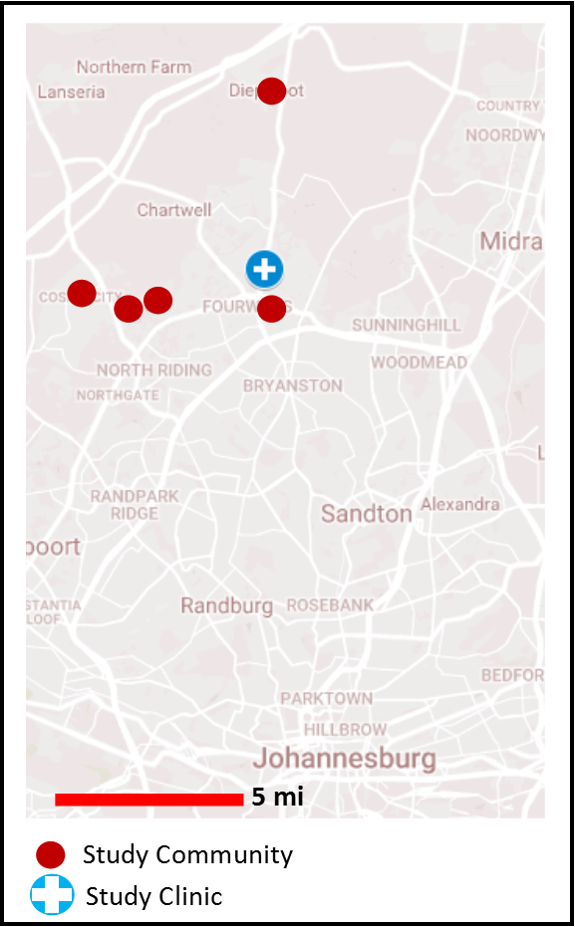
Study Setting
Witkoppen Health and Welfare Centre
High-volume primary care clinic in northern Johannesburg, South Africa
Serves neighboring communities of Diepsloot, Kya Sands, Cosmo City, Fourways and Msawawa (~5-30 mins by public transport)
Communities a mixture of informal and formal housing

Slide 7
Intervention Description
Based on the MSF model
Each club has 25-30 participants
Run by a lay HIV counsellor and supported by a Primary Health Care Nurse
Meet every 2 months
Blood draw every 6 mo, annual medical visit at clinic
Screened for pregnancy, TB symptoms and BP (if hypertensive) at each visit
Community clubs held at community venues (e.g. community center, churches)
Participants were referred back to clinic-based standard of care when:
  Missing a club visit and no ART pick-up within 5d
  Viral rebound (a viral load >400 copies/ml or 2 viral loads >50-400 copies/ml)
  Developing excluding comorbidity requiring clinic-based care
  Incident pregnancy
  Sending “buddy” for pickup 2x in a row
  Voluntary choice

Slide 8
Inclusion/Exclusion Criteria
Inclusion Criteria | Exclusion Criteria
Age ≥18 years | Currently on D4T containing regimen
No change in ART regimen in previous year | Currently pregnant or intending to become in ≤6 mos
Virally suppressed for ≥12 months (confirmed at baseline) | Current comorbidity or chronic illness (diabetes, epilepsy, active TB, cancer, mental illness, etc.)
 | Uncontrolled hypertension or treatment with >1 drug
 | Attending clinic with HIV infected child
 | Currently experiencing ART side effects

Slide 9
Definitions and Statistical Methods
Primary Outcome
Retention in club-based care (including viral suppression)
Statistical Methods
Primary: Comparison of community versus clinic-based club arms for retention in club-based care using Kaplan-Meier survival curves (log-rank test)
Secondary: Univariate and multivariate Cox Proportional Hazards modeling risk of loss from club-based care
  Robust variance estimator clustered on club

Slide 10
Study Enrollment
Files of all ART patients pre-screened daily (~2000/month)
Potentially eligible screened by clinician
n=1202
Ineligible
n=356 (30%)
Randomized
n=846 (70%)
Community Club
n=434 (51%)
Clinic Club
n=412 (49%)
Screening failure
n=35 (8%)
Screening failure
n=36 (9%)
Community Club
n=399 (51%)
Clinic Club
n=376 (49%)

Slide 11
Study Enrollment
Files of all ART patients pre-screened daily (~2000/month)
Screened by clinician
n=1202
Ineligible
n=356 (30%)
Randomized
n=846 (70%)
Not virally suppressed on baseline blood draw
Community Club
n=434 (51%)
Clinic Club
n=412 (49%)
Screening failure
n=35 (8%)
Screening failure
n=36 (9%)
Community Club
n=399 (51%)
Clinic Club
n=376 (49%)

Slide 12
Baseline Participant Characteristics
Characteristic | Community Clubs (n=399) | Clinic-based Clubs (n=376)
Female sex | 267 (66.9%) | 239 (63.6%)
Age, median (IQR) | 38 yrs (32-43) | 38 yrs (33-43)
Age category
18-29 years | 52 (13.0%) | 47 (12.5%)
30-44 years | 260 (65.2%) | 253 (67.3%)
45+ years | 76 (20.2%) | 87 (21.8%)
Unemployed | 95 (23.9%) | 64 (17.1%)
On FDC | 356 (89.2%) | 331 (88.0%)
Hypertensive | 21 (5.3%) | 27 (7.2%)
Baseline CD4 cells /mm³ (IQR) | 527 (377-690) | 472 (342-665)
CD4 category
<350 cells/mm³ | 108 (27.2%) | 80 (21.3%)
350-499 cells/mm³ | 101 (25.4%) | 92 (24.5%)
≥500 cells/mm³ | 188 (47.4%) | 204 (54.3%)

Slide 13
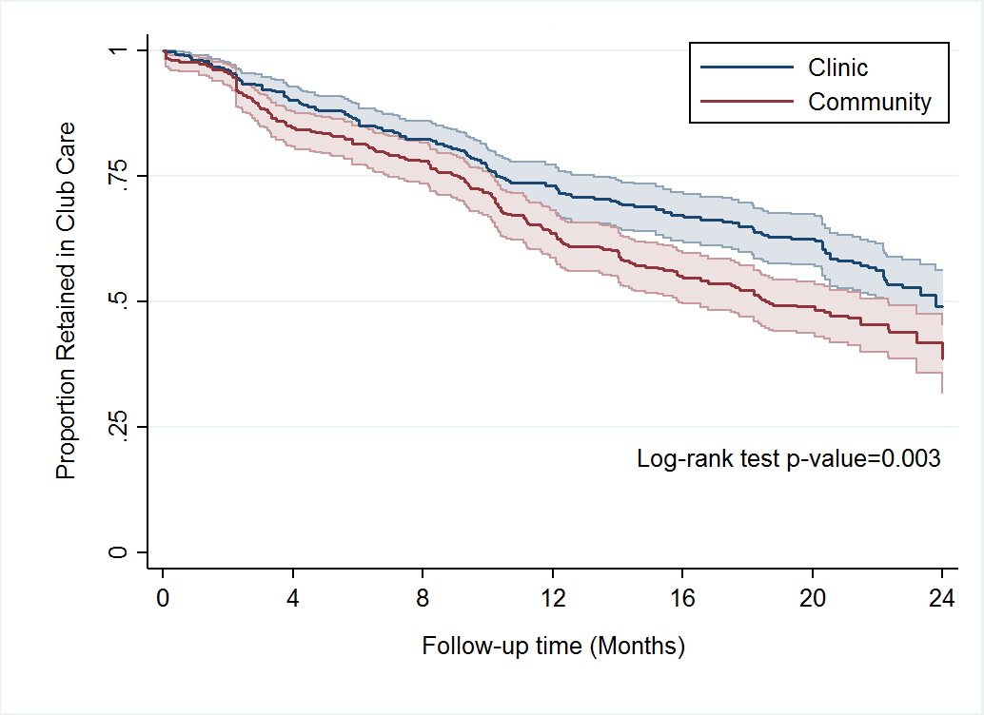
Primary Outcome: Retention in Club-based Care
24 month proportion retained in club care and virally suppressed:
Clinic: 57% (95% CI: 52-62%)
Community: 48% (95% CI: 43-53% )
Log-rank test p-value 0.003

Slide 14
Primary Outcome: Retention in Club-based Care
24 month proportion retained in club care and virally suppressed:
Clinic: 57% (95% CI: 52-62%)
Community: 48% (95% CI: 43-53% )
Overall retention in care and virally suppressed:
53% (95% CI: 49-62%)
Log-rank test p-value 0.003

Slide 15
Reasons for Loss From Club-based Care
Reason | Community club (n=207) | Clinic club (n=160)
Missing club visit and ART pick-up | 120 (58%) | 78 (49%)
Viral rebound | 27 (13%) | 33 (21%)
Pregnancy | 16 (8%) | 20 (13%)
Other club rule violation | 20 (10%) | 16 (10%)
Voluntarily return to SOC | 16 (8%) | 9 (5%)
Developed comorbidity | 6 (3%) | 4 (3%)
Regimen Change | 2 (1%) | 0 (0%)
Χ² p-value 0.180

Slide 16
Risk of Loss from Club-based Care
Characteristic | Univariate |  | Multivariate*
 | HR | p value | aHR | p value
Club Type
Clinic | REF |  | REF
Community | 1.36 (1.01-1.86) | 0.045 | 1.44 (1.16-1.80) | 0.001
*Multivariate model adjusted for sex, age, employment status and baseline CD4 count.

Slide 17
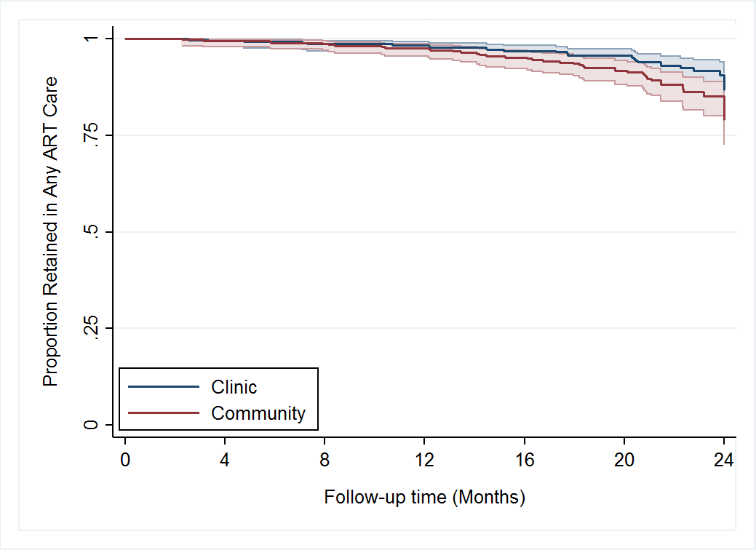
Retention in Any ART Care & Viral Suppression
24 month proportion retained in Any ART care and virally suppressed:
Clinic: 93% (951% CI: 90-95%)
Community: 88% (95% CI: 84-91% )
Log-rank test p 0.024

Slide 18
Risk of Loss from Any ART Care/Viral Rebound
Characteristic | Univariate |  | Multivariate*
 | HR | p value | aHR | p value
Club Type
Clinic | REF |  | REF
Community | 1.69 (0.98-2.90) | 0.057 | 1.65 (0.96-2.83) | 0.070
*Multivariate model adjusted for sex, age, employment status and baseline CD4 count.

Slide 19
Conclusions
24 month retention in club care was higher among participants in clinic-based clubs versus community-based clubs
Overall retention in the adherence club intervention was poor (53%)
Most common reason for return to SOC was missing club visits
Viral rebound and voluntary withdrawal from clubs were rare
Retention in care in community-based clubs in this pragmatic trial was much lower compared to published findings from Cape Town
  This trial: 48% in club-based care, 88% in any ART care
  Grimsrud, 2016: 94%
  Luque-Fernandez, 2013: 97%
  Potential reasons:
    Differences in timing of outcome assessed (Retention in any ART care vs retention in club-based care)
    Lack of randomization (Luque-Fernandez: “only some stable patients were offered participation, based on the clinician’s enthusiasm for the model”)
    Differences in approach (patient population, eligibility criteria, others?)

Slide 20
Limitations
2 year follow-up is a proxy for what is intended as a life-long intervention
Those dropping out of care at study clinic may seek care at another clinic- underestimation of retention in any ART care
Unblinded treatment assignment could have led to bias in referral back to standard clinic-based care
Generalizability to other settings/countries?

Slide 21
Implications for public health
Must be cautious about assuming clinic-based intervention effects carry over into the community
Looking at retention within club care is an important outcome
A better understanding of which aspects of adherence clubs are associated with success is needed

Slide 22


Acknowledgements
Witkoppen Health and Welfare Centre
Study participants
Elry Rampela
Galegole Mokoana
Sr. Thobile Mthembu
Gauta Moperero
Lilian Ngwako
Zanele Tshabalala
Veronica Modise
Collrane Frivold
Lavina Ranjan
Community Advisory Forum
All clinicians
Community Partners
Gauteng Dept of Health
Afrika Tikkun - Diepsloot
Department of Social Development Hall- Diepsloot
Multi-purpose Hall- Cosmo City
Msawawa - Kyasands
St. Mungo Church - Bryanston
Funding Source
USAID Innovations Grant AID-674-A-12-00033
The contents of this presentation are the sole responsibility of Witkoppen Health and Welfare Centre and do not necessarily reflect the views of USAID or the United States Government.

Slide 23
-

Slide 24
Re-initiation of Standard Clinic-based Care
Period | Community Clubs (n=207) | Clinic Club (n=160) | p-value
Return to care 60d after last club visit | 57% (95% CI: 50-64%) | 58% (95% CI:50-66%) | 0.848
Return to care 90d after last club visit | 72% (95% CI: 65-79%) | 73% (95% CI: 65-80%) | 0.832

