Slide 1

Part 10
Measuring participation
Citation: Chisholm B. DIY WhatsApp-based microtraining. 2026. Available from: https://www.differentiatedservicedelivery.org/resources/diy-whatsapp-based-microlearning/
Need help? Contact Briony on briony.c@icloud.com

Slide 2
In this section
  Step 1: Measuring participation
  Step 2: Measurement intervals
  Step 3: Record participant number
  Step 4: Monitoring participation (iPhone/Android/desktop)
  Step 5: Recording participation

Slide 3
Step 1: Measuring participation
This can only be done on the phone from which the sessions are sent
  WhatsApp’s ‘read’ function can be used to see who has opened each message*
  If you have the contact details of participants stored on the phone, this can be done one by one (extra admin)
  If you don’t have contact details, you can measure proportions of participants who have read lessons at specified timepoints
*While this does not guarantee that participants have actually read the messages - just that they have opened them - it does give an indication of participation
3

Slide 4

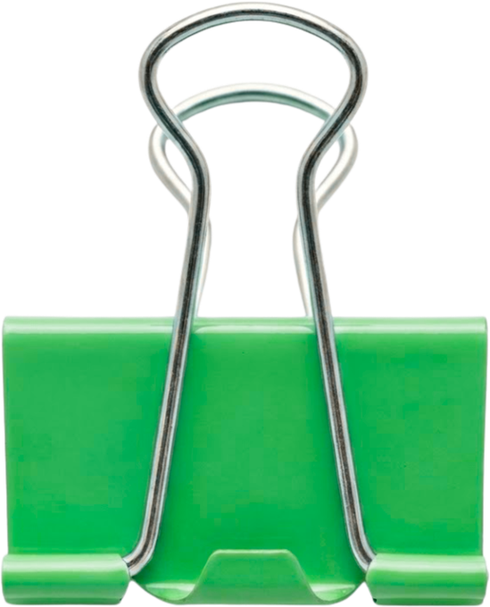
Step 2: Measurement intervals
In the planning stage, decide what intervals you wish to measure, for example:
For sessions being delivered weekly, on a Wednesday at 13:00, readings could be taken:
For sessions being delivered twice weekly, on a Monday and Wednesday at 13:00, readings could be taken:
  Wednesday, 14:00: ‘live’/within 1 hour
  Thursday, 13:00: within 1 day
  Following Wednesday, 12:00: within 1 week
  Monday, 14:00: ‘live’/within 1 hour
  Tuesday, 13:00: within 1 day
  Following Monday, 12:00: within 1 week
  Wednesday, 14:00: ‘live’/within 1 hour
  Thursday, 13:00: within 1 day
  Following Wednesday, 12:00: within 1 week
Remember
This can only be done by
the facilitator who
sends the messages.
Only they have access to message info
4

Slide 5
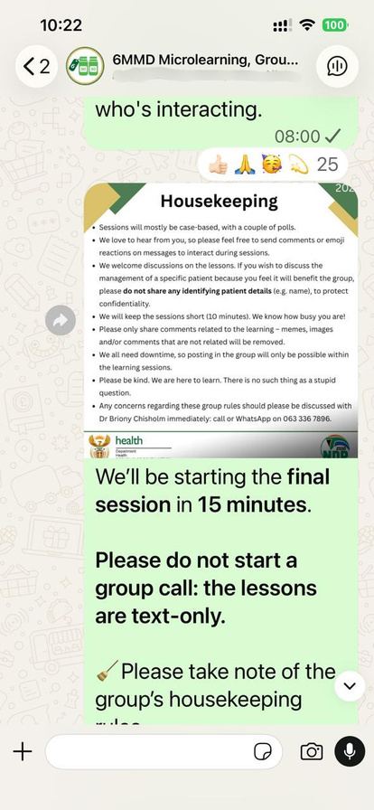
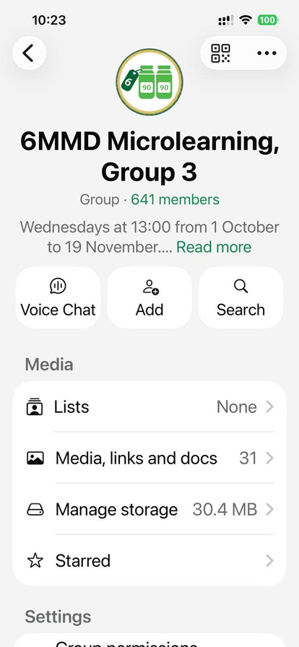
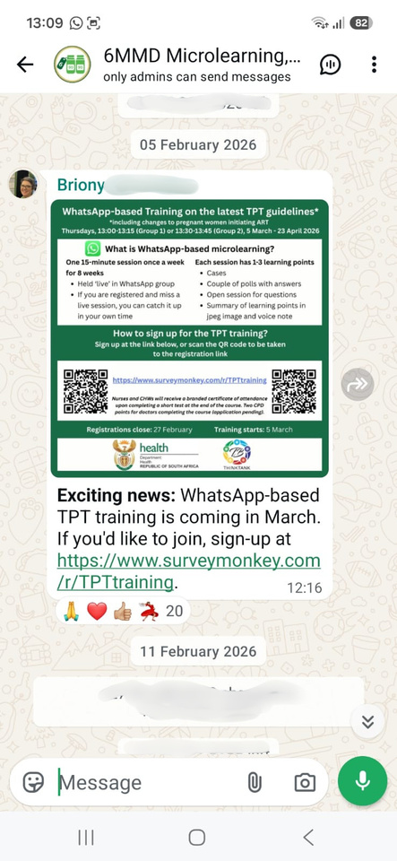
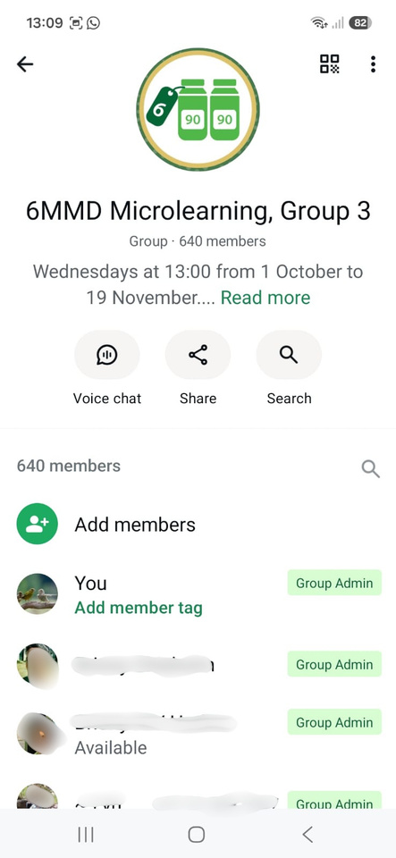
Step 3: Record participant number
Before each session, record number of participants in the group (excluding admins)
  Click on group name at the top
  Number of members shows below group name
5

Slide 6
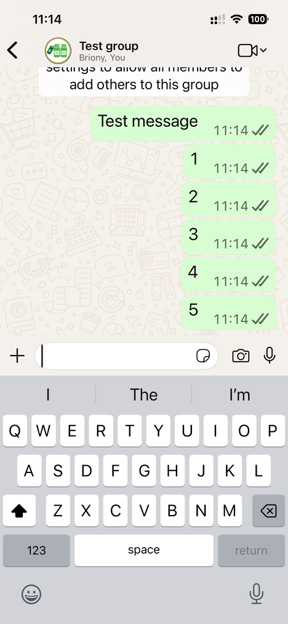
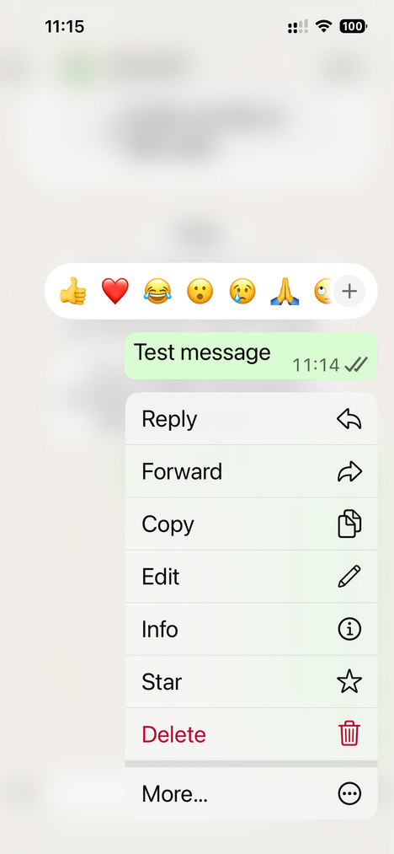
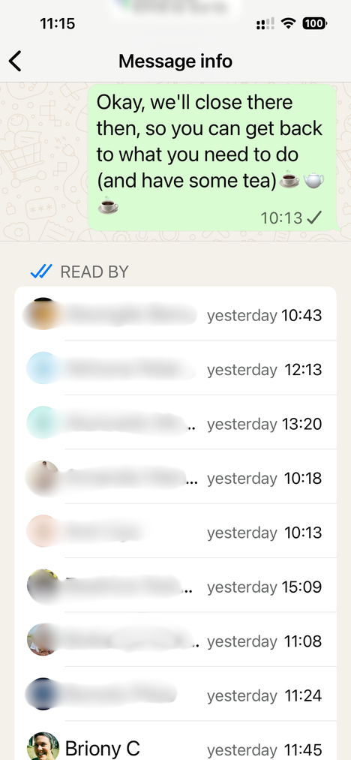
Step 4: Monitoring participation (iPhone)
Hold your finger on the message you want to see
This is generally the last message sent in a session
Click on ‘Info’
The list of participants who have read the messages, and when, will show
Below this, there is a delivery report
6

Slide 7
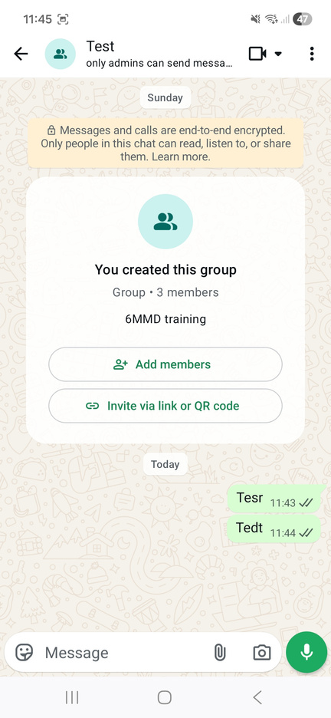
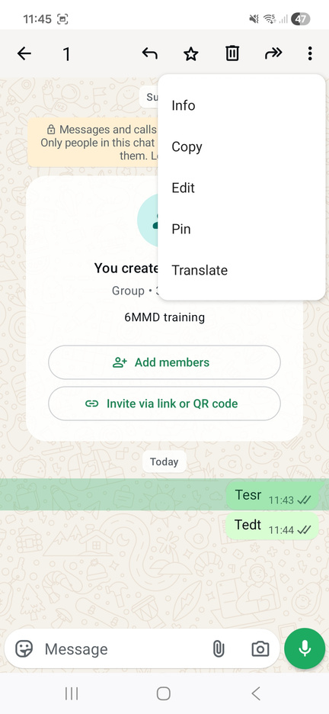
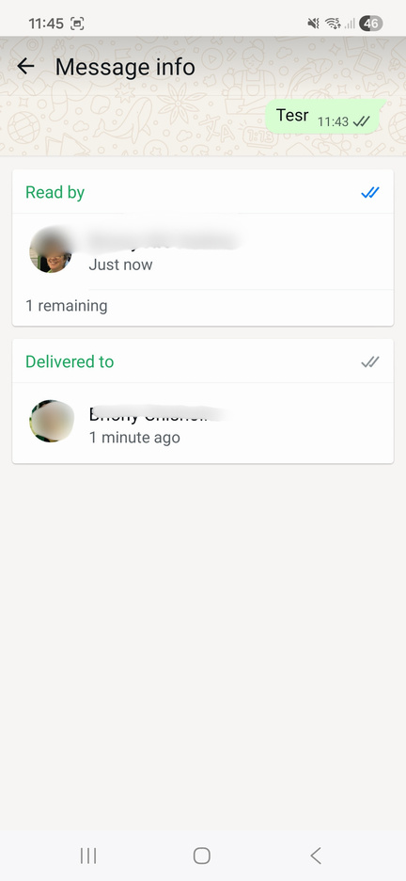
Step 4: Monitoring participation (Android)
Hold your finger on the message you want to see
This is generally the last message sent in a session
Click on three dots
(top right), then ‘Info’
The list of participants who have read the messages, and when, will show
Below this, there is a delivery report
7

Slide 8
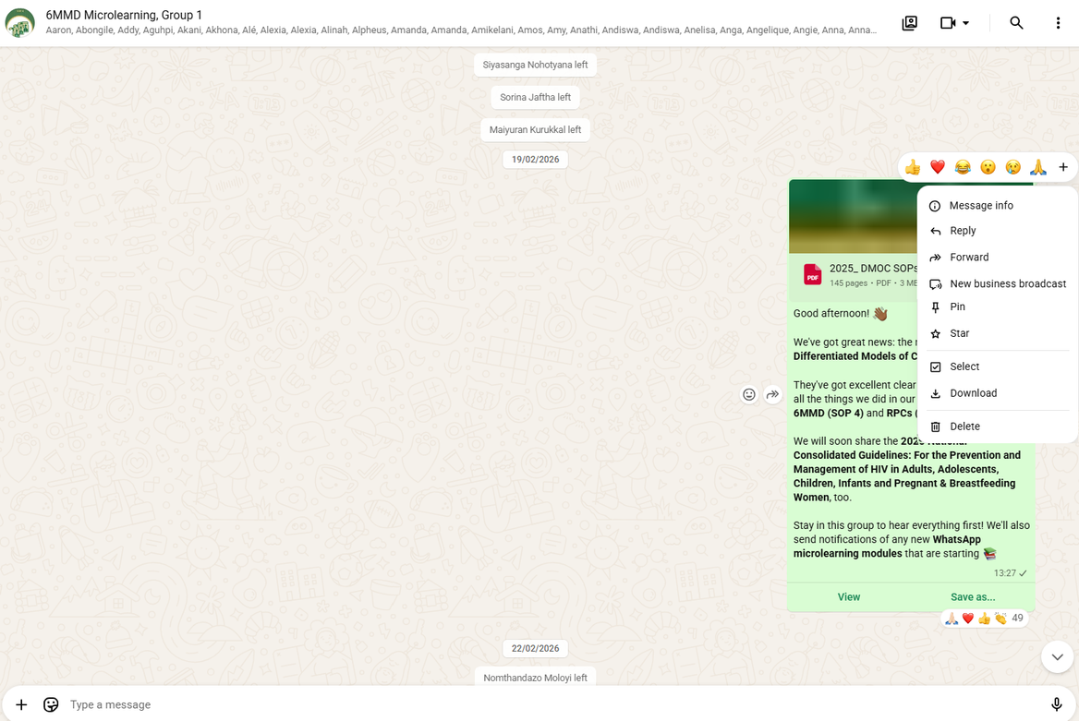
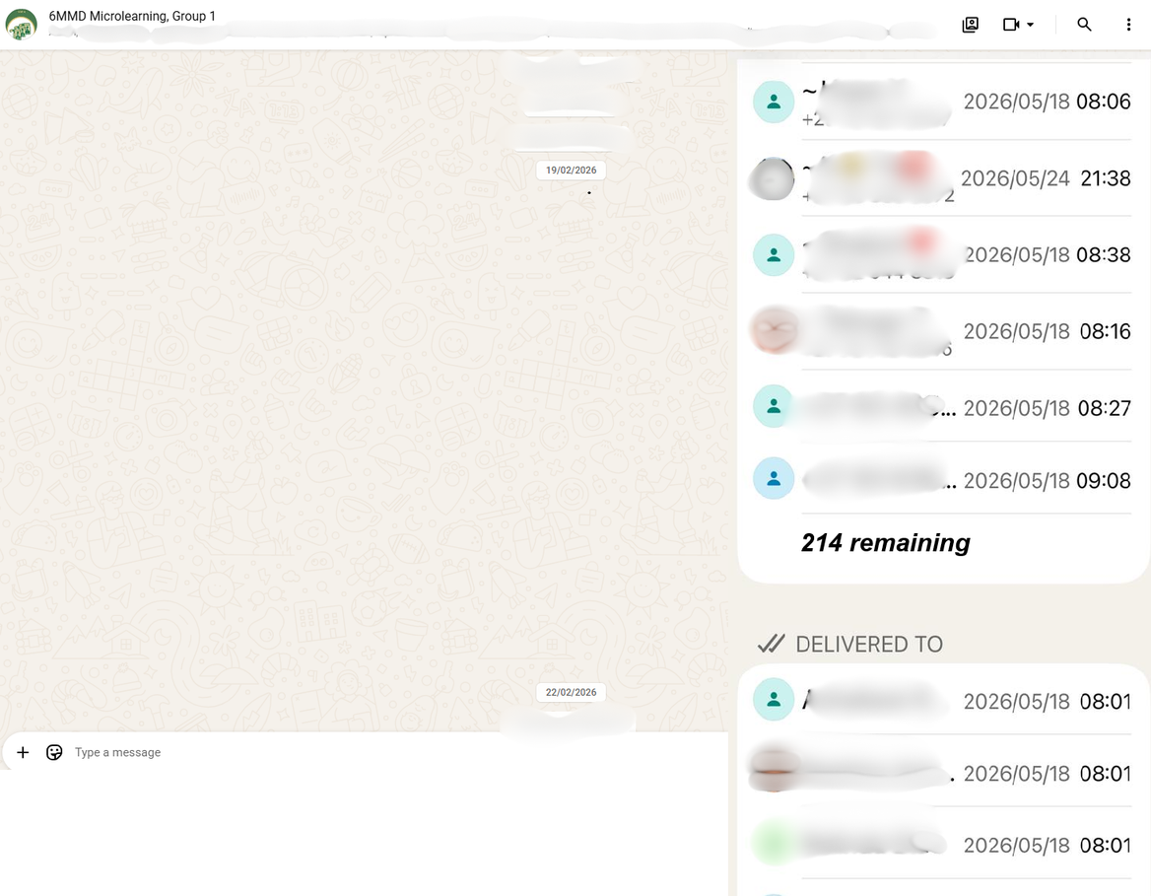

Step 4: Monitoring participation (desktop)
At each timepoint, record the number of participants who have ‘read’ the messages
  Right-click on the last message
  Click on ‘’Message info’
  Message info is divided into:
    SEEN BY (number you want)
    DELIVERED TO
  At the bottom of the SEEN BY section, it’ll say ‘x remaining’. Count the participants who have received the message but not opened it yet. This number can be deducted from number of participants.
Example
501 participants in group. 24-hour reading: 226 remaining:
501 - 226 = 275 have read the message
8

Slide 9
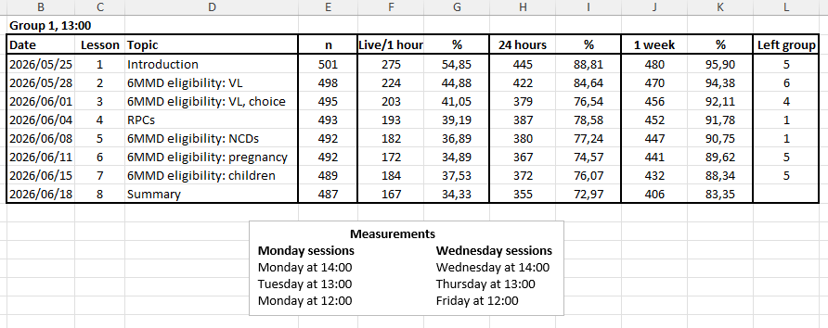
Step 5: Recording participation
Set phone reminders to remember to take measurements
9

