Slide 1
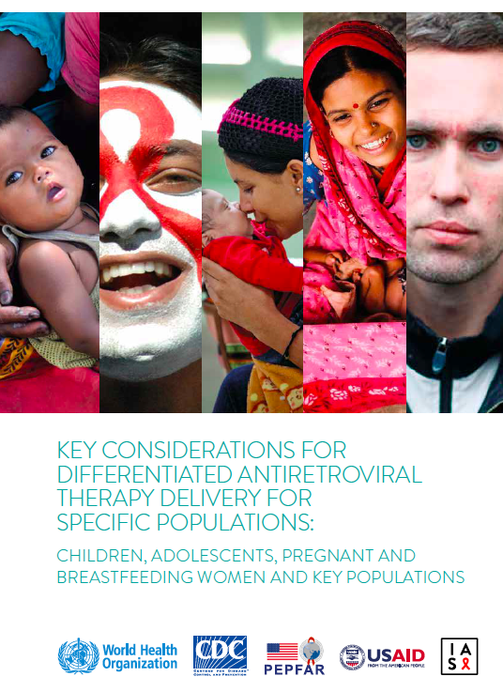
Differentiated ART delivery for specific populations
Nathan Ford
WHO

Slide 2
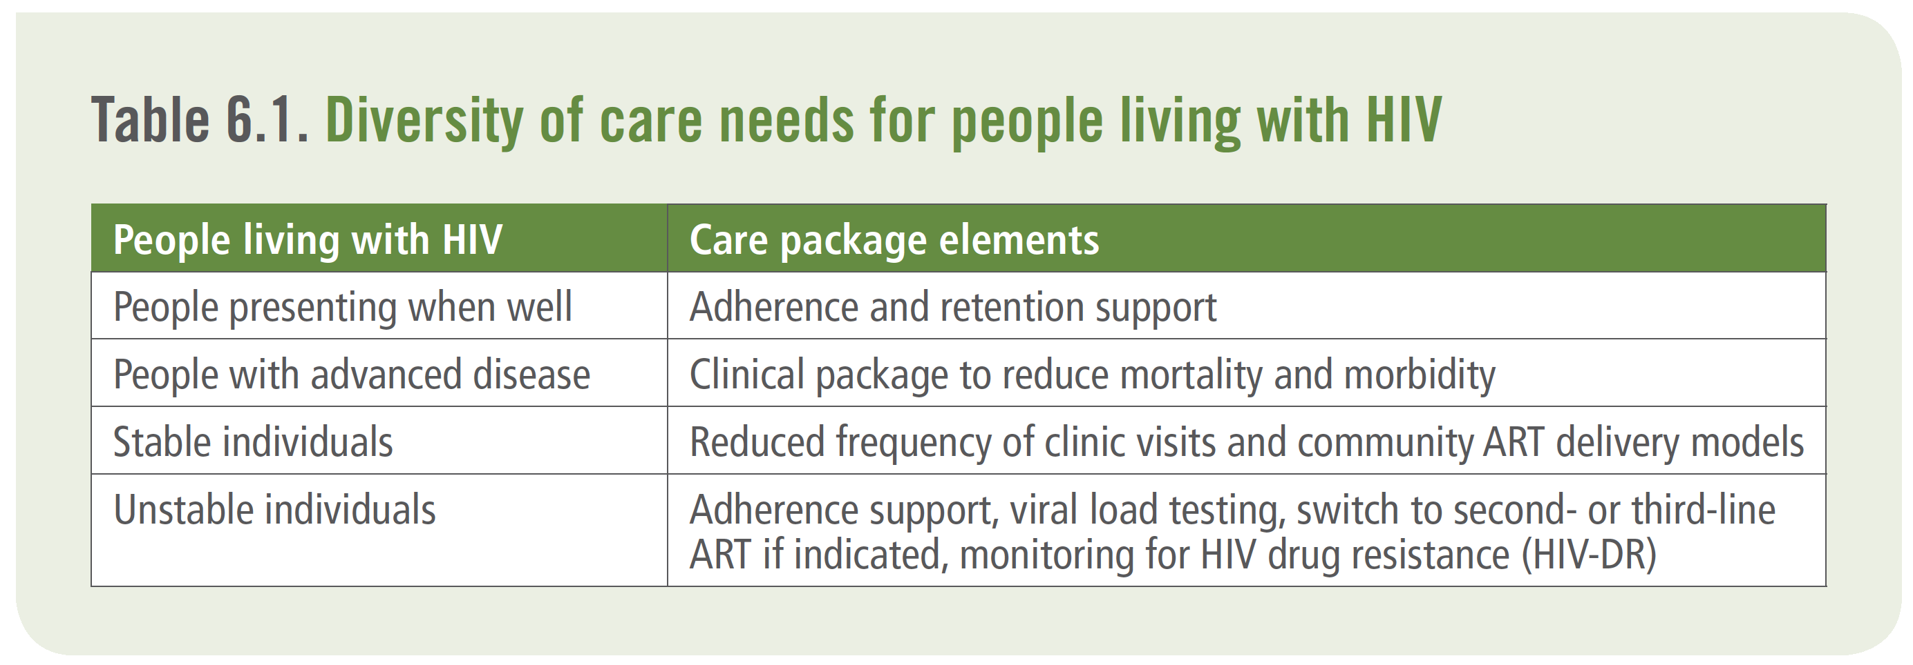
2016…
Stable patients on antiretroviral therapy
The following criteria define stable patients on
antiretroviral therapy*:
• Receiving ART for at least 1 year AND no adverse drug reactions requiring regular monitoring
AND
• No current illnesses or pregnancy AND
• Good understanding of lifelong adherence AND
• Evidence of treatment success: two consecutive undetectable viral load measures (or, in the absence of viral load monitoring, rising CD4 counts or CD4 counts above 200 cells/mm³ and objective adherence measure)
*Note: Stable, rapidly growing young children may need to be monitored more frequently due to greater
risk of disease progression and for treatment dosing/ weight changes.

Slide 3
Key points
Clinically stable children, adolescents and pregnant and breastfeeding women as well as members of key populations (people who inject drugs, sex workers, men who have sex with men, transgender people and people living in prisons and closed settings) can benefit from access to differentiated antiretroviral therapy (ART) delivery models
Services should be tailored to keep families together as much as possible to simplify access and reduce cost
Differentiated ART delivery can address inequities in the access to HIV treatment services and enable key population communities to be more involved in HIV treatment and care
Extension of differentiated care to adolescents and pregnant and breastfeeding women as well as members of key populations has highlighted the importance of psychosocial support and the need to better define how a differentiated ART delivery model can provide psychosocial support components

Slide 4
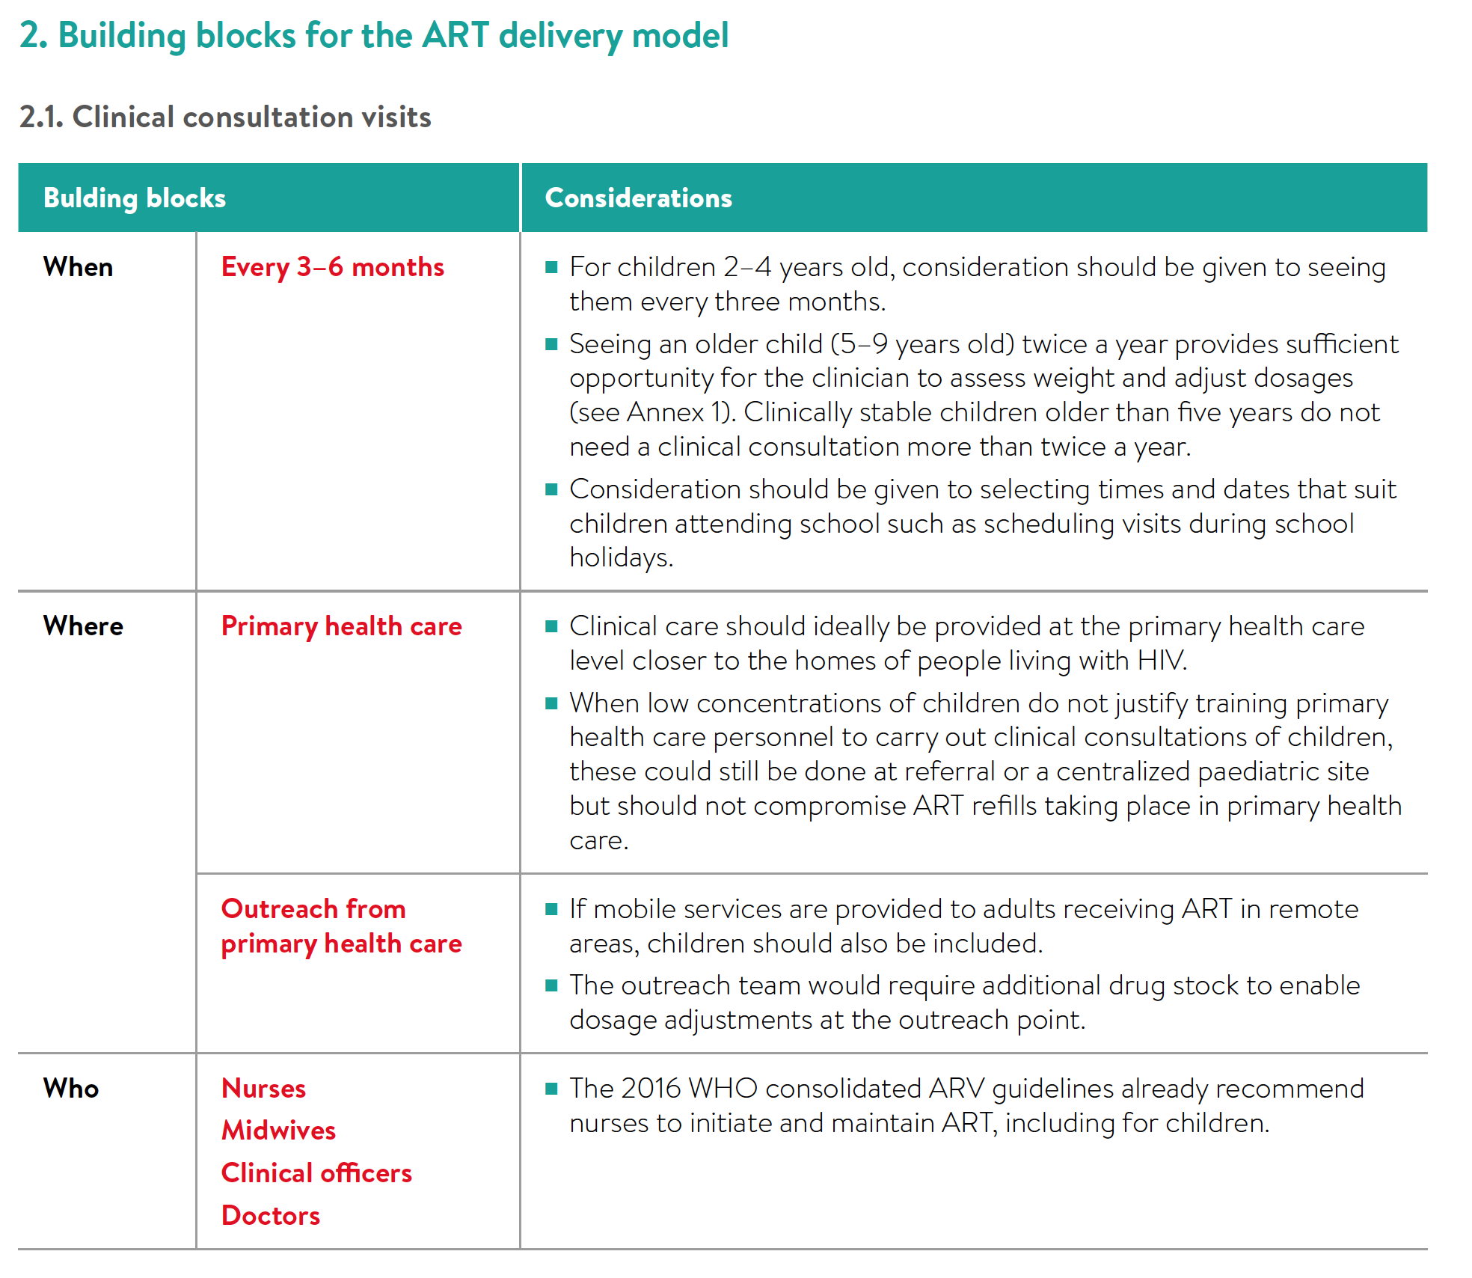

Slide 5
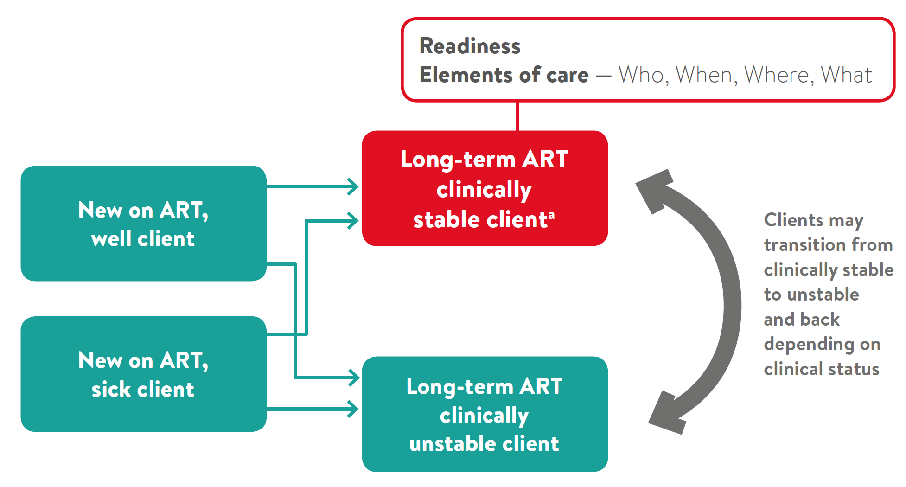
Transitions between categories of clients in a differentiated ART delivery approach

Slide 6
