Slide 1

Part 1
Introduction to microlearning
Citation: Chisholm B. DIY WhatsApp-based microtraining. 2026. Available from: https://www.differentiatedservicedelivery.org/resources/diy-whatsapp-based-microlearning/
Need help? Contact Briony on briony.c@icloud.com

Slide 2
What is microlearning?
“Microlearning deals with relatively short, small learning units and short-term focused activities.”
Theo Hug¹
Length of microlearning:
5 seconds - 15 minutes²⁻⁵
Essentially, microlearning is learning delivered in bite-sized nuggets, often via a mobile device, allowing quick, easy and engaging access⁵⁻⁸
  Hug T. In: Microlearning Conference 2005: Learning & Working in New Media Innsbruck, Austria, 2006. 2.Jahnke I, Lee Y-M, Pham M, et al. Technology, Knowledge and Learning 2020; 25: 585-619. 3. Díaz Redondo R, Caeiro Rodriguez M, López Escobar JJ, et al. Multimedia Tools and Applications 2021; 80: 1-31. 4. Denojean-Mairet M, López-Pernas S, Agbo FJ, et al. Smart Learning Environments 2024; 11: 46. 5. Taylor A and Hung W. Educational technology research and development 2022; 70: 363-395. 6.Buchem I and Hamelmann H. Microlearning: a strategy for ongoing professional development. 2010. 7. Alias NF and Razak RA. Interactive Learning Environments 2024: 1-21. 8. De Gagne JC, Park HK, Hall K, et al. JMIR Med Educ 2019; 5: e13997. 20190723.

Slide 3
What is microlearning?
Buchem and Hamelmann’s⁶ five design principles simply illustrate
microlearning for ongoing professional development:
  Format: small, easy to read, standard output type
  Focus: clear, based on one topic or idea
  Autonomy: self-contained, no need to look for further information
  Structure: has essential elements, such as topic or URL
  Addressability: a single resource or reference
3
6. Buchem I and Hamelmann H. Microlearning: a strategy for ongoing professional development. 2010.

Slide 4

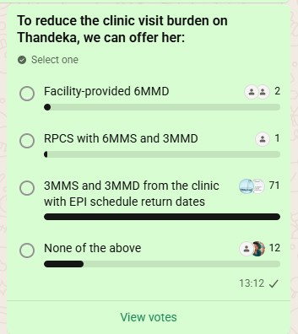
What is WhatsApp-based microlearning?
  WhatsApp groups of healthcare workers training together
  Short sessions: 10-15 minutes
  Sessions are text-based
  2-3 learning points delivered predominantly as cases
  Polls to encourage interaction
  Short period (2-4 minutes) open to allow comments/questions
  JPEG and voice-note summaries of lesson
4

Slide 5


Components of creating microlearning sessions
(done concomitantly)
Lesson design
Clear steps for adaptive
and iterative development of lessons
Recruitment
Clear steps for recruitment
Adjustments
Subject expert review
Adjust lessons through a number of drafts and consultation with expert reviewer
Expert review of content
TRAINING
Review cycle
Final content review/finalisation
Planning phase
Design stage
Review guidelines and establish learning points required
Draft lessons designed
Review by organisation requesting training
Marketing and admin
WhatsApp group creation
  Ongoing advertising of the training through relevant channels
  Group management plan
WhatsApp group is populated as sign-ups happen
Recruitment and WhatsApp group creation
Microlearning
familiarisation
Planning
Finalisation of WhatsApp group
Introduction to microlearning for all leads involved in recruitment and/or participants
  Human resource allocation
  Establish key dates
  Establish recruitment plan
  Create sign-up survey
  WhatsApp group is populated as sign-ups happen
  Group management: monitoring participation
5

Slide 6

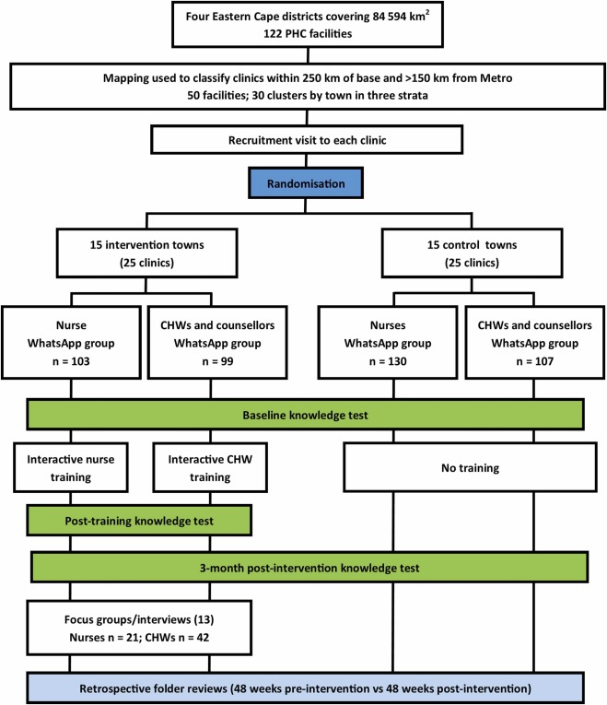

Evidence to support WhatsApp-based microlearning
Setting
50 clinics in four predominantly rural districts in the Eastern Cape
Participants
Nurses and CHWs, in-person recruitment
Outcome measurements
Uptake and participation; change in knowledge; change in patient care; usability
Data collection
Online questionnaires; WhatsApp analysis; focus groups; retrospective folder reviews
6

Slide 7
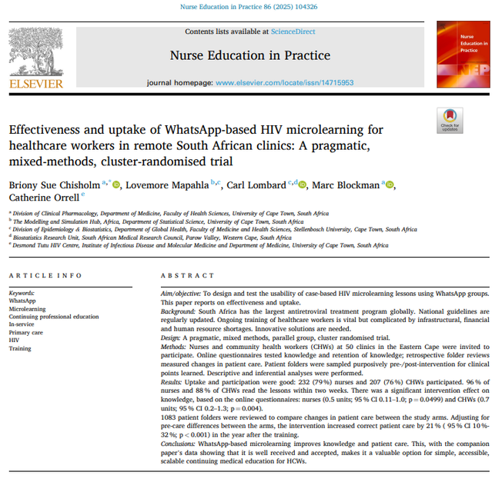
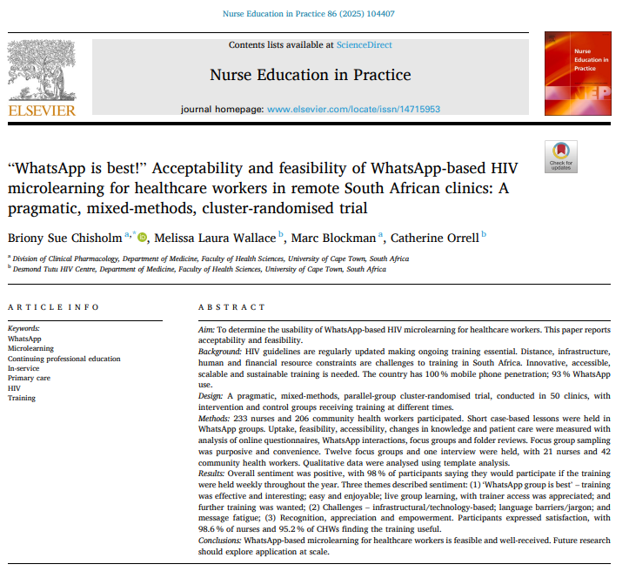
Results
“I think WhatsApp-based training is convenient and easy to use for everyone.” (Nurse, focus group)
Uptake
79% of nurses and
76% of CHWs agreed to participate
Participation
By two weeks 96% of nurses and
88% of CHWs had read the lessons
98% said they would participate in this kind of training if it were held weekly all year
Improved knowledge
Statistically significant improvement in knowledge between the intervention and control arm after three months follow-up
Improved patient care
Increased correct patient care by 21%
(95% CI 10%-32%; p < 0.001)
in the year after the training
References: 1. Chisholm BS, Mapahla L, Lombard C, Blockman M, Orrell C. Nurse Educ. Pr. (2025). Article 104326. 10.1016/j.nepr.2025.104326. Chisholm B, Wallace ML, Blockman M, Orrell C. Nurse Educ. Pr.. 86 (2025). Article 104407. 10.1016/j.nepr.2025.104407
7
Notes:
6

Slide 8

Using WhatsApp-based microlearning
for 6MMD training
August 2025
  Phased introduction of 6MMD in South Africa at select facilities:
  Phase 1 (1 August 2025); Phase 2 (1 September 2025); countrywide (1 April 2026)
Challenges
  Short timeline
  Limited virtual training
  Facility-level support from implementing partners reduced (funding cuts)
WhatsApp-based microlearning as an add-on to the virtual training
8
Notes:
8

Slide 9
WhatsApp-based microlearning:
quick implementation
10 July
First discussion
11 July
Funding secured
28 July
Recruitment started
15 August
Registrations closed
18 August
Training started
6 weeks
from conception to
start of training
Sign-up survey design
Lesson planning and ongoing training development
9

Slide 10

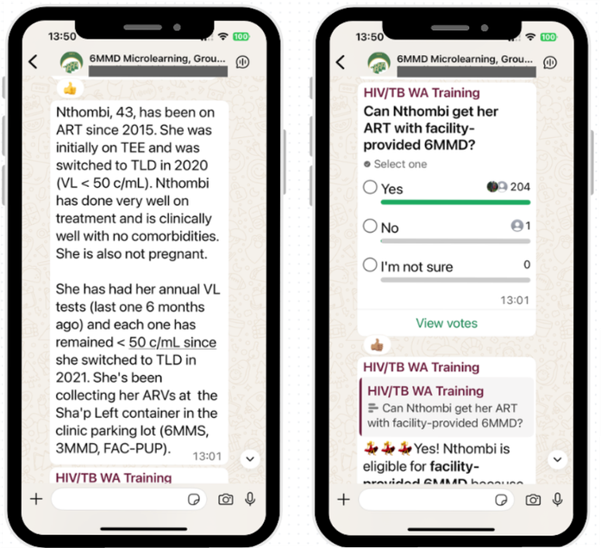

WhatsApp-based microlearning approved to augment NDoH virtual provincial 6MMD training
10

Slide 11
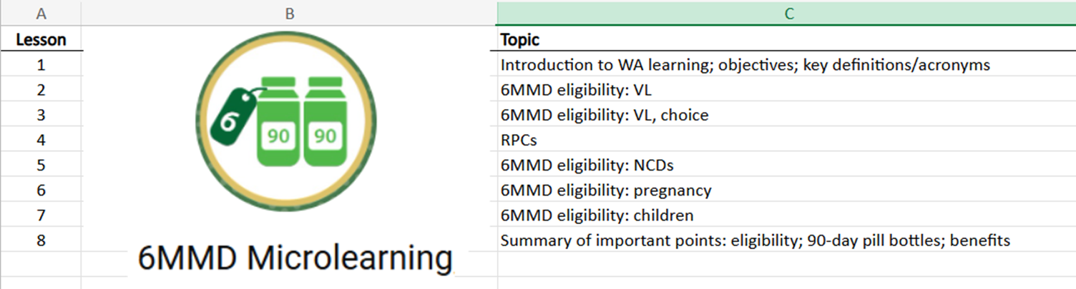

WhatsApp-based microlearning facility-based 6MMD module developed, validated and approved by NDoH
11

Slide 12

Recruitment and sign-ups
2 285 participants signed up
over three rounds
Sign-up
SurveyMonkey survey
Group 1
Group 2
Group 3
834
701
750
sign-ups for training starting on 18 August
sign-ups for training starting on 15 September
sign-ups for training starting on 1 October
12

Slide 13
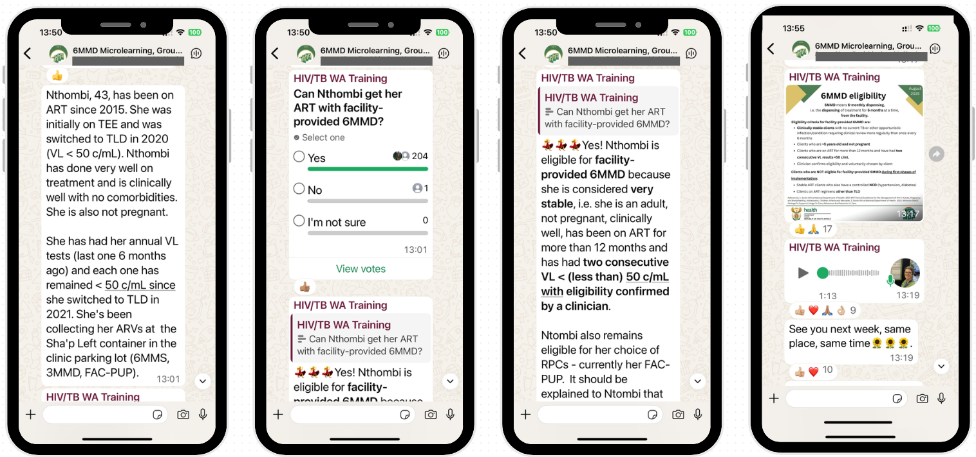
WhatsApp-based microlearning to augment
online 6MMD training
Weekly lessons for 8 weeks: 10-15 minutes at 13:00
13

Slide 14
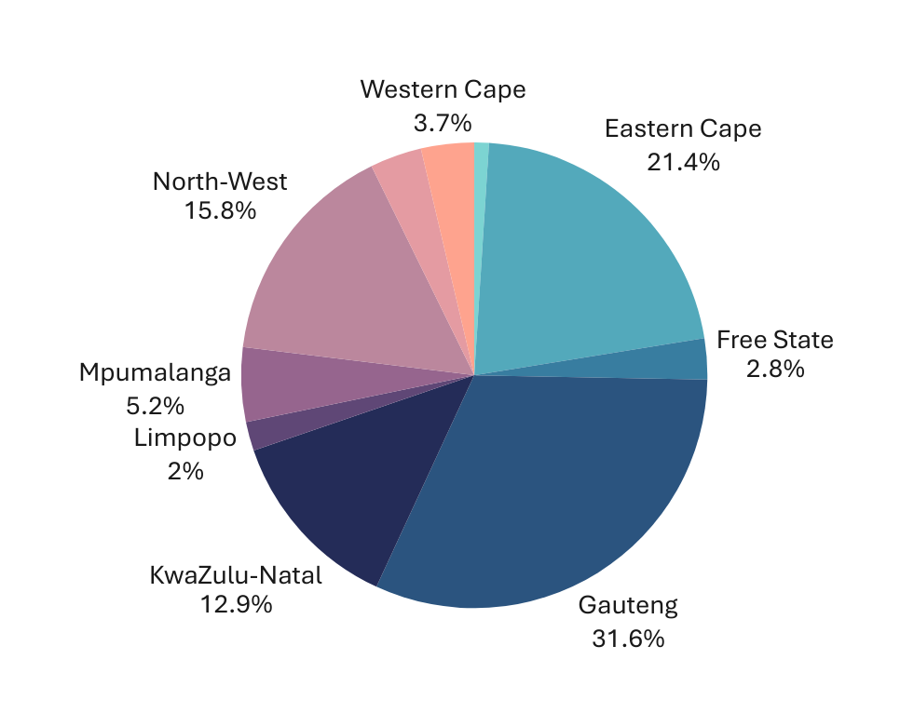

Participant demographics (combined)
Sector
NDoH 58.69%
Partner organisations 27.66%
PLHIV 1.05%
Other 12.60%
CHW/Counsellor Doctor Pharmacist Nurse
1.49% 10.77% 10.68% 62.06%
Profession
Province
14

Slide 15

Participation (groups combined)
Measured using WhatsApp ‘blue ticks’ at three time points
  ‘Live’/within 1 hour
  Within 24 hours
  Within a week
 | Live/1 hour | Live/1 hour | 24 hours | 24 hours | 1 week | 1 week
 | Average | Range | Average | Range | Average | Range
Session 1 | 67.14 | 64.8-69.3 | 91.55 | 88.4-93.5 | 95.38 | 92.9-96.6
Session 2 | 56.97 | 51.3-61.3 | 86.63 | 85.4-88.8 | 92.26 | 90.2-93.6
Session 3 | 51.96 | 44.3-61.4 | 83.77 | 82.2-85.9 | 91.30 | 88.6-92.7
Session 4 | 53.68 | 49.5-57.7 | 81.35 | 80.6-82.4 | 89.44 | 88.1-90.3
Session 5 | 47.24 | 42.1-51.5 | 79.10 | 78.3-79.7 | 87.15 | 85.7-88.4
Session 6 | 49.31 | 46.9-51.8 | 79.00 | 78.5-79.5 | 86.45 | 85.0-87.8
Session 7 | 44.11 | 42.3-46.6 | 75.27 | 73.9-76.0 | 85.85 | 85.4-86.4
Session 8 | 51.09 | 45.6-54.5 | 78.40 | 76.3-80.0 | 84.93 | 84.0-86.2
15

Slide 16
Participation (groups and sessions combined)
52.7% 81.88% 89.10%
Read lessons in ‘live’ session/within 1 hour
Read lessons
within 24 hours
Read lessons
within a week
16
Notes:
14

